Slide 1
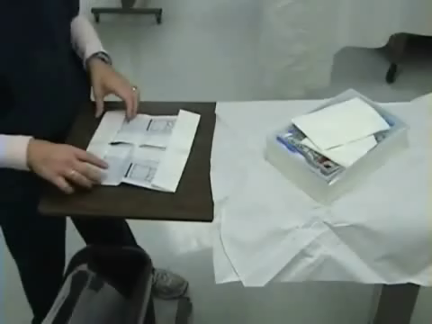

Step 23: Open all the supplies. Fluff cotton balls in tray before pouring antiseptic solution over them. Alternately, open package of antiseptic swabs.

Slide 2
Step 22: Place sterile tray on drape between patient’s thighs.
Step 25: With thumb and one finger of non-dominant hand, spread labia and identify meatus.
Step 26: Use the dominant hand to pick up a cotton ball or antiseptic swab. Clean one labial fold, top to bottom, then discard the cotton ball. Using a new cotton ball/swab for each stroke, continue to clean the other labial fold, then directly over the meatus

Slide 3
Step 27: If the catheter is preattached to sterile tubing and drainage container, position catheter and setup within easy reach on sterile field. Ensure that clamp on drainage bag is closed.
Step 24: Lubricate 1 to 2 inches of catheter tip. To Facilitates catheter insertion and reduces tissue trauma.

Slide 4
Step 28: Hold the catheter 2 to 3 inches from the tip and insert slowly into the urethra .
Advance the catheter until there is a return of urine (approximately 2 to 3 inches). Once urine drains, advance catheter another 2 to 3 inches .

