Slide 1

Step19: Prepare urine drainage setup if a separate urine collection system is to be used. Secure to bed frame according to manufacturer’s directions.

Slide 2
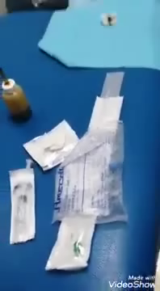

Slide 3
Step 20: Open sterile catheterization tray on a clean over bed table using sterile technique. Step 21: Grasp upper corners of drape and unfold drape without touching unsterile areas.
Put on sterile gloves.

Slide 4
