Slide 1

Etiology
Both initial and recurrent attacks are non-suppurative complications of group A-Beta hemolytic streptococci upper respiratory tract infection. Skin infection usually lead to acute glomerulonephritis.

Slide 2
Epidemiology
Occur in all ages except infants, but the peak incidence is between 5-15 years when streptococcal infections are most frequent.
The disease high prevalence in developing areas of the world due to the low socioeconomic status (overcrowding, poor housing and due to lack of adequate treatment of streptococcal throat infection).
There may be a genetic predisposing for susceptibly to rheumatic fever among children since illness runs in families.

Slide 3
Clinical manifestations
Revised jones criteria used to diagnose RF

Slide 4
Major criteria | Minor criteria | Minor criteria | Evidence of preceding streptococcal infection
-Carditis. -Polyarthritis. -Erythema marginatum. -Subcutaneous nodules. -Chorea. | -Arthralgia. -Fever. -Prolonged P-R interval. -Elevated acute phase reactants: Erythrocyte sedimentation rate. C-reactive protein. | -Arthralgia. -Fever. -Prolonged P-R interval. -Elevated acute phase reactants: Erythrocyte sedimentation rate. C-reactive protein. | -Positive throat culture for streptococci or rapid streptococcal antigen test. -Elevated or increasing streptococcal antibody titer.
For all patient with evidence of preceding group A streptococcal infection
Diagnosis of initial rheumatic fever |  | 2 major manifestations or 1 major plus 2 minor manifestation + evidence of recent GAS.
Diagnosis of recurrent rheumatic fever |  | 2 major or 1 major plus 2 minor manifestation 3 minor + evidence of recent GAS.

Slide 5
I- Carditis (50-60% of cases)
Mitral and aortic valves are the most affected valves. Carditis is the only entity of rheumatic fever that can result in permanent damage to heart (chronic valvular disease)

Slide 6
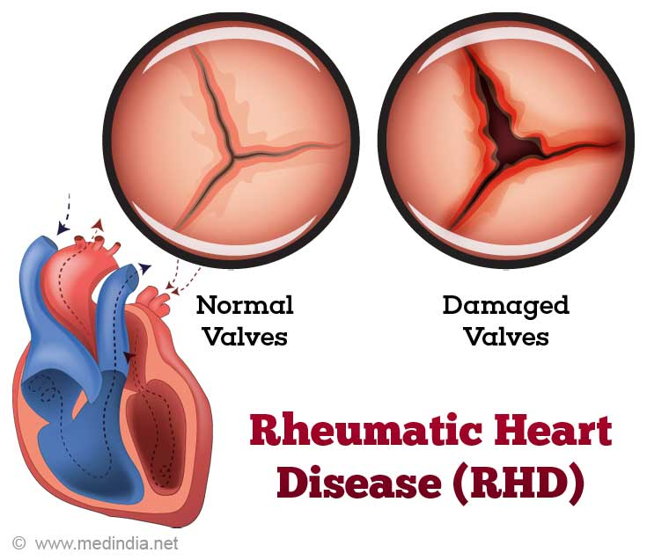

Slide 7
Carditis
New murmur or change in the existing murmurs.
Tachycardia
Cardiomegaly
Friction rub (pericarditis).
Pericardial pain.
Change in ECG.

Slide 8
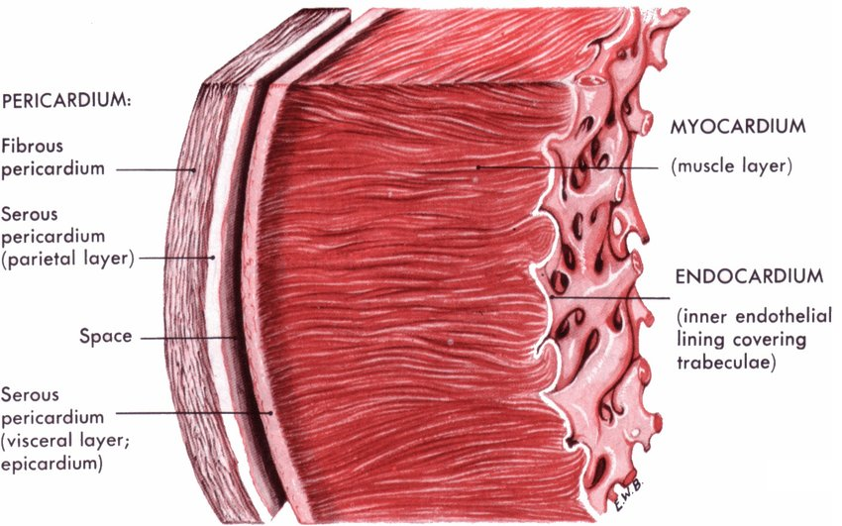
Carditis can involve:
a- Endocarditis (valvulitis).
b- Myocarditis (muscle).
c- Pericarditis.

Slide 9
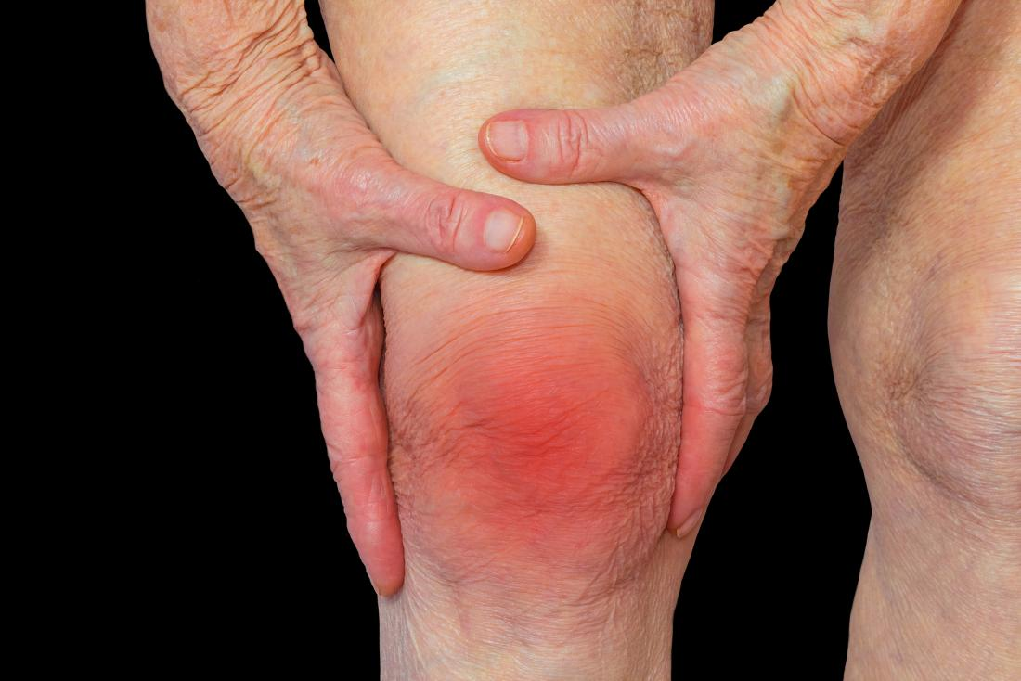
II- Polyarthritis (75% of cases)

Slide 10
Polyarthritis
Arthritis is the early manifestation of acute rheumatic fever.
Arthritis is migratory.
It is usually involves large joints as knee, hips, shoulders, wrists, ankles and elbows.
The affected joint is tender, red, hot and swollen with limitation of movement.
Dramatic response to salicylate (aspirin) within 12-24 hours. Untreated cases doesn’t persist in the same joint more that one week.
Arthritis resolve completely and dose not result in chronic joint disease.

Slide 11
III- Rheumatic chorea (10-15% of cases)
It has a long latent period (2-6 months).
Involuntary movements: these are purposeless or semi purposeful, irregular, non-repetitive rapid, jerking movements of the limbs and face. These movements are exaggerated by emotional stress but disappear during sleep. The child tends to drop things, to spill from a cup and handwriting deteriorates. There is characteristic grimacing of the face. Speech is commonly disturbed.
Emotional disorders: there is alteration of temperament with characteristic lability of emotions. The child may laugh or cry without apparent reason.
Muscular hypotonia.

Slide 12
IV- Erythema marginatum
It occurs occasionally in rheumatic fever patients. It is usually seen over the trunk. The lesions begin as red raised non pruritic macules then extend laterally to form wavy lines or rings with pale centers. They vary in shape and site from hour to hour.

Slide 13
V- Subcutaneous nodules (≤ 1% of cases)
They are a rare (< 1% of patients with acute rheumatic fever) and consist of firm nodules approximately 1cm in diameter along the extensor surfaces of joint such as knees, elbows, ankles.

Slide 14
Clinical manifestations
Arthralgia cannot be counted as a minor manifestation if arthritis is used as a major manifestation.
Prolonged P-R interval should not be counted as a minor manifestation if Carditis is used as a major manifestation.
The diagnosis of rheumatic fever is acceptable without two major manifestations or one major and two minor criteria in pure chorea.
The diagnosis of acute rheumatic fever should not be made in those patients with elevated or increasing streptococcal antibody titers who do not fulfill the jones criteria.

Slide 15
Therapeutic management of rheumatic fever
The aim of medical management are:
1- Eradicate group A streptococcal infection.
2- Treatment of rheumatic manifestations.
3- Therapy for complications, such as heart failure.

Slide 16
1- Eradicate GABHS infection
Antibiotic | Dose | Route of administration
Benzathine penicillin G Penicillin V (oral penicillin) Erythromycin | 600.000-1.200.000 units 250mg/dose 40mg/kg/24hrs | IM once. Oral, twice daily for 10 days. Oral, divided in 3 doses for 10 days.

Slide 17
2- Treatment of rheumatic manifestations
Arthritis: Salicylate (aspirin).
Carditis:
  Mild aspirin.
  Moderate to sever: bed rest and prednisone, and supportive III (digoxin-diuretics-fluid restriction- oxygen).
Chorea: phenobarbital or haloperidol.
Erythema marginatum and subcutaneous nodules NOT need for treatment.

Slide 18
3- Therapy for complication
Antibiotic | Dose | Route of administration
Benzathine penicillin G Penicillin V (oral penicillin) Erythromycin | 600.000-1.200.000 units 250mg/dose 250 mg/kg/24hrs | IM once every 2-3 weeks. Oral, twice daily. Oral, twice daily.

Slide 19
Prevention of rheumatic fever
General measures of prevention streptococcal infection include: prevention of over-crowding, good oral hygiene, good nutrition and treatment of dental caries
Primary prevention (eradication of GABHS): eradication of streptococcal upper respiratory tract infection to prevent an initial attack of rheumatic fever.
Secondary prevention (therapy for complication)

Slide 20
1- Primary prevention (Eradicate GABHS infection)
Antibiotic | Dose | Route of administration
Benzathine penicillin G Penicillin V (oral penicillin) Erythromycin | 600.000-1.200.000 units 250mg/dose 40mg/kg/24hrs | IM once. Oral, twice daily for 10 days. Oral, divided in 3 doses for 10 days.

Slide 21
3- Secondary prevention (Therapy for complication)
Antibiotic | Dose | Route of administration
Benzathine penicillin G Penicillin V (oral penicillin) Erythromycin | 600.000-1.200.000 units 250mg/dose 250 mg/kg/24hrs | IM once every 2-3 weeks. Oral, twice daily. Oral, twice daily.

Slide 22
Duration of secondary prevention (therapy for complication)
Rheumatic fever without carditis | 5yr or until 21yrs of age, whichever is longer
Rheumatic fever with carditis but without residual heart disease (no vascular disease) | 10 yr or into adulthood, whichever is longer
Rheumatic fever with carditis with residual heart disease (no vascular disease) | At least 10 yr since the last episode and at least until 40 yrs of age: some time lifelong prophylaxis.

Slide 23
Nursing Considerations
The objectives of nursing care for child with A.R.F. are to:
1. Encourage compliance with drug regimens.
2. Relieve joint pain.
3. Facilitate recovery from the illness.
4. Provide emotional support.
5. Prevent the disease.

Slide 24


