Slide 1

NURSING MANAGEMENT OF CARDIOVASCULAR DISORDERS
Pediatric Nursing
Third year students
1st online lecturer
Prepared by
Atiat Osman
Lecturer Of Pediatric Nursing

Slide 2
Outline
Fetal circulation
Heart diseases
  Congenital disorders
  Acquired disorders
Nursing care plan for child undergoing heart surgery

Slide 3
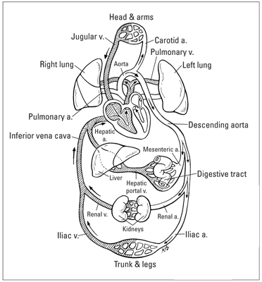

Slide 4
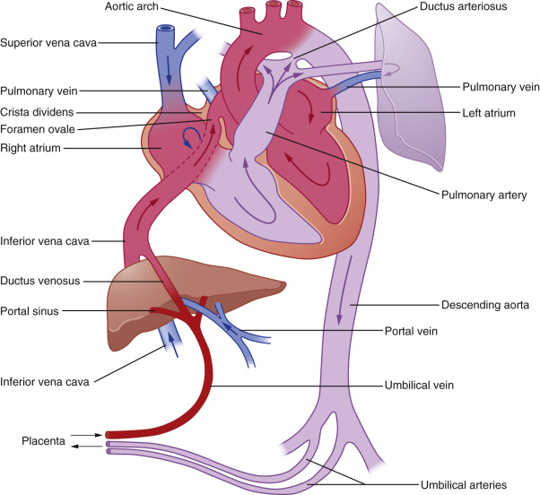
Fetal circulation

Slide 5
Classification of congenital heart disease

Slide 6
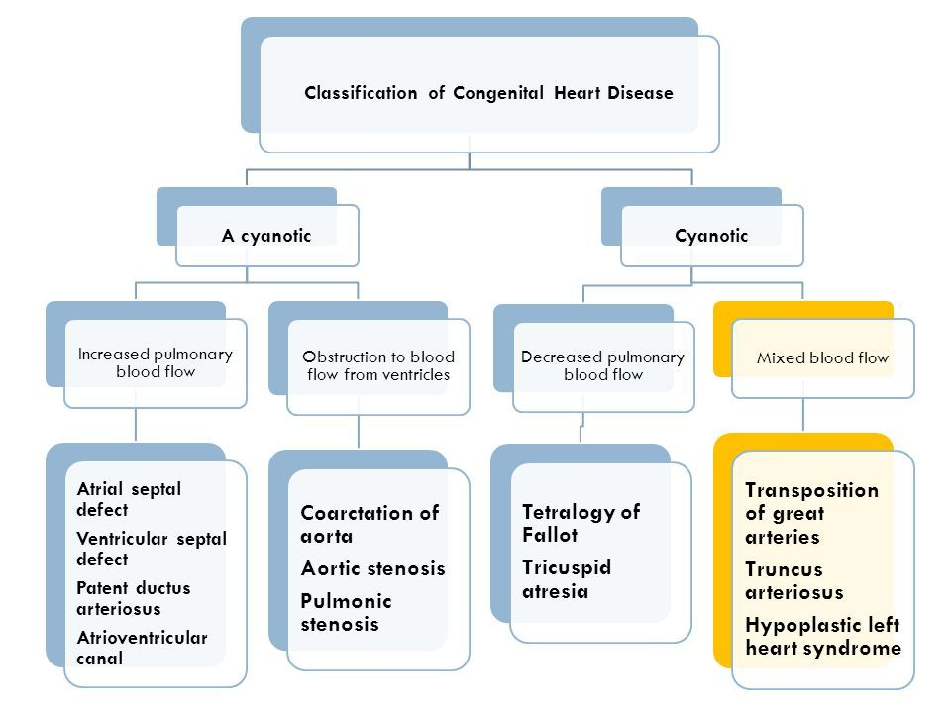

Slide 7
Etiology of congenital heart diseases (CHD)
The etiology of most CHD is not unknown, but several factors are associated with a higher than normal incidence of the disease include:
Maternal rubella during pregnancy.
Maternal alcoholism, age over 40 years.
Maternal chronic disease such as diabetes mellites and heart disease.
Genetic factors.
Exposure to radiation or drugs during pregnancy.

Slide 8
A Cyanotic defect
left to right shunting

Slide 9
A Cyanotic defect
1- Ventricular septal defect (VSD)
2- Patent duct arteriosus (PDA)
3- Atrial septal defect (ASD)
4- Pulmonary stenosis
5- Aortic stenosis
6- Coarctation of aorta

Slide 10
Ventricular septal defect (VSD)

Slide 11
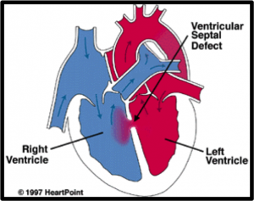
Incidence: it is account about 20%
of all CHD.
Types: according to anatomical site of the defect.
  Membranous.
  Muscular (5-20%).
Pathophysiology

Slide 12
Clinical manifestations
Vary according to defect size
Small defects: asymptomatic.
Large defects:
  Repeated respiratory infection.
  Dyspnea, slow physical development.
  Feeding difficulties.
  Heart failure, cardiac enlargement and cyanosis may occur.

Slide 13
Treatment
Small defect: Spontaneous closure may during the first 2 years of age.
Large defect: Surgical repair requires open heart surgery and cardiopulmonary bypass.
Oral diuretics and digoxin in CHF occurs.

Slide 14
Complications
Heart failure.
Episodes of respiratory infection.
Pulmonary hypertension duo to high pulmonary blood flow.

Slide 15
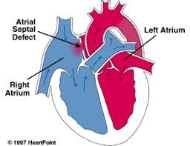
Atrial septal defect (ASD)
Incidence: approximately 10% of all CHD.
Pathophysiology

Slide 16
Clinical manifestations
  Small defect is asymptomatic
  Large defect:
    Poor growth.
    Fatigue, dyspnea
    Recurrent respiratory infection.
Treatment
  Surgical of trans-catheter repair.

Slide 17
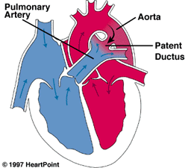
Patent duct arteriosus (PDA)
Incidence: 5-10% of all congenital heart diseases.
Pathophysiology

Slide 18
Clinical manifestations
Small PDA is not associated with symptoms.
Large PDA produce easy fatigability, dyspnea, repeated respiratory infection and heart failure.
  Classic machinery murmur, which is continuous from systole into diastole.
  A thrill murmur as the 2nd intercostal space and may radiate toward the left clavicle and left sternal.
  Left ventricle hypertrophy, may develop to left heart failure in infancy in severe cases.
  Enlarge heart size occur with large PDA.

Slide 19
Treatment
Supportive: fluid restriction with diuretics and digitalis for congestive heart failure.
Ductus closure in indicated in all patient as it is more liable to complications. Closure is either by catheter of surgery.
Complications
Bacterial endocarditis.
Congestive heart failure.
Pulmonary hypertension.

Slide 20
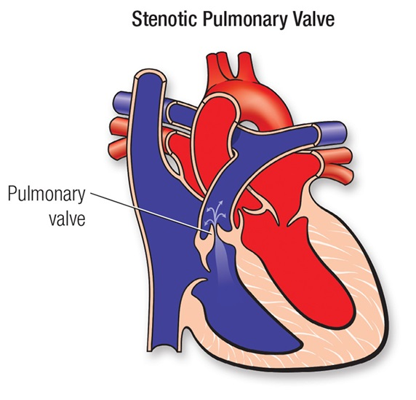
Pulmonary stenosis

Slide 21
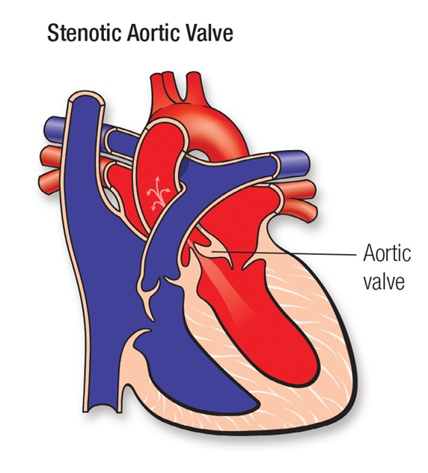
Aortic stenosis

Slide 22
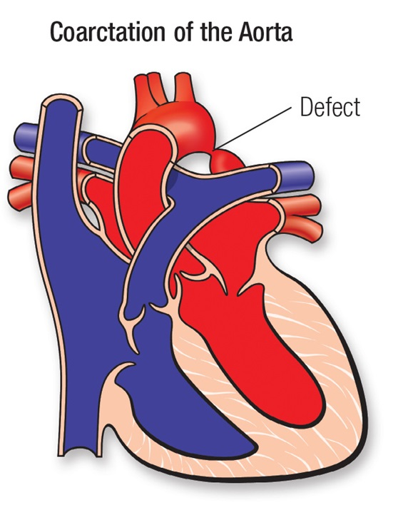
Coarctation of aorta

Slide 23
Cyanotic defects

Slide 24
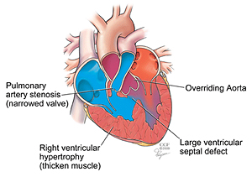
Tetralogy of Fallot

Slide 25
Clinical manifestations
Cyanosis usually appear within few months (due to presence of PDA).
Clubbing of the fingers and toes.
Dyspnea on exertion, older children learn that squatting position relives dyspnea. In infant, the knee chest position is comfortable
Stunted growth.
Intolerance of effort: exercise usually causes severe dyspnea.
Cyanotic spells.
Congestive heart failure not predominant with tetralogy of Fallot.

Slide 26
Treatment
a) Medical
Antibiotic prophylaxis before tooth extraction or GIT and urinary procedure.
Treatment of cyanotic spells:
Comfort the child and put in knee-chest position.
Administer O₂ by face mask.
Injection morphine SC.
Avoid cold as it increase oxygen consumption.
If acidosis is present give I.V. sodium bicarbonate.

Slide 27
b) Surgical
Palliative and total corrective surgery is being done on infants and children of all age.
Complications
Polycythemia secondary to cyanosis and hypoxia.
Cerebral thrombosis and cerebral spells.
Infective endocarditis.

Slide 28
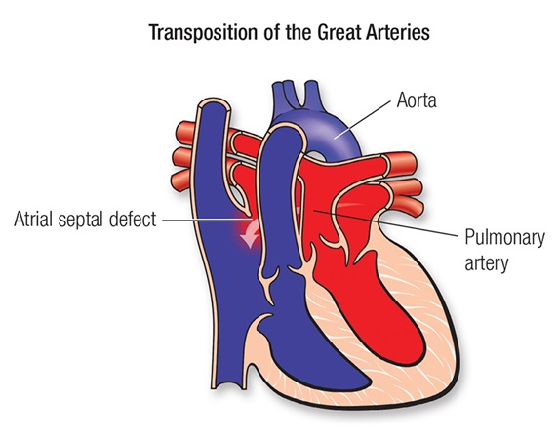
Transposition of great arteries

Slide 29
Acquired heart disease

Slide 30
Rheumatic fever (RF)
Rheumatic fever is an inflammatory disease involving mainly the joints, the heart and less frequently the CNS, the skin and the subcutaneous tissue. It is always potentially serious and may lead to permanent cardiac damage (chronic valvular disease).

