Slide 1

South Valley University faculty of nursing
First year
Adult Nursing Department

Slide 2
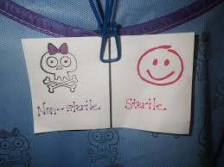
Preparing a sterile field
Prepared by : Nehad Abdelrazik

Slide 3
Definition
A sterile field:
Is an area free of microorganisms and prepared to receive sterile items.

Slide 4

procedure

Slide 5
Prepare sterile field just before planned procedure.
Select clean work surface above waist level.
Assemble necessary equipment, sterile drab, and sterile supplies.
Check dates or labels on supplies for sterility of equipment.

Slide 6
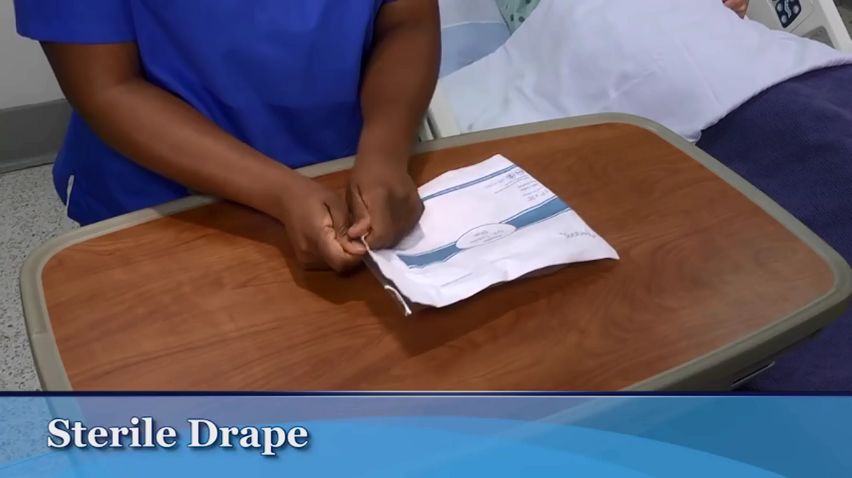
5.Place pack containing sterile drape on work surface and open.

Slide 7
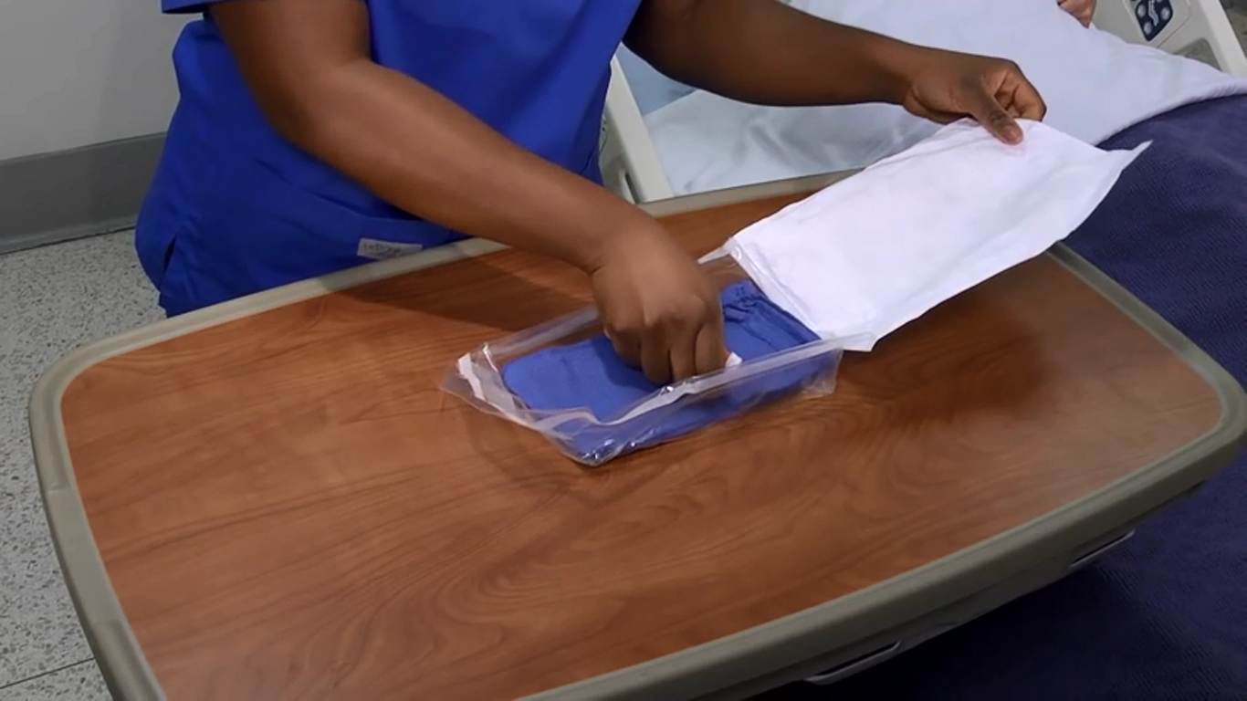
6.With fingertip of one hand, pickup folded top edge of sterile drape.

Slide 8
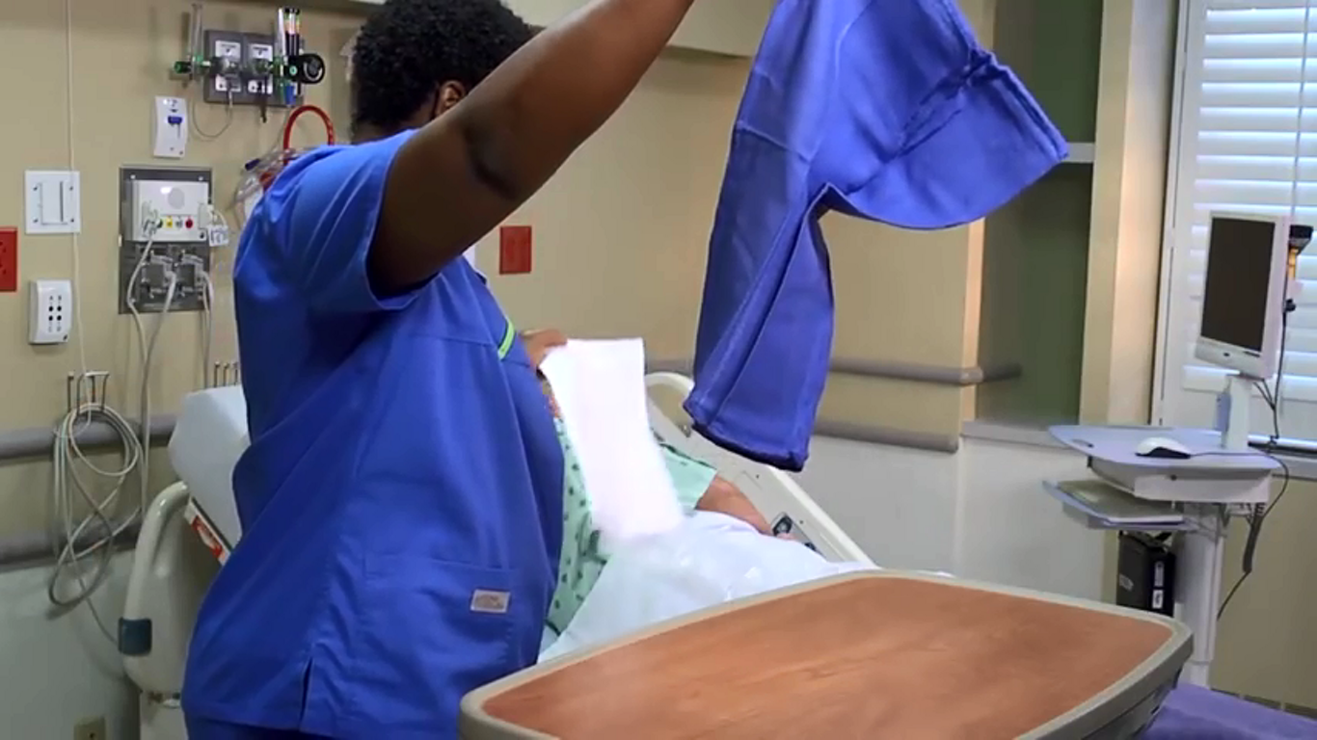
7.Gently lift drape up from its outer cover and let it unfold by itself without touching any object. Discard outer cover with your other hand.

Slide 9
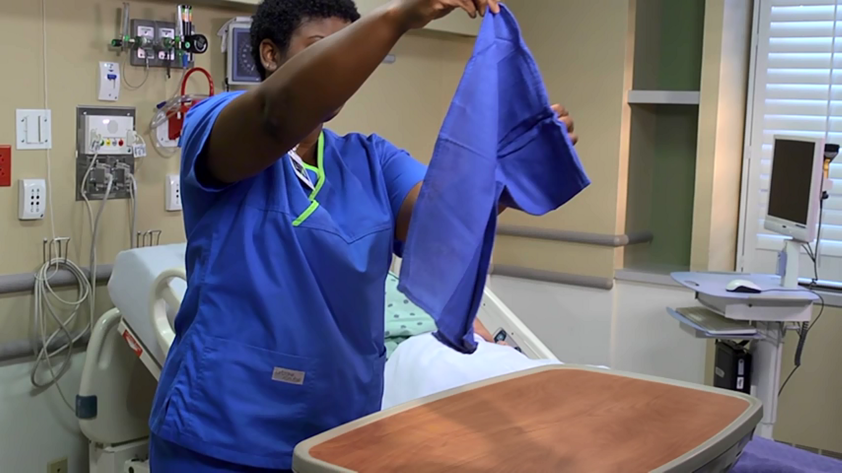
8.With other hand, grasp adjacent corner of drape and lift it straight up and away from your body.

Slide 10
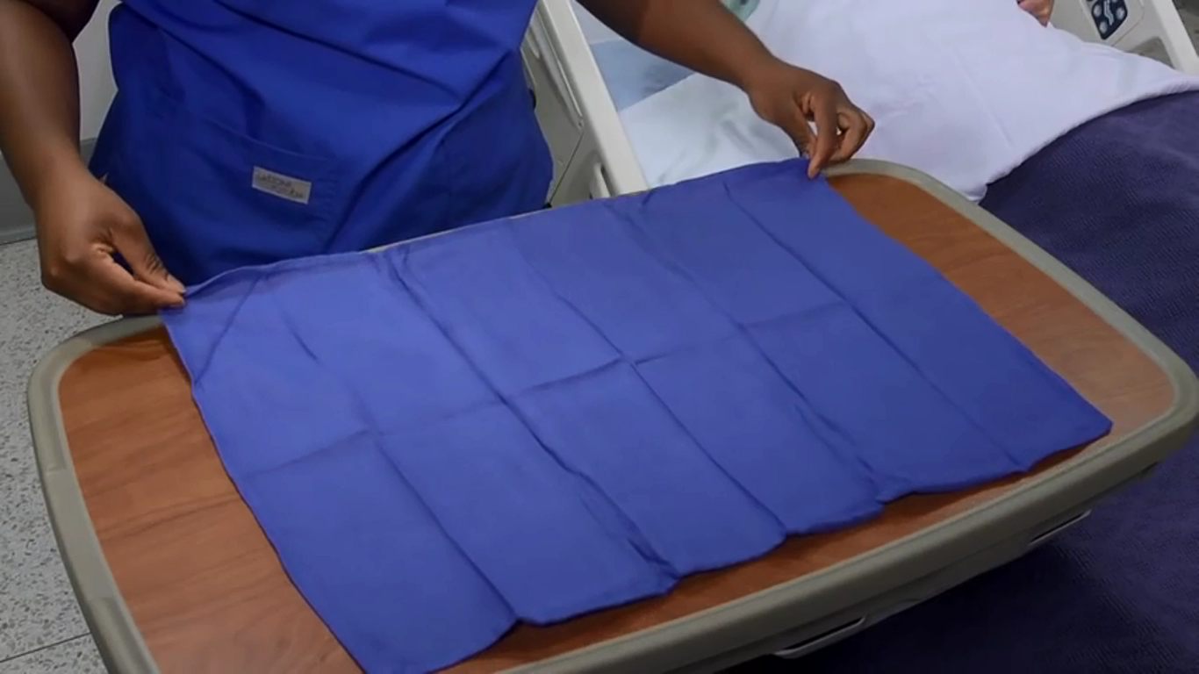
9.Holding drape, first position the bottom half over intended work surface.
10.Allow top half of drape to be placed over work surface area.

Slide 11
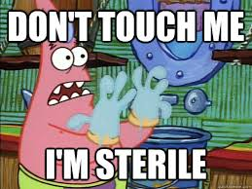

Slide 12
Holding sterile items:-
11.Open sterile item (following package directions) while holding outside wrapper in non dominant hand.
12.Carefully peel wrapper onto non dominant hand.
.

Slide 13
13.Being sure wrapper does not fall down on sterile field, place item onto field at angle. Don't hold arm over sterile field.
14.Dispose of outer wrapper.
15.Perform procedure using sterile technique.
16.Document procedure

Slide 14
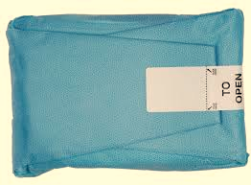

Slide 15
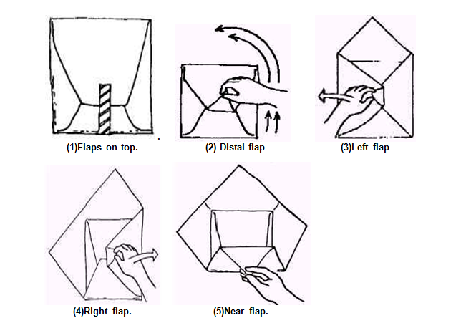

Slide 16
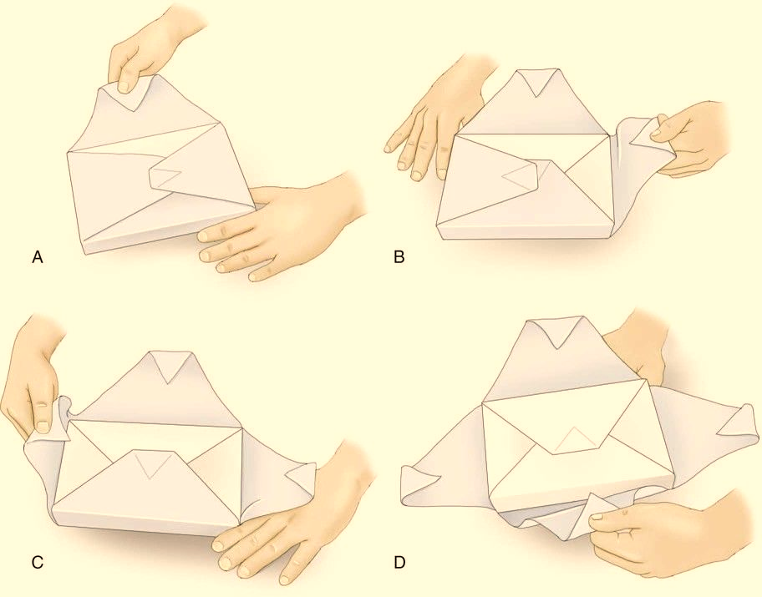

Slide 17

THANK YOU !

