Slide 1


Slide 2
Perineal care

Slide 3
Perineal area;
The perineum is the part of the woman’s body between her legs, including the vagina (birth canal) and rectum.

Slide 4
Causes:
The perineum is severely stressed as a baby is pushed through the vagina (birth canal).
Allow the episiotomy to heal.
This care take 1 to 3 weeks.

Slide 5
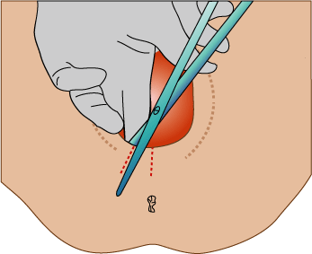

Slide 6
Objectives:
1- To clean the vulva and perineum.
2- To promote healing, prevent infection and relieve edema and soreness.
3- To eliminate offensive odor and make woman Comfortable.
5- To stimulate micturition.
6- To observe condition of perineum.

Slide 7
Indications:
1- Before vaginal examination and catheterization.
2- On admission and at six hour interval during labor as well as immediately before and after delivery.
4- After urination and or defecation in post-partum period.
5- Before dressing on episiotomy wound.
6- Pre and post-operative of perineal and vaginal surgery.
7- In case of leucorrhea

Slide 8
Procedure
1- Wash hands.
2- Prepare equipment and take to bedside.
3- Explain the procedure to woman and screen the bed.
4- expose the perineal area.
5- Put mackintosh and towel under the woman and place the bed pan with the towel ( lithotomy position).
6- Remove the soiled perineal pad from above to downward .

Slide 9
7- With forceps and cotton sponges clean as follows:
From symphysis pubis upward to the umbilicus.
The far thigh then, the near thigh.
The far labia from above downward, then the near labia.
Center from clitoris downward to perineum and rectum.
Pour the rest of solution over the vulva and rectum.

Slide 10
Dry and clean genitalia with cotton sponges by the same technique.
Remove the bed pan and instruct the women turn on her side & dry her buttocks with cotton.
Apply sterile perineal pad.
Rearrange bed & clothes to make women more comfortable.

Slide 11
Charting:
Record the time of procedure.
vital signs especially temperature.
Observation of the vulva and perineum.
Report abnormal observation and woman’s complains.

Slide 12
Any question?

