Slide 1

Performing a urinary ostomy care
By/ Eman Abdelmobdy

Slide 2
Performance objectives:
Define urinary ostomy.
Assemble necessary equipment for performing urinary ostomy care.
Prepare the patient for performing urinary ostomy care.
Perform urinary ostomy care correctly.

Slide 3
Definition
Urostomy: is a surgically created opening on the body surface. Such diversions are usually permanent, and the patient wears an external appliance to collect the urine because urine elimination from the stoma cannot be controlled voluntarily.

Slide 4
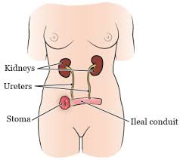

Slide 5
Equipment
Basin with warm water
Skin cleanser, towel, washcloth
Silicone-based adhesive remover
Gauze squares
Washcloth or cotton balls
Skin protectant

Slide 6
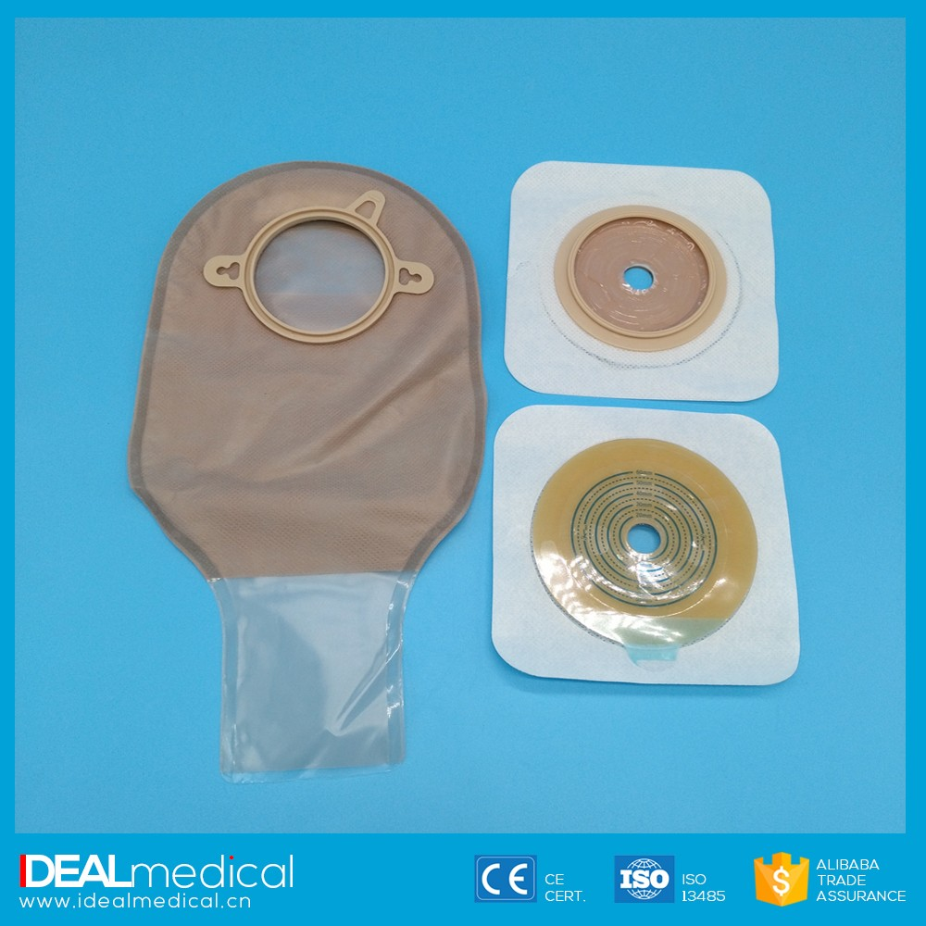
Ostomy appliance

Slide 7
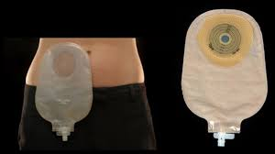

Slide 8
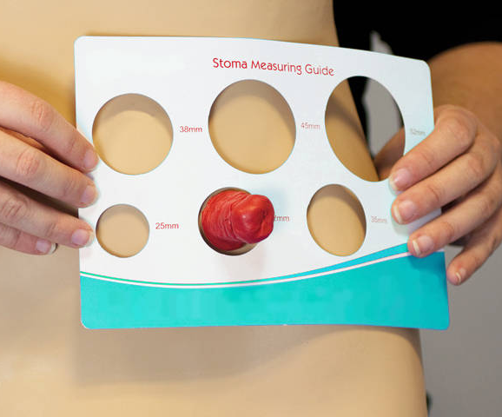
Stoma measuring
guide

Slide 9
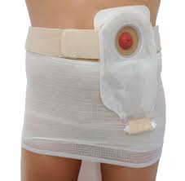
Ostomy belt (optional)

Slide 10
Graduated container
Disposable gloves
Waterproof, disposable pad
Small plastic trash bag

Slide 11
Procedure
Step 1: Bring necessary equipment to the bedside stand or over bed table.
Step 2: Perform hand hygiene.
Step 3: Identify the patient.
Step 4: Close curtains around bed and close the door.

Slide 12
Step 5: Explain what you are going to do.
Step 6: Assist patient to a comfortable sitting or lying position in bed.
Step 7: Adjust the bed to a comfortable working height.
Step 8: Place waterproof pad under the patient at the stoma site.

Slide 13
Emptying the appliance
Step 1: Put on gloves.
Step 2: Hold end of appliance over a bedpan, or measuring device. Remove the end cap from the spout. Open spout and empty contents into the bedpan or measuring device .

Slide 14
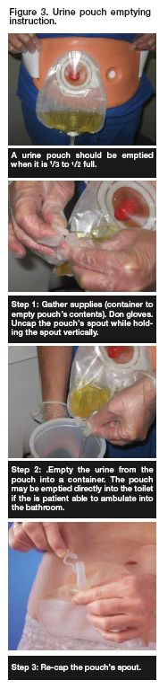
1
2
3
4

Slide 15
Step 3: Close the spout. Wipe the spout with toilet tissue. Replace the cap.
Step 4: Remove equipment.
Step 5: Remove gloves.
Step 6: Assist patient to comfortable position.
Step 7: If appliance is not to be changed place bed in lowest position.
Step 8: Perform hand hygiene.

Slide 16
Changing the appliance
Step 9: Place a disposable waterproof pad on the over bed table or other work area. Set up the washbasin with warm water and the rest of the supplies.
Step 10: Place a trash bag within reach.
Step 11: Put on clean gloves.
Step 12: Place waterproof pad under the patient at the stoma site. Empty the appliance if necessary as described in steps 9–10.
Step13: Gently remove appliance faceplate from skin by pushing skin from appliance rather than pulling appliance from skin

Slide 18
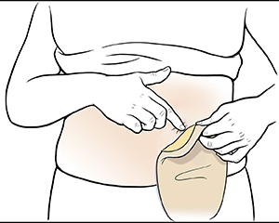

Slide 19
Step 14: Apply a silicone-based adhesive remover by spraying or wiping with the remover wipe .
Step 15: Place the appliance in the trash bag, if disposable. If reusable, set aside to wash in lukewarm soap and water and allow to air dry after the new appliance is in place

Slide 20
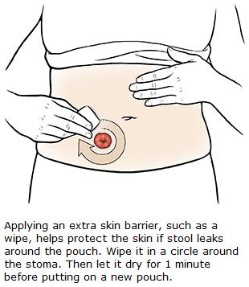
Step 16: Clean skin around stoma with mild soap and water or a cleansing agent and a washcloth .

Slide 21
Step 17: Remove all old adhesive from skin; additional adhesive remover may be used.
Step 18: Do not apply lotion to peristomal area to prevent a tight adhesive seal.
Step 19: Gently pat area dry. Make sure skin around stoma is thoroughly
Dry.
Step 20: Assess stoma and condition of surrounding skin.

Slide 22
Step 21: Place one or two gauze squares over stoma opening

Slide 23
Step 22: Apply skin protectant to a 2-inch (5-cm) radius around the stoma, and allow it to dry completely, which takes about 30 seconds.
Step 23: Lift the gauze squares for a moment and measure the stoma opening, using the measurement guide.
Step 24: Replace the gauze.

Slide 24
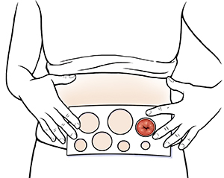

Slide 25
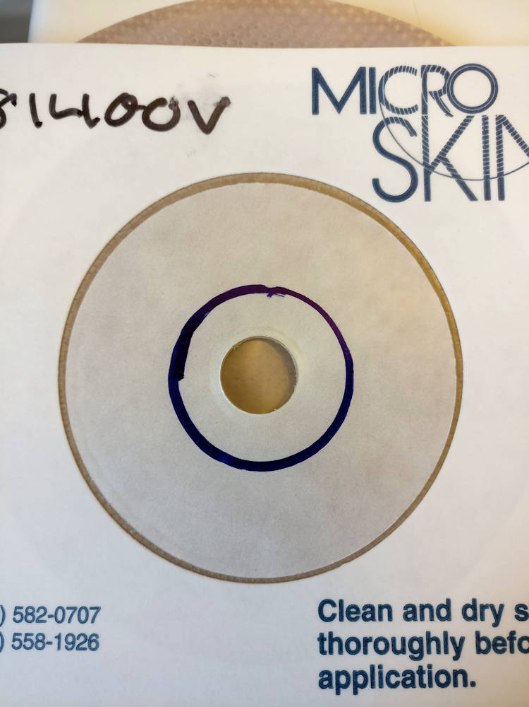
Step 25: Trace the same size opening on the back center of the appliance. Cut the opening 1/8 inch larger than the stoma size

Slide 26
Step 26: Check that the spout is closed and the end cap is in place.
Step 27: Remove the backing from the appliance.
Step 28: Quickly remove the gauze squares and discard appropriately; ease the appliance over the stoma.

Slide 27
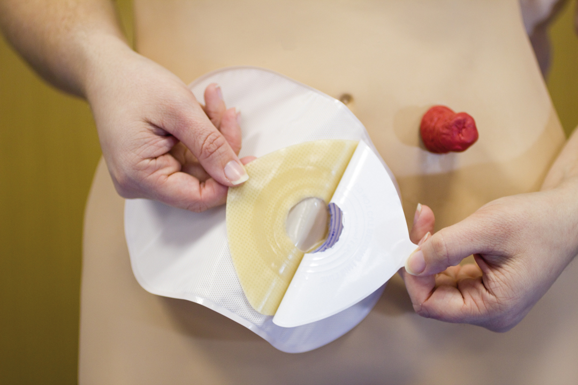

Slide 28
Step 29: Gently press onto the skin while smoothing over the surface. Apply gentle pressure to the appliance for a few minutes.

Slide 29
Step 30: Secure optional belt to appliance and around patient.

Slide 30
Step 31: Remove gloves.
Step 32: Assist the patient to a comfortable position. Cover the patient with bed linens.
Step 33: Place the bed in the lowest position.
Step 34: Put on clean gloves. Remove or discard any remaining equipment and assess patient’s response to procedure.

Slide 31
Step 35: Remove gloves and perform hand hygiene.
Step 36: Document the procedure, including the appearance of the stoma, condition of the peristomal skin, characteristics of the urine, and the patient’s response to the procedure.

Slide 32


