Slide 1
بسم الله الرحمن الرحيم
( قالوا سبحانك لا علم لنا إلا ما علمتنا انك أنت العليم الحكيم)
صدق الله العظيم
( سورة البقرة الآية 32 )

Slide 2
Enterobius Vermicularis
(Pinworm Or Oxyuris)
Disease: Entrobiasis, pinworm infection.
Distribution: It is cosmopolitan commonly in children.
Host: Man is the natural host.
Habitat: Adult worms are found in the caecum, appendix, and adjacent portion of ascending colon.
Infective stage: Infective egg.
Mode of infection:
1-Ingestion of eggs by:
-Handling contaminated linen, clothing and articles.
-External autoinfection (hand to mouth)
-Contaminated foods or drink

Slide 3
2-Retro-infection: In rare instance when the eggs on the perianal skin hatch and the liberated larvae migrate back through the anus
3-Air-born by polluted eggs in dust also rarely.
Life cycle:
•Eggs laid on perianal skin containing infective larvae are swallowed and hatch out in the intestine.
•They moult in the ileum and enter the caecum, where they mature into adults.
•The gravid female migrates down the colon to the rectum.

Slide 5
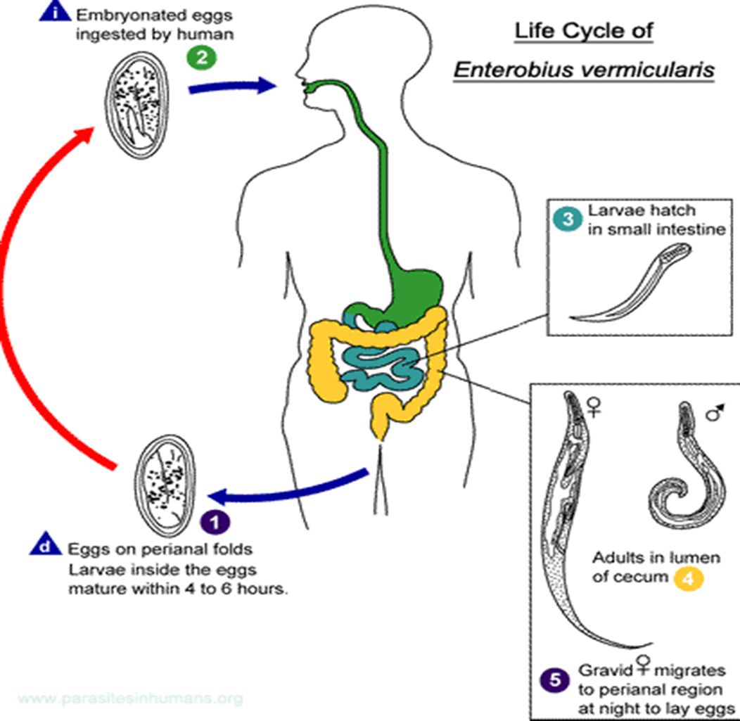

Slide 6
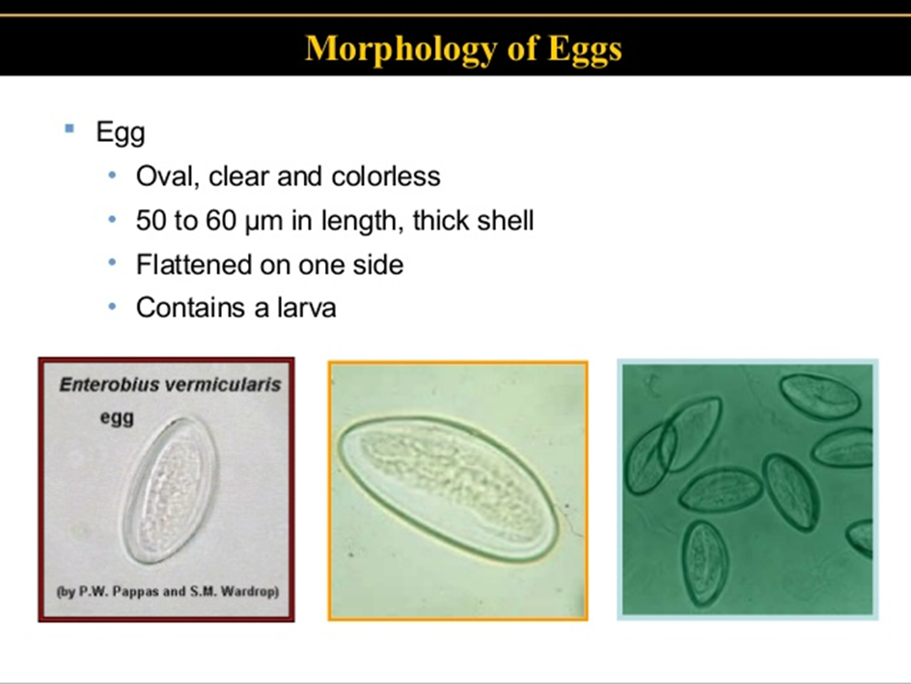

Slide 7
At night, when the host is in bed, the worm comes out through the anus and crawls about on the perianal and perineal skin to lay its sticky eggs. The worm may retreat into the anal canal and come out again to lay more eggs. The female worm may wander into the vulva, vagina and even into the uterus and fallopian tubes, sometimes reaching the peritoneum.
Pathogenesis and clinical picture:
•Enterobiasis occurs mostly in children. It is more common in females than in males. About one-third of infections are asymptomatic.
•Intense irritation and pruritus of the perianal and perineal area (pruritis ani) due to adults.

Slide 8
•The worm crawling into the vulva and vagina causes irritation and a mucoid discharge. It may migrate upto the uterus, fallopian tubes and into the peritoneum. This may cause symptoms of chronic salpingitis, cervicitis, peritiontis, and recurrent urinary tract infections.
Diagnosis:
•Clinically: Pruritus ani at night
•Laboratory:
✓Finding Entrobius vermicularis eggs in faeces (in about 5 % of infected cases).
✓Adult female worms can be seen in faeces or in anal area at night by parents or during the clinical examination.

Slide 9
✓Finding of the eggs in perianal and perineal skin using clear cellulose adhesive tape (e.g. National Institute of Health (NIH) and Scotch adhesive tape swabs).
•As regards Scotch adhesive tape swab the tape is applied with its sticky side down to the skin then transferred to a glass slide with placing a clearing agent (e.g. toluene or cedar oil) between the slide and the tape for staining the clearing the field.
•The tape is examined for the presence of the eggs.
•The tape is used in the morning before bathing or defecation.
•Repeated tapes may be necessary for the diagnosis.

Slide 10
Treatment: (Treatment of all family members)
Albendazole 400 mg once) or mebendazole (100 mg once) can be used for single dose therapy. It is necessary to repeat the treatment after 2 weeks to take care of autochthonous infections and ensure elimination of all worms. Treat the whole family or group of children .
Prevention and control:
1.Washing of hands before eating and after defecation.
2.Mass treatment should be for all members of the household.
3.Cutting nails short.
4.Wearing tight underclothes during sleep.

Slide 11
Ancylostoma Duodenale
Disease: ancylostomiasis .
Distribution: Worldwide especially in tropical and subtropical areas.
Definitive host: Man only.
Habitat: Small intestine, particularly in the jejunum and less often in the duodenum.
Infective stage: Third stage filariform larva.
Life cycle:
•Adult worm inhabiting the small intestine of man .
•Female worm lays eggs which are not infective for humans.
•When deposited in the soil, the embryo develops inside the eggs.

Slide 12
•Rhabditiform larva, hatches out of the egg, molts twice, to become the third-stage infective filariform larva.
•When a person walks barefooted on soil containing the filariform larva, they penetrate the skin and enter the subcutaneous tissue.
•Larvae are carried along the venous circulation to the right side of the heart and to the lungs. Here, they escape from the pulmonary capillaries into the alveoli, migrate up the respiratory tract to the pharynx, and are swallowed, reaching the small intestine.
•During migration or on reaching the esophagus, they undergo third molting.
•They feed, grow in size, and undergo a final molting in the small intestine and develop the buccal capsule, by which they attach themselves to the small intestine and grow into adults.

Slide 13
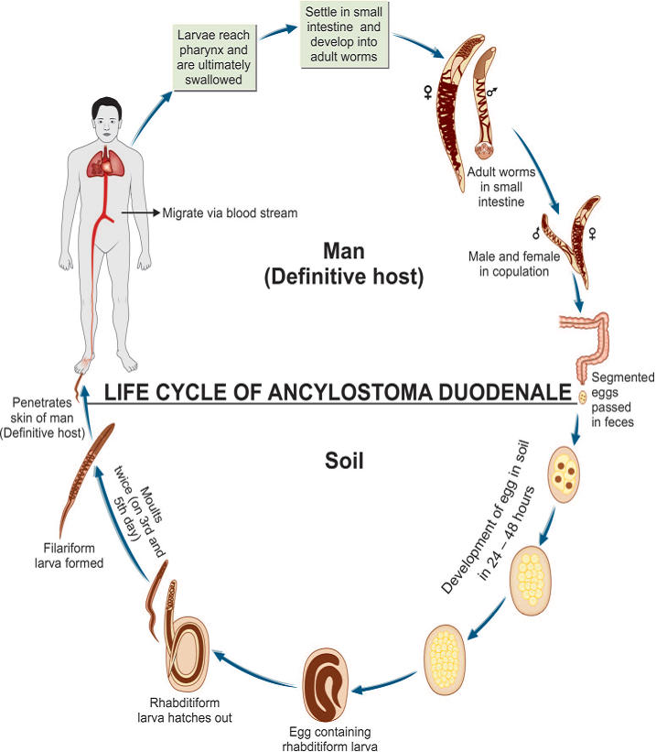

Slide 14
Pathogenesis and clinical picture:
•Asymptomatic.
•Hookworm may produce a local irritation at the site of infection.
•As the worms mature in the jejunum, patients may have vague colicky abdominal pain, flatulence, nausea, anorexia, vomiting and diarrhea with red to black stools.
•Each Ancylostoma worm ingests 0.15-0.2 mL of blood daily leading to anemia.
Diagnosis:
1.Clinical picture in an endemic area.
2.Demonstration of characteristic oval segmented hookworm eggs in feces by direct wet microscopy or by concentration methods is the best method of diagnosis

Slide 15
3.Stool culture: Harada Mori method of stool culture is carried out to demonstrate third stage filariform larvae
4.Blood examination reveals microcytic, hypochromic anemia and eosinophilia.
Treatment:
•Albendazole (400 mg single dose) or mebendazole (500 mg once).
•Treatment of hookworm disease also includes relief of anemia.
Prevention and control:
•Prevention of soil pollution with feces and proper disposal of night soil and use of sanitary latrines.
•Use of footwear to prevents and gloves.
•Treatment of cases.
•Health education.

