Slide 1

بسم الله الرحمن الرحيم

Slide 2
Disaster Management

Slide 3


Slide 4
Out lines:
Introduction.
Definition of disaster
Factors contributing to disasters
Types of disasters
Elements at risk from disaster
Impact of disaster on community
Definition of disaster management
Aims of disaster management
Principles of effective disaster management

Slide 5
Stages of disaster management
Disaster Management Cycle
1- Mitigation
2- Preparedness
3- Response
4- Recovery
Health sector of disaster
Steps of safety measures during disaster
Role of nurse in different phases
Roles of Communities in Disaster Management

Slide 6
Introduction:
Disaster Management is the coordination and integration of all activities necessary to build, sustain and improve the capability to prepare for, protect against, respond to and recover from threatening or actual natural or human-induced disasters.

Slide 7
Definition of disaster:
A Disaster: A disaster is a serious disruption of the functioning of a community or society causing widespread human, material, economic or environmental loses which exceed the ability of the affected community/society to cope using its own resources.

Slide 8
Factors contributing to disasters
Poverty.
Social inequality.
Environmental degradation result from poor land use.
Rapid population growth.

Slide 9
Types of disasters:
1-Natural disasters. These disasters include floods, hurricanes, earthquakes and volcano eruptions that can have immediate impacts on human health, as well as secondary impacts causing further death.
2-Environmental emergencies. These emergencies include technological or industrial accidents, usually involving hazardous material, and occur where these materials are produced, used or transported.

Slide 10
3-Complex emergencies. These emergencies involve a break-down of authority, looting and attacks on strategic installations. Complex emergencies include conflict situations and war.
4-Pandemic emergencies. These emergencies involve a sudden onset of a contagious disease that affects health but also disrupts services and businesses, bringing economic and social costs.

Slide 11
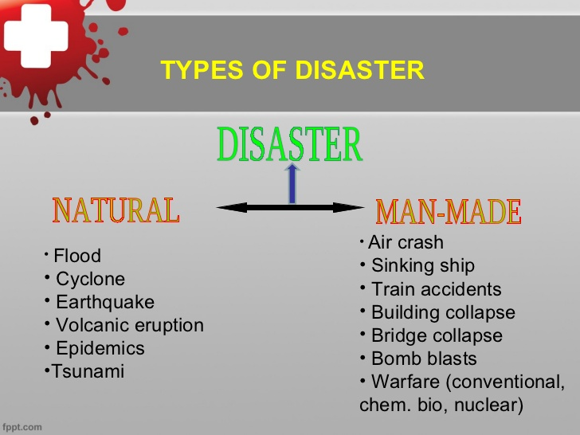
of disaster Types

Slide 12
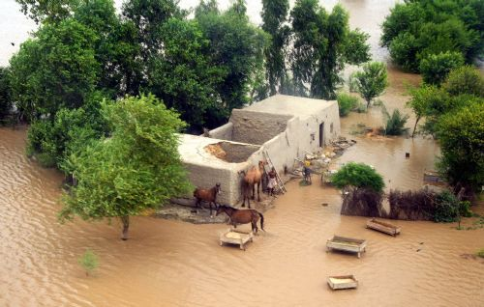

Slide 13
Elements at risk from disaster:
People
Livestock
Rural Housing Stock
Houses Vulnerable
Crops, Trees, Telephone, Electric poles
Boats, Working Implements
Personal Property
Electricity, Water and Food Supplies
Infrastructure Support

Slide 14
Impact of disaster on community
1-Effects on the social environment
. social environment impacts in terms of safety, health and wellbeing, and psychosocial components.

Slide 15
Effects on the built environment
The built environment in terms of effects on infrastructure that supports essential services, rural infrastructure, residential infrastructure, commercial or industrial infrastructure, and public building.

Slide 16
Effects on the economic environment
The economic environment in terms of effects on individuals, businesses, infrastructure and government

Slide 17
Effects on the natural environment
The impacts on the natural environment that have flow-on effects to the community in relation to: air , water , land and soil , plants and animals. Disasters may impact on all aspects of a community.

Slide 18
Disaster Management

Slide 19
Definition of disaster management:
Disaster management can be defined as the organization and management of resources and responsibilities for dealing with all humanitarian aspects of emergencies, in particular preparedness, response and recovery in order to lessen the impact of disasters.

Slide 20
AIM of disaster management

Slide 21
Reduce (Avoid, if possible) the potential losses from hazards.
Assure prompt and appropriate assistance to victims when necessary.
Achieve rapid and durable recovery.
To establish a policy/legal and institutional framework for management of disasters for disaster risk reduction, at all levels.

Slide 22
Aim of disaster managemrnt
To ensure that institutions and activities for disaster risk management are coordinated at all levels, including international, regional, sub-regional Eastern African, national and sub-national .
To mobilizes resources, including establishment of specific funds for disaster risk reduction strategies and programmed.

Slide 23
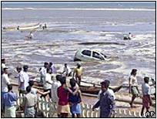

Slide 24
Principles of effective disaster management

Slide 25
• An effective Disaster Early Warning, Information and Prediction System
• Mainstreaming disaster management in development programming
• Strong link between Early Warning and Disaster Response through harmonized and standardized rapid response interventions to disasters
• Established and functional semi-autonomous agency responsible for disaster management with oversight from the Ministry of State for Special Programmed

Slide 26
Provides for flexible financial and response procedures to facilitate appropriate, effective and timely planning and management of disaster control initiatives.
• Reinforces the disaster management strategies of vulnerable and affected communities.
• Individuals are responsible for their own safety

Slide 27
Stages of disaster management

Slide 28
1. Before a disaster (pre-disaster).
Activities taken to reduce human and property losses caused by a potential hazard. For example strengthening the existing weak structures, preparation of the disaster management plans . risk reduction measures taken under this stage are termed as mitigation and preparedness activities.

Slide 29
2. During a disaster (disaster occurrence).
Initiatives taken to ensure that the needs and provisions of victims are met and suffering is minimized. Activities taken under this stage are called emergency response activities.

Slide 30
3. After a disaster (post-disaster)
Initiatives taken in response to a disaster with a purpose to achieve early recovery and rehabilitation of affected communities immediately after disaster strikes. These are called as response and recovery activities.

Slide 31


Slide 32
Disaster management cycle

Slide 33
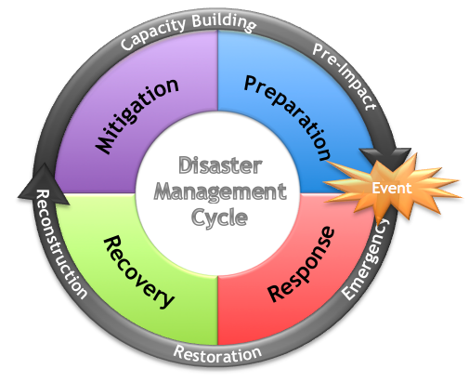

Slide 34
1- Mitigation
. Personal mitigation is a key to national preparedness. Individuals and families train to avoid unnecessary risks. This includes an assessment of possible risks to personal/family health and to personal property.

Slide 35
Preparednes 2-
Personal preparedness focuses on preparing equipment and procedures for use when a disaster occurs, i.e., planning. Preparedness measures can take many forms including the construction of shelters, installation of warning devices, creation of (e.g., power, water, sewage

Slide 36
3- Response
The response phase of an emergency may commence with search and rescue but in all cases the focus will quickly turn to fulfilling the basic humanitarian needs of the affected population. This assistance may be provided by national or international agencies and organizations.

Slide 37
4- Recovery
The recovery phase starts after the immediate threat to human life has subsided. The immediate goal of the recovery phase is to bring the affected area back to some degree of normalcy.

Slide 38
Health sector of disaster
1)Strategy, Policy and Legal framework
2) Health system that consist of 1) service delivery, 2) health workers, 3) health information, 4) medical products, technology and vaccines, 5) health finance, and 6) governance and leadership , 7)health facilities.

Slide 39
3) Information and Knowledge management
4) Operation and logistics management system
5) Community readiness

Slide 40
Steps of safety measures during disaster
Prepare emergency supplies (food, water, blankets) and First Aid kits, including prescription medications.
Learn how to turn off gas, water and electricity in case the lines are damaged.

Slide 41
Know the safe spots in every room - under sturdy tables, desks or against inside walls, and know the danger spots - windows, mirrors, hanging objects, fireplaces
Create a disaster preparedness plan so that everyone in the family will know what to do in the event of a quake or other emergency.

Slide 42


Slide 43
Role of nurse in different phases

Slide 44
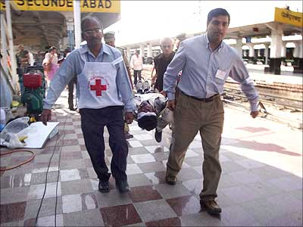

Slide 45
During preventive phase, the nurse should:
Be anticipatory guidance that encourage expressing feelings about disaster before it occurs to minimize its impact.
Monitoring risk factors.
Increase community awareness and preparation.
Develop and implement programs and education to prevent disasters from occurring.

Slide 46
During preparedness phase, the nurse should
  Assist in developing disaster plan.
Elements of disaster plan:
Lines of communication
Modes of transport
Mobilization Care of dead bodies
Warning
Treatment
Support of victims and families

Slide 47
During response phase, the nurse should:
Identify the population.
Triaging the victim.
Care for injured persons.
Transporting patients.
Arranging for physical facilities for the victim

Slide 48
During recovery phase, the nurse should provide:
Counseling.
Rehabilitation.
Reconstruction and repair of damage.
Continuing care.
Behavior modification.

Slide 49
Role of communities in disaster management

Slide 50
Community structures shall perform the following functions in disaster management:-
1- preparedness of community members to disaster management.
2- Mobilize community resources and build community capacity and resilience to prepare for, respond to and mitigate the impact of disasters.

Slide 51
4- We should -make necessary arrangements to shift the essential household goods, domestic animals and vehicles, etc. to safer
5- ready the phone numbers of all emergency services like police, fire brigade, and medical centers.

Slide 52

THANK YOU

