Slide 1

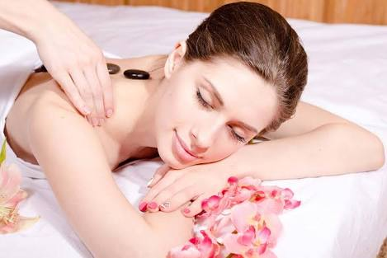
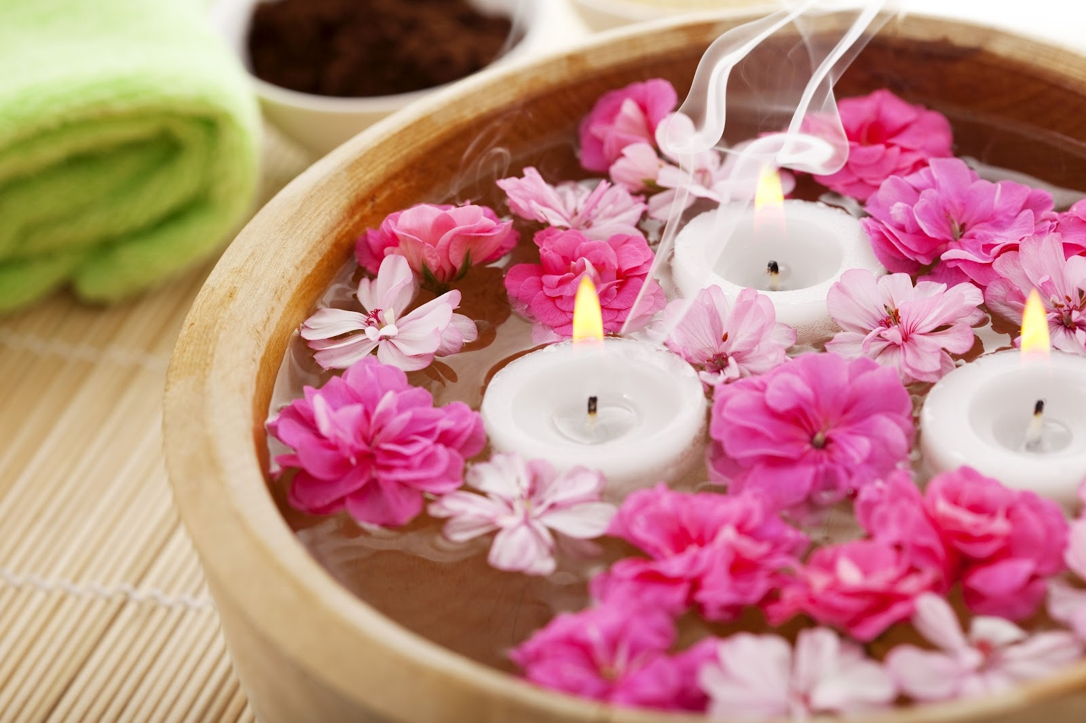

Stress Management Activities
By
Dr. Nagwa Souilm
assistant professor of Psychiatric/Mental Health Nursing, Faculty of Nursing, South Valley University

Slide 2
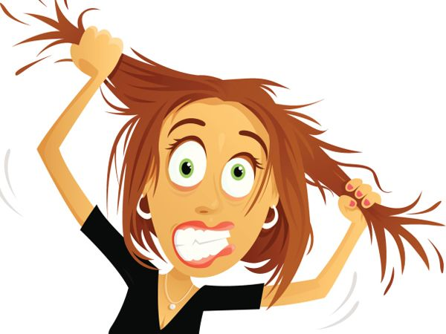
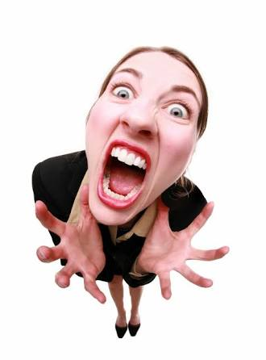
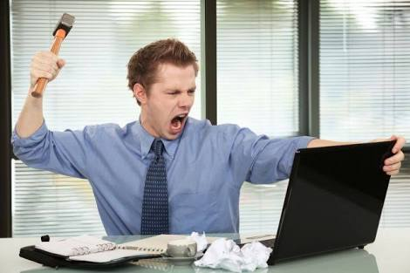

FACTS ABOUT STRESS

Slide 3
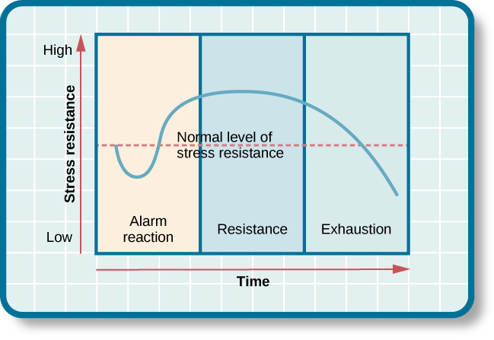
Costs of stress 1/3
    It is estimated that 1 in 3 adult workers suffer from moderate to extreme stress overload and are at risk of stress-related health problems.
    3.2 days per worker are lost each year as a result of workplace stress.
13.5 million work days are lost each year as a result of stress complaints (in Europe)
Stress related absenteeism directly costs Australian employers $10.11 billion a year. It costs the Australian economy approx. $14.81 billion a year.

Slide 4
Costs of stress 2/3
Stress is believed to account for 30% of all infertility problems. In women, stress can cause spasms in the fallopian tubes and uterus. In men, it can effect the sperm count and cause erectile dysfunction (Bouchez, 2018).

Slide 5
Costs of stress 3/3
Correlations have been found between stress and the top six causes of death: cancer, lung ailments, heart disease, liver cirrhosis, accidents, and suicide (“How Does Stress Affect Us?”, 2016).

Slide 6
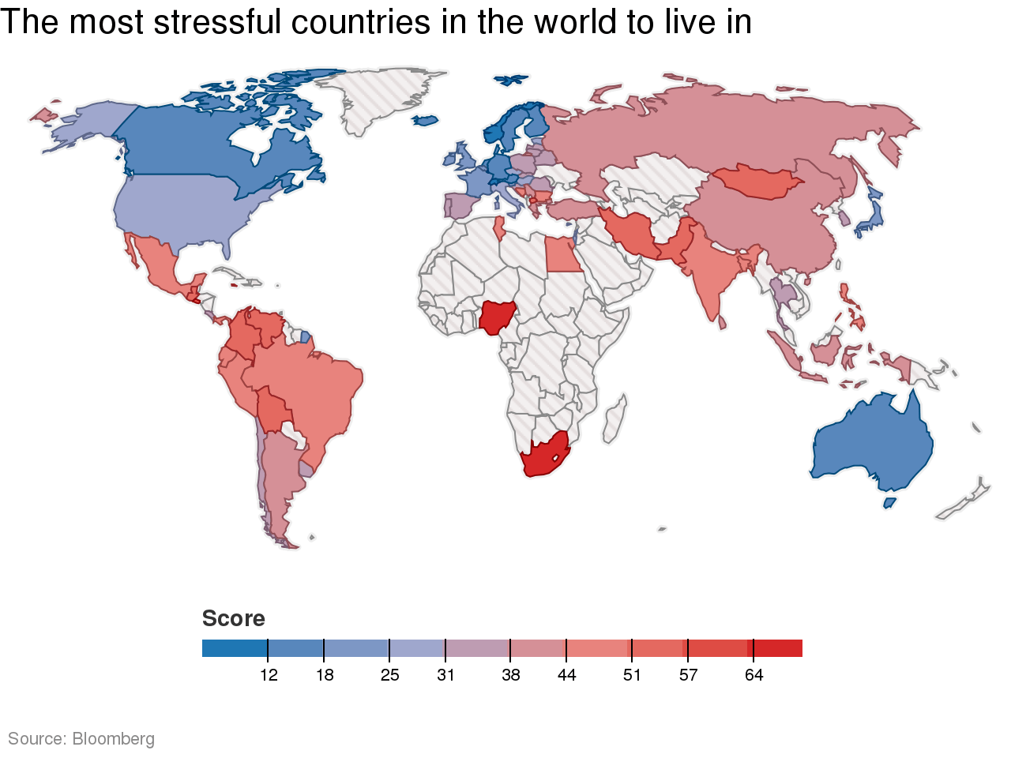
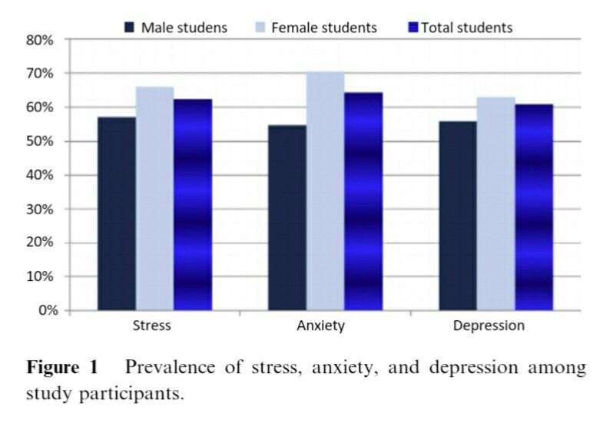
Prevalence of stress

Slide 7

What Is Stress
Stress can be defined as our mental, physical, emotional, and behavioral reactions to any perceived demands or threats.
S= P>R

Slide 8
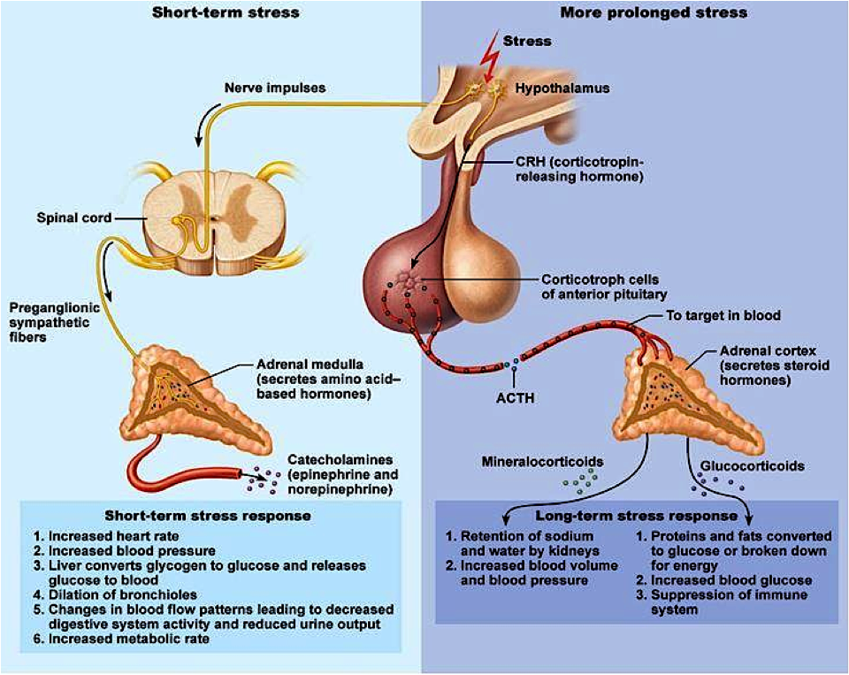
Physiology of stress response

Slide 9
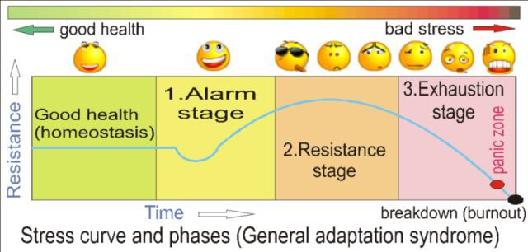
general adaptation syndrome

Slide 10
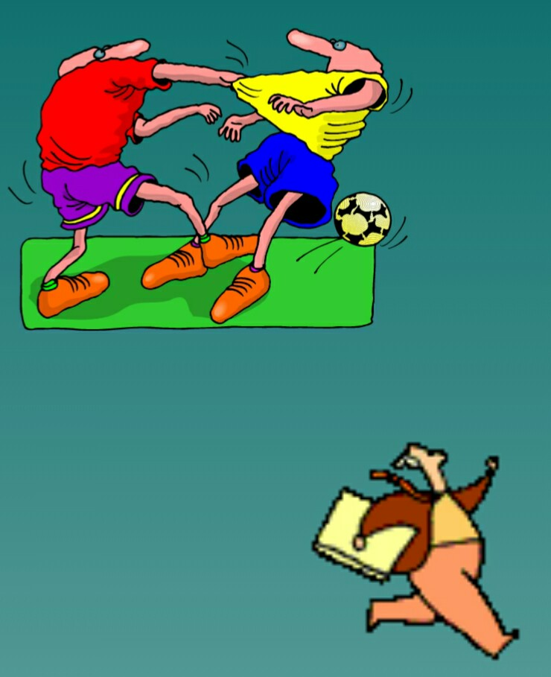
The “Fight or Flight” Response
When situations seem threatening to us, our bodies react quickly to supply protection by preparing to take action. This physiological reaction is known as the "fight or flight" response.
Alarm response

Slide 11
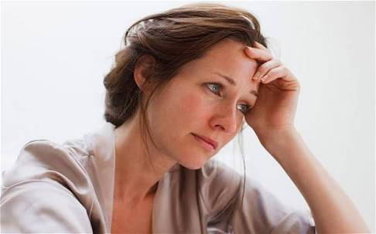
Adaptation phase
The body resists and compensates as the parasympathetic nervous system attempts to return many physiological functions to normal levels while body focuses resources against the stressor and remains on alert.

Slide 12
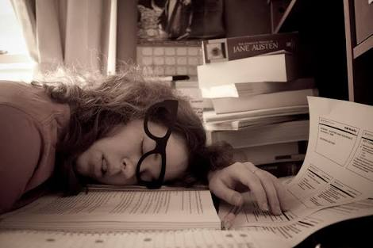

Exahusion
If the stressors continue beyond the body’s capacity, the resources become exhausted and the body is susceptible to disease and death.

Slide 13
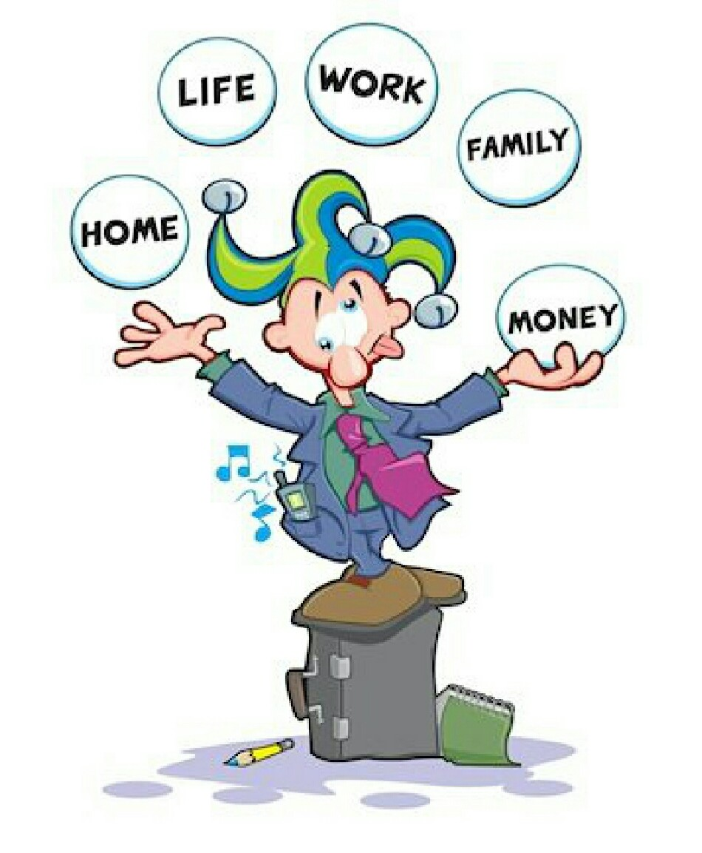
Common courses of stress
Personal Changes
Illness, end of relationship, financial shifts
Family Changes
Marriage/divorce, death, moving
Work Changes
New Job/Boss, unemployment
Environmental Changes
War, natural disaster, relocation

Slide 14
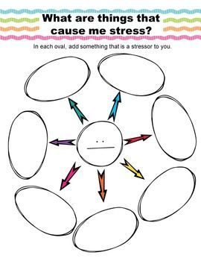

Slide 15
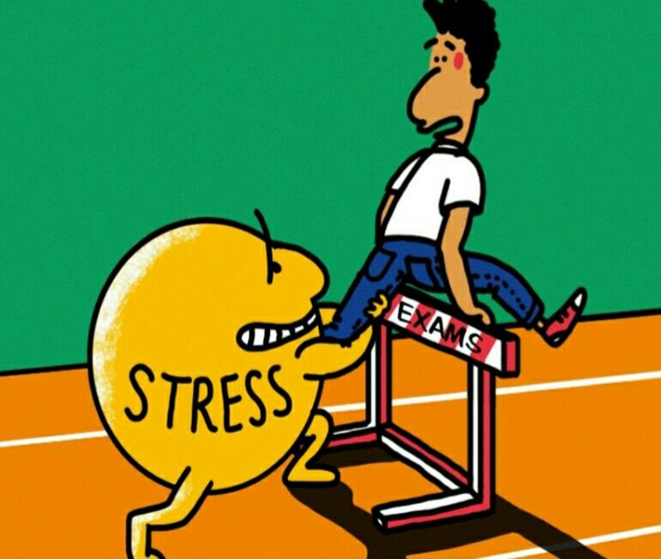

Not All Stress is Bad…
  Examples of eustress include graduating from college, getting married, receiving a promotion, or changing jobs.
  Examples of distress include financial difficulties, conflicts in relationships, excessive obligations, managing a chronic illness, or experiencing a trauma.

Slide 16
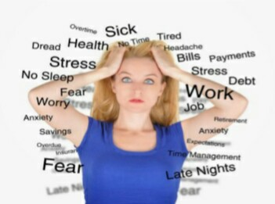
All Stressors are not equal

Slide 17
Stress and its Effects
      Do you personally suffer from excessive stress
      What are the signs of excessive stress
      What can you do to help alleviate your stress

Slide 18
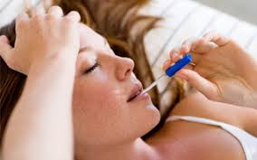
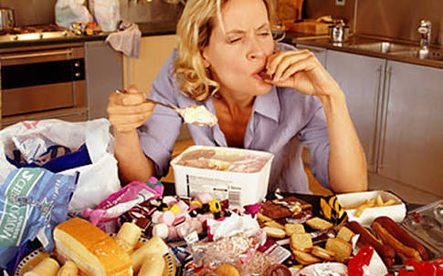
How stress affects us differently
Physical symptoms
Aches and pains
Diarrhea or constipation
Nausea, dizziness
Chest pain, rapid heart rate
Loss of sex drive
Frequent colds or flu
Behavioral symptoms
Eating more or less
Sleeping too much or too little
Withdrawing from others
Using alcohol, cigarettes,..
Nervous habits

Slide 19
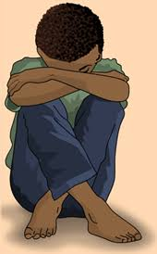

Symptoms of stress
Cognitive symptoms
Memory problems
Inability to concentrate
Poor judgment
Seeing only the negative
Anxious or racing thoughts
Emotional symptoms
Depression or general unhappiness
Anxiety and agitation
Moodiness, irritability, or anger
Loneliness and isolation

Slide 20
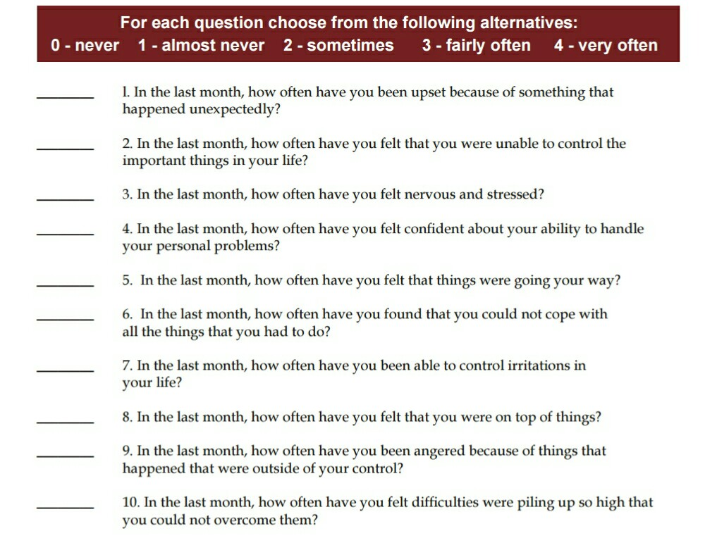
Determine Your Personal Level of Stress

Slide 21
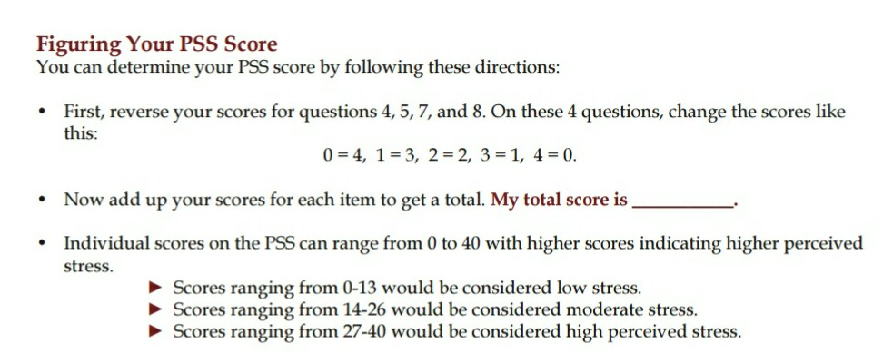
Determine Your Personal Level of Stress

Slide 22
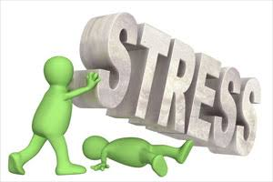

Slide 23
Barriers To Managing Stress
I just ‘deal’ with my stress, it’s not a big issue.
It’s just stress, I don’t need counseling.
Stress is just a part of my job.
I don’t have time to deal with my stress.
People who are stressed just can’t cope with reality.
I’ll be OK.
Dealing with my stress would just be too expensive.

Slide 24
1) Identify the sources of stress in your life
identify the regular stressors in your life and the way you deal with them. Each time you feel stressed, keep track of it in your journal. As you keep a daily log, you will begin to see patterns and common themes. Write down:
What caused your stress, How you felt, both physically and emotionally How you acted in response, What you did to make yourself feel better.

Slide 25
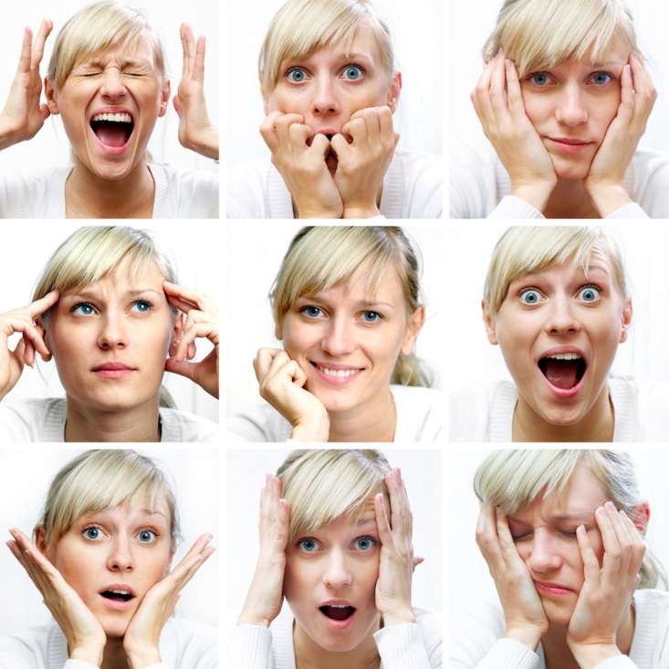
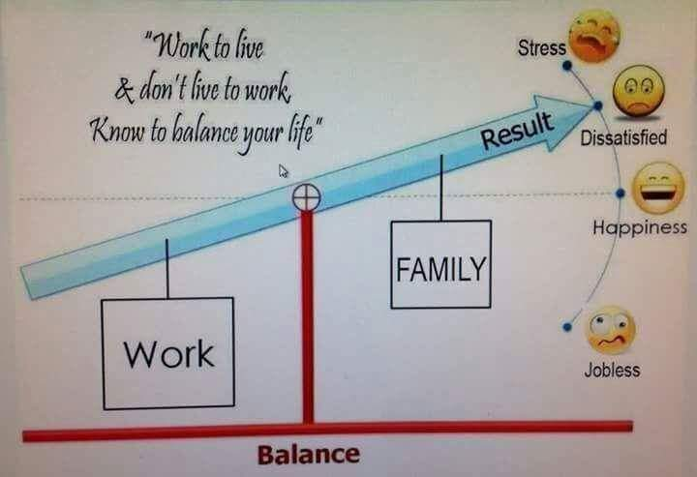
2)The four A's ( Avoid, Alter, Adapt & Accept 1/2)
Avoid unnecessary stress
Avoid people who stress you out.
Take control of your environment.
Learn how to say "no“
Alter the situation
Express your feelings instead of bottling them up
Be willing to compromise
Create a balanced schedule

Slide 26
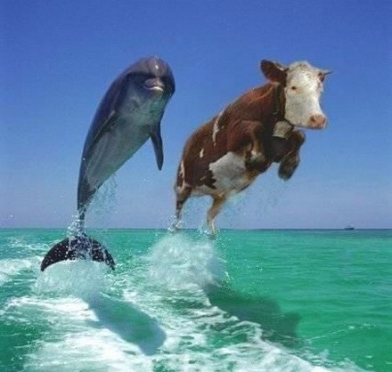
2)The four A's ( Avoid, Alter, Adapt & Accept 2/2)
Adapt to the stressor
Reframe problems
Look at the big picture
Practice gratitude
Accept the things you can't change
Don't try to control the uncontrollable
Look for the upside
Learn to forgive

Slide 27
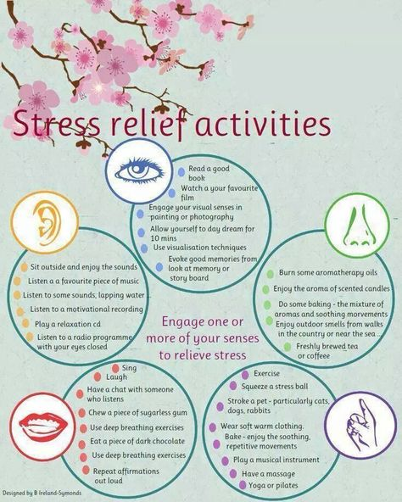
3) The ability to tap into your senses

Slide 28
4) Stress and diet 1/3
Foods that can have negative effects on the body when under stress include:
Caffeine
Foods high in fat and sugar
Alcohol

Slide 29
Stress and diet 2/3
Stress relieving foods to eat more of:
Fruit and vegetables
- B vitamins
- Vitamin C
- Magnesium

Slide 30
Stress and diet 3/3
Stress relieving foods to eat more of:
Complex carbohydrates (to enhance levels of serotonin - the mood-boosting hormone that helps you to feel happy and more relaxed).
Essential fatty acids EFAs(Omega 3,6)
Calcium-rich foods

Slide 31
5) Relaxation techniques
Deep breathing
Massage
Aromatherapy
Visualization
Yoga

Slide 32
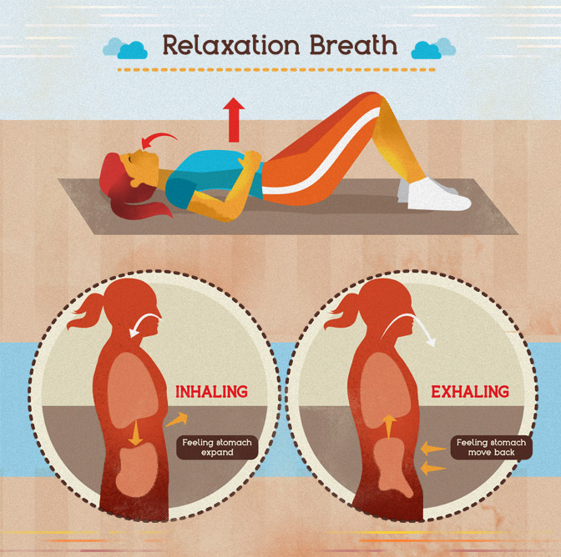
A) Deep breathing
Need to learn breathing technique until it becomes an automatic habit!
Practice 15 times a day for 1 minute
Breathe every time you are waiting for something! Phone, kids, in line, at work…

Slide 33
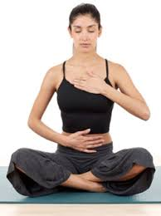
A) Deep breathing ( Con.....)
Slowly inhale counting one, pause for a moment and slowly exhale counting two
Slowly inhale counting three, pause for a moment and slowly exhale counting four..
Continue inhaling and counting four and exhaling…

Slide 34
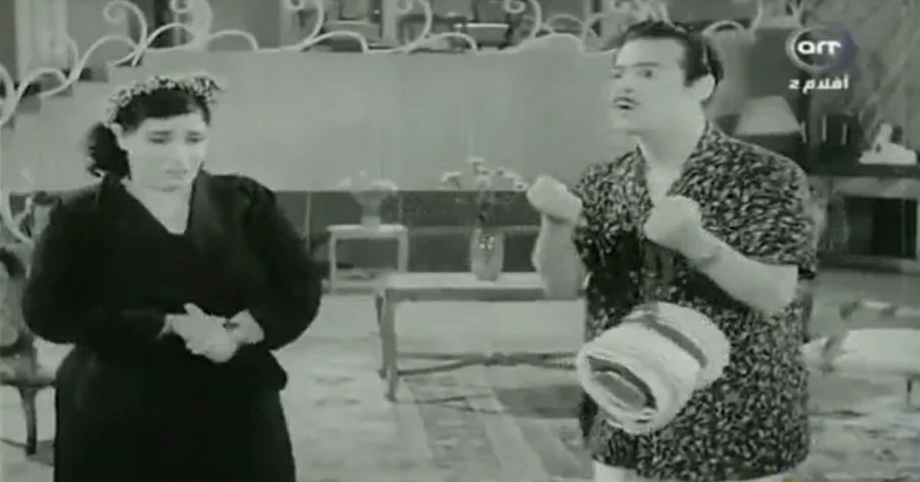

Slide 35
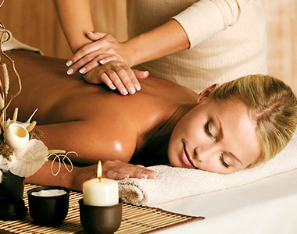
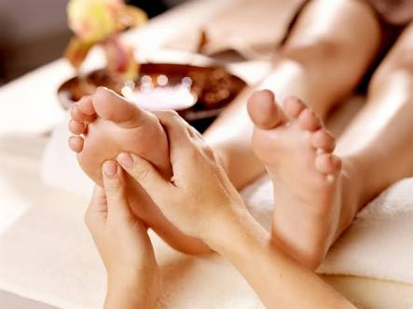
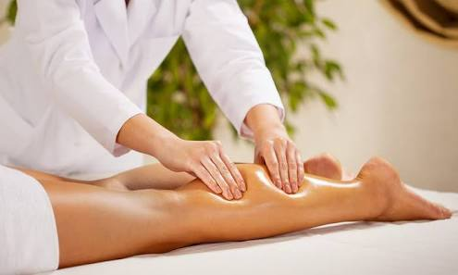
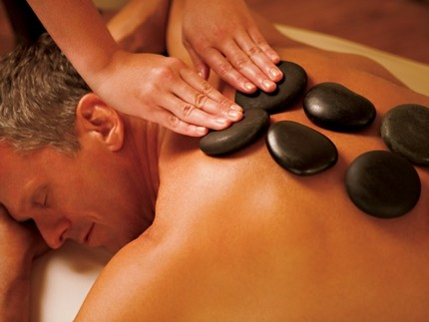
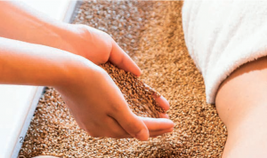
B) Massage
Quartz Massage
Tranquillity Pro-Sleep
Aromasoul Elements Massage
Marine Mud Massage
Warm Stone Ritual Massage
Sole Focus Massage

Slide 36
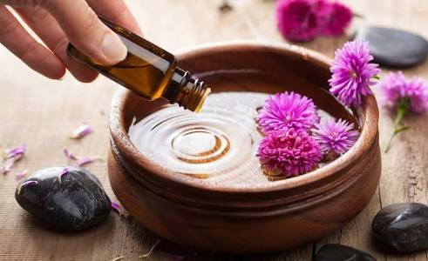
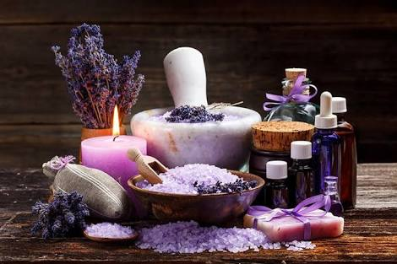
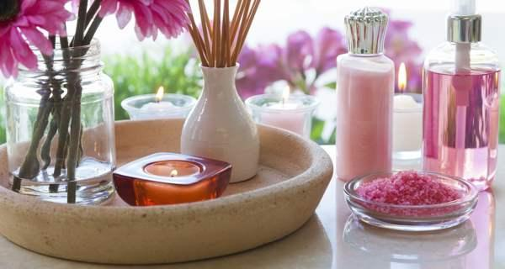
C)Aromatherapy
Aromatherapy can be performed in several different ways:
Diffusing a combination of essential oils into the air (or just one single oil)
Inhaling oils through the nostrils directly off of a cloth or from the bottle
Receiving massage therapy utilizing oils
Soaking in an oil-infused bath
Rubbing oils directly onto the skin

Slide 37

D) Visualization
Visualization is simply a mental rehearsal. You create images in your mind of having or doing whatever it is that you want. You then repeat these images over and over again, daily for about five minutes a day. In your five-minute practice, use your imagination to see yourself being successful in whatever goal you may have.

Slide 38
Visualization Techniques
Visualize with the 'Mental Rehearsal' Technique
Create Goal Pictures

Slide 39
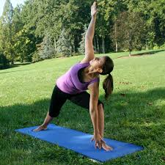
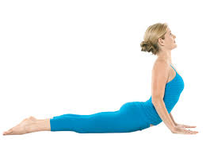
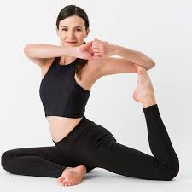
E) yoga
Improves your flexibility
Builds muscle strength
Betters your bone health
Maintains your nervous system
Lowers blood sugar
7) Drains your lymphs and boosts immunity
8)Ups your heart rate
9) Drops your blood pressure
10) Regulates your adrenal glands

Slide 40

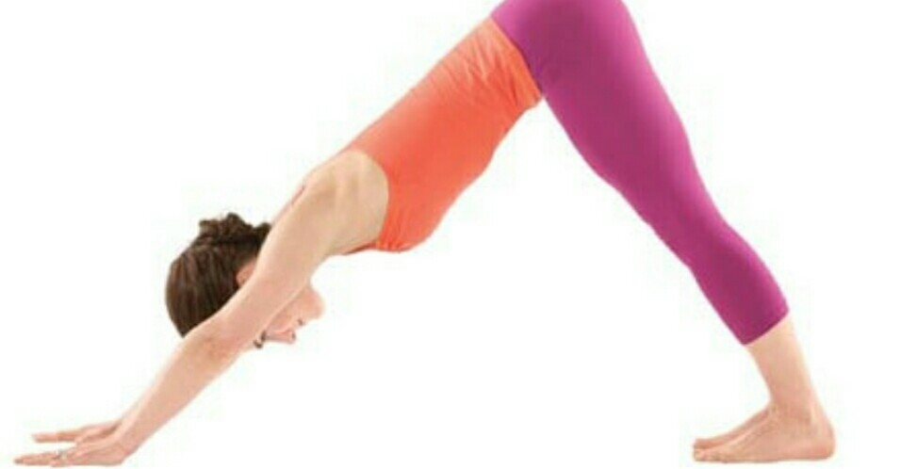

Slide 41
Questions?
Thank You

