Slide 1

Musculoskeletal System
I. Anatomy and Physiology
By
Dr/ Mona Mohammed

Slide 2
Introduction
The musculoskeletal system is composed of bones, joints, muscles, tendons, ligaments, and cartilage. The skeleton consists of 206 bones that are divided into the ‘axial’ and the ‘appendicular’ skeleton.

Slide 3
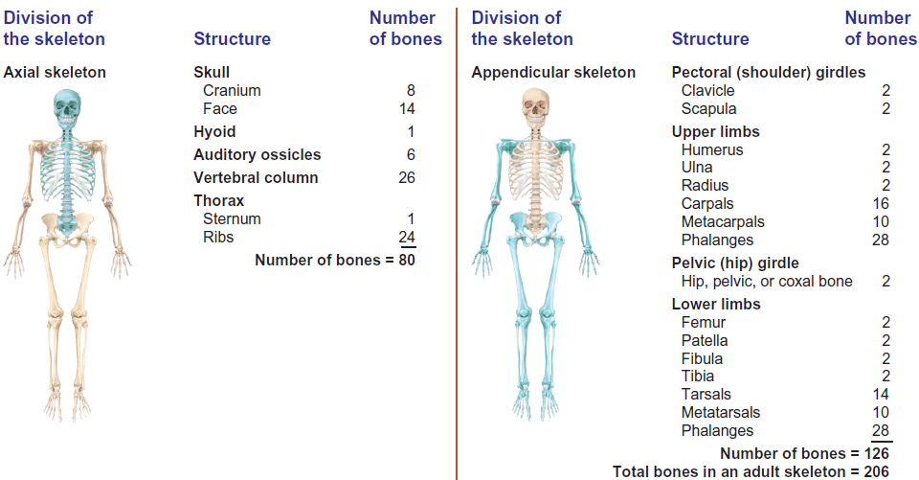
The bones of the adult skeletal system

Slide 4
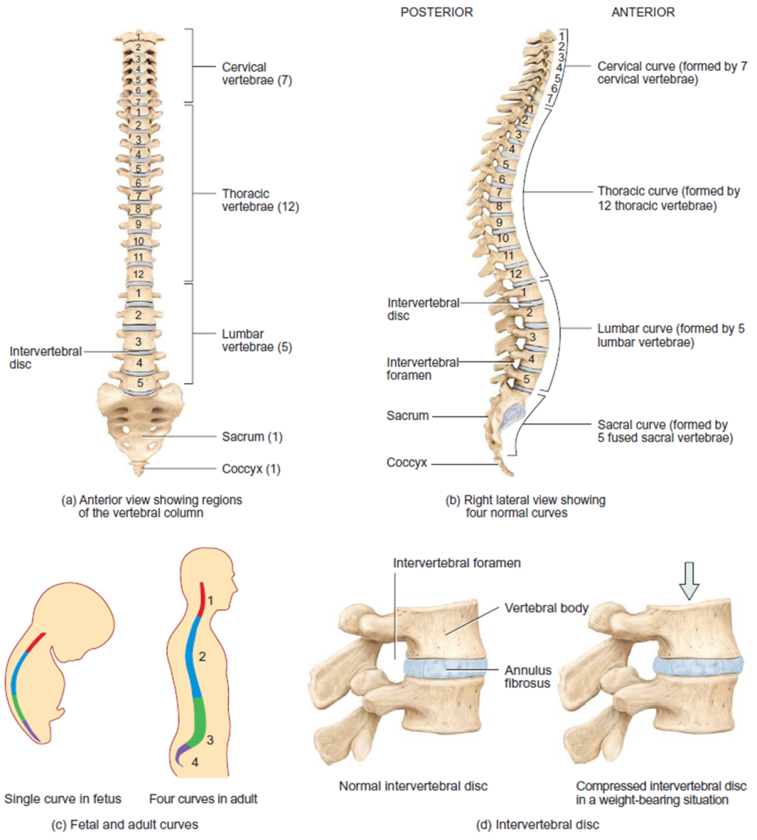
The vertebral column

Slide 5
Bone:
In essence, the bones protect and shape the body; the two types of bone tissue are spongy (cancellous/soft) and compact (cortical/ hard) bone. Both types are found in varying amounts in all bones.
The first is spongy bone, which is light and contains many spaces. It is found at the rounded, irregular ends, or epiphyses, of long bones.
The second is compact bone, which is dense and hard. It covers bones and is found chiefly in the long shafts, or diaphyses, of bones in the arms and legs.
Bone is composed of cells, protein matrix, and mineral deposits. The three types of bone cells are osteoblasts, osteocytes, and osteoclasts.

Slide 6
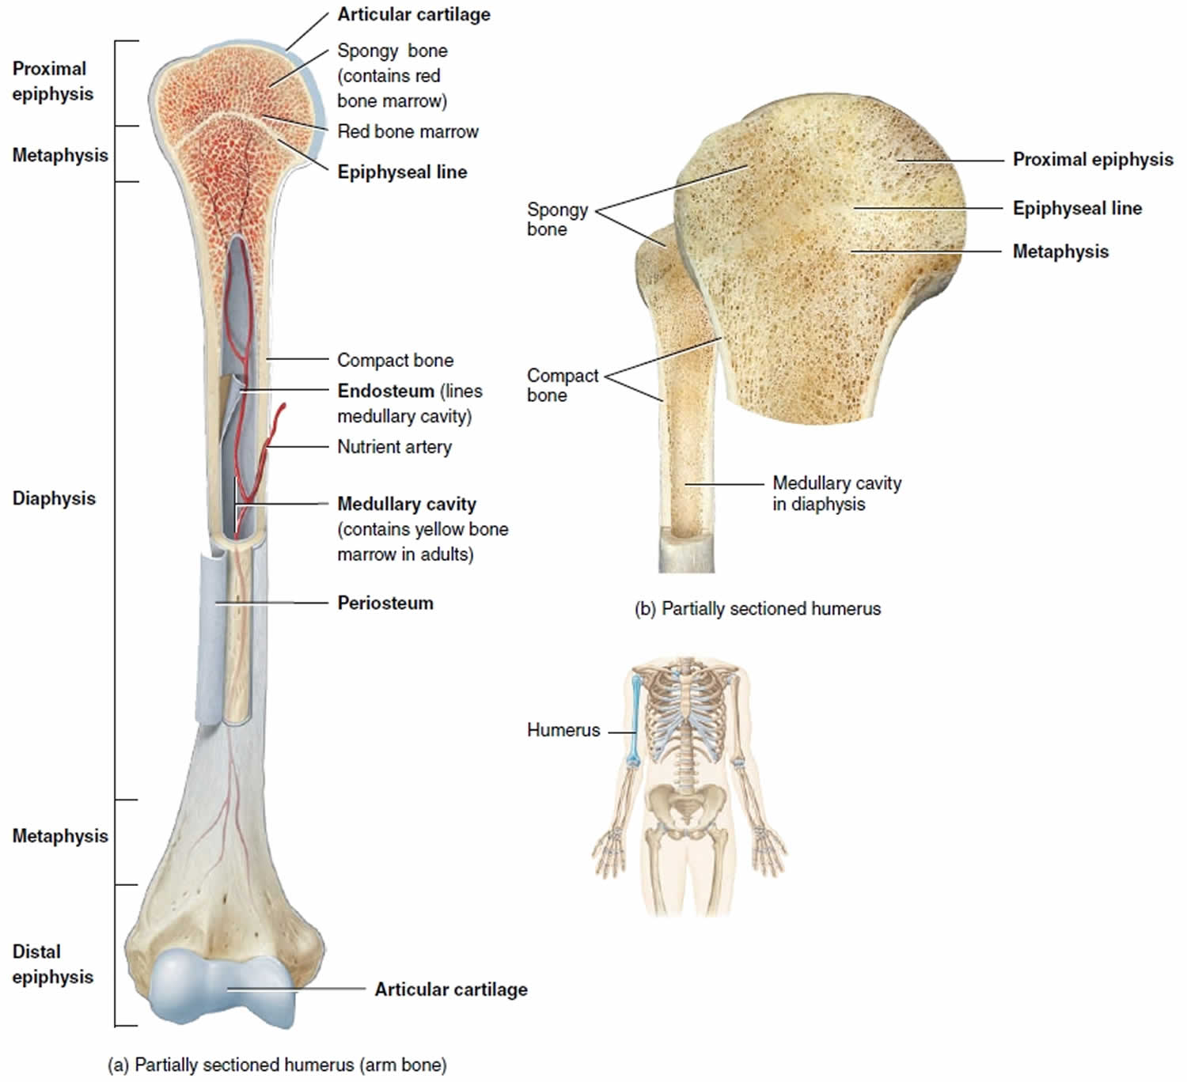
Parts of a long bone

Slide 7
The bones of the skeleton are classified as:
Short bones, such as those in the fingers and toes.
Long bones, such as the femur and ulna.
Flat bones, such as the sternum.
Irregular bones, such as the vertebrae.

Slide 8
The Function of the Bones:
Giving the body a framework.
Providing attachment sites for muscle and tendons, allowing movement of the body as a whole and of parts of the body by forming joints that are moved by muscles.
Being involved in haemopoesis (production of blood cells in the bone marrow).
Providing a storage site for minerals (calcium, phosphate, magnesium, and fluoride) and a reservoir for blood calcium.
Protection and support to body organs, such as the lungs, heart, and brain.

Slide 9
Muscle:
The bones are unable to move the body on their own, so the muscles provide movement and also generate heat. The motion of the skeletal system arises from the contraction and relaxation of the skeletal muscles.
Four major muscle groups of the body include the muscles of the head and neck, the trunk, the upper extremity and the lower extremity.

Slide 10
Types of Muscular Tissue:
There are three types of muscular tissue:
Smooth: located in the walls of the hollow visceral organs.
Cardiac: located in the walls of the heart.
Skeletal: which occurs in the muscles attached to the skeleton, the skeletal muscle fibers are striated in appearance and are under voluntary control.

Slide 11
By sustained contraction or alternating contraction and relaxation, muscle tissue has six main functions:
It brings about body movement.
It maintains body posture.
It assists in stabilization of the joints.
It assists in the movement of substances in the body.
It aids temperature control.
It helps regulate breathing (the diaphragm).

Slide 12
Joints:
A joint, or articulation, is where two bones come together, for example in the knee. In terms of the amount of movement they permit, there are three main joint types: immovable (synarthrosis), slightly movable (amphiarthrosis) and freely movable (diarthrosis). Synovial joints (diarthroses) such as the hip or knee are by far the most common classification of joint within the human body. Additional examples of synovial joints include pivotal, ball and socket, and hinge.

Slide 13
Tendons and Ligaments:
Tendons and ligaments are two types of connective tissue with similar, but differing, functions. In essence, ligaments connect bone to bone, and tendons connect bone to muscle.
Cartilage:
Cartilage is a firm, dense type of connective tissue that consists of cells embedded in a substance called the matrix. The matrix is firm and compact, thus enabling it to withstand pressure and torsion. The primary functions of cartilage are to reduce friction between articular surfaces, absorb shocks, and reduce stress on joint surfaces.

