Slide 1

Lumbar puncture
Lecture by Dr. Islam Ibrahim
For second year second semester students
Tuesday 17-3-2020

Slide 2
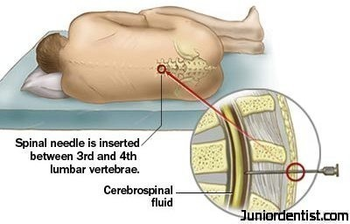
Lumbar puncture

Slide 3
Lumbar puncture:
lumbar puncture is insertion of a needle into lumbar subarachnoid space to withdraw CSF for diagnostic and therapeutic purposes.

Slide 4
Diagnostic uses:
To obtain a specimen of CSF for laboratory analysis.
To estimate CSF pressure normally (80-180 mm H₂O).
To induce radio-opaque dye.

Slide 5
Therapeutic uses:
To introduce therapeutic drugs (antibiotic)
To introduce epidural anesthesia.
Contraindications related lumber puncture:
Increased intracranial pressure.
Spinal deformity makes lumbar puncture difficult.

Slide 6
Nursing role for lumber puncture:
Pre-procedure:
Explain the purpose of the test to the patient and his family.
An informed consent should be signed by the patient prior the test.
The bladder and bowel should be emptied as possible.
Prepare the needed equipments.
The patient lie on one side with the legs pulled into the abdomen and head tucked into the chest, in order to open the spaces between the vertebrae.
Sedation may be ordered before the test.

Slide 7
During procedure:
Assure the patient.
Assist the patient to maintain the position to avoid sudden movement.
Post procedure:
Vital signs should be recorded.
Encourage increase fluid intake.

Slide 8
شكرا واتمني لكم التوفيق
والنجاح الباهر

