Slide 1


Slide 2
Genital Fistula
By
Nawal Kamal Abd El Khalek

Slide 3
Outlines:-
Introduction
Definition
Incidence
Types
Signs and symptoms
Causes
Risk factors
Complications

Slide 4
Outlines:-
Prevention
Treatment
Examples of fistula
A- Vesicovaginal fistulas
B- Ureterovaginal
C- Rectovaginal

Slide 5
Introduction:
Maternal outcomes in most countries of the developed world are good. However, in many developing countries, maternal outcomes are bleaker. Every year, more than 500,000 women die in childbirth, mostly in developing countries. Those who survive often suffer from severe and long-term morbidities. One of the most devastating injuries is obstetric fistula, occurring most often in south Asia and sub-Saharan Africa.

Slide 6
Obstetric fistula is the most common genital tract fistula worldwide. It is commonly due to childbirth injuries sustained during prolonged, obstructed and neglected labor. On average, women who develop genital tract fistulas labor for 4 days and over 90% deliver a stillborn baby.

Slide 7
Definition:
Genital fistula is an abnormal passage or opening between the genital tract and the urinary or gastrointestinal tract.

Slide 8
Incidence:
Fistulas occur in places where use and access to obstetric care is limited. While there are no sound data on the number of women living with fistula, the most commonly cited estimate is more than 2 million women living with fistula, with approximately 50,000 to 100,000 cases occurring annually, mostly in Africa, Asia, and the Arab world. Further, the unmet need for fistula repair is estimated to be as high as 99 %.

Slide 9
Types:
The types of genitourinary fistula (figure 1) are based upon the anatomic location of the connecting tract. They are classified according to their anatomical situation into the following types:

Slide 10
Types:
1- Ureteric:
Uretrouterine
Uretrocervical
Uretrovaginal
2- vesical:
vesicouterine
vesicocervical
vesicovaginal (figure 2).
3- Urethral which include urethrovaginal fistula
4- Gastrointestinal tract which include rectovaginal fistula (figure 3).

Slide 11
The commonest type is vesicovaginal fistulas then ureterovaginal fistulas (vesicovaginal fistulas approximately three times more common than ureterovaginal fistulas). More than two organs may be involved e.g vesicourethrovaginal fistula. urethrovaginal fistula results from vaginal operations in which the urethra is damaged.

Slide 12
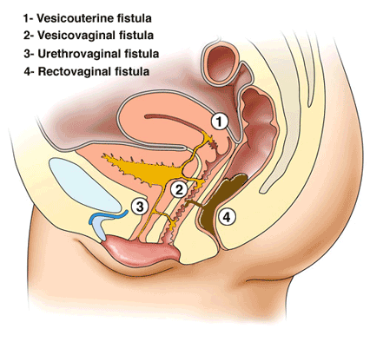
Figure (1): Urogenital fistula

Slide 13
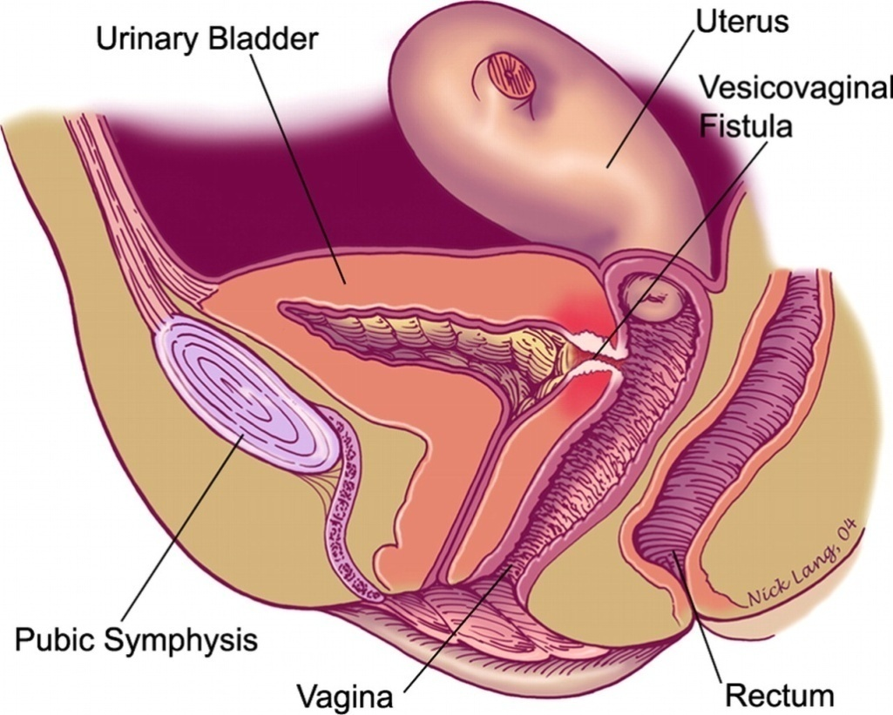
Figure (2): Vesicovaginal fistulas

Slide 14
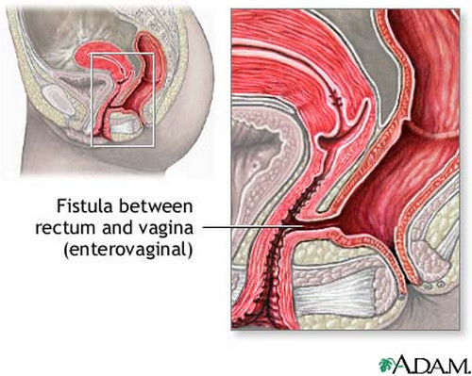
Figure (3): Vesico-colonic fistulas

Slide 15
Signs and symptoms:
Symptoms of obstetric fistula include:
Flatulence, urinary or fecal incontinence, which may be continual or only happen at night.
Foul-smelling vaginal discharge.
Repeated vaginal or urinary tract infections
Irritation or pain in the vagina or surrounding areas
Pain during sexual activity

Slide 16
Causes:
Prolonged labor or obstructed labor
Poorly performed abortions.
Pelvic fractures.
cancer or radiation therapy
Infected episiotomies after childbirth.
Sexual abuse and rape.
Large fetus or malpresentation of fetus

Slide 17
Causes:
female genital mutilation may explain as many as 15% cases of Vesicovaginal fistula in some areas of Africa
Injury during other gynecologic or obstetric surgery (for example, a poorly repaired episiotomy after a complicated delivery or injury during a caesarian section or destructive delivery)

Slide 18
Risk factors:
1- Direct Causes:
Primary risk factors include early or closely spaced pregnancies and lack of access to emergency obstetric care.
Young age at first birth
Cephalo-pelvic disproportion (CPD)

Slide 19
Risk factors:
2- Indirect Causes:
Poverty
Malnutrition
Lack of education
Early marriages and early childbirth
Lack of quality maternal healthcare

Slide 20
Diagnosis:
Diagnosis is essential to plan appropriate treatment. Diagnosis is done based on clinical, radiological and cystoscopic examination
Clinical examination: Reveal wet vulva, vagina with urinary dermatitis
Ultrasound screening :
Screening of KUB area is very useful in detecting associated hydrouretronephrosis which points to obstructed ureter.

Slide 21
Diagnosis:
hydrouretronephrosis which points to obstructed ureter.
Intravenous urogram (IVU) will identify the structural abnormalities in upper urinary tract.
Hysterogram is required to confirm the leakage of contrast into bladder and to diagnose vesicouterine and vesicocervical fistula
Combocystoscopy: Include cystoscopy and speculm examination under anaesthesia if necessary with methylene blue

Slide 22
Complications:
  1- Physical complications:
The most direct consequence of an obstetric fistula is the constant leaking of urine, feces, and blood as a result of a hole that forms between the vagina and bladder or rectum that lead to:

Slide 23
Complications:
      Severe burn wounds on the legs from the continuous dripping.
      Nerve damage that can result from the leaking can cause women to struggle with walking and eventually lose mobility
      Women limit their intake of water and liquid which can lead to dangerous cases of dehydration.
      Ulceration and infections can persist

Slide 24
Complications:
      kidney disease and kidney failure which can each lead to death
      Only a quarter of women with a fistula in their first birth are able to have a living baby, and therefore have little chances of conceiving a healthy baby later on.
      Some women die due to obstetric fistula and other complications from childbirth

Slide 25
Complications:
  2- Social complications:
Physical consequences of obstetric fistula lead to severe sociocultural stigmatization for various reasons.
      patient's incontinence and pain also render her unable to perform household chores and childrearing as a wife and as a mother

Slide 26
Complications:
      misconceptions about obstetric fistula are that it is caused by venereal diseases As a result, many girls are divorced or abandoned by their husbands and partners, family, friends, and even isolated by health workers

Slide 27
Complications:
      Girls are pushed to live in isolation where they will likely die from starvation or an infection in the birth canal.
The unavoidable odor is viewed as offensive, thus their removal from society is seen as essentia

Slide 28
Complications:
  3- Psychological consequences:
Common psychological consequences that fistula patients face are:
      Fear from losing their child
      Fear from inability to perform their family roles
      Fear of developing another fistula in future pregnancies.

Slide 29
Examples for fistula
        1- Vesicovaginal fistula
Incidence:
The incidence of fistula varies from country to country. The same are applied to the aetiological factors. However 350 vesicovaginal fistulas are treated each year in England and wales.

Slide 30
        1- Vesicovaginal fistula
Aetiology
A- Congenital: This is very rare.
B- Traumatic: Due to different types of trauma:
1- Obstetric trauma:
This is the commonest cause of vesicovaginal fistula in Egypt and other developing countries. Obstetric trauma leads to two types of fistula:

Slide 31
        1- Vesicovaginal fistula
Necrotic obstetric fistula: Due to obstructed labor which leads to prolonged compression, ischemia and necrosis of soft tissues between the fetal head and pelvic.
Traumatic obstetric fistula: The bladder may be directly injured during caesarean section, forceps

Slide 32
Figure (4): Obstetric trauma

Slide 33
1- Vesicovaginal fistula
2- Surgical trauma:
Fistula may occur after total abdominal or vaginal hysterectomy
3- Direct trauma:
As falling on sharp objects, fracture of the pelvis and defloration injuries. Neglected foreign body or vaginal pessary may lead to ulceration and fistula formation.

Slide 34
1- Vesicovaginal fistula
C- Inflammatory: as in case of syphilis, bilharziasis or tuberculosis of the bladder or vagina
D- Neoplastic: malignant tumour of the cervix, vagina or bladder. The commonest cause of a malignant vesicovaginal fistula is advanced cervical carcinoma.

Slide 35
1- Vesicovaginal fistula
E- Postirradiation: radium applied for the treatment of carcinoma of the cervix or vagina may cause ischemic necrosis and fistula. The fistula appears 3-9 months after irradiation.

Slide 36
Diagnosis:
1- History: History can give idea about the etiology of the fistula weather it is due to labor, surgery, irradiation, …etc. also the history can differentiate between the different types of urinary incontinence which may be true, false, urgency or stress incontinence.

Slide 37
2- Symptoms:
Incontinence of urine
Soreness of the vulva and pruritus
Pain may be felt in suprapubic region
Psychological disturbances

Slide 38
3- Signs:
A- General examination: patient is examined for renal failure, anemia and malnutrition
B- Abdominal examination: the kidneys are palpated for tenderness or enlargement

Slide 39
C- Vaginal examination:
Inspection for vaginitis, vulvitis and ulceration
Digital palpation
Speculum examination
Special examination as methylene blue test, intravenous pyelography and cystoscopy

Slide 40
Treatment
  In case of inflammatory or malignant fistula, the treatment is that of the primary cause
  In congenital and traumatic fistula the treatment is operative closure. If the bladder is injured during labor, it is useless to close fistula immediately because of edema and friability of the tissue.

Slide 41
Treatment
  A foley catheter is fixed in the bladder for three weeks and gives antibiotic. The fistula may heal completely or is left smaller in size
      Vaginal operations
      abdominal operations

Slide 42
Preoperative preparation:
complete blood count
Estrogen locally or by mouth for atrophic tissues in postmenopausal patients
Treatment of infection in the genital tract
Treatment of any urinary tract infection
Kidney function test
Cystoscopy

Slide 43
Postoperative care:
The catheter should be left for at least 10-14 days
Observation of urine every two hours / day and night. If there is no urine, this indicates either anuria or obstruction of the catheter
Antibiotics to prevent infection of urine and wound

Slide 44
Postoperative care:
Large quantities of fluids, at least 3 liter per day
If a vaginal pack was inserted, it is removed after 24 hours
If nonabsorbable material was used to close the vagina, it is removed 21 days after operation and in the operating room and preferably under general anesthesia

Slide 45
        2- Uretrovaginal fistula
Etiology:
Congenital: This is very rare.
Traumatic: Due to different types of trauma:
Obstetric trauma is a rare cause because the ureter is displaced upwards during
Surgical trauma: total hysterectomy is the commonest cause of this type of fistula

Slide 46
        2- Uretrovaginal fistula
Direct trauma: As fracture of the pelvis or vaginal rupture
Postirradiation: as application of radium for the treatment of cervical carcinoma

Slide 47
Diagnosis:
Partial incontinence of urine
Methylene blue test
Intravenous pyelography
Cystoscopy

Slide 48
Treatment:
Reimplantation of the ureter into the bladder

Slide 49
        Rectovaginal fistula
Etiology:
A- Congenital: This is very rare
B- Traumatic: Due to different types of trauma
1- Obstetric trauma:
The commonest cause of rectovaginal fistula is incomplete healing of a complete perineal tear

Slide 50
Necrotic obstetric fistula: Due to obstructed labor causing prolonged compression, ischemia and necrosis of the rectovaginal septum.
Traumatic obstetric fistula caused by instruments as perforation

Slide 51
2- Surgical trauma: The rectum may be injured during operation as total hysterectomy or posterior colpoperineorraphy
3- Direct trauma: As defloration injuries, falling on sharp objects, ulceration of neglected pessary or foreign body.

Slide 52
C- Inflammatory: pelvic abscess may open into the vagina and rectum. Syphilis, bilharziasis or tuberculosis of the vagina or rectum are rare cases
D- Neoplastic: malignant tumour of the cervix, vagina or rectum.
E- Postirradiation: radium applied for the treatment of carcinoma of the cervix or vagina may cause ischemic necrosis and fistula.

Slide 53
Diagnosis:
1- Symptoms:
The Symptoms depend upon the size of the fistula:
If it is large, there is loss of voluntary control over the passage of faeces and fistula.

Slide 54
Diagnosis:
If the fistula is small the patient may complain of involuntary escape of flatus and stools
Irritation secondary to vulvitis, vaginitis and persistent vaginal discharge

Slide 55
2- Signs:
The condition diagnosed by exposing the posterior vaginal wall in good light. Small fistula is diagnosed by rectal examination

Slide 56
Treatment:
In case of inflammatory or malignant fistula, the treatment is that of the cause
In congenital and traumatic fistula the treatment is closure of the fistula by operation

Slide 57
Prevention:
1- Primary prevention
Adolescent and maternal nutrition
Education and empowerment for women
Delaying marriage and child bearing
Educate local communities about the cultural, social, and physiological factors that condition and contribute to the risk for fistula.

Slide 58
2- Secondary prevention
access to obstetrical care
support from trained health care professionals throughout pregnancy
Skilled attendance at every birth
Monitoring of every labor with the partograph for early recognition of obstructed labor

Slide 59
providing access to family planning
Ready access to high quality emergency obstetric care
Quick and safe cesarean sections for women in obstructed labor.
Community awareness raising and education about prevention and treatment of obstetric fistula

Slide 60
3- Tertiary prevention
Early recognition of developing or developed fistula in women who have had an obstructed labor or genital trauma
Standard protocol at health centers for management of women who have survived prolonged/obstructed labor to prevent further damage
Helping the local communities to advocate for women's rights.

Slide 61
Treatment
Detection of fistula soon after surgery justifies temporary indwelling catheter to aim for spontaneous closure of fistula which is reported to be successful in 15-20 % of cases.

Slide 62
Treatment
Timing of fistula repair surgeon should delay the repair till the local infection and inflammation subsides and the tissue is healthy enough to repair. 6 weeks is required. Obstetric fistula requires 2-3 months.

Slide 63



