Slide 1
First year
Adult Nursing Department
Prepared by : Nehad Abdelrazik

Slide 2
Dressing technique Wound care

Slide 3
Purposes
To cover and protect the wound.
To absorb the minimal drainage.
To avoid infection.
To assess wound condition.

Slide 4
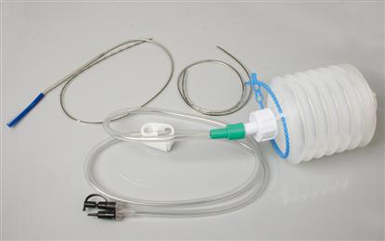
the wound and drains

Slide 5
Assessment
Appearance of the wound and drains.
Assess signs of infection as redness, swelling, foul odor, amount of drainage, color of wound exudates (yellow indicate purulent), unusual pain or tenderness and bleeding may be occur.
Assess the patient's allergy.

Slide 6
Equipment
Clean disposable gloves.
Sterile gloves.
Container for proper disposal of soiled dressing.
Sterile 4x4 gauze pads.
Antiseptic ointments as order.
Sterile package.
Adhesive tape.
Antiseptic solution.

Slide 7
Procedure
Wash hands.
Prepare equipment.
Introduce your self and identify patient.
Explain procedure to the patient
Provide privacy.
Assist patient to comfort position.

Slide 8
Expose wound.
Place opened disposal plastic bag near patient's bed.
Clean disposable gloves must be used when removing unclean dressing.
Check the position of drains before removing of dressing.
Pouring a small amount of sterile saline onto the dressing if it is adhering to skin.

Slide 9
Assess drainage for amount type, color and odor.
Discard dressing in plastic bag and drop glove in bag.
Open sterile dressing and place supplies on bedside table.
Pour solution over sponges in container or sponges placed in sterile iodine bowl.

Slide 10
Use sterile or clean gloves according to agency protocol.
Clean wound.
Use one gauze square for each wipe, From least contaminated area to most contaminated area.
Discarding it in plastic bag.

Slide 11
Clean around drain, moving from center
outward in a circular motion.
Dry wound using sponge in the same motion.
Apply antiseptic ointment if ordered.

Slide 12
Place dressing over wound as outer layer.
Remove gloves and discard it in plastic bag.
Assist patient to comfort position.
Documentation and report.
Date and time of dressing done.
Brief description of the wound site.

