Slide 1


Urinary Catheterization
Second year- Medical Surgical department
Prepared by /
Eman Abd El-mobdy Ali

Slide 2
Performance objectives:
The student will be able to:
Define urinary catheterization.
List purpose and indications of performing urinary catheterization
Assemble necessary equipment for performing urinary catheterization.
Prepare the patient for performing urinary catheterization.
Performing urinary catheterization correctly.
Identify documentation items.

Slide 3
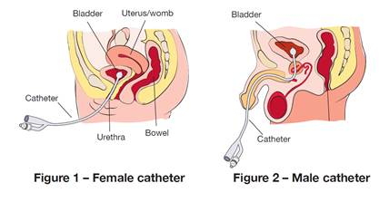
Definition:
Urinary catheterization is the introduction of a catheter (tube) through the urethra into the bladder.

Slide 4
Purposes
Facilitates direct drainage of the urinary bladder.
To help determine the etiology of various genitourinary conditions.

Slide 5
Indications
1. Acute or chronic urinary retention including obstruction and neurogenic bladder
2. Benign prostatic hyperplasia,
3. Urinary incontinence

Slide 6
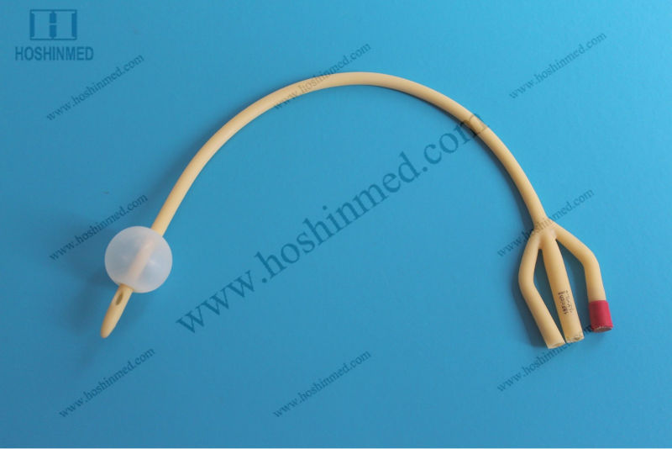
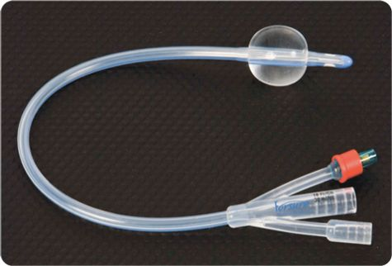
Types
Silicon
Foley

Slide 7
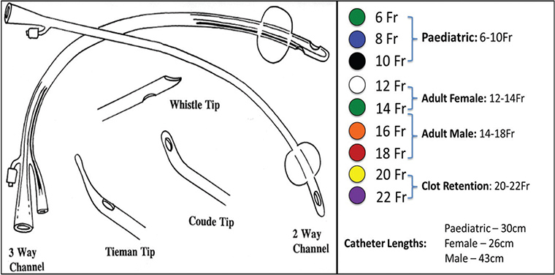

Slide 8

Types
Intermittent urethral catheters

Slide 9
Intermittent urethral catheters, or straight catheters, are used to drain the bladder for shorter periods.

Slide 10

Types
Indwelling urinary catheter :

Slide 11


Slide 12
Indwelling urinary catheter is inserted in the same way as an intermittent catheter, but the catheter is left in place.

Slide 13
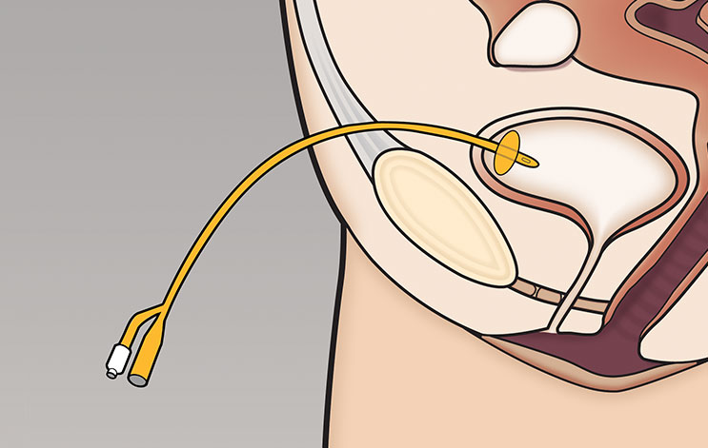
Types
A suprapubic catheter

Slide 14
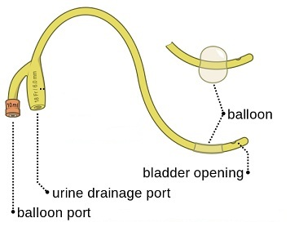

Slide 15
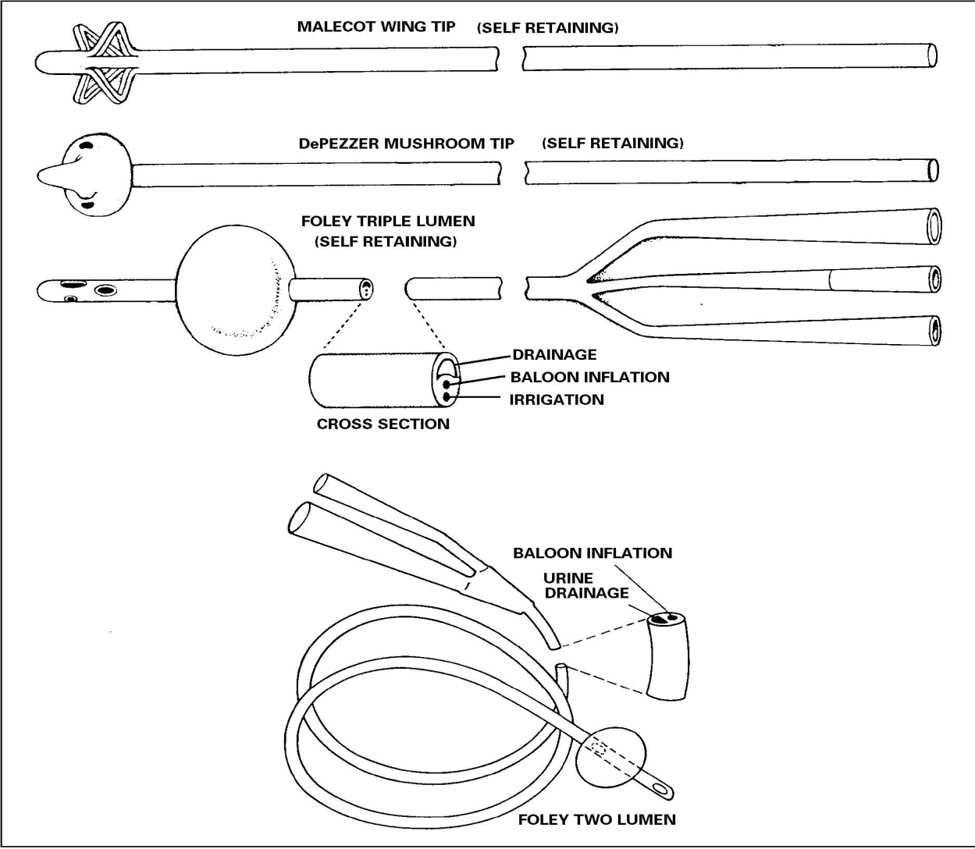

Slide 16
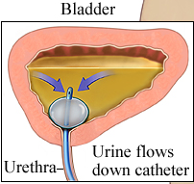

Slide 17
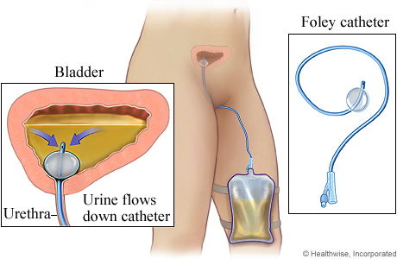
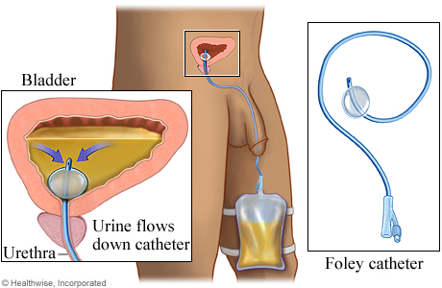

Slide 18
A suprapubic catheter is a type of catheter that is left in place .The catheter is inserted through a hole in the abdomen and then directly into bladder. Used when the urethra is damaged or blocked.

