Slide 1
Third year
Pediatric Nursing
Clinical Lecture
CPR (Neonatal Resuscitation)
Prepared by: Fatma Abdellah Mohamed

Slide 2




Slide 3

Neonatal Resuscitation

Slide 4

Out lines:

Slide 5
Definition
Risk Factors Associated with the Need for Resuscitation
Equipment
Initial steps in resuscitation

Slide 6

Objectives

Slide 7
At the end of this lecture , the learners will be able to do the following :-
Define neonatal resuscitation
Enumerate Risk Factors Associated with the Need for Resuscitation
Identify equipment.
Discuss initial steps in resuscitation

Slide 8

Introduction

Slide 9
Approximately 90% of newborns make smooth transition from intrauterine to extra uterine life requiring little or no assistance, 10% of newborns need some assistance, and only 1% requires extensive resuscitation.

Slide 10

Definition of resuscitation

Slide 11
Is the method in which the body can maintain the cardiopulmonary function.

Slide 12

Risk Factors Associated with the Need for Resuscitation

Slide 13
Antepartum (before labor and delivery)
Intrapartum (during labor and delivery)

Slide 14
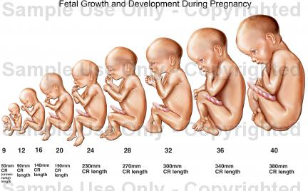
1- Antepartum Risk Factors :
Bleeding in second or third trimester.
Drugs/medications
Inadequate prenatal care.
Multiple gestations

Slide 15
Mother‘s age Less than age 16 or more than 35
Post-term gestation.
Previous Rh sensitization.
Previous still birth
Toxemia, hypertension, diabetes.
Oligo- hydramnions

Slide 16
2-Intrapartum Risk Factors
Abraptio placenta.
Abnormal presentation.
Bleeding.
Emergency C.S.

Slide 17
Meconium-stained amniotic fluid.
Prolonged labor or precipitous delivery (prolonged than 24 hrs.).
Prolonged second stage of labor (greater than 2 hrs.)
Prolapsed cord.

Slide 18
Placenta previa.
Premature labor
Rupture of membranes greater than 24 hours before delivery
Use of narcotics within 4 hours of delivery.
Uterine tetany.

Slide 19
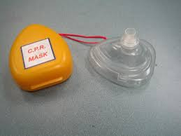
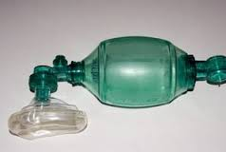
Equipment

Slide 20
1-Suction equipment:
Bulb syringe.
Mechanical suction.
Suction catheters 5, 6 Fr.
Meconium aspirator

Slide 21
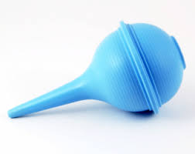
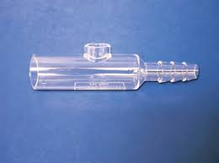
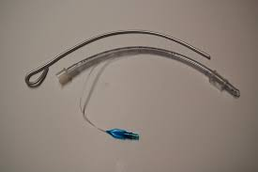
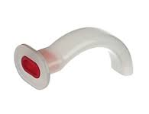

Slide 22
2-Bag and mask equipment:
Neonate resuscitation bag (AMPO bag)
Face mask
Oxygen with flow meter and tubing.
Oral airway

Slide 23
3-Intubations equipment:-
Laryngoscope with straight blades .No 0 (P.T) and No .1 (F.T).
Battery for laryngoscope
Endotracheal tubes sizes 2.5,3, 3.5, 4 mm.
Scissors – Gloves – stylet.

Slide 24
4- Drugs:
Epinephrine
Volume Expanders
Naloxone
Sodium bicarbonate

Slide 25
5- Miscellaneous
Radiant warmer-stethoscope-tape-Syringe-needle-alcohol-umbilical catheter, towel

Slide 26
Initial steps in resuscitation:
Assess for:
Term gestation
Breathing and crying
Good muscle tone
Pink color
Non meconium stained

Slide 27
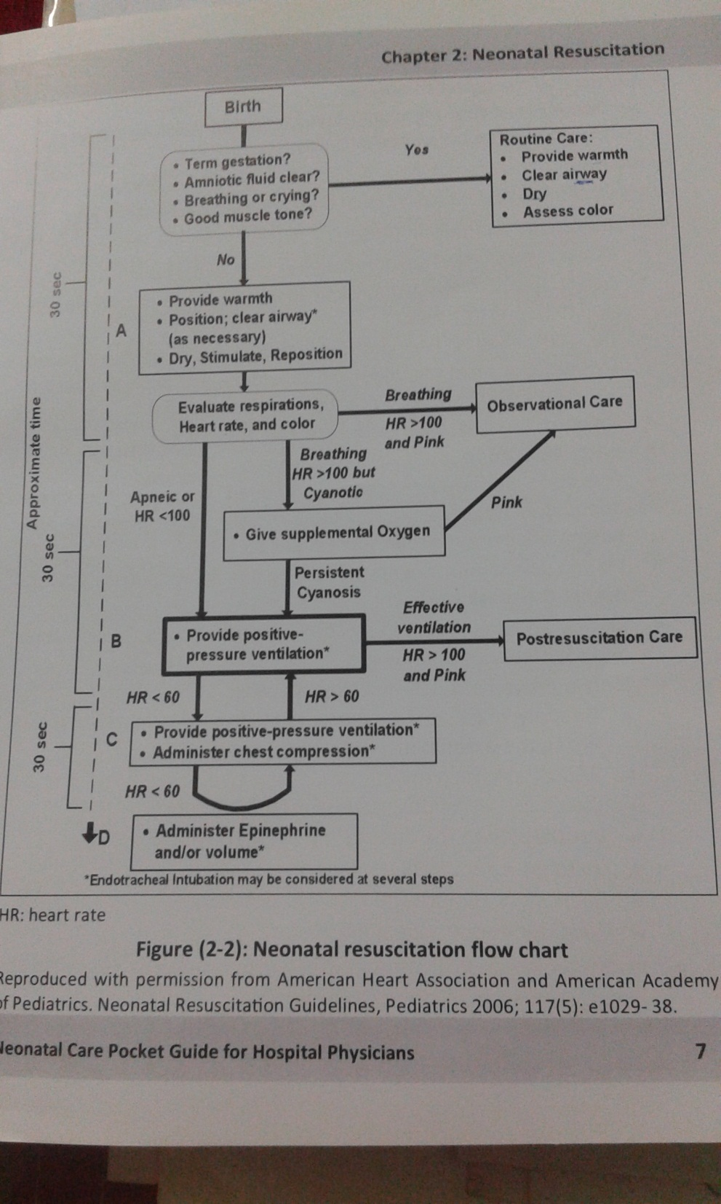

Slide 28
1-Prevention of Heat Loss (warming)
Immediately after delivery :
Dry the infant's head and body
Remove any wet coverings from the neonate
Cover with dry wrappings
Cover the newborn's head
Put the baby under radiant warmer

Slide 29
2-Opening the Airway by positioning

Slide 30

Head tilt –chin lift

Slide 31
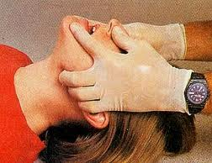
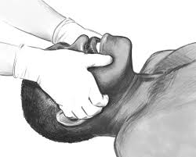
Jaw thrust method

Slide 32
Suction

Slide 33
Provision of Tactile Stimulation

Slide 34
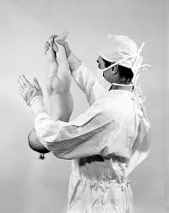
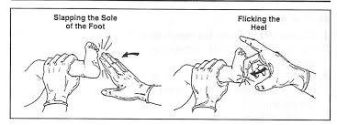
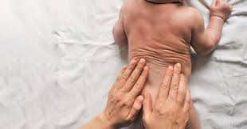

Slide 35
Three Items are assessed every 30 seconds
Heart rate (Pulse)
Respiration (Breathing)
Circulation (colour)

Slide 37
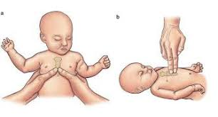
Chest compression
Thumb technique:
Two –finger method:
The ratio is 3:1 of compression to PPV

Slide 38
Evaluate Heart Rate
  HR decreasing HR less than 100b/m start PPV
  HR decreasing HR less than 80b/m continue PPV and start compression
HR increasing HR more than 80b/m continue PPV and stop compression
If HR remains less than 60b/m continue compression and PPV and consider medication and consider intubation

Slide 39
Medications

Slide 40
Epinephrine
Route: IV (through the umbilical vein). Endotracheal administration may be considered while IV access is being established.
Dose: 0.1-0.3 ml/kg (consider higher dose, 0.3-1 ml/kg, for endotracheal route only); dose
can be repeated after 3-5 minutes.
Preparation: 1:10,000 solution.
Rate: rapidly, as quickly as possible

Slide 41
Volume expansion
blood loss (e.g., extensive vaginal bleeding, abruptio placentae, placenta previa,,…etc).
Recommended volume expander is normal saline, Ringer's lactate, or O Rh-negative
blood packed RBCs.
Route: umbilical vein.
Dose: 10 ml/kg (another dose may be needed).
Rate: slowly (over 5-10 minutes).

Slide 42
Sodium bicarbonate
it may be indicated for correction of documented severe metabolic acidosis.
Do not give sodium bicarbonate unless the lungs are being adequately ventilated.
Route: umbilical vein.
Dose: 2 mEq/kg (8.4% concentration).
Preparation: diluted 1:1 with appropriate diluent (glucose 5% or sterile water
Rate: slowly, no faster than a rate of 1 mEq/kg/minute (to minimize the risk of intraventricular hemorrhage).

Slide 43
Naloxone Hydrochloride
If a mother has recently received narcotics within 4 hrs of delivery and her infant fails to breathe, first assist ventilation with positive pressure, and then consider giving
naloxone to the infant (0.1 mg/kg, 1mg/ml solution, I.V. or I.M).

Slide 44




THANK YOU

