Slide 1

Applying anti-embolism stocking
كلية التمريض-قسم التمريض الباطني والجراحي
Marwa hamdy

Slide 2
Definition:
Anti-embolism stockings are firm elastic hose that compress the veins of the legs.

Slide 3
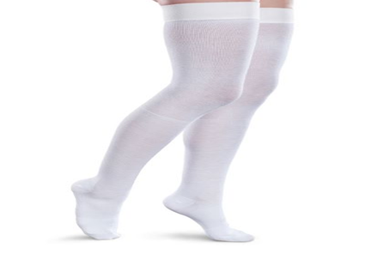
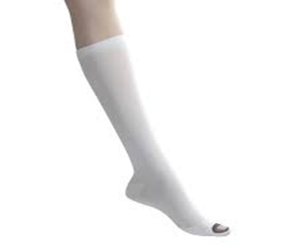
Types of anti-embolism stocking:
One type extends from the foot to the knee.
Another type extends from the foot to mid-thigh

Slide 4
Purposes:
To facilitate venous return from the lower extremities.
To prevent venous stasis and venous thrombosis.
To reduce peripheral edema

Slide 5
Indications:
After surgery.
Patients who are immobile.
Patients who have vascular disorders such as thrombophlebitis, varicose veins, and other conditions of impaired circulation of the lower extremities.

Slide 6
Contraindications:
Suspected or proven peripheral arterial disease.
Peripheral arterial bypass grafting.
Local conditions for example skin dermatitis, gangrene or recent skin graft.
Severe leg oedema or pulmonary oedema from congestive heart failure.

Slide 7
Assessment
Rates, volumes, and rhythms of posterior tibial and dorsalis pedis pulses (note if unequal bilaterally).
Skin colour (note pallor, cyanosis, or other pigmentation).
Sensation (note any numbness, tingling, pain).

Slide 8
Skin temperature (e.g., warm, cool).
Presence of edema (pitting or non-pitting).
Skin condition (e.g., thickened, shiny, and hairless).

Slide 9
Planning
Before applying antiembolism stockings, determine any potential or present circulatory problems and the surgeon’s orders involving the lower extremities.

Slide 10
Equipment:
Measuring tape.
Clean antiembolism stockings of appropriate size and type ordered (e.g., knee or mid-thigh)

Slide 11
Implementation
Take measurements as needed to obtain the appropriate size stockings:
Measure the length of both legs from the heel to the gluteal
fold (for thigh-length stockings) or from the heel to the popliteal
space (for knee-length stockings).

Slide 12
Measure the circumference of each calf and each thigh at the widest point.
- Compare the measurements to the size chart to obtain stockings of correct size. Large stockings do not place adequate pressure on the legs to facilitate venous return and may bunch, increasing the risk of pressure and skin irritation. Stockings that are too small may impede blood flow to the feet and cause discomfort.

Slide 13
Procedure
Step1. Introduce yourself to the patient, and verify the patient’s identity .
Rationale: Attain patient's cooperation and prevent mistakes.
Step 2: Explain to the patient what you are going to do, why it is necessary, and how he or she can participate.
Rationale: Decreases anxiety and encourages compliance and participation.

Slide 14
Step 3: Perform hand hygiene, and follow other appropriate infection prevention and control procedures.
Rationale: Reduces the transmission of microorganisms.
Step 4: Provide for patient privacy.
Rationale: Decreases embarrassment.

Slide 15
Step 5: Select an appropriate time to apply the stockings:
- Apply stockings in the morning, if possible, before the patient gets up from bed.
Rationale: In the sitting and standing positions, the veins can become distended, resulting in edema; the stockings should be applied before this happens.

Slide 16
- Assist the patient who has been ambulating to lie down and elevate the legs for 15 to 30 minutes before applying the stockings.
Rationale: This facilitates venous return and reduces swelling.

Slide 17
Step 6. Prepare the patient:
- Assist the patient to the lying position in bed.
- Wash and dry the legs, as needed.
Step 7. Apply the stockings:
- Reach inside the stocking from the top, and grasping the heel, turn the upper portion of the stocking inside out over the foot portion.
Rationale: Firm elastic stockings are easier to fit over the foot and calf
when inverted in this manner, rather than bunching the stocking up.

Slide 18
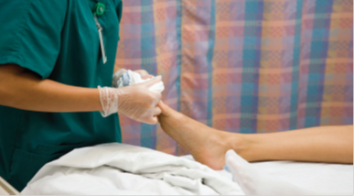
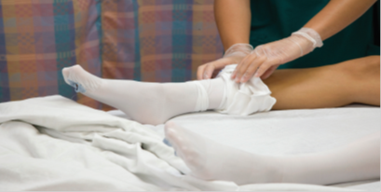
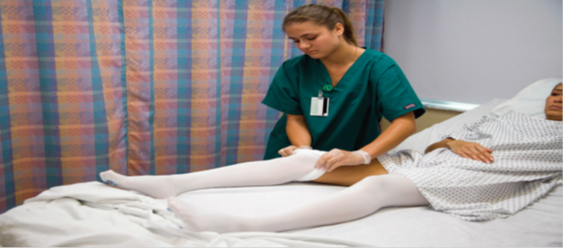

Slide 19
Ask the patient to point the toes, and position the stocking on the patient’s foot, taking care to place the toe and heel portions of the stocking appropriately.
Rationale: Pointing of the toes makes application easier.
- Grasp the upper edge of the stocking, and gently pull the stocking over the leg, turning it right side out in the process.

Slide 20
Inspect the patient’s leg and stocking, smoothing any folds or creases.
- Ensure that the stocking is not rolled down or bunched at the top or ankle.
Rationale: Folds and creases can cause skin irritation under the stocking; bunching of the stocking can further impair venous return.

Slide 21
Remove the stockings for 30 minutes every 8 hours, inspecting the legs and skin while the stockings are off.
- Soiled stockings can be laundered by hand with warm water and mild soap. Hang to dry.
Step 8: Document the procedure. Record the procedure, your assessment data, and when the stockings are removed and reapplied.

Slide 22


