Slide 1

Stroke
Stroke define as:
when prolonged interruption in the blood flow to part of the brain occurs.
A stroke called brain attack or cerebrovascular accident(CVA)

Slide 2
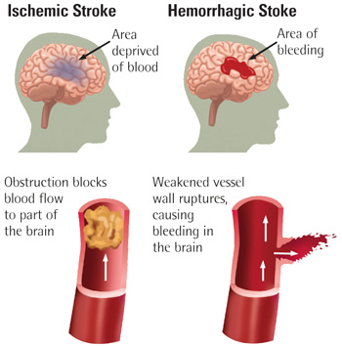
Types of stroke
There are two main types of stroke as:
1- Ischemic strokes:
Occur when a thrombus or embolus obstructs an artery carrying blood to the brain
2- Hemorrhagic strokes
Occur when a cerebral blood vessel ruptures and blood is released in brain tissue

Slide 3
Risk factors for (CVA)
Uncontrollable as:
Age- Sex- Race- Genetics
Controllable as:
Hypertension- Atrial fibrillation- Diabetes- Hyperlipidemia- History of TIA or CVA- Smoking
Obesity- Thrombogenic substances- Valvular disease or replacement

Slide 4
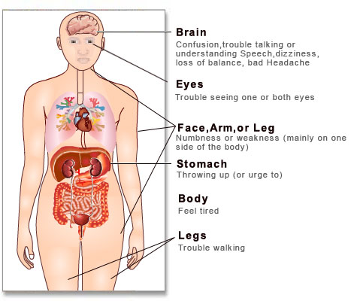
Clinical manifestation for stroke
A stroke happens fast. Most people have two or more signs so the most common signs are:
Sudden numbness or weakness of face, arm or leg (mainly on one side of the body)
Sudden trouble seeing in one or both eyes.
Sudden trouble walking, dizziness or loss of balance.
Sudden confusion or trouble talking or understanding speech.
Sudden severe headache with no known cause.

Slide 5
Women may have unique symptoms:
Sudden face and arm or leg pain.
Sudden hiccups.
Sudden nausea.
Sudden tiredness.
Sudden chest pain.
Sudden shortness of breath
Sudden pounding or racing heartbeat.

Slide 6
Effects of stroke
If stroke in the right half of the brain:
Problems judging distances
Short-term memory loss
If stroke in the left half of the brain:
Speech and language problems
Slow and cautious behavior
Memory problems
If stroke in thecerebellum:
Abnormal reflexes of the head and upper body.
Balance problems.
Dizziness, nausea and vomiting.
If strokes in the brain stem
develop paralysis or not be able to move or feel on one or both sides of the body.

Slide 7
management for stroke
Medical management:
1- Pharmacological approach: treatment varies and is directed toward relieving the cause if known and aimed at rehabilitation and prevention of future CVAs.
2- Surgical approach:
If atherosclerosis of the carotid artery is the cause a carotid endarterectomy is considered

Slide 8
Nursing management for stroke:During acute phase (1st 24-48hrs):
Maintain patient airway
Position the patient on his side to prevent aspiration.
Remove secretion from airway.
Precaution should be taken to avoid prolonged suctioning which would increase
Monitor respiratory function by auscultation of chest
Monitor vital signs frequently.
Monitor neurological assessment frequently.
Monitor urinary function (a Foley catheter is usually inserted).
Maintain intake and output record.
Evaluate fluid and electrolyte balance.
Establish seizure precautions as necessary.

Slide 9
Post-acute phase and rehabilitation
Provide routine hygienic care.
Monitor vital signs and neurological assessment.
Perform passive (ROM) exercises 4 times daily to all joints.
Apply change position every 2 hours.
Elevate the head of the bed 30 degree to control the increased ICP.
Apply elastic stocking.
Apply catheter care (if present).
Make sure that the patient is safe and prevent falls.

Slide 10
Encourage patient to independence as possible.
Feel hemiplegic's patients by placing the food on the good side of the mouth.
Provide good skin care.
Assist the patient with their assistive and supportive devices.
Follow the ordered bowel and bladder retraining program.
Help the person with their activities of daily living Assist the patient with mobility and ambulation.
Encourage and support the patient.

Slide 11
Transient ischemic attach (TIA):
It is a sudden, brief attack of neurologic impairment caused by a temporary interruption in cerebral blood flow.

Slide 12
شكرا واتمني لكم التوفيق
والنجاح الباهر

