Slide 1
Psychiatric disorders
Dr Mohamed Moslem Al-Hefny

Slide 2
III - Anxiety Disorders

Slide 3
Anxiety Disorders
Panic Disorder and Agoraphobia
Specific Phobia
Social Phobia
Generalized Anxiety Disorder

Slide 4
Generalized Anxiety Disorder
Diagnostic Criteria for Generalized Anxiety Disorder
Excessive anxiety and worry (apprehensive expectation), occurring more days than not for at least 6 months, about a number of events or activities (such as work or school performance).
The person finds it difficult to control the worry.
The anxiety and worry are associated with three (or more) of the following six symptoms (with at least some symptoms present for more days than not for the past 6 months).
  restlessness or feeling keyed up or on edge
  being easily fatigued
  difficulty concentrating or mind going blank
  irritability
  muscle tension
  sleep disturbance (difficulty falling or staying asleep, or restless unsatisfying sleep)

Slide 5
Exclusion of other psychiatric disorder.
Exclusion of substance/general medical condition.
Social/occupational dysfunction

Slide 6
Panic Disorder and Agoraphobia
Criteria for Panic Attack
A discrete period of intense fear or discomfort, in which four (or more) of the following symptoms developed abruptly and reached a peak within 10 minutes:
palpitations, pounding heart, or accelerated heart rate
sweating
trembling or shaking
sensations of shortness of breath or smothering
feeling of choking
chest pain or discomfort
nausea or abdominal distress
feeling dizzy, unsteady, lightheaded, or faint
derealization (feelings of unreality) or depersonalization (being detached from oneself)
fear of losing control or going crazy
fear of dying
paresthesias (numbness or tingling sensations)
chills or hot flushes

Slide 7
Panic Disorder and Agoraphobia
Diagnostic Criteria for Panic Disorder without Agoraphobia
Both (1) and (2):
  recurrent unexpected panic attacks
  at least one of the attacks has been followed by 1 month (or more) of one (or more) of the following:
    persistent concern about having additional attacks
    worry about the implications of the attack or its consequences (e.g., losing control, having a heart attack, “going crazy”‌)
    a significant change in behavior related to the attacks
Absence of agoraphobia
Exclusion of other psychiatric disorders.
Exclusion of substance/general medical condition.

Slide 8
Panic Disorder and Agoraphobia
Diagnostic Criteria for Panic Disorder with Agoraphobia
Both (1) and (2):
  recurrent unexpected panic attacks
  at least one of the attacks has been followed by 1 month (or more) of one (or more) of the following:
    persistent concern about having additional attacks
    worry about the implications of the attack or its consequences (e.g., losing control, having a heart attack, “going crazy”‌)
    a significant change in behavior related to the attacks
The presence of agoraphobia
Exclusion of other psychiatric disorders.
Exclusion of substance/general medical condition.

Slide 9
Panic Disorder and Agoraphobia
Criteria for Agoraphobia
Anxiety about being in places or situations from which escape might be difficult (or embarrassing) or in which help may not be available in the event of having an unexpected or situationally predisposed panic attack or panic-like symptoms. Agoraphobic fears typically involve characteristic clusters of situations that include being outside the home alone; being in a crowd or standing in a line; being on a bridge; and traveling in a bus, train, or automobile.
Note: Consider the diagnosis of specific phobia if the avoidance is limited to one or only a few specific situations, or social phobia if the avoidance is limited to social situations.
The situations are avoided (e.g., travel is restricted) or else are endured with marked distress or with anxiety about having a panic attack or panic-like symptoms, or require the presence of a companion.
Exclusion of other psychiatric disorders.
Exclusion of substance/general medical condition.

Slide 10
Specific Phobia
Diagnostic Criteria for Specific Phobia
Marked and persistent fear that is excessive or unreasonable, cued by the presence or anticipation of a specific object or situation (e.g., flying, heights, animals, receiving an injection, seeing blood).
Exposure to the phobic stimulus almost invariably provokes an immediate anxiety response, which may take the form of a situationally bound or situationally predisposed panic attack.
Note: In children, the anxiety may be expressed by crying, tantrums, freezing, or clinging.
The person recognizes that the fear is excessive or unreasonable.
Note: In children, this feature may be absent.
The phobic situation(s) is avoided or else is endured with intense anxiety or distress.
Social/occupational dysfunction
In individuals under age 18 years, the duration is at least 6 months.

Slide 11
Exclusion of other psychiatric disorders.
Specify type:
Animal type
Natural environment type (e.g., heights, storms, water)
Blood-injection-injury type
Situational type (e.g., airplanes, elevators, enclosed places)
Other type (e.g., fear of choking, vomiting, or contracting an illness; in children, fear of loud sounds or costumed characters)

Slide 12
Social Phobia
Diagnostic Criteria for Social Phobia
A marked and persistent fear of one or more social or performance situations in which the person is exposed to unfamiliar people or to possible scrutiny by others. The individual fears that he or she will act in a way (or show anxiety symptoms) that will be humiliating or embarrassing.
Note: In children, there must be evidence of the capacity for age-appropriate social relationships with familiar people and the anxiety must occur in peer settings, not just in interactions with adults.
Exposure to the feared social situation almost invariably provokes anxiety, which may take the form of a situationally bound or situationally predisposed panic attack.
The person recognizes that the fear is excessive or unreasonable.
The feared social or performance situations are avoided or else are endured with intense anxiety or distress.
Specify if:
Generalized: if the fears include most social situations (also consider the additional diagnosis of avoidant personality disorder)

Slide 13
Social/occupational dysfunction
In individuals under age 18 years, the duration is at least 6 months.
Exclusion of other psychiatric disorders.
Exclusion of substance/general medical condition.

Slide 14
IV- Obsessive compulsive and related disorders

Slide 15
Obsessive-Compulsive Disorder
Diagnostic Criteria for Obsessive-Compulsive Disorder
Either obsessions or compulsions:
Obsessions as defined by (1), (2), (3), and (4):
  recurrent and persistent thoughts, impulses, or images that are experienced, at some time during the disturbance, as intrusive and inappropriate and that cause marked anxiety or distress
  the thoughts, impulses, or images are not simply excessive worries about real-life problems
  the person attempts to ignore or suppress such thoughts, impulses, or images, or to neutralize them with some other thought or action
  the person recognizes that the obsessional thoughts, impulses, or images are a product of his or her own mind (not imposed from without as in thought insertion)
Compulsions as defined by (1) and (2):
  repetitive behaviors (e.g., hand washing, ordering, checking) or mental acts (e.g., praying, counting, repeating words silently) that the person feels driven to perform in response to an obsession, or according to rules that must be applied rigidly
  the behaviors or mental acts are aimed at preventing or reducing distress or preventing some dreaded event or situation; however, these behaviors or mental acts either are not connected in a realistic way with what they are designed to neutralize or prevent or are clearly excessive

Slide 16
Diagnostic Criteria for Obsessive-Compulsive Disorder
At some point during the course of the disorder, the person has recognized that the obsessions or compulsions are excessive or unreasonable.
Social/occupational dysfunction
Exclusion of substance/general medical condition.

Slide 17
Behaviour | Thinking
Obsession is followed by: Washing (patients may literally rub the skin off their hands by excessive hand washing) Compulsive avoidance of contaminated object. The feared object is often hard to avoid (e.g., feces, urine, dust, or germs). Patient may be unable to leave their homes because of fear of germs. | Obsession of contamination. | Contamination (the most common)
Obsession is followed by a compulsion of checking. The checking may involve multiple trips back into the house to check the stove, for example. | Obsession of doubt. It often implies some danger of violence (e.g., forgetting to turn off the stove or not locking a door). | Pathological Doubt (the second most common)
Patients obsessed with thoughts of aggressive or sexual acts may report themselves to police or confess to a priest. | Intrusive obsessional thoughts without a compulsion. Such obsessions are usually repetitious thoughts of a sexual or aggressive act that is reprehensible to the patient. | Intrusive Thoughts (the third most common)
Obsession leads to a compulsion of slowness. Patients can literally take hours to eat a meal or shave their faces. | It is the need for symmetry or precision. | Symmetry (the fourth most common)

Slide 18
OCD Related Disorders
Body dysmorphic disorder
Trichotillomania
Hoarding disorder

Slide 19
V- Trauma and stress related disorders

Slide 20
Posttraumatic Stress Disorder
Diagnostic Criteria for Posttraumatic Stress Disorder
The person has been exposed to a traumatic event in which both of the following were present:
  the person experienced, witnessed, or was confronted with an event or events that involved actual or threatened death or serious injury, or a threat to the physical integrity of self or others
  the person's response involved intense fear, helplessness, or horror.
  Note: In children, this may be expressed instead by disorganized or agitated behavior.
The traumatic event is persistently reexperienced in one (or more) of the following ways:
  recurrent and intrusive distressing recollections of the event, including images, thoughts, or perceptions. Note: In young children, repetitive play may occur in which themes or aspects of the trauma are expressed.
  recurrent distressing dreams of the event. Note: In children, there may be frightening dreams without recognizable content.
  acting or feeling as if the traumatic event were recurring (includes a sense of reliving the experience, illusions, hallucinations, and dissociative flashback episodes, including those that occur on awakening or when intoxicated). Note: In young children, trauma-specific reenactment may occur.
  intense psychological distress at exposure to internal or external cues that symbolize or resemble an aspect of the traumatic event
  physiological reactivity on exposure to internal or external cues that symbolize or resemble an aspect of the traumatic event

Slide 21
Persistent avoidance of stimuli associated with the trauma and numbing of general responsiveness (not present before the trauma), as indicated by three (or more) of the following:
  efforts to avoid thoughts, feelings, or conversations associated with the trauma
  efforts to avoid activities, places, or people that arouse recollections of the trauma
  inability to recall an important aspect of the trauma
  markedly diminished interest or participation in significant activities
  feeling of detachment or estrangement from others
  restricted range of affect (e.g., unable to have loving feelings)
  sense of a foreshortened future (e.g., does not expect to have a career, marriage, children, or a normal life span)
Persistent symptoms of increased arousal (not present before the trauma), as indicated by two (or more) of the following:
  difficulty falling or staying asleep
  irritability or outbursts of anger
  difficulty concentrating
  hypervigilance
  exaggerated startle response

Slide 22
Duration of the disturbance (symptoms in Criteria B, C, and D) is more than 1 month.
Social/occupational dysfunction
Specify if:
Acute: if duration of symptoms is less than 3 months
Chronic: if duration of symptoms is 3 months or more
Specify if:
With delayed onset: if onset of symptoms is at least 6 months after the stressor

Slide 23
Case Study

Slide 24
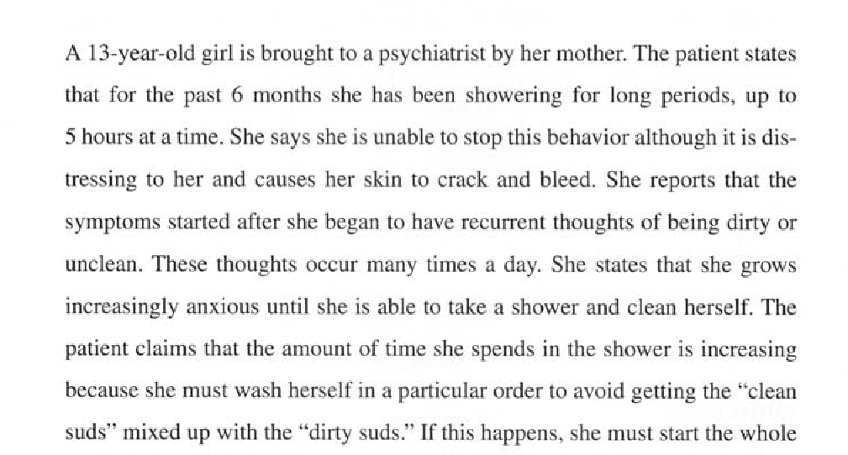

Slide 25
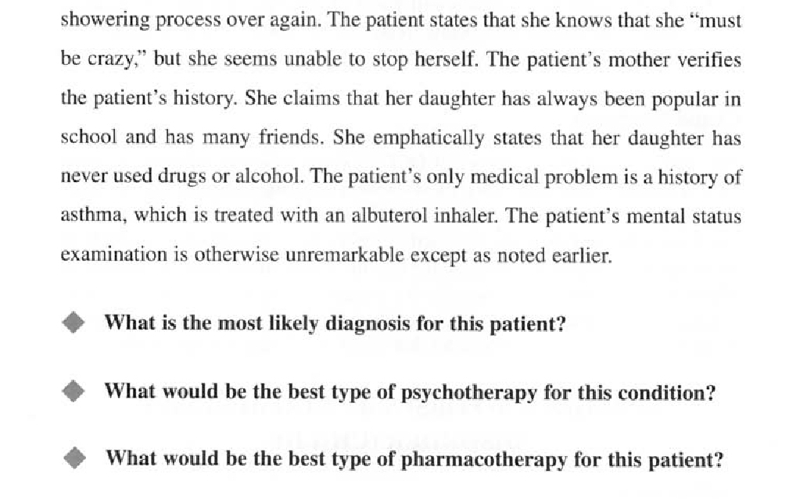

Slide 26
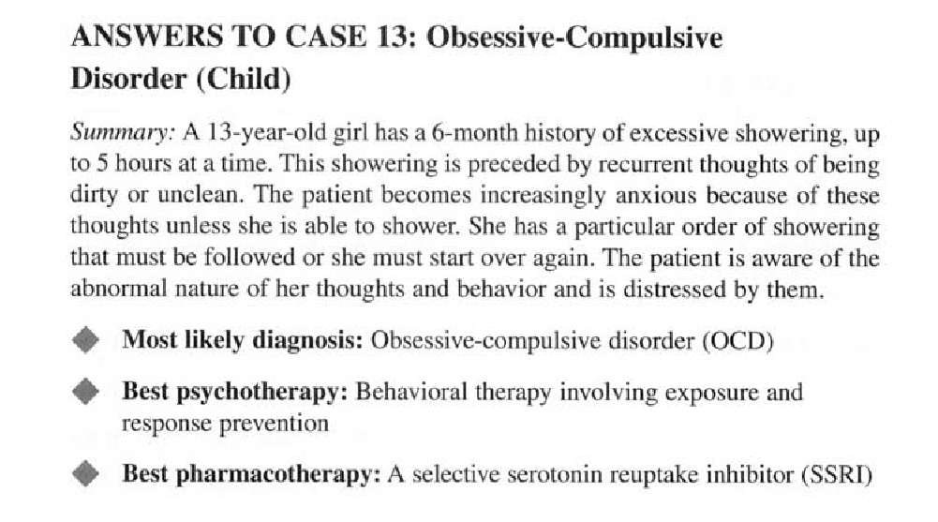

Slide 27
Thank You

