Slide 1
Psychiatric disorders
Dr Mohamed Moslem Al-Hefny

Slide 2
II – Mood Disorders

Slide 3
Mood Disorders
Mood is a pervasive and sustained feeling tone that is experienced internally and that influences a person's behavior and perception of the world.
Affect is the external expression of mood.
Mood can be normal, elevated, or depressed.
Healthy persons experience a wide range of moods and have an equally large repertoire of affective expressions; they feel in control of their moods and affects.
Mood disorders are a group of clinical conditions characterized by a loss of that sense of control and a subjective experience of great distress.

Slide 4
Classification of Mood Disorders
Major depressive disorder (MDD) or unipolar depression is a disorder with only major depressive episodes, without a history of a manic, mixed, or hypomanic episode.

Slide 5
Bipolar disorder
Bipolar I disorder is a disorder with one or more manic episodes, and sometimes major depressive episodes.
Bipolar II disorder is a disorder with episodes of major depression and hypomania rather than mania.

Slide 6
Dysthymia (dysthymic disorder) is characterized by at least 2 years of depressed mood that is not sufficiently severe to fit the diagnosis of major depressive episode. It represents less severe form of major depression.
Cyclothymia (cyclothymic disorder) is characterized by at least 2 years of frequently occurring hypomanic symptoms that cannot fit the diagnosis of manic episode and of depressive symptoms that cannot fit the diagnosis of major depressive episode. It represents a less severe form of bipolar disorder.

Slide 7
Minor depressive disorder
Recurrent brief depressive disorder

Slide 8
Major Depressive Episode – Diagnostic Criteria
Five (or more) of the following symptoms have been present during the same 2-week period and represent a change from previous functioning; at least one of the symptoms is either (1) depressed mood or (2) loss of interest or pleasure.
Note: Do not include symptoms that are clearly due to a general medical condition, or mood-incongruent delusions or hallucinations.
  depressed mood most of the day, nearly every day, as indicated by either subjective report (e.g., feels sad or empty) or observation made by others (e.g., appears tearful). Note: In children and adolescents, can be irritable mood
  markedly diminished interest or pleasure in all, or almost all, activities most of the day, nearly every day (as indicated by either subjective account or observation made by others)
  significant weight loss when not dieting or weight gain (e.g., a change of more than 5% of body weight in a month), or decrease or increase in appetite nearly every day. Note: In children, consider failure to make expected weight gains.
  insomnia or hypersomnia nearly every day
  psychomotor agitation or retardation nearly every day (observable by others, not merely subjective feelings of restlessness or being slowed down)
  fatigue or loss of energy nearly every day
  feelings of worthlessness or excessive or inappropriate guilt (which may be delusional) nearly every day (not merely self-reproach or guilt about being sick)
  diminished ability to think or concentrate, or indecisiveness, nearly every day (either by subjective account or as observed by others)
  recurrent thoughts of death (not just fear of dying), recurrent suicidal ideation without a specific plan, or a suicide attempt or a specific plan for committing suicide

Slide 9
Major Depressive Episode – Diagnostic Criteria
Social/occupational dysfunction.
Exclusion of mixed episode.
Exclusion of substance/general medical condition.
Exclusion of bereavement (The symptoms are not better accounted for by bereavement, i.e., after the loss of a loved one, the symptoms persist for longer than 2 months or are characterized by marked functional impairment, morbid preoccupation with worthlessness, suicidal ideation, psychotic symptoms, or psychomotor retardation.)

Slide 10
Criteria for Manic Episode
A distinct period of abnormally and persistently elevated, expansive, or irritable mood, lasting at least 1 week (or any duration if hospitalization is necessary).
During the period of mood disturbance, three (or more) of the following symptoms have persisted (four if the mood is only irritable) and have been present to a significant degree:
  inflated self-esteem or grandiosity
  decreased need for sleep (e.g., feels rested after only 3 hours of sleep)
  more talkative than usual or pressure to keep talking
  flight of ideas or subjective experience that thoughts are racing
  distractibility (i.e., attention too easily drawn to unimportant or irrelevant external stimuli)
  increase in goal-directed activity (either socially, at work or school, or sexually) or psychomotor agitation
  excessive involvement in pleasurable activities that have a high potential for painful consequences (e.g., engaging in unrestrained buying sprees, sexual indiscretions, or foolish business investments)

Slide 11
Criteria for Manic Episode
Social/occupational dysfunction.
Exclusion of mixed episode.
Exclusion of substance/general medical condition.
Note: Manic-like episodes that are clearly caused by somatic antidepressant treatment (e.g., medication, electroconvulsive therapy, light therapy) should not count toward a diagnosis of bipolar I disorder.

Slide 12
Criteria for Hypomanic Episode
A distinct period of persistently elevated, expansive, or irritable mood, lasting throughout at least 4 days, that is clearly different from the usual nondepressed mood.
During the period of mood disturbance, three (or more) of the following symptoms have persisted (four if the mood is only irritable) and have been present to a significant degree:
  inflated self-esteem or grandiosity
  decreased need for sleep (e.g., feels rested after only 3 hours of sleep)
  more talkative than usual or pressure to keep talking
  flight of ideas or subjective experience that thoughts are racing
  distractibility (i.e., attention too easily drawn to unimportant or irrelevant external stimuli)
  increase in goal-directed activity (either socially, at work or school, or sexually) or psychomotor agitation
  excessive involvement in pleasurable activities that have a high potential for painful consequences (e.g., the person engages in unrestrained buying sprees, sexual indiscretions, or foolish business investments)

Slide 13
Criteria for Hypomanic Episode
The episode is associated with an unequivocal change in functioning that is uncharacteristic of the person when not symptomatic.
The disturbance in mood and the change in functioning are observable by others.
The episode is not severe enough to cause marked impairment in social or occupational functioning, or to necessitate hospitalization, and there are no psychotic features.
Exclusion of substance/general medical condition.
Note: Hypomanic-like episodes that are clearly caused by somatic antidepressant treatment (e.g., medication, electroconvulsive therapy, light therapy) should not count toward a diagnosis of bipolar II disorder.

Slide 14
Unipolar Depression treatment
Psychosocial Therapies (psychotherapy)
Cognitive therapy
Behavior therapy
Biological therapies
Pharmacotherapy
Antidepressant Medications
Augmentation drugs: lithium, antiepileptics, antipsychotics, thyroid
ECT
Vagal Nerve Stimulation
Sleep Deprivation
Phototherapy

Slide 15
Antidepressant Medications
MAO inhibitors (Tranylcypromine)
Tricyclic antidepressnats (Clomipramine, Imipramine, Amitryptyline, Dothiepin,Tianeptine)
Selective serotonin reuptake inhibitors (Citalopram, Escitalopram, Fluoxetine, Paroxetine, Sertraline, Fluvoxamine)
Serotonin–norepinephrine reuptake inhibitors (Venlafaxine, Duloxetine)
Norepinephrine reuptake inhibitors (Reboxetine)
Atypical antidepressants (Mirtazapine, Bubrobione, Trazodone)

Slide 16
The pharmacological treatment of bipolar disorders
The pharmacological treatment of bipolar disorders is divided into both
Treatment of acute episode
Treatment of acute mania or hypomania
Treatment of acute depression
Maintenance treatment

Slide 17
Treatment of Acute Mania
Lithium Carbonate
Antieplieptic drugs (Valproate, Carbamazepine, Oxcarba-zepine, Clonazepam & Lorazepam)
Anti-psychotics (Atypical & Typical)
ECT

Slide 18
Treatment of Acute Bipolar Depression
Standard anti-depressants + mood stabilizer
Mood stabilizers
ECT

Slide 19
Maintenance Treatment of Bipolar Disorder
Lithium Carbonate
Antieplieptic drugs (Valproate, Carbamazepine, Lamotrigine)
Anti-psychotics (Olanzapine)
Thyroid supplementation

Slide 20
Case Study

Slide 21
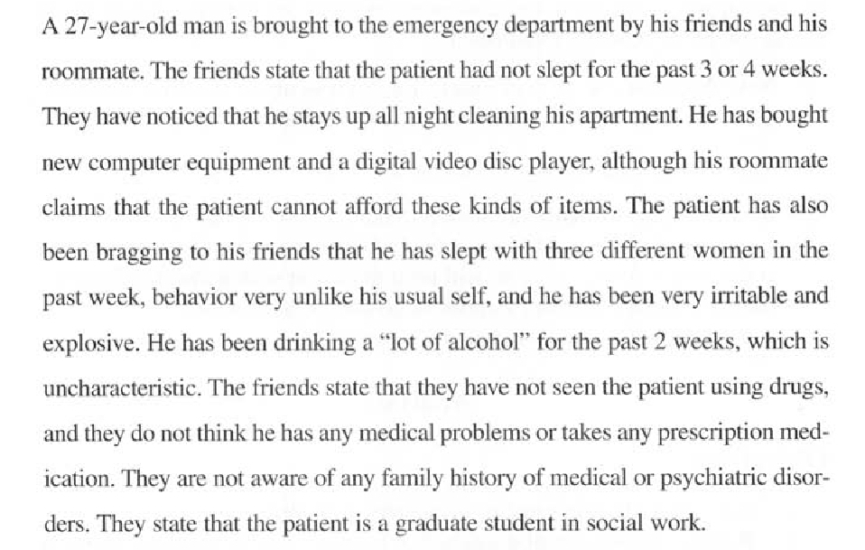

Slide 22
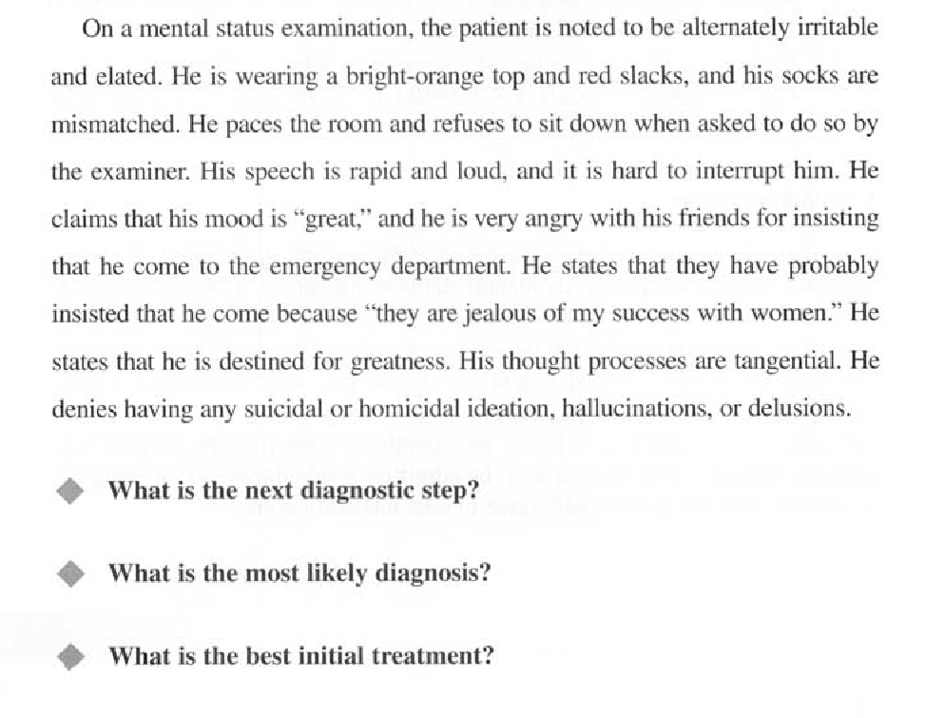

Slide 23
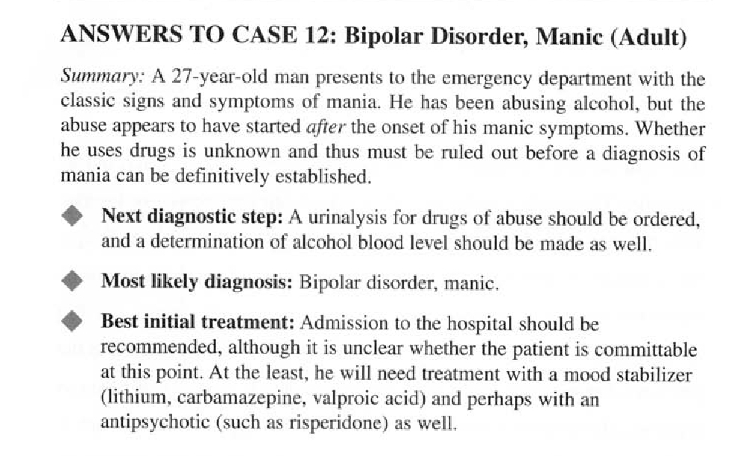

Slide 24
Thank You

