Slide 1
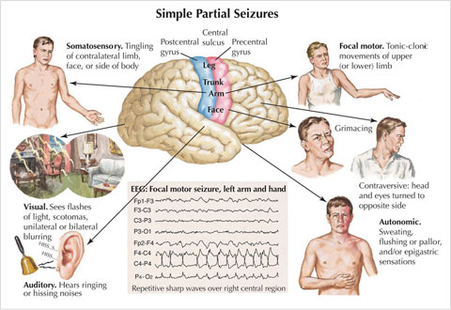


Slide 2
1-Prodromal phase: It the time immediately before a seizure and consists of vague emotional changes as depression, anxiety and nervousness.
2- The epileptic cry: It characterized by spasm of the respiratory, throat and glottis muscles.
3- Postictal phase: It characterized by headache, fatigue, deep sleep, confusion, and nausea and muscle soreness

Slide 3
Status epilepticus:
Is relatively rare, it characterized by a series of tonic-clonic seizures in which the client dose not regain consciousness between seizures
Nursing intervention during seizure:
Provide privacy.
Patient should be lowered to the floor and a soft object placed under his head to prevent injury.
If patient has fallen to the floor, at the onset of a seizure. He should not be moved during the attack.
Loosen constrictive clothing.

Slide 4
Push aside any furniture that may injured the patient during the seizure.
If the patient is in bed, remove pillows and raise side rails.
If an aura precedes the seizure, insert an oral airway to educe bite of tongue or cheek.
Do not try to pry open jaws that are clenched in a spasm to insert anything. This can lead to broken teeth and injury to the lips and tongue.
Do not attempt to restrain the patient during the seizure. It can produce injury.
If possible place the patient on one side with head flexed forward, which allow the tongue to fall forward and facilitates drainage of saliva and mucus.
Set up suction equipment at the patient's bedside.
Use during or after a seizure to clear the patient's airway.
Institute and reinforce the importance of anticonvulsant drug therapy

Slide 5
Nursing intervention after seizure:
Keep bed flat and patient turned on his side until he is alert to maintain airway patent.
Room lighting should be dim and noise kept to a minimum.
Loosen restrictive clothing (if not done during seizure).
Check vital signs immediately following seizure and every 30 minutes (or as ordered) until patient is alert.
Check lips, tongue and inside of mouth for injuries.
If patient is incontinent, change clothing and bedding with as little disturbance as possible.
If the patient becomes agitated (postictal) use gentle restraint.
Convulsions should be described in details in the nurse's note, and reported to the physician.

Slide 6
Patient teaching after seizure:
Give patient information about nature of his disorder, long term plan of treatment, side effects of medications.
Instruct patient to keep record of events surrounding his seizures
Avoid stimulation hat precipitate seizure activity
Make adjustments in life style to have a life as normal as possible.
Patient should carry an identification card
Help family to accept disease and patient.

Slide 7
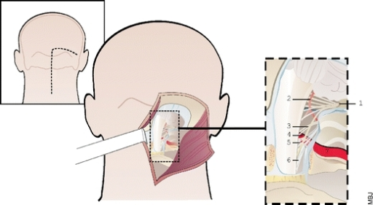
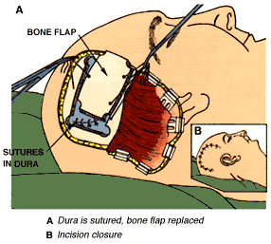
Medical intervention as:
1- Anticonvulsants:
2- Barbiturates:
3- Benzodiazepines
Surgical intervention:

Slide 8
شكرا واتمني لكم التوفيق
والنجاح الباهر

