Slide 1
By Neurology department stuff
Introduction
Notes:
‹#›

Slide 2
Introduction
Neuroanatomy.
Neurophysiology.
Neuropathology.
Neuroradiology.
Neuropediatrics.
Neuro-ophthalmology.
Neurology.
Notes:
‹#›

Slide 3
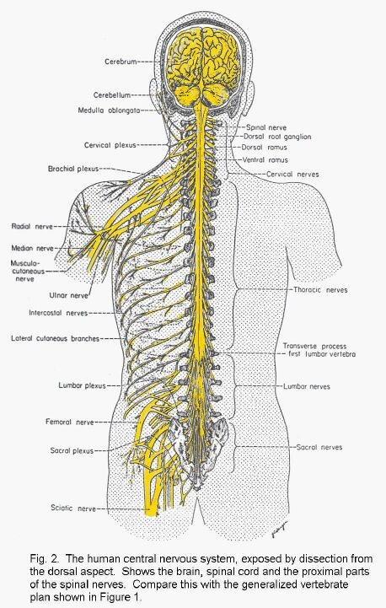
Anatomical features of the nervous system
There are two main divisions of the nervous system:
(1)-Central Nervous System (CNS):
- Brain
- Spinal Cord
Both of them are enclosed & protected in bone (skull & vertebral column), protective coverings (meninges) & fluid filled spaces (CSF).
(2)-Peripheral nervous system:
- Cranial nerves
- Spinal nerves
Notes:
‹#›

Slide 4
Central Nervous System (CNS)
The Brain:
Is nearly about 2% of the total body weight (1.5-2 kg in adult), contains billions of neurons (nerve cells).
Nerve cells with common form, function & connections within the CNS are grouped together to form nuclei, outside the CNS are grouped together to form ganglia.
Brain is formed of:
(A) cerebrum (B) brain stem (C) cerebellum
Notes:
‹#›

Slide 5
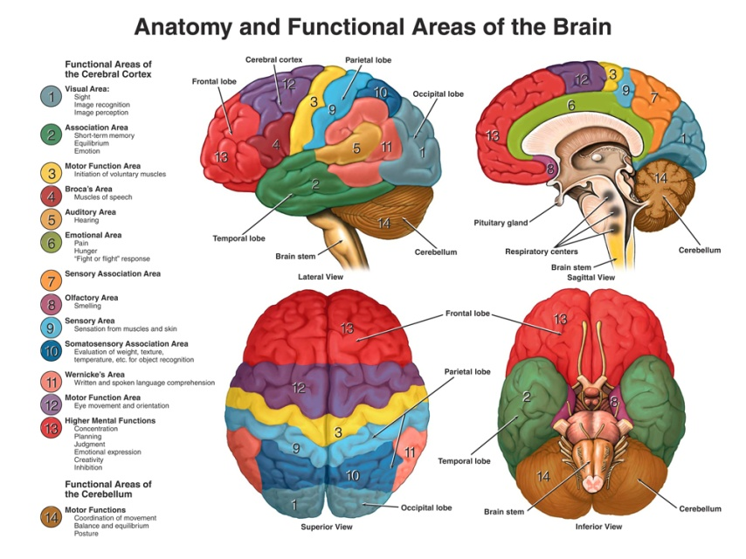
(A) The cerebrum
Is composed of two cerebral hemispheres with outer grey matter (cerebral cortex) composed of nerve cells, and inner subcortical white matter composed of nerve fibers.
The two cerebral hemispheres are connected to each other by the corpus callosum.
Notes:
‹#›

Slide 6
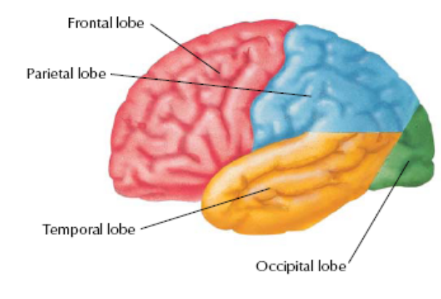
(A) The cerebrum
Notes:
‹#›

Slide 7
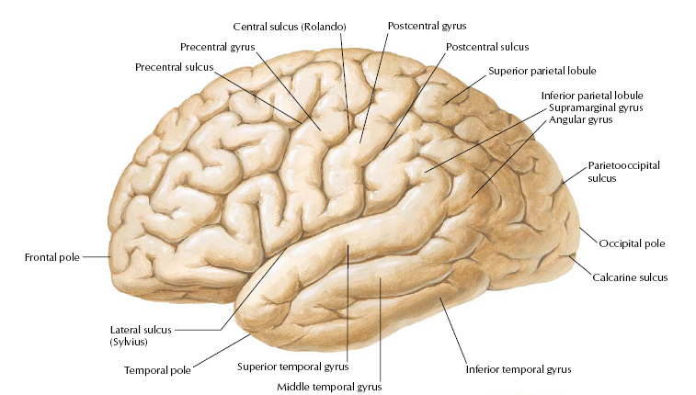
(A) The cerebrum
Notes:
‹#›

Slide 8
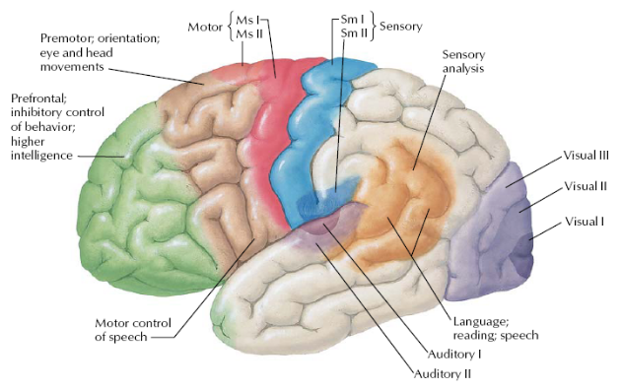
The Cerebral cortex
Notes:
‹#›

Slide 9
The Cerebral cortex
The cortex is divided functionally & anatomically into lobes & areas of specific function.
(1)-The Frontal lobe :
- Concerned mainly with control of movements.
- Lies anterior to the central sulcus & contains:
a- Motor area (4).
b- Premotor area (6).
c- Motor speech center (Broca’s area 44).
d- Writing center (Exner’s area 45).
e- Area 8 of voluntary conjugate eye movement.
f- Prefrontal area.
Notes:
‹#›

Slide 10
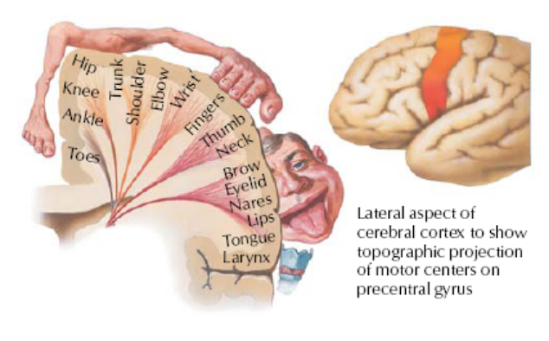
The Cerebral cortex
Notes:
‹#›

Slide 11
The Cerebral cortex
(2)-The Parietal lobe:
Lies behind the central sulcus & concerned mainly with sensation.
Cortical sensory areas 1,2,3.
Visual psychic area 39 of speech.
(3)-The temporal lobe :
Lies below the lateral sulcus (fissure of sylvius)
Auditory sensory area (41,42).
Auditory psychic area (22).
Uncus.
Notes:
‹#›

Slide 12
The Cerebral cortex
(4)- The occipital lobe:
Lies behind the parieto-occipital sulcus, concerned mainly with vision.
a) Visual sensory area 17.
b) Visual psychic area (18 & 19).
N.B
In the depth of each cerebral hemisphere, there are certain principal grey nuclei:
Thalamus, hypothalamus.
Basal ganglia (caudate nucleus, lentiform nucleus- globus pallidus & putamen)
Notes:
‹#›

Slide 13
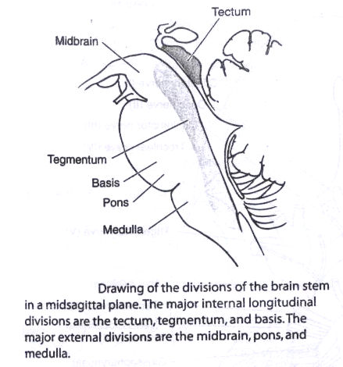
(B) The brain stem:
Consists of three parts: Mid brain, Pons & Medulla.
It contains important structures:
(1) The cranial nerve nuclei:
(3) & (4) in the midbrain .
(5), (6), (7) & (8) in the pons.
(9), (10), (11) & (12) in the medulla.
(2)The Substentia Nigra, Red nucleus of the mid brain & the inferior olivary nuclei of the medulla which are important in controlling movements.
(3)The Reticular formation which is related to sleep, consciousness, behavior & memory.
(4)Respiratory, Cardiac &Vomiting centers .
Notes:
‹#›

Slide 14
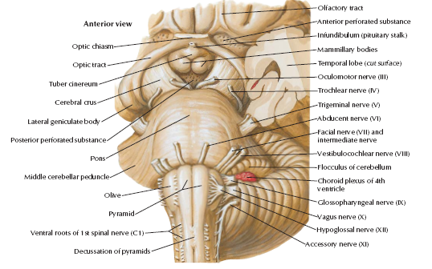
(B) The brain stem:
Notes:
‹#›

Slide 15
(C) The cerebellum
Anatomically consists of two cerebellar hemispheres that are connected by the vermis and three cerebellar peduncles that connect it with the brain stem.
Functionally it can be divided into 3 divisions:
Archicerebellum → concerned with equilibrium.
Paleocerebellum → concerned with muscle tone.
Neocerebellum → concerned with coordination of fine movements.
Notes:
‹#›

Slide 16
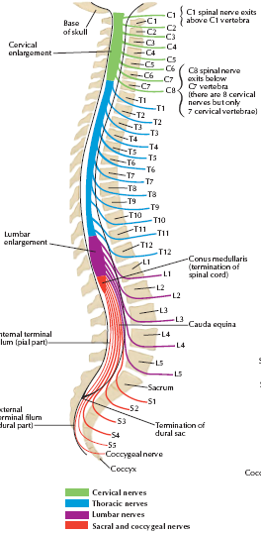
The spinal cord " (myelon, medulla spinalis)"
Is an elongated structures, about 42-45 cm long in adults, its upper end continuous with the brain stem at the foramen magnum & extends to the lower border of the 1st lumber vertebra.
The lower tapering border of the spinal cord is termed conus medullaris.
The cord is divided into 31 segments:
Cervical
(8)
Thoracic
(12)
Lumbar
(5)
Sacral
(5)
Coccygeal
(1)
Notes:
‹#›

Slide 17
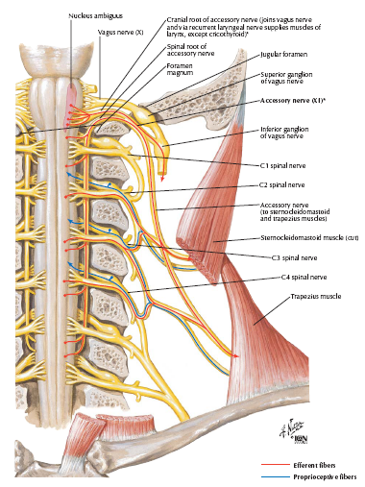
The spinal cord " (myelon, medulla spinalis)"
Notes:
‹#›

Slide 18
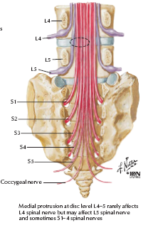
The spinal cord " (myelon, medulla spinalis)"
Notes:
‹#›

Slide 19
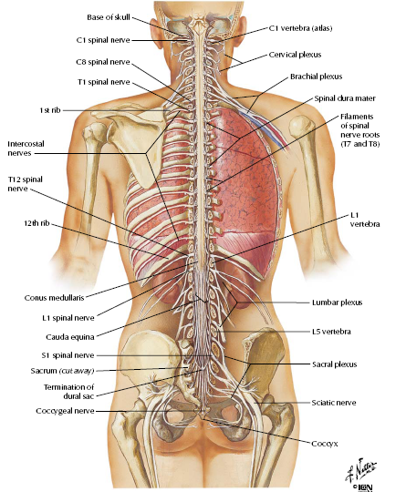
The spinal cord " (myelon, medulla spinalis)"
Notes:
‹#›

Slide 20
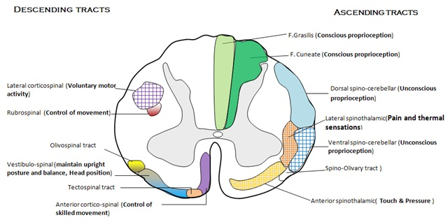
The spinal cord " (myelon, medulla spinalis)"
Notes:
‹#›

Slide 21
The spinal cord " (myelon, medulla spinalis)"
* There are tow enlargements; Cervical & Lumbar enlargements with the brachial plexus & lumbar plexus originate from those enlargements in order.
* In contrast to the brain, the cord consists of inner H shaped grey matter surrounded by the white matter.
-The grey matter consists of 2 posterior horns "sensory" & 2 anterior horns (motor) and intermediolateral horns in the dorsal “thoracic" & sacral regions (for sympathetic & parasympathetic efferents).
-The white matter contains many ascending & descending tracts.
Notes:
‹#›

Slide 22
The peripheral nervous system
Consisting of the cranial nerves with their nuclei, anterior horn cells (AHC), spinal nerves, peripheral nerves, neuromuscular junctions & the muscles .
N.B:
From the cerebral cortex to the spinal cord → upper motor neurons.
From the AHC till the muscles → lower motor neurons.
Both of them has characteristic clinical features.
Notes:
‹#›

Slide 23
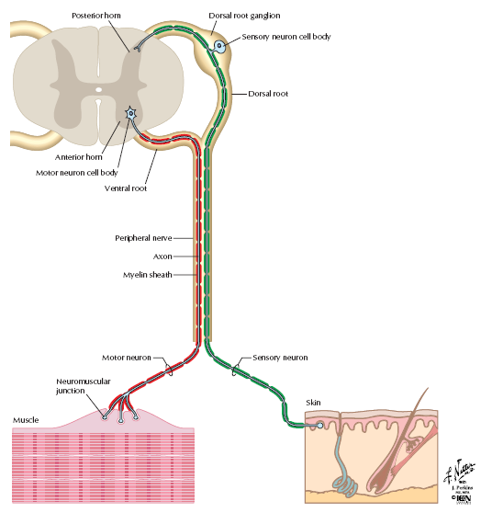
The peripheral nervous system
Notes:
‹#›

Slide 24
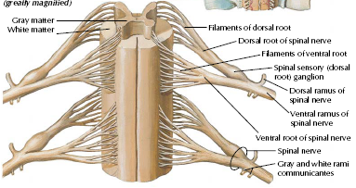
The peripheral nervous system
Notes:
‹#›

Slide 25
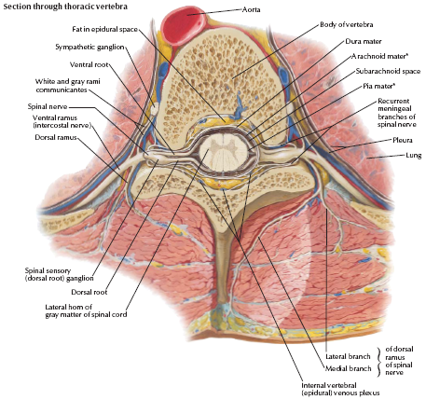
The peripheral nervous system
Notes:
‹#›

Slide 26
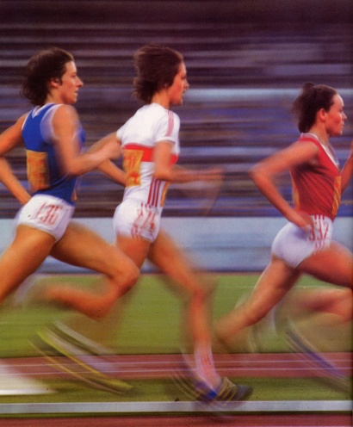
Organizations of movements in the motor system:
For normal voluntary motor activity, the following parts of the nervous system must be normal and cooperate:
The corticospinal tract "pyramidal tract, upper motor neurons".
The basal ganglia .
The cerebellum .
The lower motor neurons .
Notes:
‹#›

Slide 27
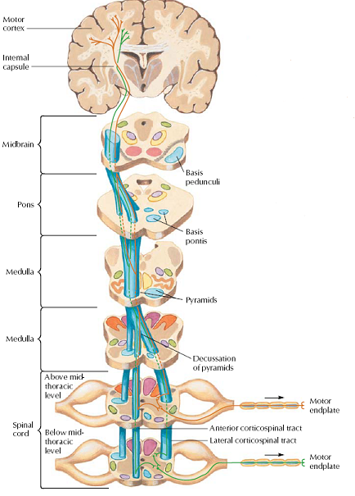
The pyramidal tract
Notes:
‹#›

Slide 28
The basal ganglia
The basal ganglia has the following influence on the motor system:
Regulation of posture.
Plays a vital role in initiating movements, lesions → akinisia or bradykinisia.
Gives off smooth coordinating voluntary motor activity.
Regulation of muscle tone and voluntary movements, lesions → rigidity & tremors.
Notes:
‹#›

Slide 29
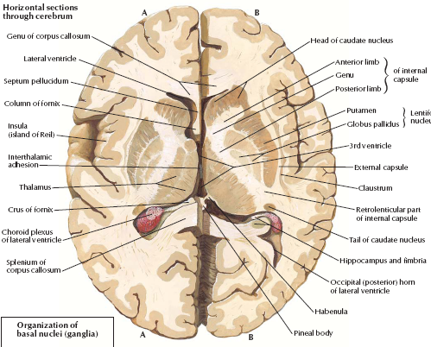
The basal ganglia
Notes:
‹#›

Slide 30
The cerebellum
The cerebellum shares in the organization of the motor system activity through:
Regulation of postural reflexes and equilibrium, lesions → unsteady.
Regulation of muscle tone, lesions → hypotonia.
Regulation and smooth coordination of limb movements, lesions → ataxic movements.
Notes:
‹#›

Slide 31
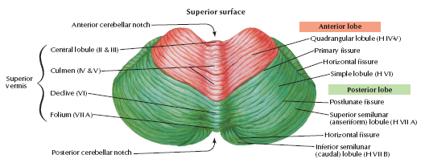
The cerebellum
Notes:
‹#›

Slide 32
The lower motor neurons
Forming the final process in organizing motor activity, it constitute the following:
Nuclei of motor cranial nerves.
Anterior horn cells of the spinal cord → giving off the anterior roots which form with the afferent posterior roots the spinal nerves → the peripheral nerves→ neuromuscular junction → muscles.
Notes:
‹#›

Slide 33
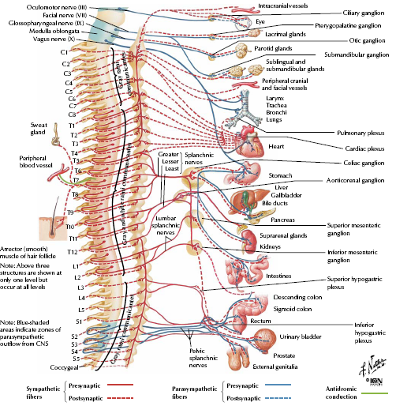
The autonomic nervous system
Sympathetic:
T1→ L4.
Parasympathetic:
Cranial→ 3,7,9,10.
Sacral→ S3,4,5.
Notes:
‹#›

Slide 34
Thank You

