Slide 1
بسم الله الرحمن الرحيم

Slide 2
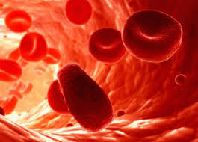
Introduction to blood diseases
Dr. Shimaa Abd-allah Ahmed

Slide 3
objectives
Blood component
Site of hematopoiesis
hematopoiesis and regulating factor
CBC INTERPRETATION
BONE MARROW BIOPSY

Slide 4
Haematopoiesis

Slide 5
Blood consists of
Red blood cells
White blood cells
Platelets
plasma

Slide 6
Site of Haematopoiesis
Yolk sac 3 weeks ,Liver And Spleen 6th week -7 months
Red Bone Marrow In The Medullary Cavity Of All Bones >7 months -childhood.
In Childhood, Red Marrow Is Progressively Replaced By Fat (Yellow Marrow), So
In Adults, Normal Haematopoiesis Is Restricted To The Vertebrae, Pelvis, Sternum, Ribs, Clavicles, Skull, Upper Humeri And Proximal Femora.
However, red marrow can expand in response to increased demands for blood cells.

Slide 8
Stem cell
Can differentiate to blood cell
Self renewal
Proliferation
May differentiate to other cells

Slide 10
Regulation of hematopoiesis
Growth factor
Colony stimulating factor, erythropiotin, thrombopiotin
Hormones
Growth hormone, thyroid hormone, steroid hormone, androgens

Slide 11
INVESTIGATION OF DISEASES OF THE BLOOD
The full blood count
Tests consists of
Counts of RBC, WBC, Platelets
Red blood cell
-RBCS count
Hemoglobin level
Hematocrit value
Mean corpuscular volume
Mean corpuscular hemoglobin
Red cell distribution width

Slide 12
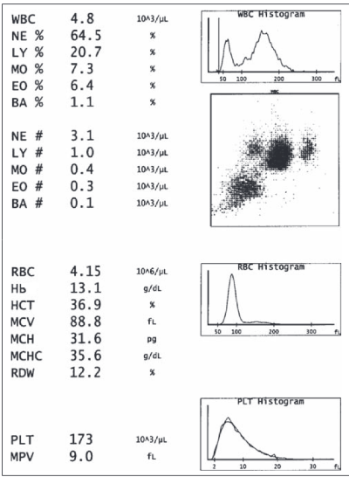

Slide 13
RBCs count (120 day)
Male 4.7-6.1 million/cmm
Female 4-5 million/cmm
Hemoglobin level
Male 13.5-17.5 gm/dl
Female 12-16 gm/dl
Hematocrit HCT
Male41-53%
Female 36-45

Slide 14
The size of red cells (mean cell volume, MCV= haematocrit/ red cell count x10) normal 80-97fl
Microcytic <80 fl,normocytic 80-97 fl,macrocytic >97 fl
The amount of haemoglobin present in the red cells (mean cell haemoglobin, MCH = haemoglobin/ red cell count x 100)Pg average 30 pg 15/5 millionx10
The amount of haemoglobin present per red cell volume (mean cell haemoglobin concentration, MCHC = haemoglobin/ haematocrit )g/dl 15/45 x100=35

Slide 15
RDW
SD OF Red cell width indicate variability in size =anisocytosis
e.g
Iron deficiency anemia
Megaloblastic anemia

Slide 16
Reticulocyte
Normal value 0.5% - 2%.
Hence 0.5% - 2 % RBCs are replaced per day
Uses
To evaluate anemia
Response to treatment of anemia
Note
If the disease causing the anemia is inside the marrow, the reticulocyte count is decreased
If the disease causing the anemia is outside the marrow, the reticulocyte count is increased

Slide 18
NORMAL COUNTS
Total WBC Count : 4000 – 11000 / cu.mm.
Differential count
Leukocyte | Percentage
Neutrophils | 40 – 70 %
Eosinophils | 1 – 4 %
Basophils | 0 – 1 %
Monocytes | 4 – 8 %
Lymphocytes | 20 – 40 %

Slide 19
Platelets count
Normal 150-450,000/cmm
7-10 life span days

Slide 20
Blood film

Slide 22
Bone marrow examination
indications for bone marrow biopsy:
unexplained cytopenias;
unexplained leukocytosis, erythrocytosis, or thrombocytosis; staging of lymphoma and some solid tumors
diagnosis of plasma cell neoplasms
Bone marrow aspirate and biopsy commonly are performed the posterior iliac crests. the sternum.
In newborns and young infants, the anterior tibia

Slide 23
Thank You

