Slide 1

Urinary stones
By
Assis. Prof. Mohammed Hosny Hassan
Associate Professor of Medical Biochemistry, Faculty of Medicine, SVU

Slide 2
ILOs
Mention the normal urinary pH and describes how its changes can help in diagnosing types of urinary stones.
Lists the main chemical types of urinary stones.
Mention the radiologic appearance of these stones.
Describe different shapes of urinary crystals associated with each type of stone.
Explain the pathological condition, metabolic disorder that lead to the formation of these stones.

Slide 3
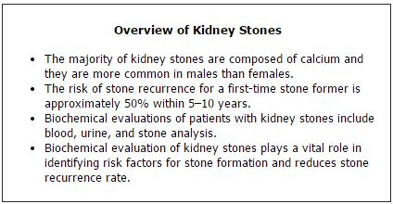

Slide 4
Pathogenesis of Kidney Stones
Various factors contribute to the formation of kidney stones. Supersaturation of urine by constituents, such as cystine, calcium, or oxalate, is the most widely accepted mechanism for stone formation. Normally, when the solute concentration reaches the saturation point and crystallization begins, it is impeded by inhibitors present in urine, including citrate, pyrophosphate, glycosaminoglycans, nephrocalcin, and Tamm-Horsfall protein. As solute concentration continues to increase, however, a critical supersaturation point is reached. Above this level, inhibitors of crystallization become ineffective and spontaneous crystallization can occur.

Slide 5
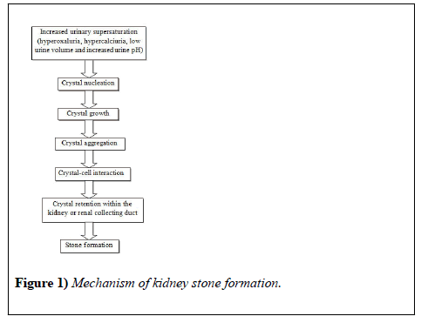

Slide 6
Promotors of stone formation
Components | Pathophysiological mechanism
Promoters:
Uric acid or urate | Has an Antagonistic effect on substances in the urine. Promotes heterogeneous nucleation by uric acid or monosodium urate. Binding of calcium oxalate to cells is increased.
Urine pH | Highly acidic pH enhances calcium oxalate crystallization. Formation of uric acid crystals is enhanced. Promotes secondary nucleation of calcium oxalate by formation of calcium phosphate precipitates.
Urine volume | Promotes crystallization
Hypercalciuria | Increased intestinal calcium absorption which may be 1, 25-dihydroxyvitamin D [1,25(OH)2D] dependent or independent. Decreased renal calcium reabsorption. Increases movement of calcium from bones. Enhances urine supersaturation and hence crystallization of calcium.
Hyperoxaluria | Because of an innate error in metabolism oxalate overproduction occurs. Increased dietary intake and bioavailability Increased intestinal oxalate absorption. Urinary supersaturation and formation of calcium oxalate crystals.

Slide 7
Inhibitors of stone formation
Alkaline pH | Inhibits cystine and uric acid stone formation
Citrate | Forms complexes with calcium and therefore lower calcium oxalate supersaturation, inhibits aggregation of preformed crystals and attachment of crystals to urinary epithelium.
Pyrophosphate | Formation of both calcium oxalate and calcium phosphate crystals is inhibited.
Phytate | Inhibits calcium crystallization both in the intra-papillary tissue and urine.
Magnesium | Inhibits of growth (and presumably nucleation) of crystals as well as aggregation. While for the attachment of calcium oxalate crystals its supra-physiologic concentrations are required.
Glycoproteins | Inhibits spontaneous nucleation from metastable solutions as well as the growth of preformed crystals.

Slide 8




Types of Kidney Stones
Major Classifications of Kidney Stones
Type | Frequency | Crystal shape | X-ray Characteristic | Risk factors
Calcium oxalate | 75% | Envelope | Radiopaque | Low urine volume Hypercalciuria Hyperuricosuria Hyperoxaluria Hypocitraturia
Calcium phosphate (Brushite) | 5% | Amorphous | Radiopaque | Hypercalciuria Hyperphosphaturia Raised urine pH
Uric acid | 10% | Diamond or barrel | Radiolucent | Hyperuricosuria Low urine pH Low urine volume
Struvite (Triple phosphate) | 10% | Coffin-lid | Radiopaque | Urinary tract infection (Urease splitting organism)
Cystine | 1% | Hexagon | Faintly radiopaque | Autosomal recessive disorder

Slide 9
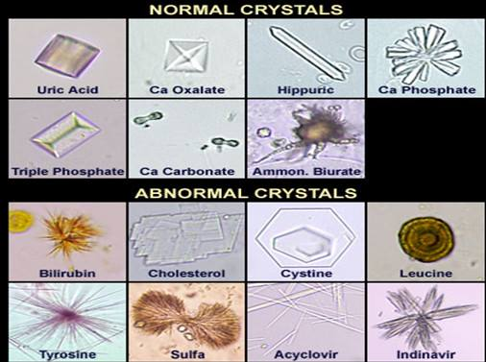
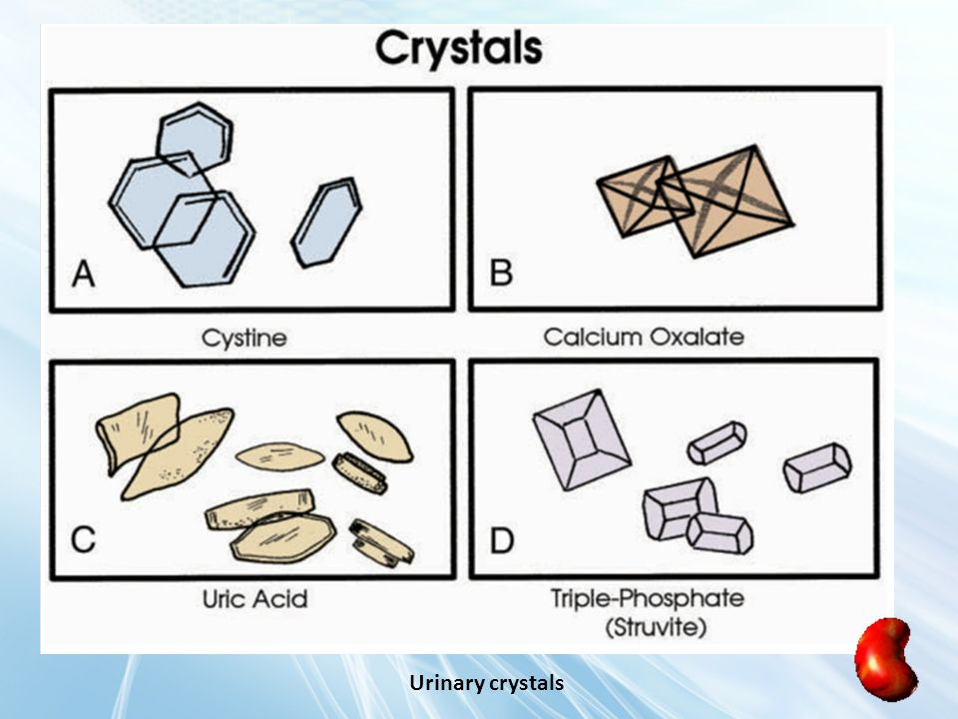

Slide 10
1. Calcium Stones
A majority of calcium stones consist of >90% oxalate with trace amounts of phosphate. Several factors contribute to formation of this type of stone. An estimated 40–60% of all calcium stone formers have hypercalciuria, which is either idiopathic or secondary to conditions that increase calcium excretion in urine, including primary hyperparathyroidism, vitamin D toxicity, and sarcoidosis.

Slide 11
Calcium stones occur primarily in individuals who excrete excess levels of oxalate in urine. Hyperoxaluria arises from either increased oxalate absorption from the gut or increased dietary intake of oxalate. Because calcium binds with oxalate in the gut and hinders its absorption, oxalate is more readily absorbed when dietary calcium is low. Besides decreased dietary calcium intake, hyperoxaluria can be due to unusually high intake of oxalate-rich food products such as spinach, and nuts. Primary hyperoxaluria, a rare autosomal recessive condition, causes disturbances in the oxalate biosynthetic pathway, leading to very high oxalate excretion.

Slide 12
An estimated 20–60% of calcium stone formers have reduced citrate excretion. The citrate buildup reduces calcium oxalate super-saturation in urine by forming complexes with calcium and directly inhibiting crystal growth and aggregation. Researchers also have demonstrated that alkaline citrate therapy increases the clearance rate of residual stone fragments following extracorporeal shock-wave lithotripsy (ESWL). This treatment also reduces post-ESWL recurrence rates both in stone-free patients and those with residual fragments. More recently, evidence suggests that citrate has beneficial effects in normocitraturic stone formers. Researchers found that keeping citrate concentrations above the normal reference range was highly effective at inhibiting residual fragment growth.

Slide 13
Familial or acquired distal renal tubular acidosis (dRTA) is a condition in which the kidneys lose their ability to produce urine with a pH ≤5.5. It is usually accompanied by hypocitraturia, which precipitates the formation of calcium oxalate stones.

Slide 14
2. Calcium Phosphate Stones
Hypercalciuria and alkaline urine lead to formation of calcium phosphate stones. Patients with these types of stones have a significantly lower threshold of renal phosphate reabsorption. The ensuing hypophosphatemia stimulates calcitriol synthesis, resulting in hypercalciuria.

Slide 15
3. Uric Acid Stones
Uric acid (UA) is an end product of purine metabolism that the body excretes in urine. Both purine overproduction and excess purine ingestion favor formation of UA stones. The three major risk factors for UA stones are low urine pH (<5.5), low urine volume, and hyperuricosuria. These factors result in undissociated UA, a poorly soluble molecule that contributes to precipitation and crystallization. As pH rises, it dissociates into a more soluble urate ion.
Patients without any obvious underlying congenital or acquired conditions are known as idiopathic UA stone formers. In these individuals, low urinary pH may be due to a defect in renal ammonium excretion that reduces the buffer for H⁺ and results in a pH increase. Some studies have suggested a link between this defect and insulin resistance.

Slide 16
4. Struvite Stones
Struvite stones consist of a mixture of magnesium, ammonium, and phosphate. They are associated with chronic urinary tract infections and are more prevalent in women. Several urea-splitting microorganisms are responsible for struvite stone formation, including Proteus, Staphylococcus, Klebsiella, and Pseudomonas. These bacteria hydrolyze urea to produce NH4⁺ and OH– ions that contribute to the alkalinity of urine. Both ammonium and alkaline urine are essential for struvite supersaturation of urine.

Slide 17
5. Cystine Stones
Cystinuria is an inheritable autosomal recessive disorder of amino acids transport, specifically cystine, arginine, ornithine, and lysine transporters.
These individuals excrete increased amounts of urinary cystine. Because cystine has limited solubility, increased levels in urine favor its precipitation and contribute to formation of cystine stones. Stone formation usually is the only clinical manifestation of this disorder, which can occur at any age, although the mean is 20–40 years.

Slide 18
Biochemical Investigations of Risk Factors
Analyses involve three components: blood, urine, and the actual stone.
Blood investigations assess levels of electrolytes, calcium, phosphate, uric acid, and parathyroid hormone, as well as renal and thyroid functions and vitamin D status.
Analysis of urine is probably the most important element of assessing patients, irrespective of stone type. Urine pH plays a critical role in stone composition. Acidic urine promotes UA and cystine stones, whereas alkaline urine promotes calcium phosphate and struvite stones. A simple test performed during an outpatient visit is all it takes to measure urine pH. However, urinary pH fluctuates over a 24-hour period, typically increasing after meals, and dropping <5.5 in periods of fasting. Therefore, urine normally is alkaline during the day and slightly acidic in the early morning and late at night.

Slide 19
Urine culture is another important element of assessing patients. The presence of infection can lead to struvite stones and low urine citrate.
The cornerstone of kidney stone biochemical evaluations is a 24-hour urine analysis. The results provide important prognostic information, guide preventive recommendations, and aide in monitoring therapy. Generally speaking, labs should obtain two 24-hour urine collections for comparison, as mineral excretion varies from day-to-day.
A patient's urine output is also an important indicator. Low urine volume increases the risk of stone formation. Between 12–25% of first-time stone formers have low urine excretion volume, defined as <1 L/24 hours.

Slide 20
Analysis of the stones: Numerous approaches are available to analyze kidney stones. Wet chemical analysis (WA) is the most widely employed technique. Although quantitative WA identifies the common stone components, it may miss rare and unidentified materials. Sophisticated techniques, such as X-ray diffraction crystallography, infrared spectroscopy, and scanning electron microscopy with energy dispersion, provide highly accurate stone analysis. Infrared spectroscopy also has the ability to generate accurate quantitative analysis.

Slide 21


