Slide 1
Renal cases – Renal system
Medical Biochemistry

Slide 2
CASE 1
A 58-year-old truck driver with a 30-year history of smoking one pack of cigarettes per day presents for a physical examination. He reports increased frequency of urination and nocturia, but does not have gross hematuria. Physical examination reveals an enlarged prostate. Results of his urinalysis with microscopy are :
Urinalysis Results for Case 1 Component Result Reference range
Dipstick urinalysis
Color Pale yellow —
Clarity Clear —
pH 6.5 —
Specific gravity 1.010 —
Glucose Negative Negative
Blood 1+ Negative
Ketones Negative Negative
Protein Negative Negative
Urobilinogen Negative Negative
Bilirubin Negative Negative
Leukocyte esterase Negative Negative
Nitrite Negative Negative
Urine microscopy
White blood cells 1 per high-power field 0 to 5 per high-power field
Red blood cells 7 per high-power field 0 to 4 per high-power field
Squamous epithelial cells None None

Slide 3
Q1- Based on this patient's history, symptoms, and urinalysis findings, which one of the following is the most appropriate next step?
• A. Repeat urinalysis in six months.
• B. Obtain blood urea nitrogen and creatinine levels, perform computed tomographic urography, and refer for cystoscopy.
• C. Treat with an antibiotic and repeat the urinalysis with microscopy.
• D. Inform him that his enlarged prostate is causing microscopic hematuria, and that he can follow up as needed.
21
• E. Perform urine cytology to evaluate for bladder cancer.
Q2- Descrine an algorithm for diagnosis, evaluation, and follow-up of patients with asymptomatic microscopic hematuria ?

Slide 4
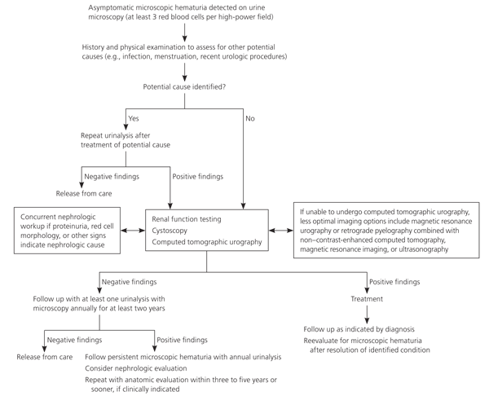

Slide 5
CASE 2:
A 33-year-old woman with a history of nephrolithiasis presents with a four-week history of urinary frequency, urgency, urge incontinence, and dysuria. She recently had ureteroscopy with lithotripsy of a 9-mm 22
obstructing left ureteral stone; she does not know if a ureteral stent was placed. She has constant dull left flank pain that becomes sharp with voiding. Results of her urinalysis with microscopy are
Urinalysis Results for Case 2 Component Result Reference range
Dipstick urinalysis
Color Yellow —
Clarity Clear —
pH 6.0 —
Specific gravity 1.010 —
Glucose Negative Negative
Blood 2+ Negative
Ketones Negative Negative
Protein Negative Negative
Urobilinogen Negative Negative
Bilirubin Negative Negative
Leukocyte esterase 2+ Negative
Nitrite Negative Negative
Urine microscopy
White blood cells 15 per high-power field 0 to 5 per high-power field
Red blood cells 6 per high-power field 0 to 4 per high-power field
Squamous epithelial cells None None

Slide 6
Q1- Based on this patient's history, symptoms, and urinalysis findings, which one of the following is the most appropriate next step?
• A. Treat with three days of ciprofloxacin (Cipro), and tailor further antibiotic therapy according to culture results.
• B. Treat with 14 days of ciprofloxacin, and tailor further antibiotic therapy according to culture results.
• C. Obtain a urine culture and perform plain radiography of the kidneys, ureters, and bladder.
• D. Perform a 24-hour urine collection for a metabolic stone workup.
• E. Perform computed tomography.
Q2- Explain you choice in Q1?
Answer:

Slide 7
Q1- C
Q2- The presence of a ureteral stent causes mucosal irritation and inflammation; thus, findings of leukocyte esterase with white and red blood cells are not diagnostic for urinary tract infection, and a urine culture is required. In this setting, plain radiography of the kidneys, ureters, and bladder would be useful to determine the presence of a stent. If a primary care physician identifies a neglected ureteral stent, prompt urologic referral is indicated for removal. Retained ureteral stents may become encrusted, and resultant stone formation may lead to obstruction.
Flank discomfort and recent history of urinary tract manipulation suggest that this is not an uncomplicated urinary tract infection; therefore, a three-day course of antibiotics is inadequate. Although flank pain and urinalysis suggest possible pyelonephritis, this patient should not be treated for simple pyelonephritis in the absence of radiography to identify a stent. A metabolic stone workup may be useful for prevention of future kidney stones, but it is not indicated in the acute setting. Finally, although computed tomography would detect a ureteral stent, it is not preferred over radiography because it exposes the patient to unnecessary radiation. Typically, microscopic hematuria requires follow-up to ensure that there is not an underlying treatable etiology. In this case, the patient's recent ureteroscopy with lithotripsy is likely the etiology.

Slide 8
CASE 3:
A 49-year-old man who has a history of neurogenic bladder due to a spinal cord injury and who performs clean intermittent catheterization visits your clinic for evaluation. He reports that he often has strong-smelling urine, but has no dysuria, urge incontinence, fever, or suprapubic pain. Results of his urinalysis with microscopy are
Urinalysis Results for Case 3 Component Result Reference range
Dipstick urinalysis
Color Dark yellow —
Clarity Turbid —
pH 7.0 —
Specific gravity 1.010 —
Glucose Negative Negative

Slide 9
Component Result Reference range
Blood Negative Negative
Ketones Negative Negative
Protein Negative Negative
Urobilinogen Negative Negative
Bilirubin Negative Negative
Leukocyte esterase Positive Negative
Nitrite Positive Negative
Urine microscopy
White blood cells 20 per high-power field 0 to 5 per high-power field
Red blood cells 2 per high-power field 0 to 4 per high-power field
Squamous epithelial cells None None
Bacteria Many —

Slide 10
Q1- Based on this patient's history, symptoms, and urinalysis findings, which one of the following is the most appropriate next step?
• A. Inform the patient that he has a urinary tract infection, obtain a urine culture, and treat with antibiotics.
• B. Refer him to a urologist for evaluation of a complicated urinary tract infection.
• C. Perform computed tomography of the abdomen and pelvis to evaluate for kidney or bladder stones.
• D. Inform him that no treatment is needed.
• E. Obtain a serum creatinine level to evaluate for chronic kidney disease.
Q2- Explain you choice in Q1?
Answer:
Q1- D
Q2- Although the urinalysis results are consistent with a urinary tract infection, the clinical history suggests asymptomatic bacteriuria. Asymptomatic bacteriuria is the isolation of bacteria in an appropriately collected urine specimen obtained from a person without symptoms of a urinary tract infection. The presence of bacteria in the urine after prolonged catheterization has been well described. In the absence of

Slide 11
symptoms of a urinary tract infection or nephrolithiasis, there is no need to culture the urine, treat with antibiotics, refer to a urologist, or perform imaging of the abdomen and pelvis. There is no reason to suspect acute kidney injury in this setting; thus, measurement of the serum creatinine level is also unnecessary

