Slide 1
Renal Examination
Mohamed.A.Elsayed
Assistant lecturer of internal medicine
SVU

Slide 2
Introduction
Introduce yourself to the patient.
Briefly explain to the patient what the examination involves.
Assess the patient from the end of the bed:
Check around the bedside for catheter bags (including urine volume and colour) or peritoneal dialysis bags.
Inspect the patient’s skin for any evidence of bruising, scratch marks, or vasculitic rashes.
Ensure to comment on any alternative vascular access routes present (e.g.permcaths).
In any renal examination, a major aspect is assessing fluid status and much of the examination is targeted at this; many examiners may want you to state (based on your examination findings) whether the patient is fluid depleted, euvolemic, or fluid overloaded.

Slide 3
GENERAL EXAMINATION
Level of consciousness (e.g. uraemic encephalopathy).
Decubitus: orthopnea ( pleural effusion) , prayer position in (pericardial effusion).
Fascies: Earthy look ( muddy brown in renal failure).
Complexion:
Pallor : GIT bleeding & ESRD
Jaundice : hemolysis , Viral hepatitis.
Cyanosis : e.g. respiratory failure with effusion.

Slide 4
Vital signs:
Pulse: rate, volume , special character (hyperdynamic circulation with big pulse volume e.g. anaemia & A-V shunt).
Blood pressure: hypertension related to ESRD , hypotension in hypovolemia.
Temperature & Respiratory rate.

Slide 5
The Hands
Inspect the palmar creases for pallor:
Especially important in anaemia secondary to end stage renal disease.
Assess patient’s skin turgor:
Gently pull lightly upwards on the patients skin overlying the hand or arm.
The rate at which it returns to baseline when released is roughly associated with degree of hydration.
Measure capillary refill time:
Should be less than 2 seconds.
Feel the hands to assess temperature.
Palpate the radial pulse to assess rate , volume ( e.g. weak in dehydration and hypotension) and special character ( water hummer pulse in anaemia).
Check for a flapping tremor ( end organ damage):
Can be a sign of uraemia.
Check for clubbing.

Slide 7
The Arms
Ask to check the blood pressure:
hypertension associated with ESRD , hypotension with dehydration.
Assess any arteriovenous fistulae that are present. These can be radio-cephalic, brachio-cephalic, or brachio-basilic.
Look for signs of recent use (e.g. dressings or needle entry)
Palpate for thrills (should be continuous) and a pulse (should be soft and easily compressible)
Elevate the upper limb and assess for its collapse.
You can auscultate AV fistula ( Continues murmur).

Slide 8
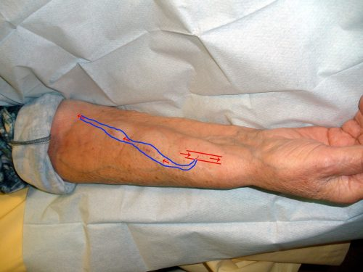
A-V fistula:
Arteriovenous fistula.

Slide 10
The Neck and Face
Assess the jugular venous pressure (JVP):
Affected by fluid status and contractility of the heart
Allow patient to relax their head back onto the pillow and turn head to left
Look between the two heads of the sternocleidomastoid for the double peak of the JVP:
If unsure between carotid pulse and JVP, press gently over the region; if the pulsations disappear, likely to be JVP
Measure vertically upwards from the sternal angle.
A swollen or puffy eyelid ( Nephrotic syndrome).
Assess the patients eyes:
Check for corneal arcus or xanthalasma, both signs of hyperlipidaemia (seen in nephrotic syndrome).
Ask the patient to pull their eyelid down:
Assess for pale conjunctivae (suggests possible anaemia).
Ask the patient to put their tongue out:
Assess the moistness of the mucous membranes (Dehydration).
uremic fetor ( Ammonia) (urine-like odor).

Slide 11
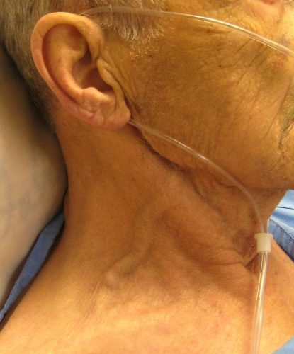
Raised JVP

Slide 12
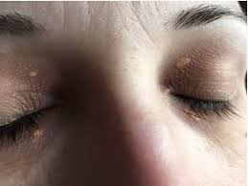
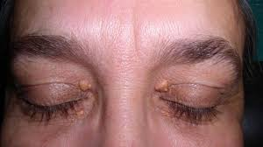

Slide 13
The Legs
Assess for peripheral oedema over the ankles
If this is to be properly assessed, one should place one finger in one place for at least 30 seconds.
Feel for any indentation.
If any peripheral oedema is found, move up the leg to assess level of oedema.

Slide 14
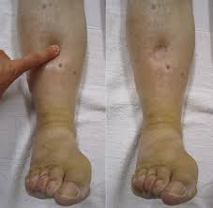

Slide 15
Abdomen
Lie the patient flat (if tolerated) and inspect the abdomen for :
Scars:
Nephrectomy scars in the flank or renal transplant scars (e.g. a Rutherford-Morrison scar) in the iliac fossa.
Peritoneal dialysis scars.
Evidence of distension or visible masses.
Retraction (sunken abdomen or scaphoid abdomen): as in dehydration .

Slide 16
Palpate the abdomen for
Tenderness in the 9 areas, specifically noting additionally at the renal angle and suprapubically for distended bladder
Ballot the kidneys
Place one hand under patient’s flank, pressing fingertips of other hand into the same flank from above
Feel any enlarged kidney between your fingers
Percuss the abdomen:
Check for evidence of ascites
If suspected, confirm by examining for shifting dullness & transmitted thrill.
Auscultate for renal bruits ( Harsh systolic murmur using the bell of the stethoscope) 1inch superior and lateral to the umbilicus.

Slide 18
The Chest and heart
Auscultate the heart:
Auscultate over the 4 valve areas for stenosis or murmurs:
Mitral regurgitation is more common in patients with polycystic kidney disease.
Listen for a pericardial rub (for potential cases of uraemic pericarditis).
Auscultate the lungs for evidence of any pulmonary oedema (Coarse crepitations) and uremic asthma ( Sibilant rhonchi).

Slide 19
Completing the Examination
Remember, if you have forgotten something important, you can go back and complete this.
Digital Rectal Examination (to assess the prostate)
Urine dipstick.
Fundoscopy (for any evidence diabetic or hypertensive retinopathy).

Slide 20
Renal examination movie:

