Slide 1
History Taking

Slide 2
Subjects
Main components of general history taking

Slide 3
Main components of history taking
Personal history
Chief complaint and its duration
History of the present illness HOPI
Review of systems
Past medical history
Past surgical history
Family history
Personal and social history
Occupational history
Drug and allergy history

Slide 4
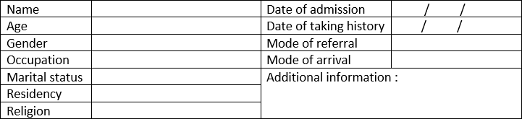
1. Personal history
It should include the following patient information

Slide 5
2. Chief complaint and its duration
Remember, it is the chief complaint, what brings the patient to seeking medical care and its duration, duration, duration, do not forget duration!!

Slide 6
2. Chief complaint and its duration
The chief complaint is preferable to be one single complaint but could be more than one.
Usually it is the nearer to the present time. For example, if someone developed cough he will not see his doctor, but if the cough is complicated later by seeing blood then he will visit his doctor. Then what brings the patient is the blood not the cough.

Slide 7
2. Chief complaint and its duration
The chief complaint is usually said in the patient own words
Don’t use diarrhea, instead write frequent bowel motion ….

Slide 8
3. History of the present illness
It includes
Analysis of the chief complaint.
Analysis of the associated symptoms.
Analysis of other symptoms of involved system.
Basic investigations done.
Progression since the day of admission (if he already had been admitted)
Post operative fluid intake, medications, passing of flatus and movement of patient.

Slide 9
Write
Our goal in this series is to
Complete & Highly organized
history of present illness
following the rules.

Slide 10
3. History of present illness
If the patient has already known disease, you should start your HOPI as
The patient is a known case of -------- Who presented with .....
(HTN, DM, Asthma, TB, ….etc)

Slide 11
3. History of present illness
Analyzing of a symptom means talking about all the clinical clues regarding the symptoms that will help us to reach a diagnosis.
Like, Diarrhea Onset? – Characterestics? – Amount? – Color? …. Etc.
We will learn how to analyze exactly each symptoms in next lectures ….

Slide 12
4. Review of systems (ROS)
Why review of systems ?
To know how is the patients overall wellbeing, what systems are involved, possibly involved, may be involved or not involved at all.
In ROS, we ask the patient about specific symptoms of each body systems.

Slide 13
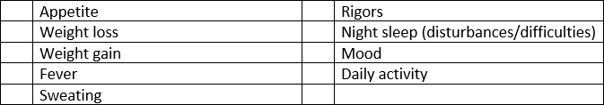
4. Review of systems (ROS)
General

Slide 14

4. Review of systems (ROS)
Cardiovascular system

Slide 15
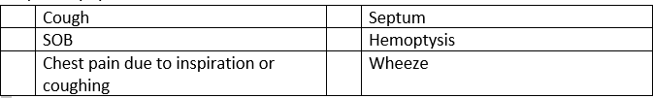
4. Review of systems (ROS)
Respiratory system

Slide 16
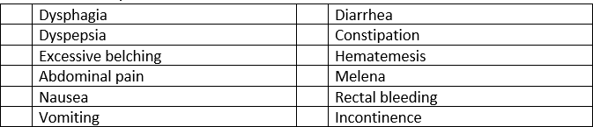
4. Review of systems (ROS)
Gastrointestinal system

Slide 17
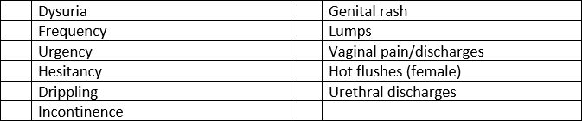
4. Review of systems (ROS)
Genitourinary tract

Slide 18
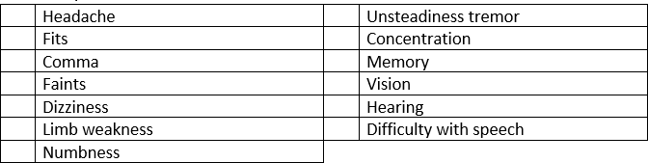
4. Review of systems (ROS)
Nervous system

Slide 19
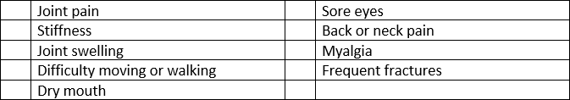
4. Review of systems (ROS)
Musculoskeletal system

Slide 20
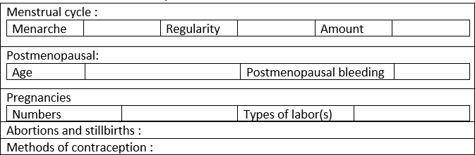
4. Review of systems (ROS)
Menstrual & obestetric history

Slide 21

4. Review of systems (ROS)
Endocrine system

Slide 22
4. Review of systems (ROS)
Hematological

Slide 23
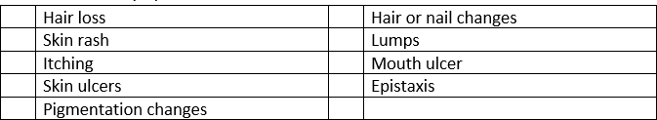
4. Review of systems (ROS)
Mucocutaneous system

Slide 24
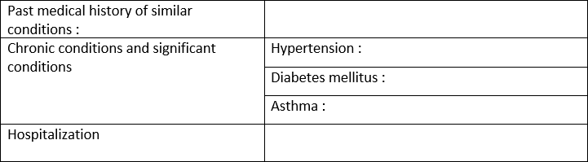
5. Past medical history

Slide 25

6. Past surgical history

Slide 26
7. Family history

Slide 27
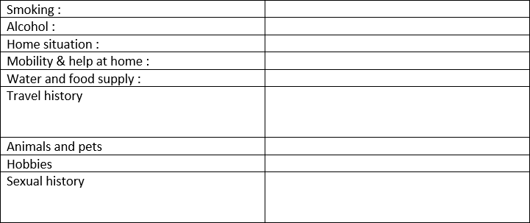
8. Personal and social history

Slide 28
9. occupational history
What did the patient working now?
OR
What he did used to work in the past?

Slide 29
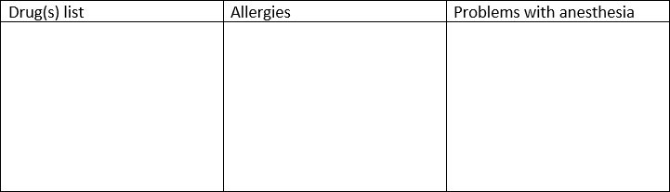
10. Drugs and allergy history

Slide 30
Thank You

