Slide 1

Endocrinology Examination
(Thyroid)
By
Dr. Areej Alkhateeb
Assistant Lecturer of Internal Medicine and Cardiology
Department of Internal Medicine
Faculty of Medicine, South Valley University

Slide 2
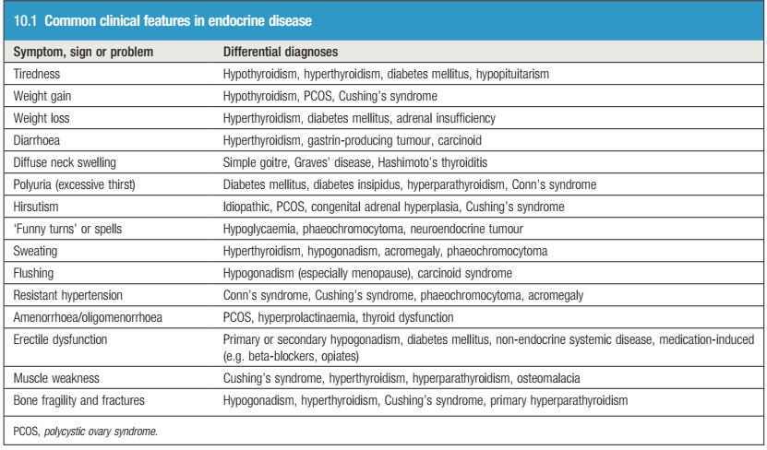
The common clinical features in Endocrine System
Macleod’s Clinical examination book (2018)

Slide 3
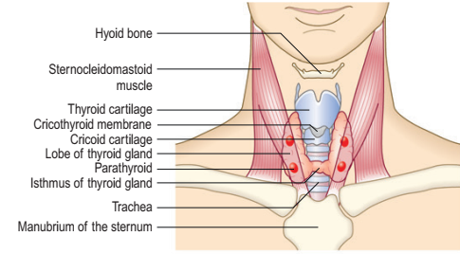
Anatomy Of The Thyroid
Macleod’s Clinical examination book (2018)

Slide 4
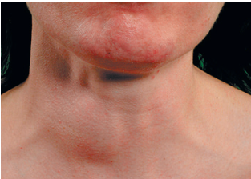
Hyperthyroidism
It is a clinical state of increased metabolism caused by elevated circulating levels of thyroid hormones.
Classification of hyperthyroidism:
Simple goitre:
Physiological, Colloidal, Simple Nodular Goitre (SNG)
Toxic goitre:
Diffuse toxic goitre = Grave’s (autoimmune disease)
Toxic multinodular goitre mainly due to iodine deficiency.
Neoplastic:
Benign and Malignant
Inflammation:
Hashimoto’s thyroiditis.
5. Congenital cretenoid goitre
Macleod’s Clinical examination book (2018)

Slide 5
History, Symptoms and Signs
Mostly toxic goitre at middle age, malignancy >50yrs, SNG at any age
Common symptoms:
1. Neck swelling+/- pain
2. Pressure symptoms (dyspnoea, dysphagia,
hoarseness of voice)
3. Systemic symptoms ( weight loss in spite of good appetite, intolerance to heat, palpitation, polyphagia, tremors, menstrual disturbance)
4. Malignant manifestation (rapidly growing painful swelling)

Slide 6
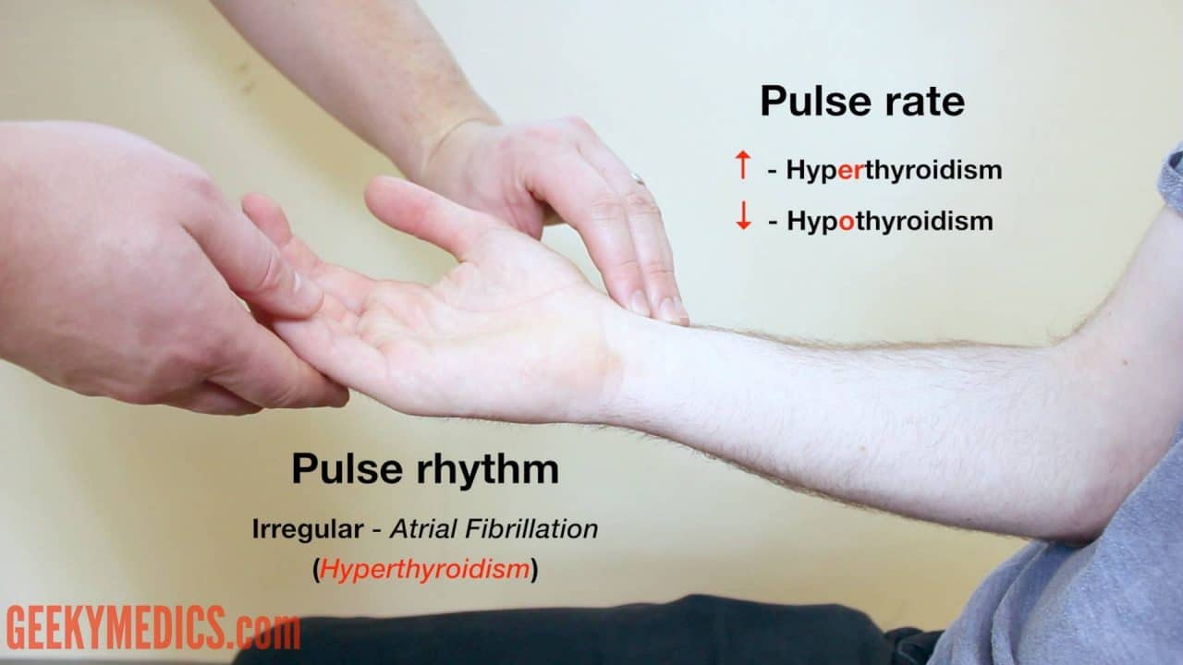
Examination
General examination include changes
in vital signs:
Temp with toxic goitre
HR, regular or irregular, large volume
(water hummer pulse).
Wide pulse pressure.
Cachexia in malignancy
Underbuilt and irritability
HF signs (orthopnoea)

Slide 7
Special examination of:
Hands
Eyes
Neck

Slide 8
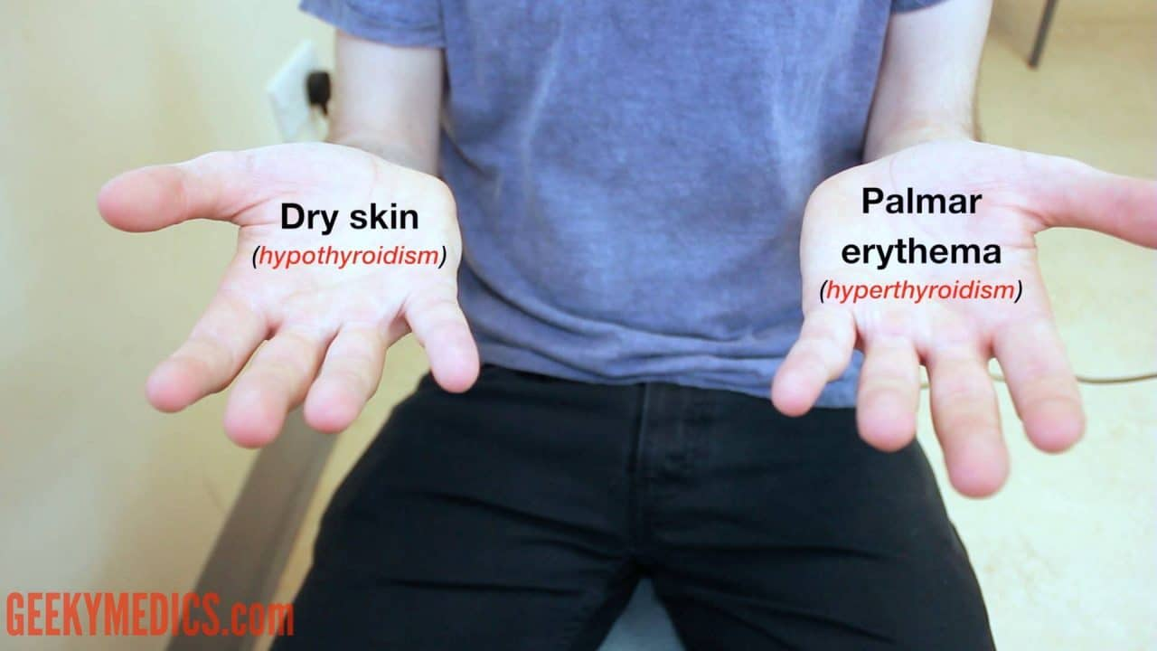
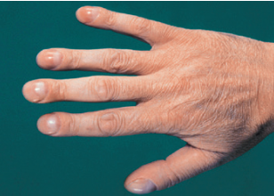
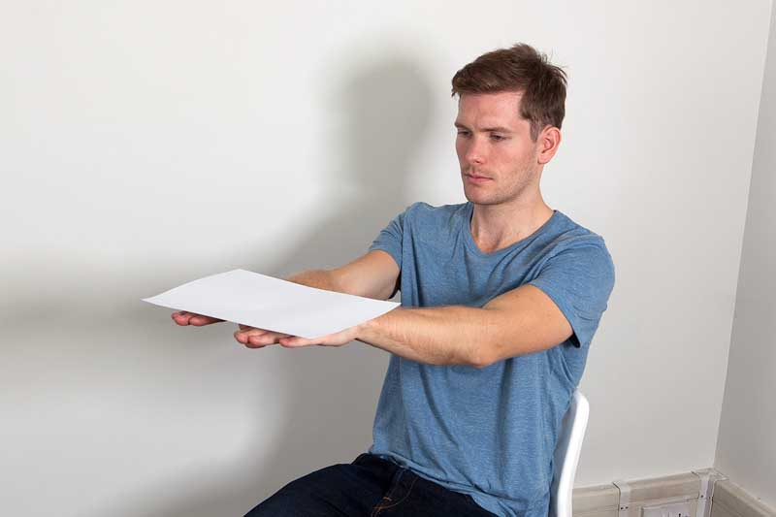
Hands
Thyroid acropachy with Grave’s (clubbing)
Fine tremors with +ve hand paper test

Slide 9
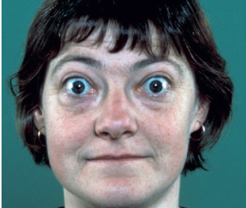
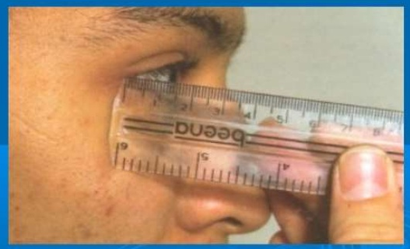
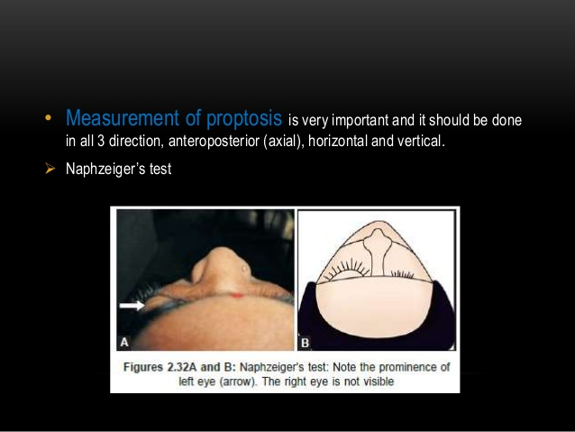
Eye Examination
Exophthalmos (proptosis), is specific to Graves’
disease, and it technically refers to the visibility of
the sclera above the lower eyelid.
Tests of exophthalmos: Naffziger, Frazer’s and Ruler tests.
Macleod’s Clinical examination book (2018)

Slide 10
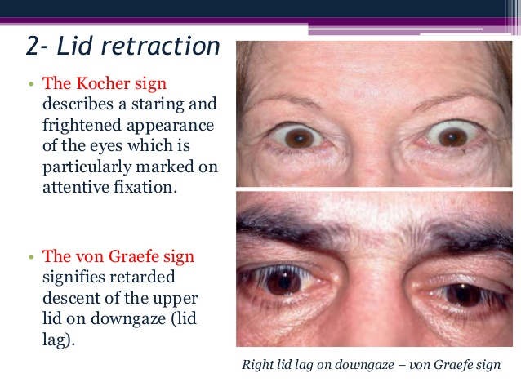
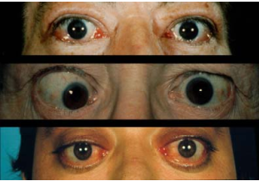
Stellwag’s sign: infrequent blinking (Normally= 5-8times/min)
Lid retraction is due to sympathetic stimulation of
the smooth muscle component of levator palpebrae
superioris.
Periorbital oedema and
Conjunctival oedema (chemosis).
THEJCE.com (2007)

Slide 11
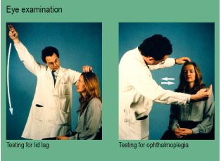
Eye tests:
Von Graefe’s sign: upper eye lid lags when moving eye downwards with fixed head.
Mobius sign: lack of convergence on looking near object due to weakness of medial recti muscle.
THEJCE.com (2007)

Slide 12
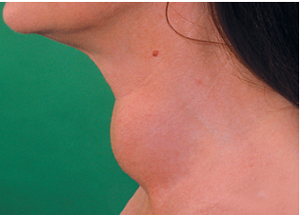
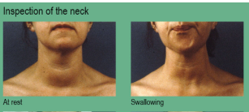
Neck Examination
By inspection:
Ask patient to swallowing water and comment on (6S):
Site; lower part of front of neck
Shape; diffuse (butterfly) or localized
Size; (cmX cm)
Surface; smooth (1ry toxic), nodular (2ry toxic or SNG), irregular (Malignancy)
Skin over; dilated veins (retrosternal goitre), scar of thyroidectomy, redness (inflammation), infiltration (malignancy)
Special signs: pulsation (upper pole pulsation with 1ry toxic; or transmitted from carotid artery), move up and down, lower edge, deep structure, draining LN
THEJCE.com (2007)

Slide 13
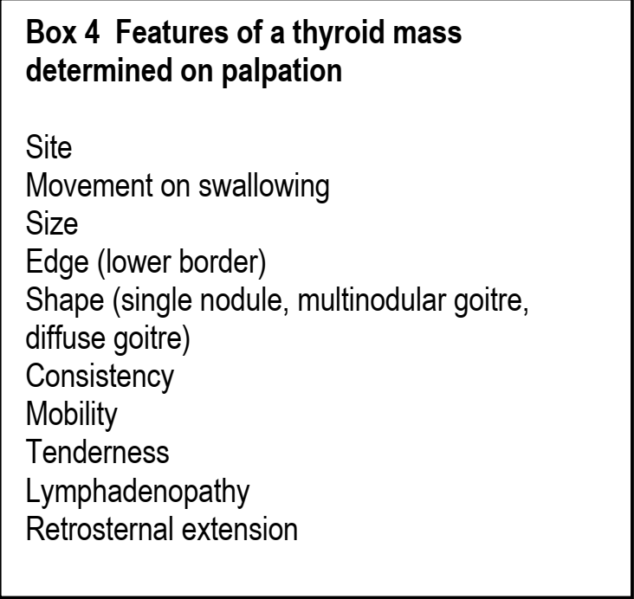
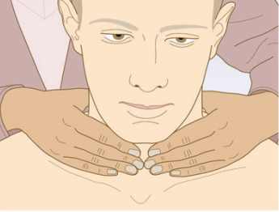
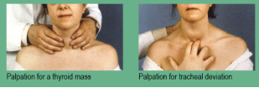
Neck palpation
Classic method from behind the patient:
With flexion of neck and slightly tilt the head laterally and press by one hand over one lobe and feel the other lobe by other hand, then comment on the (6S).
Palpation of tracheal deviation.
THEJCE.com (2007)

Slide 14
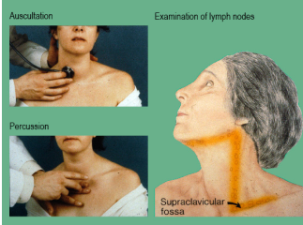
Neck percussion and auscultation
Direct percussion on manubrium sterni is normally resonant (if dull= retrosternal goitre).
Auscultation: a systolic murmur may be heard over upper pole (thyroid bruit commonly with 1 ry toxic goitre).
Draining LNs: upper and lower deep cervical LNs.
THEJCE.com (2007)

Slide 15
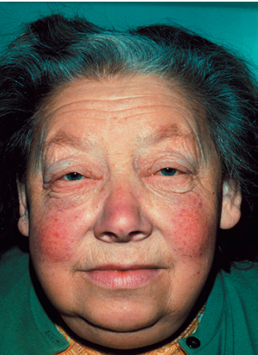
Hypothyroidism
Hypothyroidism is caused by reduced levels of thyroid hormones.
It is usually due to autoimmune Hashimoto’s thyroiditis, and affects women approximately six times more commonly than men.
Most other causes are iatrogenic and include previous radioiodine therapy or surgery for Graves’ disease.
Macleod’s Clinical examination book (2018)

Slide 16
History, Symptoms and Signs
History of drug intake or thyroidectomy or radioactive iodine
Symptoms mainly:
Intolerance to cold, weight gain, HTN, hypoglycaemia, tiredness and weakness, apathy, constipation, menorrhagia and gynecomastia.
Signs:
Temperature
HR
BP
Puffy eyes due to periorbital oedema, loss of outer 1/3 of eye brow hair and xanthelasma.
Pallor due to: Anaemia, myxedematous deposition
Pseudo macroglossia (thick protruded tongue)
Husky voice due to myxedematous deposition on vocal cord.

Slide 17
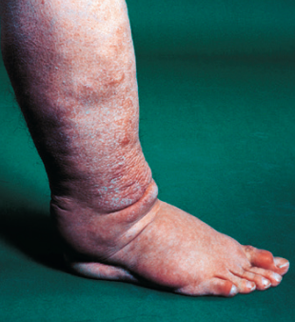
Upper and Lower Limbs: Non pitting oedema due to intradermal accumulation of proteins.
Skin changes: Dry, cold, thickened, non- sweaty skin with yellowish discoloration due to carotenemia or pallor. Vitiligo with autoimmune types. Thick nails with spared hair.
Neck: Scar of previous thyroidectomy or
Firm, diffusely enlarged as with Hashimoto’s or
Decreased in size with idiopathic atrophy.
CVS: Cardiomegaly or pericardial effusion.
CNS: Apathy, depression, slurred speech, hyporeflexia, proximal myopathy, peripheral neuritis and conductive deafness due to myxomatous deposition on auditory canal.
Macleod’s Clinical examination book (2018)

Slide 18
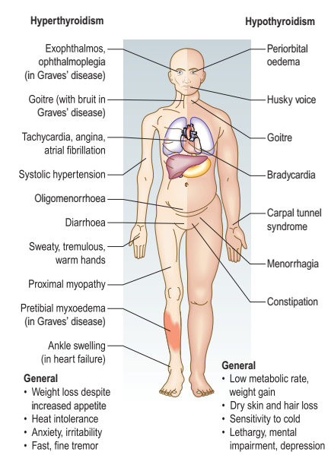
Main Features of Hypo and Hyper-thyroidism
Macleod’s Clinical examination book (2018)

Slide 19
Some YouTube videos may be helpful
https://www.youtube.com/watch?v=RfmO9k9neWM
https://www.youtube.com/watch?v=ziaYBkgEZNU
https://www.youtube.com/watch?v=2fgozmrRnQE

Slide 20
Thank You

