Slide 1
Congenital Diseases of the larynx
_

Slide 2
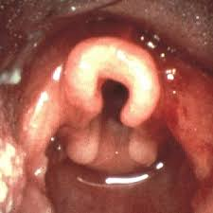
Laryngomalacia

Slide 3
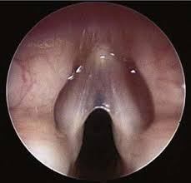
Laryngeal web

Slide 4
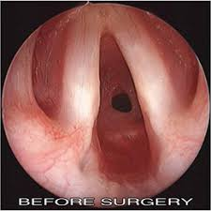
laryngeal subglottic stenosis

Slide 5
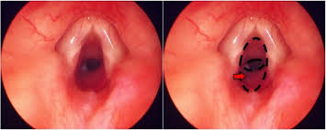
laryngeal subglottic haemangioma

Slide 6
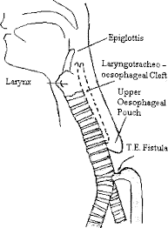
laryngo-tracheo-oesophageadeft:

Slide 7
Laryngeal Trauma

Slide 8
Types of Trauma:
1- Mechanical:
a) Surgical:y
b) Accidental:
2- Physical:
-Radiotherapy (Irradiation perichondritis).
-Hot steam inhalation.
3- Chemical:

Slide 9
FB inhalation
Comlete closure
Incomplete closure

Slide 10
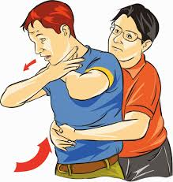
heimlich maneuver

