Slide 1
Adrenal Gland disorders
By
Dr. Areej Alkhateeb
Assistant Lecturer of Internal Medicine and Cardiology
Department of Internal Medicine
Faculty of Medicine, South Valley University

Slide 2
Adrenal cortex
Adrenal medulla
Anatomy and physiology The adrenals are small, pyramidal organs lying immediately above the kidneys on their posteromedial surface. The adrenal medulla is part of the sympathetic nervous system and secretes catecholamines. The adrenal cortex secretes cortisol (a glucocorticoid), mineralocorticoids and androgens.

Slide 3
Adrenal cortex
Physiology:
The adrenal cortex produces steroids:
Glucocorticoids (eg cortisol),which affect carbohydrate, lipid, and protein metabolism.
Mineralocorticoids, which control sodium and potassium balance (eg aldosterone).
Androgens, sex hormones which have weak effect until peripheral conversion to testosterone and dihydrotestosterone.
Corticotropin-releasing factor (CRF) from the hypothalamus stimulates adrenocorticotropic hormone (ACTH) secretion from the pituitary, which in turn stimulates cortisol and androgen production by the adrenal cortex. Cortisol is excreted as urinary free cortisol and various 17-oxogenic steroids.

Slide 4
Cushing’s syndrome
This is the clinical state produced by chronic glucocorticoid excess + loss of the normal feedback mechanisms of the hypothalamo–pituitary–adrenal axis and loss of circadian rhythm of cortisol secretion (normally highest on waking).
The chief cause is oral steroids. Endogenous causes are rare: 80% are due to ACTH; of these a pituitary adenoma is the commonest cause.

Slide 5
ACTH-dependent causes (ACTH)
• Cushing’s disease: Bilateral adrenal cortex hyperplasia from an ACTH-secreting pituitary adenoma (usually a microadenoma). F:M>1:1. Peak age: 30–50yrs. • Ectopic ACTH production: Especially small cell lung cancer and carcinoid tumours. Specific features: pigmentation (due to ACTH), hypokalaemic metabolic alkalosis ( cortisol leads to mineralocorticoid activity), weight loss, hyperglycaemia. Classical features of Cushing’s are often absent.
Rarely, ectopic CRF production: Some thyroid (medullary) and prostate cancers.

Slide 6
ACTH-independent causes ( ACTH due to -ve feedback)
• Iatrogenic: Pharmacological doses of steroids (common). • Adrenal adenoma/cancer: May cause abdo pain ± virilization in female. • Adrenal nodular hyperplasia: It is similar to adrenal adenoma. • Rarely: Carney complex, McCune–Albright syndrome.

Slide 7
Symptoms: Weight; mood change (depression, lethargy, irritability, psychosis); proximal weakness; gonadal dysfunction (irregular menses; hirsutism; erectile dysfunction); acne; recurrent Achilles tendon rupture; occasionally virilization if female.
Signs: Central obesity; plethoric, moon face; buffalo hump; supraclavicular fat distribution; skin & muscle atrophy; bruises; purple abdominal striae; osteoporosis; BP; glucose; infection-prone; poor healing. Signs of the cause (eg abdominal mass).
Tests: 24hrs urinary free cortisol is a very useful screening method of outpatient, while for diagnosis are the following tests:

Slide 8
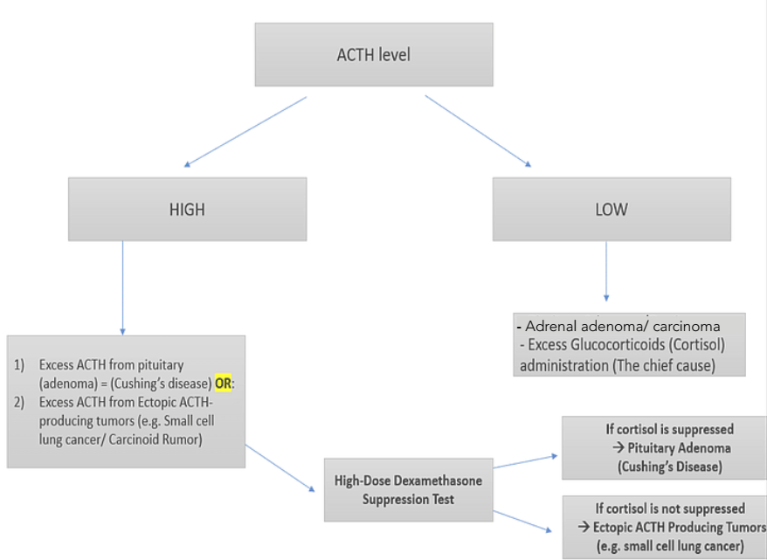

Slide 10
Treatment: Depends on the cause. • Iatrogenic: Stop medications if possible. • Cushing’s disease: Selective removal of pituitary adenoma (trans-sphenoidally). Bilateral adrenalectomy if source unlocatable, or recurrence post-op or complication. • Adrenal adenoma or carcinoma: Adrenalectomy: ‘cures’ adenomas but rarely cures cancer. Radiotherapy & adrenolytic drugs follow up if carcinoma. • Ectopic ACTH: Surgery if tumour is located and hasn’t spread. Metyrapone, ketoconazole, and fluconazole cortisol secretion pre-op or if awaiting effects of radiation.

Slide 11
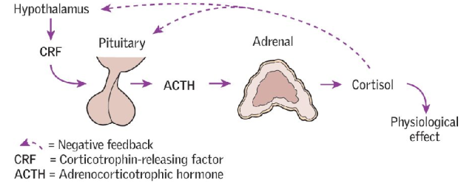
Adrenal insufficiency
Primary adrenocortical insufficiency (Addison’s disease) is rare, but can be fatal. Destruction of the adrenal cortex leads to glucocorticoid (cortisol) and mineralocorticoid (aldosterone) deficiency.
Signs: It is a vague condition. It might be misdiagnosed as viral infection or anorexia nervosa in features.
Physiology:
X

Slide 12
Causes: autoimmun, TB (commonest cause worldwide), adrenal metastases (eg from lung, breast, renal cancer), lymphoma, opportunistic infections in HIV (eg CMV, Mycobacterium avium); adrenal haemorrhage (Antiphospholipid syndrome; SLE), congenital (late-onset congenital adrenal hyperplasia).
Secondary adrenal insufficiency The commonest cause is iatrogenic, due to long-term steroid therapy leading to suppression of the pituitary–adrenal axis. Other causes are rare and include hypothalamic–pituitary disease leading to ACTH production. Mineralocorticoid production remains intact, and there is no hyperpigmentation as in Addison’s disease.

Slide 13
Symptoms: Often diagnosed late: thin, tired, tearful ± weakness, anorexia, dizzy, faints, flu-like myalgias/arthralgias. Mood: depression, psychosis. GI: nausea/ vomiting, abdominal pain, diarrhoea/constipation. Think of Addison’s in all with unexplained abdominal pain or vomiting. Pigmented palmar creases & buccal mucosa ( ACTH; cross-reacts with melanin receptors). Postural hypotension. Vitiligo.
Signs of critical deterioration: Shock ( BP, tachycardia), T°, coma.

Slide 14
Tests: Na⁺& K⁺ (due to mineralocorticoid), glucose (due to cortisol). Also: uraemia, Ca²⁺ , eosinophilia, anaemia.
Short ACTH stimulation test: Do plasma cortisol before and ½h after synthetic ACTH molecule IM (Tetracosactide). Addison’s is excluded if 30min cortisol >550nmol/L. Steroid drugs may interfere with assays.
ACTH serum level: In Addison’s, 9AM ACTH is (>300ng/L: inappropriately high). It is low in secondary causes.
21-Hydroxylase adrenal autoantibodies: +ve in autoimmune disease.
Plasma renin & aldosterone: to assess mineralocortocoid status.
Chest-XR/Abd-XR: Any past TB, eg upper zone fibrosis of lung or adrenal calcification. Abdominal CT for TB, histoplasma, or metastatic disease.

Slide 15
Treatment:
For Addisonian crisis (shocked): Replace steroids: ~15–25mg hydrocortisone daily, in 2–3 doses.
Mineralocorticoids to correct postural hypotension, Na⁺, K⁺: fludrocortisone PO from 50–200mcg daily. If there is a poor response, suspect an associated autoimmune disease.
Steroid use: Add 5–10mg hydrocortisone to daily intake before strenuous activity/exercise. Double steroids in febrile illness, injury, or stress. Give out IM in case of vomiting. Avoid abrupt withdrawal.
Follow-up: Yearly (BP, U&E); watch for autoimmune diseases (pernicious anaemia).

Slide 16
Hyperaldosteronism
Primary hyperaldosteronism:
Excess production of aldosterone, independent of the renin–angiotensin system, causing sodium and water retention, and renin release. Consider if: hypertension, hypokalaemia, or alkalosis in someone not on diuretics. Sodium tends to be mildly raised or normal. Symptoms: Often asymptomatic or signs of hypokalaemia: weakness (even quadriparesis), cramps, paraesthesiae, polyuria, polydipsia. BP but not always.
Causes: ~ ⅔ due to a solitary aldosterone-producing adenoma (linked to mutations in K⁺ channels) —Conn’s syndrome. ~⅓ due to bilateral adrenocortical hyperplasia. Rare causes: adrenal carcinoma; or glucocorticoid-remediable aldosteronism (GRA)—the ACTH regulatory element of the 11ᵦ-hydroxylase gene fuses to the aldosterone synthase gene, aldosterone production, & bringing it under the control of ACTH.

Slide 17
Tests: U&E, renin and aldosterone, and adrenal vein sampling. Do not rely on a low K⁺, as >20% are normokalaemic. For GRA (suspect if there is a family history of early hypertension), genetic testing is available.
Treatment: Conn’s: laparoscopic adrenalectomy. Spironolactone (antimineralocorticoid; 25–100mg/24h PO) for 4wks pre-op controls BP and K⁺.
•Hyperplasia: treated medically: spironolactone or amiloride. •GRA: dexamethasone 1mg/24h PO for 4wks, normalizes biochemistry but not always BP. If BP is still , use spironolactone as an alternative.
•Adrenal carcinoma: surgery ± post-operative adrenolytic therapy with mitotane—prognosis is poor.

Slide 18
• Secondary hyperaldosteronism:
Due to a high renin from renal perfusion, eg in renal artery stenosis, accelerated hypertension, diuretics, congestive cardiac failure or hepatic failure.
• Bartter’s syndrome:
This is a major cause of congenital (autosomal recessive) salt wasting—via a sodium and chloride leak in the loop of Henle via mutations in channels and transporters. Presents in childhood with failure to thrive, polyuria, and polydipsia. BP is normal. Sodium loss leads to volume depletion, causing renin and aldosterone production, leading to hypokalaemia and metabolic alkalosis, urinary K⁺ and Cl⁻. Treatment: K⁺ replacement, NSAIDS (to inhibit prostaglandins), and ACE-i.

Slide 19
Phaeochromocytoma
Neuroendocrine tumour of the adrenal medulla and originates from the chromaffin cells along the paravertebral sympathetic chain extending from pelvis to base of skull. Mainly are abdominal (>95%) and >90% in adrenal medulla. Secretes excessive amounts of catecholamines (adrenaline and noradrenaline) and its metabolites (metanephrine), which act on the adrenergic receptors (alpha and beta).
Phaeochromocytomas roughly follow the 10% rule: 10% are malignant, 10% are extra-adrenal, 10% are bilateral, and 10% are familial.
Recent data suggest higher incidence in patients with genetic mutations affecting several genes including SDH (succinyl dehydrogenase). A dangerous but treatable cause of 2ry hypertension. About 10% are part of hereditary cancer syndromes, eg thyroid, MEN-2A and 2B, neurofibromatosis, von Hippel–Lindau syndrome (SDH mutations).

Slide 20
Adrenergic Receptors
Alpha-Adrenergic Receptors
α1: vasoconstriction, intestinal relaxation, uterine contraction, pupillary dilation
α2: ↓ presynaptic NE (clonidine), platelet aggregation, vasoconstriction, ↓ insulin secretion
Beta-Adrenergic Receptors
β1: ↑ HR/contractility, ↑ lipolysis, ↑ renin secretion
β2: vasodilation, bronchodilation, ↑ glycogenolysis
β3: ↑ lipolysis, ↑ brown fat thermogenesis

Slide 21
Classic triad: Episodic headache, sweating, tachycardia and hypertension.
Tests:
•Biochemical: 24h urine for metanephrines/metadrenaline (better than catecholamines and vanillylmandelic acid), WCC.
•Localization: Abdominal CT/MRI, or metaiodobenzylguanidine (MIBG; chromaffin-seeking isotope) scan (can find extra-adrenal tumours).

Slide 22
Treatment:
Surgery: α-blockade pre-op: phenoxybenzamine (α-blocker) is used before β-blocker to avoid crisis from unopposed α –adrenergic stimulation, β-block too if heart disease or tachycardic.
Post-op: Do 24h urine metanephrine 2wks post-op, monitor BP (risk of BP). Emergency: If malignant; chemotherapy or therapeutic radiolabelled MIBG may be used.
Follow-up: Lifelong: malignant recurrence may present late, genetic screening.

Slide 24
Hirsutism, virilism, gynaecomastia and hypogonadism
Hirsutism: is common (10% of women) and usually benign. It implies male pattern hair growth in women. Causes are familial, idiopathic, or are due to increased androgen secretion by the ovary (eg polycystic ovarian syndrome, ovarian cancer), the adrenal gland (eg late-onset congenital adrenal hyperplasia, Cushing’s syndrome, adrenal cancer), or drugs (eg steroids). Polycystic ovarian syndrome (PCOS) causes secondary oligo - or amenorrhoea, infertility, obesity, acne, and hirsutism. Blood tests: testosterone, LH:FSH ratio. Treatment: Oestrogens, Metformin and Clomifene.
Virilism: Onset of amenorrhoea, clitoromegaly, deep voice, temporal hair recession + hirsutism. Look for an androgen-secreting adrenal or ovarian tumour.

Slide 25
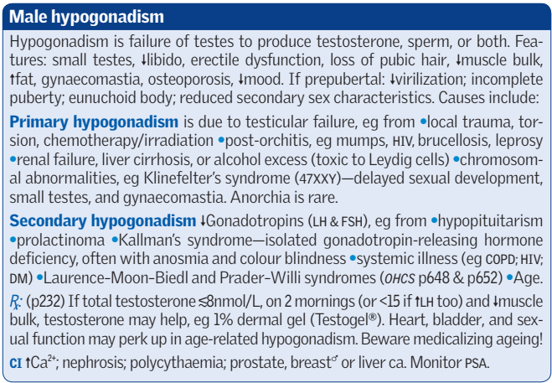
Gynaecomastia: It is abnormal amount of breast tissue in men; may occur in normal puberty. Oestrogen/androgen ratio (vs galactorrhoea in which prolactin is increased). Causes: Hypogonadism (1ry or 2ry), liver cirrhosis, drugs: oestrogens, spironolactone, digoxin, consider testosterone if hypogonadism ± antioestrogen (tamoxifen).

Slide 26
Thank You

