Slide 1
Psychiatric disorders
Dr Mohamed Moslem Al-Hefny

Slide 2
I - Psychotic Disorders

Slide 3
Psychotic Disorders
Psychotic = Delusions + Hallucinations
Brief psychotic disorder (>1m)
Shizophreniform disorder (>6m)
Schizophrenia (<6m)

Slide 4
Schizophrenia - Diagnostic Criteria
Characteristic symptoms: Two (or more) of the following, each present for a significant portion of time during a 1-month period (or less if successfully treated):
  delusions
  hallucinations
  disorganized speech (e.g., frequent derailment or incoherence)
  grossly disorganized or catatonic behavior
  negative symptoms, i.e., affective flattening, alogia, or avolition
Note: Only one Criterion A symptom is required if delusions are bizarre or hallucinations consist of a voice keeping up a running commentary on the person's behavior or thoughts, or two or more voices conversing with each other.

Slide 5
Schizophrenia - Diagnostic Criteria
Duration: Continuous signs of the disturbance persist for at least 6 months. This 6-month period must include at least 1 month of symptoms (or less if successfully treated) that meet Criterion A (i.e., active-phase symptoms) and may include periods of prodromal or residual symptoms.

Slide 6
Schizophrenia - Diagnostic Criteria
Schizoaffective and mood disorder exclusion.
Substance/general medical condition exclusion.
Social/occupational dysfunction

Slide 7
Schizophrenia - Types
Subtypes of schizophrenia
Paranoid
Disorganized
Catatonic
Undifferentiated
Residual

Slide 8
Schizophrenia - Types
Paranoid type
Preoccupation with one or more delusions or frequent auditory hallucinations.
None of the following is prominent: disorganized speech, disorganized or catatonic behavior, or flat or inappropriate affect.

Slide 9
Schizophrenia - Types
Disorganized type
All of the following are prominent:
  disorganized speech
  disorganized behavior
  flat or inappropriate affect
The criteria are not met for catatonic type.

Slide 10
Schizophrenia - Types
Catatonic type
motoric immobility as evidenced by catalepsy (including waxy flexibility) or stupor
excessive motor activity (that is apparently purposeless and not influenced by external stimuli)
extreme negativism (an apparently motiveless resistance to all instructions or maintenance of a rigid posture against attempts to be moved) or mutism
peculiarities of voluntary movement as evidenced by posturing (voluntary assumption of inappropriate or bizarre postures), stereotyped movements, prominent mannerisms, or prominent grimacing
echolalia or echopraxia

Slide 11
Schizophrenia - Types
Undifferentiated type
A type of schizophrenia in which symptoms that meet Criterion A are present, but the criteria are not met for the paranoid, disorganized, or catatonic type.

Slide 12
Schizophrenia - Types
Residual type
Absence of prominent delusions, hallucinations, disorganized speech, and grossly disorganized or catatonic behavior.
The presence of negative symptoms or two or more symptoms listed in Criterion A for schizophrenia, present in an attenuated form (e.g., odd beliefs, unusual perceptual experiences).

Slide 13
Schizophrenia - Treatment
Biological therapies
Pharmacotherapy (antipsychotics)
First-generation antipsychotics (Haloperidol, Chlorpromazine, Trifluoperazine, Fluphenazine)
Second-generation antipsychotics (Aripiprazole, Clozapine, Olanzapine, Quetiapine, Risperidone, Sertindole , Ziprasidone)
Electroconvulsive therapy (ECT)
Psychosurgery
Psychosocial Therapies (psychotherapy)

Slide 14
Case Study

Slide 15
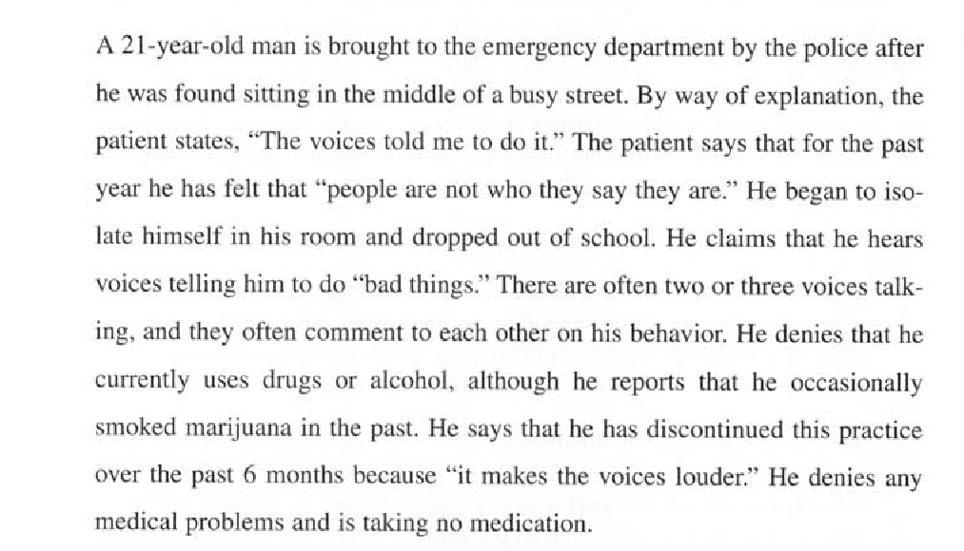

Slide 16
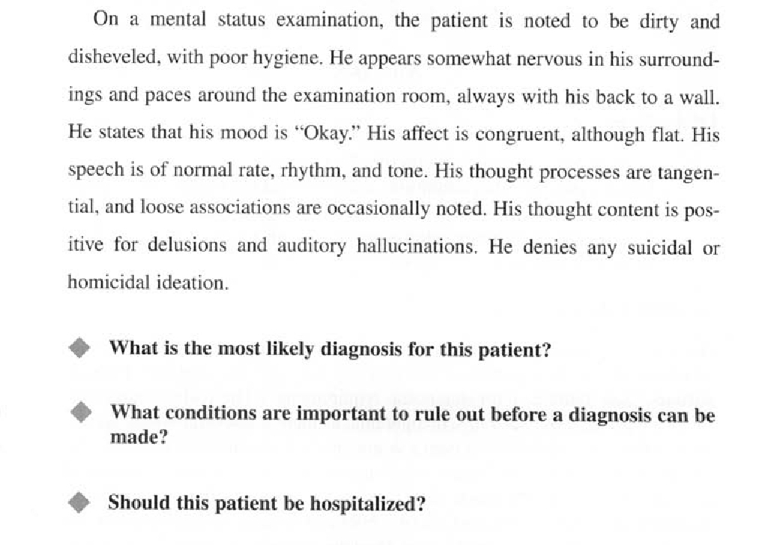

Slide 17
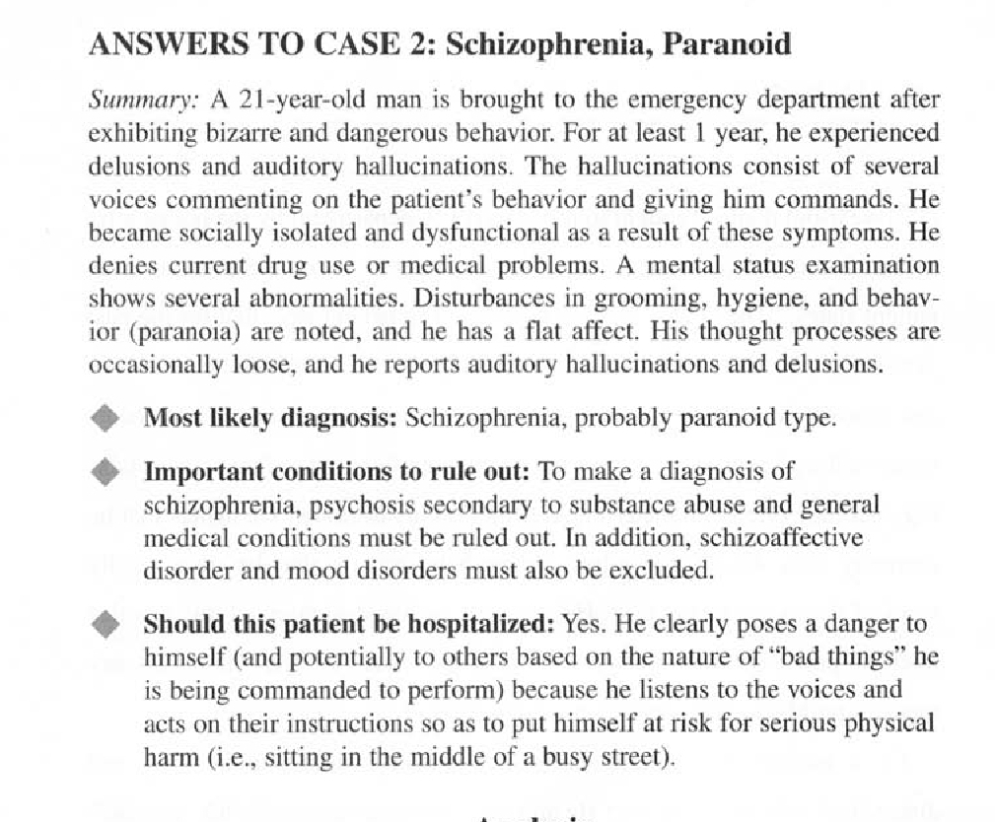

Slide 18
Thank You

