Slide 1
Radiology of theGeneral Abdomen and Pelvis

Slide 2
IMAGING MODALTIES OF GI T
PLAIN X – RAY
ULTRASOOUND
CT SCANNING
MRI
RADIOISOTOPE SCANNING
ANGIOGRAPHY
DOPPLER STUDIES
Barium studies

Slide 3
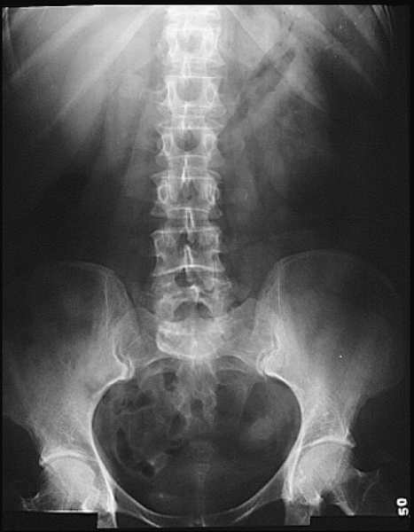

Slide 4
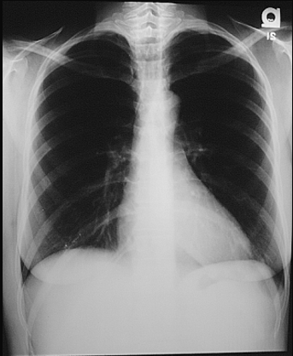

Slide 5
COMPUTED TOMOGRAPHY
Computed tomography (CT) is an excellent technique for evaluating the upper abdomen because of fast acquisition times, high spatial resolution, and mature contrast techniques.
a number of important technical considerations. These include slice thickness, interslice gap, acquisition speed, table incrementation, volume and administration rate of intravenous contrast material, and scan delay. CT of the liver has traditionally been performed with 8 to 10 mm contiguous collimation (i.e., 10 x 10 mm). However, with the advent of spiral or helical scanners, it is now possible to obtain either 5-mm contiguous collimation or 10-mm contiguous collimation reconstructed with a 5-mm overlap (10 x 5 mm). Interslice gaps may increase the likelihood that small lesions (<5 mm) will not be detected. Many of these small lesions, however, will be benign cysts or hemangiomas even if the patient has a known malignancy

Slide 6
Scanning without the use of contrast material is the simplest but least informative method of performing CT of the liver.
Normal liver parenchyma has an attenuation of +55 to +65 HU owing primarily to the glycogen content.
By comparison, the spleen does not contain glycogen and is 8 to 10 HU less than the liver.
Hepatic tumors, unless well-differentiated primary neoplasms, do not contain glycogen; therefore they are hypoattenuating relative to normal parenchyma. The difference in attenuation between parenchyma and tumor,

Slide 7
9
CT of the liver can be performed without or with contrast material.
If enhancement with contrast material is indicated, it can be achieved in a number of different ways. These include
dynamic sequential bolus iodine CT
delayed iodine CT,
and techniques that are invasive, such as CT angiography.

Slide 8
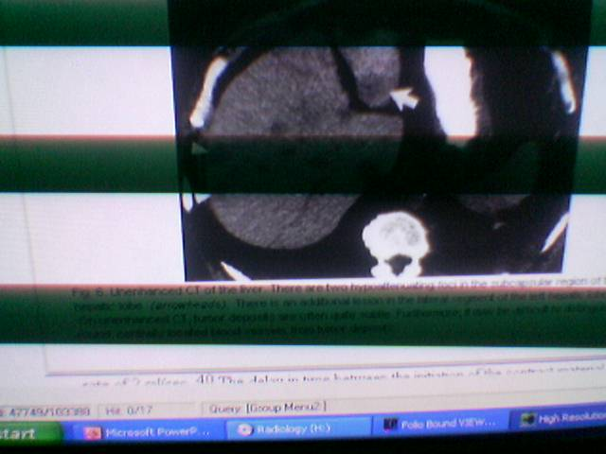

Slide 9
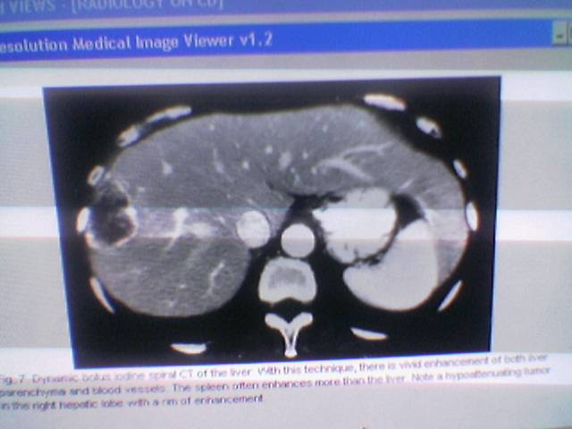

Slide 10
Doppler ultrasonography
Used in patients with cirrhosis and portal hypertension
and following liver transplantation.. Caution must be used in interpreting quantitative information since portal venous and hepatic arterial blood flow is quite variable related to patient dietary status, exercise status, position, and the phase of respiration.
Doppler ultrasonography has also been used to evaluate focal hepatic lesions. Characteristic high-velocity frequency shifts can be detected at the periphery of some malignant tumors, particularly hepatocellular carcinoma.

Slide 11
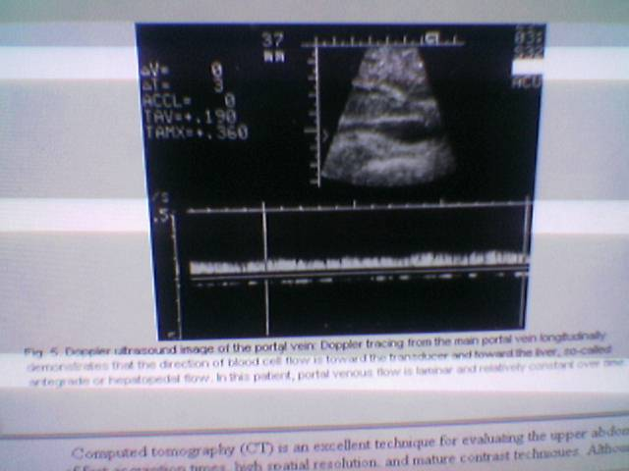

Slide 12
ULTRASONOGRAPHY
ultrasonography depends not only on the technical expertise of the individual manipulating the transducer but also on the patient habitus.. Both subcostal and intercostal scanning must be used for systematic evaluation of the entire liver.
In most patients, a transducer with a frequency on the order of 2 .5 to 3 .5 MHz will provide sufficient penetration.
In thinner patients or children, a 5 .0-MHz transducer may be used. The focal zone should be positioned between 7 and 11 cm and the depth of beam penetration should be 17 ± 1 2 cm.
The time-gain compensation curve should be adjusted so that the entire liver is of homogeneous echogenicity comparing the near and far fields

Slide 13
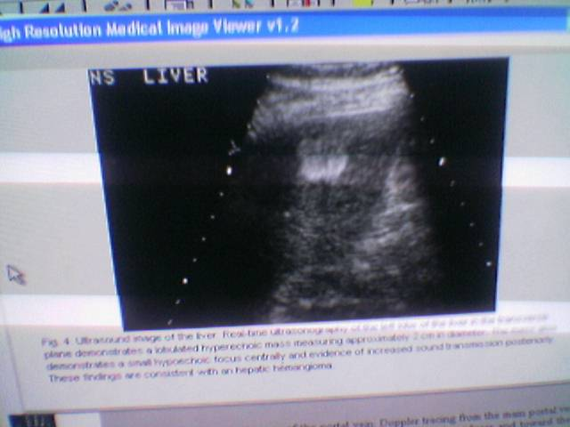

Slide 14
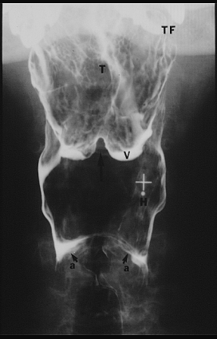

Slide 15
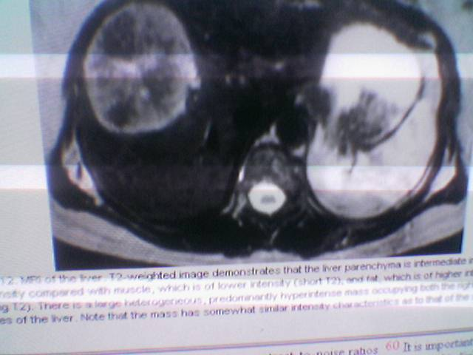

Slide 16
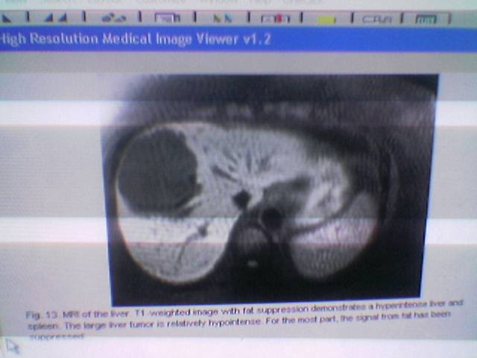

Slide 17
Technetium-99m sulfur colloid scintigraphy has been the hallmark of hepatocellular imaging.
This agent is phagocytized by the reticuloendothelial cells of the liver (Kupffer cells) and to a lesser extent by the spleen.
Focal tumor deposits in either of these organs will not contain normal reticuloendothelial cells and, therefore, will not take up the agent
As a result, tumors will appear as a negative or photopenic defect. The accuracy of this technique is roughly 85% ± 1 5%, depending on the author.
Drawbacks:
1-low sensitivity to those lesions deep within the hepatic parenchyma and those lesions smaller than 2 cm.
With single-photon emission computed tomography (SPECT), the sensitivity to lesions smaller than 2 cm is markedly improved.
2-The accuracy of radionuclide imaging for focal hepatic lesions, as with many imaging techniques, is lower in the presence of diffuse hepatic parenchyma disease.
Hepatocellular dysfunction is suggested when there is shift of the agent to nonhepatic organs such as the spleen and bone marrow. Several false-positive diagnoses can also be encountered.

Slide 18
Although the alimentary tract varies in structure and function from region to region, certain anatomic features are constant throughout the gut and their appreciation is helpful in understanding the variations and pathologic processes that may be superimposed.
the gut is a stratified tube that is organized into four layers mucosa, submucosa, muscularis propria, and either serosa or adventitia.
The mucosa consists of the surface epithelium, which also contains an array of lymphocytes, mast cells, and macrophages; an underlying layer of loose connective tissue containing blood vessels and nerves (lamina propria); and a thin layer of muscle (muscularis mucosae).

Slide 19
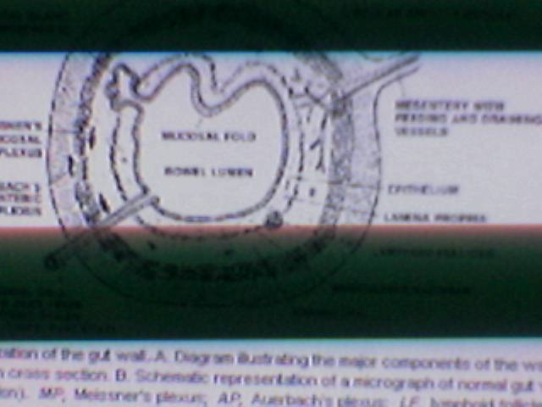

Slide 20
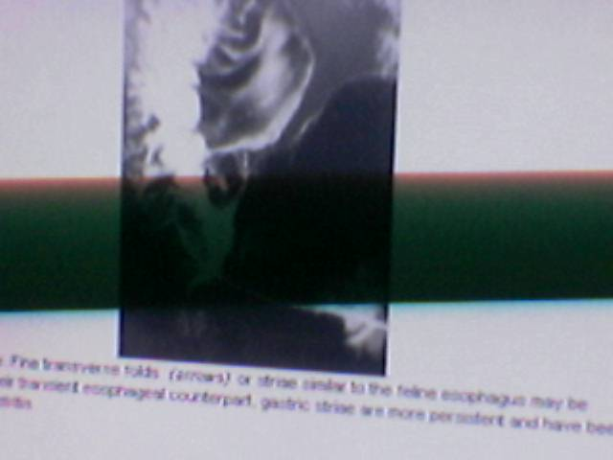
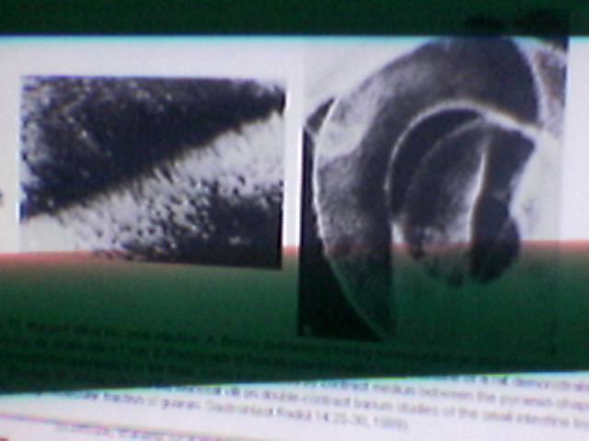

Slide 22
INTRAPERITONEAL COMPARTMENTS
The peritoneal cavity divided into several spaces where fluid is likely to collect.The configuration of these compartments is determined by peritoneal folds or ligaments and by adjacent organs.
, the right subphrenic space is separated from the posterior subhepatic space by the right coronary ligaments and bare area of liver . The left subphrenic space is separated from the lesser sac, medially by the left coronary ligament and laterally by the gastrosplenic fold

Slide 23
The superior recess of the lesser sac surrounds the anterior, medial, and posterior borders of the caudate lobe, whereas the epiploic foramen (of Winslow) lies inferior to the caudate process between the main portal vein and vena cava The lesser omentum separates the lesser sac posteriorly from the gastrohepatic space anteriorly, though these two compartments can communicate along the lateral free edge of the lesser omentum or directly through holes within these cobweblike peritoneal layers).

Slide 24
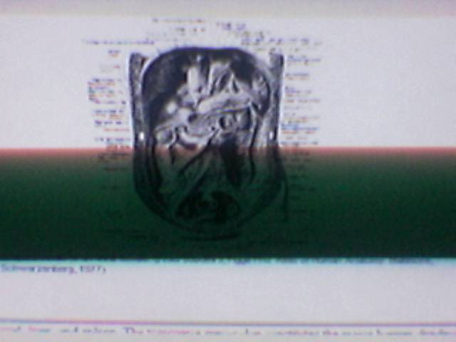

Slide 25
The transverse mesocolon constitutes the major barrier dividing the abdominal cavity into the supramesocolic and inframesocolic compartments.
The obliquely oriented root of the small bowel mesentery further divides the inframesocolic compartment into two spaces of unequal size: the smaller right infracolic space bounded inferiorly by the junction of the mesentery with the attachment of the ascending colon, and the larger left infracolic space, which is open anatomically toward the pelvis.

Slide 26
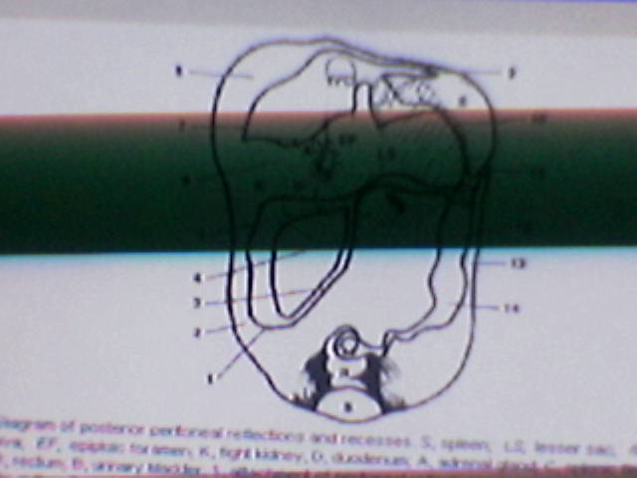

Slide 27
The pelvis is the most dependent part of the peritoneal cavity in both the supine and erect positions.
Its compartments include the midline culdesac or pouch of Douglas (rectovaginal pouch in the female and rectovesical pouch in the male) and the lateral paravesical recesses.
The pouch of Douglas is the most caudal and posterior part of the peritoneal cavity It is anatomically continuous with both paracolic gutters, the peritoneal recesses lateral to the ascending and descending colon. The right para-colic gutter is wide and deep and is continuous superiorly with the right subhepatic space and its posterosuperior extension deep to the liver, which is known surgically as Morison's pouch

Slide 28
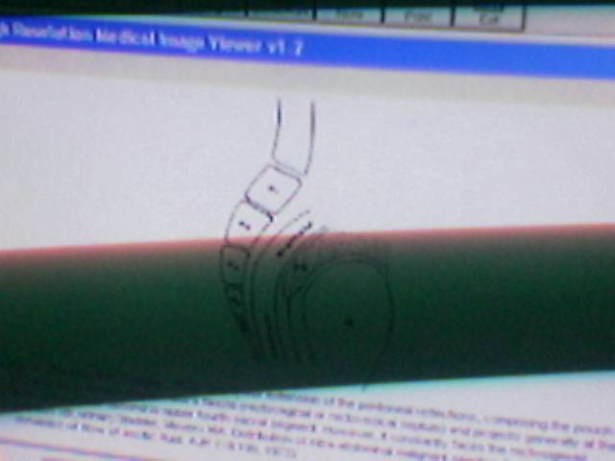

Slide 29
The liver is divided topographically into four lobes by three major fissures. The oblique fissure, or fissure for the gallbladder separates the right and left lobes.
The sagittal fissure, or fissure for ligamentum teres, divides the left lobe into lateral and medial segments.
The inferior portion of the left medial segment is known as the quadrate lobe,
The coronal fissure, or the fissure for ligamentum venosum, separates the caudate lobe from the more anterior medial and lateral segments of the left lobe.
The major fissures are important landmarks for locating liver lesions when segmental resection is planned.

Slide 30
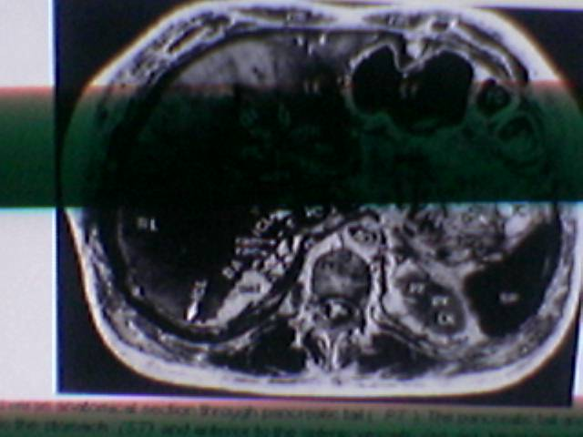

Slide 31
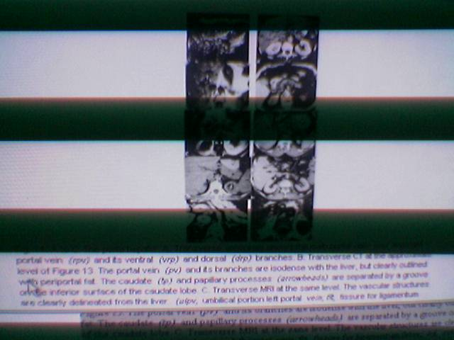

Slide 32
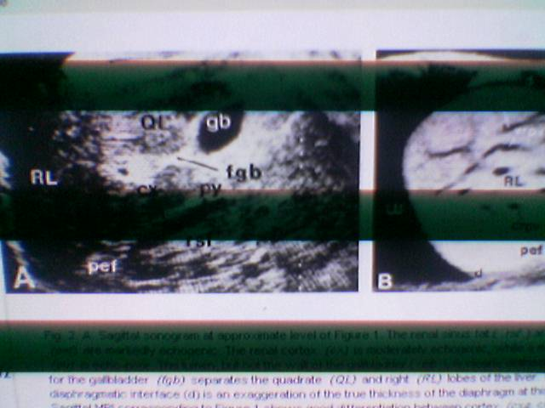

Slide 33
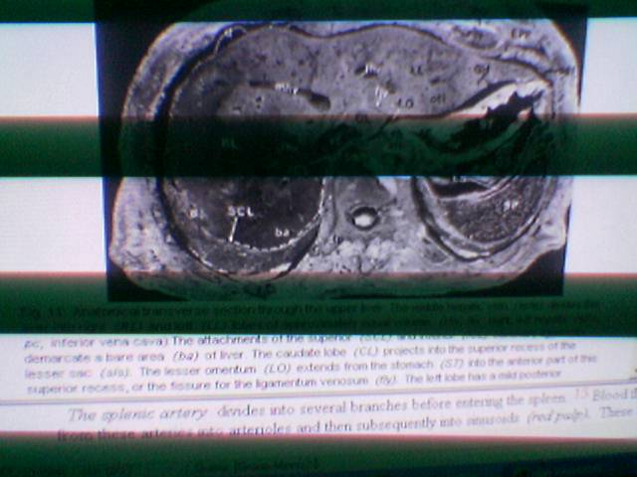

Slide 34
The right lobe of the liver is attached posterosuperiorly to the diaphragm by the right superior and inferior coronary ligaments, demarcating a bare area of posteromedial liver that is devoid of peritoneum .
In contrast, the left lobe is attached to the diaphragm by a single coronary ligament .
The right lobe may have a long posteroinferior extension or Reidel's lobe, which should not be mistaken for hepatomegaly.
At its interface with the right kidney, the right lobe has a posterior concavity of variable depth . Loss of this concavity may occur with right lobe enlargement or with absence or ptosis of the right kidney

Slide 35
lateral segment of the left lobe, referred to as"left lobe" in the illustrations, is the most variable portion of the liver. In asthenic individuals it appears elongated in transverse dimension with only a mild posterior convexity, and may curve around the anterior tip of the spleen
.

Slide 36
13. ( PT ). The pancreatic tail and body (PB) lie posterior to the stomach (ST) and anterior to the splenic vessels (sa, sv). Intrapancreatic vessels (pvl) traverse the pancreas in the interlobular sepia, between lobules of glandular tissue. (OTP, omental tuberosity of pancreatic body; sp, spleen; LS, lesser sac; GSL, gastrosplenic ligament; GO, LO, greater, lesser omentum; TC, distal transverse colon) The lateral segment of the left lobe (LL) is short in transverse diameter with a prominent omental tuberosity (OTL), The fissure for the ligamentum teres (flt) separates the lateral segment of the left lobe from the medial segment or \inferiorly) quadrate lobe (QL). (T, ligamentum teres; F, falciform ligament) The main portal vein (PV) branches into a large right branch (straight arrow) and a smaller left branch (curved arrow). (vrp, drp, ventral, dorsal branches of right portal vein; rip, ventral branch left portal vein to quadrate lobe; cd, common duct; rha, right hepatic artery) The caudate process of the liver (cp) extends between the portal vein and vena cava (VC) to connect the right lobe (RL) with the caudate lobe. The papillary process (pp) of the caudate lobe protrudes into the superior recess of the lesser sac (sls). The attachments of the inferior coronary ligament (ICL) mark the inferior aspect of the bare area of the liver (BA). The right adrenal gland (RAD) lies behind the vena cava, lateral to the right crus (rc), while the left adrenal (LAD) lies behind the splenic vessels, lateral to the left crus . (pef, perinephric fat; LK, left kidney; cxa, cxc, renal cortex; py, medullary pyramids) (Modified from Kazam E, Whalen JP: Anatomy.

Slide 38
The portal veins enter the liver at the porta hepatis with their corresponding bile ducts and hepatic arteries. As is the case with the systemic hepatic veins, the portal veins are easier to see with sonography than with CT. The right portal vein extends almost as a direct continuation of the main portal vein into the right lobe of the liver and quickly divides into right ventral and dorsal branches (see Figs. 3, 4A, 13, 14A to C, 17, and 18A). It supplies the right lobe and the lateral aspect of the caudate lobe. The left portal vein courses transversely to the left, where it sends branches to the medial caudate lobe, and then anteriorly into the fissure for the ligamentum teres, where the umbilical portion of the left portal vein sends branches to the medial and lateral segments of the left lobe (see Figs. 3, 4A, 6B, 13, and 14A to C). 10

Slide 40
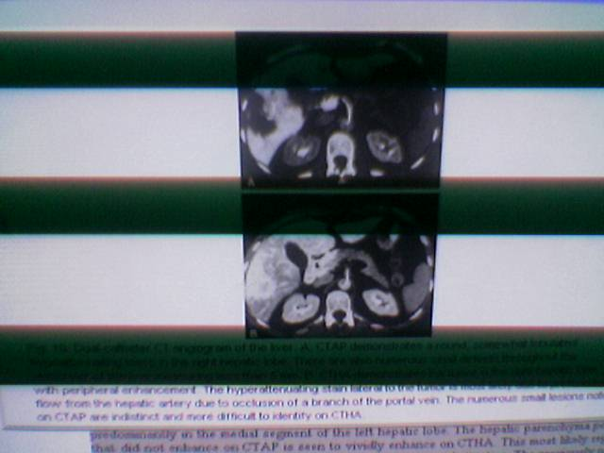

Slide 41
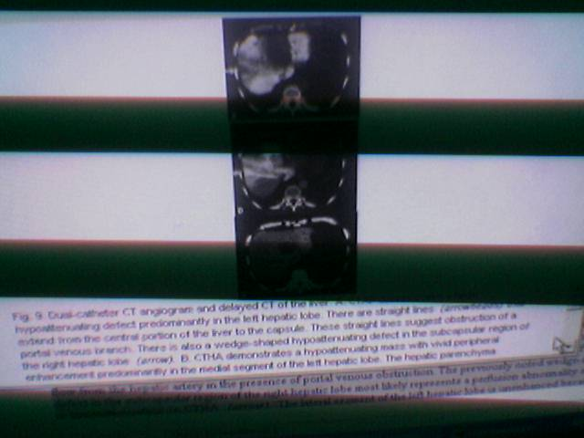

Slide 42
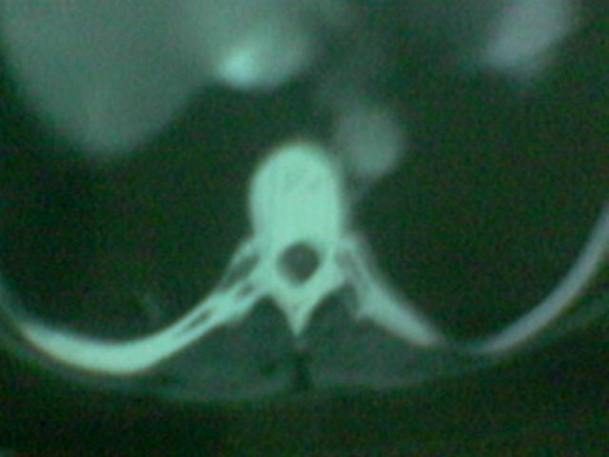

Slide 43
The portacaval space is a small compartment between the portal vein and the vena cava, which contains several important structures.
In addition to the caudate and papillary processes , there are retroportal lymph nodes with oval or rectangular contours on transverse sections . These nodes may be mistaken for portions of the caudate lobe or pancreatic head. Careful analysis of the contours of the caudate lobe on consecutive sections and a comparison of the texture of these structures with adjacent pancreas may be helpful to avoid such errors.
The cystic duct may course inferiorly along the lateral aspect of the portacaval space prior to joining the common duct .
Other portacaval structures include right hepatic arteries arising from the celiac axis or superior mesenteric arteries, posterior pancreaticoduodenal vessels , .

Slide 44
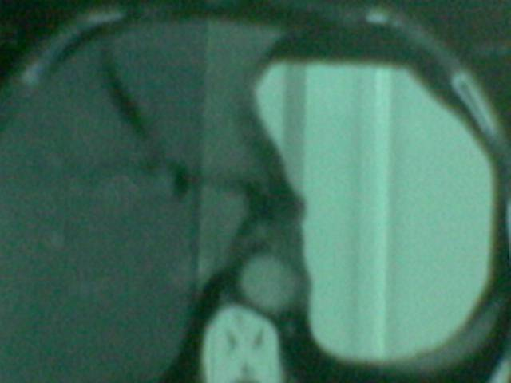

Slide 45
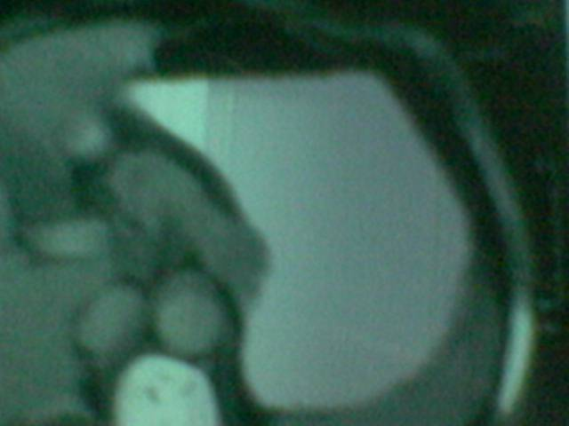

Slide 46
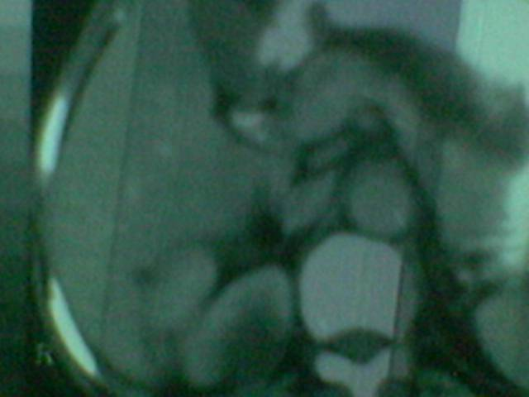

Slide 47
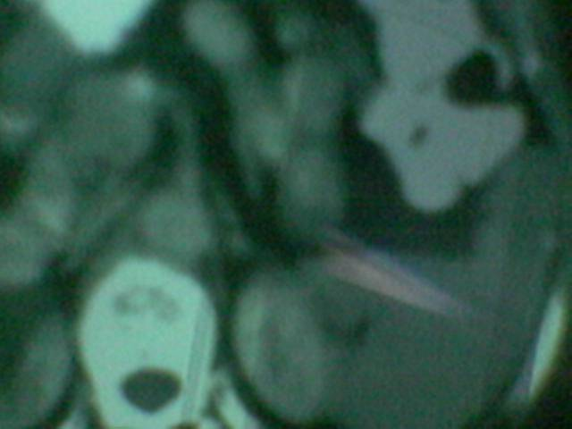

Slide 48
The diaphragm is thinnest superomedially in its central tendinous portion, and thickest peripherally near the origins of its costal and crural fibers,
The costal fibers cannot be delineated on most abdominal sonograms because they lie either too near or too far from the transducer and are obscured by ribs. The echogenic line that marks the location of the diaphragm on upper abdominal sonograms reflects the strength of its acoustic interface with lung rather than its true thickness.
On CT and MRI the costal diaphragmatic fibers are visible at their interface with subdiaphragmatic or extrapleural fat

Slide 49
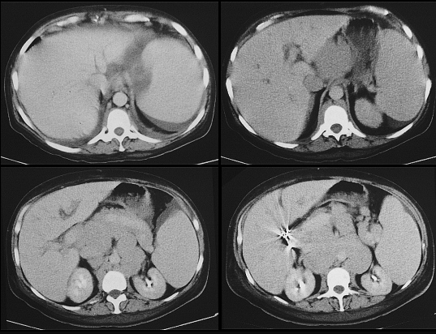

Slide 50
he stomach is globular to the left (gastric fundus), and tubular to the right (gastric body) (see Figs. 5, 6B and C, 7, 8B, 9, 10A and B, 12C and I, 13, 15, and 17). The gastric cardia marks the junction of the stomach with the cone-shaped abdominal esophagus (see Figs. 11 ,12I, and 17). 7 The abdominal esophagus is often unopacified with oral contrast and should not be mistaken for a mass. The midportion of this cone-shaped segment is normally oriented horizontally, unlike the post-hiatal segment of stomach in the presence of hiatal hernia. 7 The antrum is the distal portion of the gastric body (see Fig. 15). The pyloric sphincter is marked by a focal thickening of the antral wall at its junction with the duodenum (see Fig. 15). It may be mimicked by a prepyloric fold that is seen more proximally within the antrum, near the angular incisura.

Slide 51
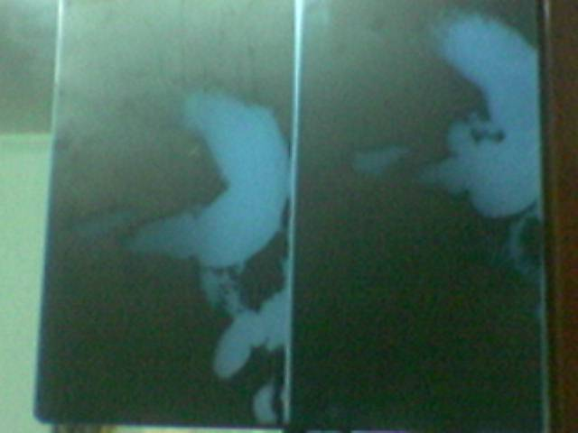

Slide 52
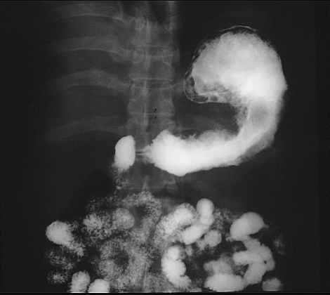

Slide 53
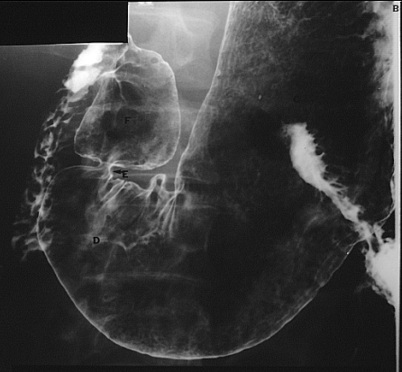

Slide 55
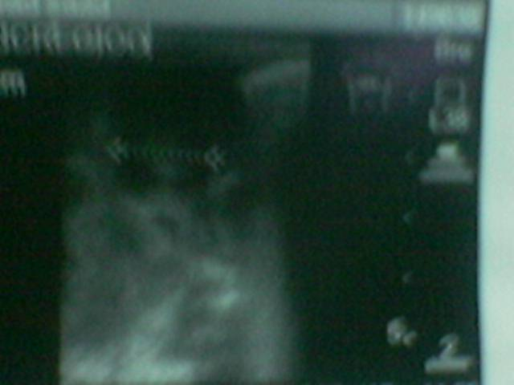

Slide 56
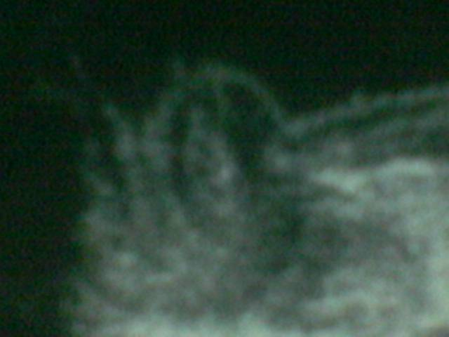

Slide 57
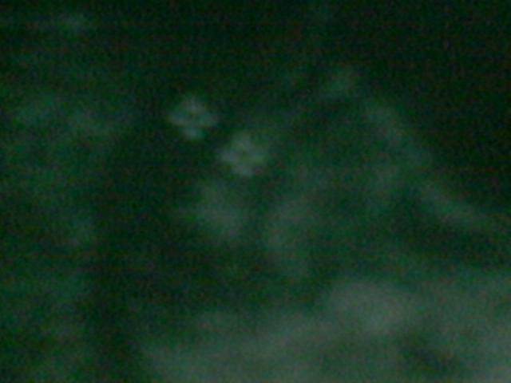

Slide 58
the spleen lies in the superolateral left upper quadrant, just below the diaphragm .
It is often lobulated, especially superiorly, and may be invaginated by infoldings of the diaphragm,
. Although intraperitoneal, the spleen extends posterior to the left kidney . Therefore, its medial portion may be mistaken for a suprarenal or renal mass, particularly if it is separated from the rest of the spleen by an inferior groove.
The spleen is attached to the stomach and kidney by peritoneal folds known as the gastrosplenic and splenorenal ligaments, respectively. Accessory spleens may be found within these ligamentst

Slide 59
he splenic artery divides into several branches before entering the spleen. Blood flows from these arteries into arterioles and then subsequently into sinusoids (red pulp).
These drain into five or more veins, which form the splenic vein in the splenorenal ligament.
Periarteriolar sheaths of lymphoid tissue (white pulp) may be visible as whitish dots on the cut surface of the spleen (see Fig. 11). 15 The white pulp appears to be concentrated within branching islands in the splenic parenchyma, surrounded by red pulp (see Fig. 11).
The spleen normally shows transient patchy opacification in the first few seconds of the arterial phase after intravenous contrast material injection (see Fig. 16G). This may reflect initial opacification of the white pulp, where the splenic arterioles are concentrated, analogous to early opacification of the renal cortex. Alternatively it may be due to closure of some of the presinusoidal arteriolar sphincters, leading to a transient lucency of the sinusoids they supply. Whatever the cause of this phenomenon, the hypovascular areas become isodense with the remainder of the spleen in a few more seconds, unlike true parenchymal lesions.

Slide 60
The spleen normally shows transient patchy opacification in the first few seconds of the arterial phase after intravenous contrast material injection (see Fig. 16G). This may reflect initial opacification of the white pulp, where the splenic arterioles are concentrated, analogous to early opacification of the renal cortex. Alternatively it may be due to closure of some of the presinusoidal arteriolar sphincters, leading to a transient lucency of the sinusoids they supply. Whatever the cause of this phenomenon, the hypovascular areas become isodense with the remainder of the spleen in a few more seconds, unlike true parenchymal lesions.

Slide 61
THE ABDOMINAL GREAT VESSELS
The abdominal great vessels and their major branches can be visualized with all three imaging methods making it possible to diagnose major morphologic abnormalities without resorting to angiography. The coronal sections that are readily available with

Slide 62
MRI have made it possible to demonstrate the great vessels just as they appear on angiography . Similar results may be obtained andvailable sonogram, using a coronal oblique view, usually from the right flankAS was indicated above, the abdominal vessels are valuable landmarks for localizing important organs and structures with sectional images. They may also be mistaken for enlarged lymph nodes, especially if they are not opacified on CT.

Slide 65
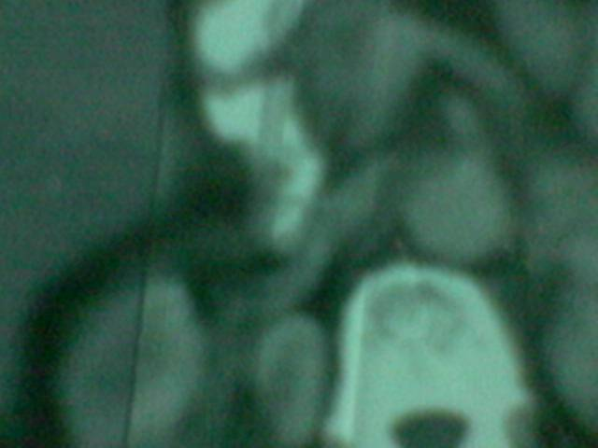

Slide 66
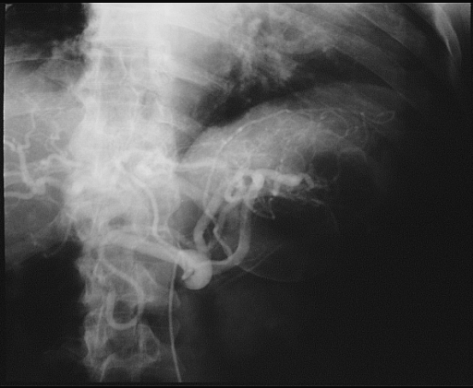

Slide 67
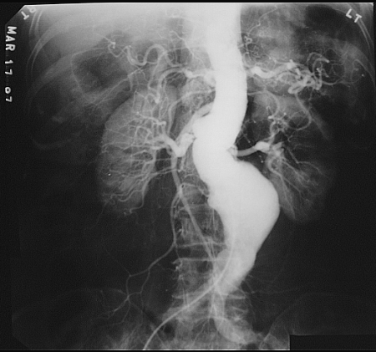

Slide 68
he ascending and descending colon and the rectum are extraperitoneal structures, whereas the cecum and the transverse and sigmoid colon are intraperitoneal structures.
The hepatic flexure of the colon is a constant companion of the gallbladder. It normally lies posterior to the liver, inferior, directly behind, or to the left of the quadrate lobe .
Occasionally it may be anteriorly interposed between the liver and diaphragm, causing a"cold" defect on radionuclide liver scans.
Rarely the colon may be posteriorly interposed between liver and diaphragm, extending up to the tenth or eleventh thoracic vertebral levels. In this high position it may mimic posterior liver masses or diaphragmatic defects on sonography.
The transverse colon usually lies below the stomach, but occasionally it may be found anterior and superior to the stomach, especially if the left lobe is hypoplastic.
The distal transverse colon, or radiologic splenic flexure, usually lies lateral to the stomach and anterior to the spleen . Occasionally it may be found between the spleen and left kidney. within the splenorenal space.

Slide 69
HE PANCREAS
The pancreas extends obliquely across the abdomen from the hilum of the spleen to the medial border of the duodenum .
THE BODY
The pancreatic body extends across the midline, behind the peritoneum, and anterior to the splenic and superior mesenteric vessels . At this point the left renal vein crosses the midline between the aorta and superior mesenteric vessels. Occasionally the pancreatic body is the most superior portion of the gland It may have a prominent anterior convexity or omental tuberosity which may be mistaken for a mass.
THE NECK

Slide 70
The pancreatic neck is a thin connection between the pancreatic body and head). It is contiguous to the right anterolateral margin of the superior mesenteric vein at its junction with the splenic vein.
THE HEad
The pancreatic head lies anterior to the vena cava, caudal to the portal vein, and superior to the transverse duodenum (see Figs. 5, 6A to C, 15, 16A and C to E, and 18A). The uncinate process is the only portion of the pancreas that lies posterior to the superior mesenteric vessels (see Figs. 15 and 16J).

Slide 71
The gastroduodenal artery is a good marker for the anterior border of the pancreatic head, while the distal common bile duct lies within 5 mm of its posterior border Occasionally the common bile duct courses lateral to the pancreatic head, within the peripancreatic fat medial to the duodenum. Also, the pancreatic head occasionally lies to the left of midline, anterolateral to the aorta. In such cases the common duct follows a transverse oblique course toward the ampulla of Vater.

Slide 73
