Slide 1
Hystrosalpingography

Slide 2
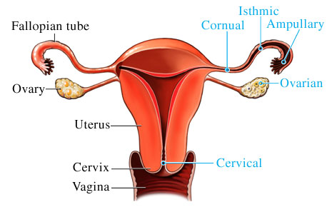

Slide 3
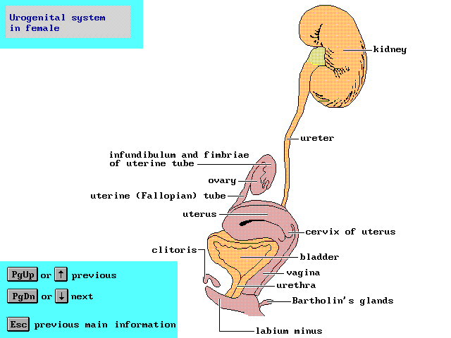

Slide 4
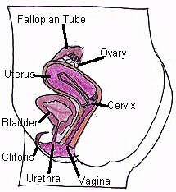

Slide 5
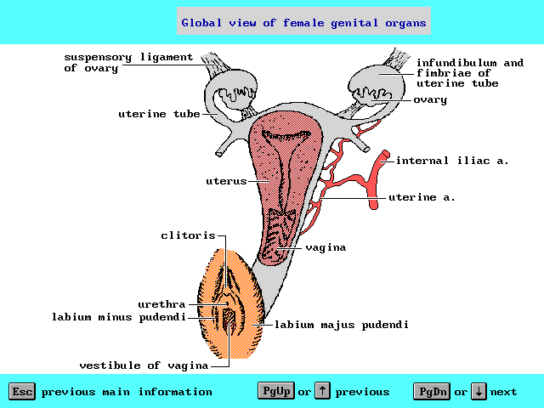

Slide 6
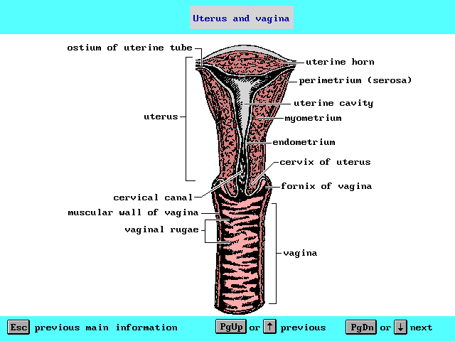

Slide 7
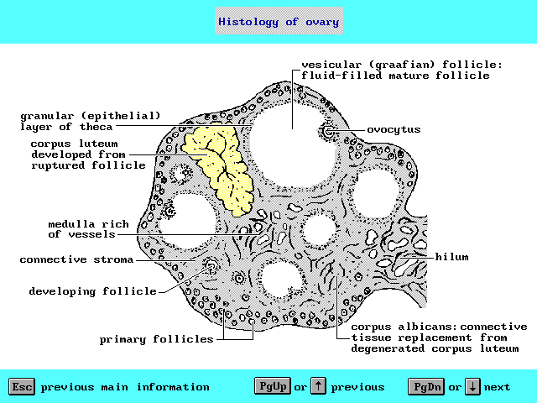

Slide 8
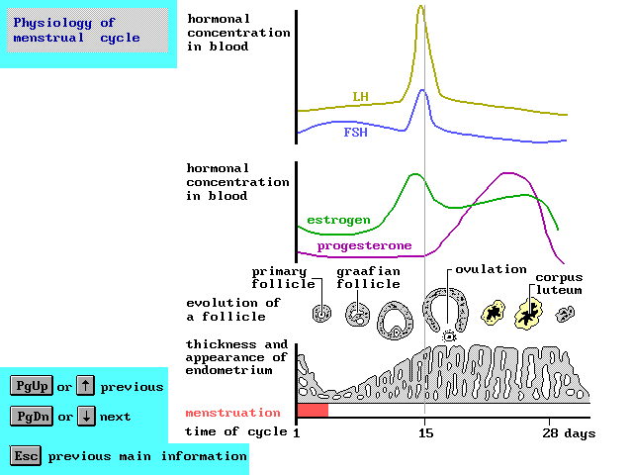

Slide 9
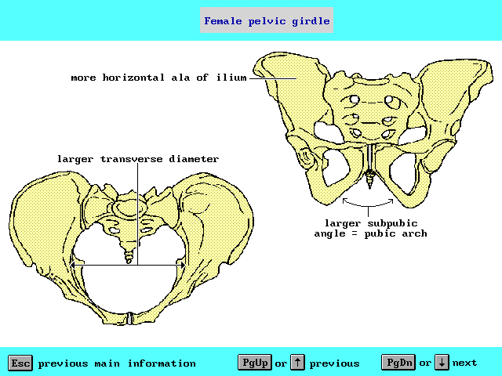

Slide 10
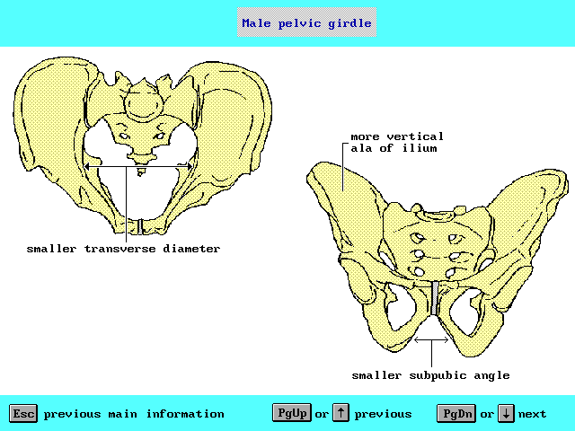

Slide 11
Indications
Infertility : tubal obstruction , congenital uterine anomalies .
After tubal surgery: patency and configuration of F.T.
Recurrent abortion : cervical canal , congenital anomalies , fibroids.

Slide 12
Indications
Abnormal uterine bleeding : fibroids , endometrial polyps, adenomyosis, uterine adhesions.
Post caesarian section : assess integrity of uterine scar.
Intervention : tubal recanalization .

Slide 13
Timing
Day 4-7 Why?
Blood has cleared from uterus.
Isthmus is most distensible.
Fallopian tubes are more readily filled.
Endometrium is not thick.

Slide 14
Irregular uterine bleeding
BLOOD CLOTS MAY MIMIC INTRAUTERINE LESIONS
DO NOT USE OIL SOLUBLE CONTRAST MEDIUM

Slide 15
Contraindications
Pregnancy.
Pelvic infection
Immediate pre and post menstrual phases. (Extravasations).
Sensitivity to contrast media.

Slide 16
Complications
Pain: normally transit lower abdominal discomfort.
Pelvic infection
Hemorrhage .
Allergic ,vasovagal attach.
Venous intravasation.

Slide 17
HSG
ANTIBIOTICS:
+ve history of PID and SBE
(Doxycycline 100 mg/twice daily two days before procedure)
(200mg immediately after procedure followed by 100mg/twice daily for 5 days)

Slide 18
CONTRAST MEDIA
WATER SOLUBLE
Less density
Better for FT visualization
Immediate smear
Disappear within one hour (except tubal block)
Less complication
No therapy effect.

Slide 19
CONTRAST MEDIA
OIL SOLUBLE
More density
Better uterine visualization
Delayed smear
Disappearance is delayed
More complications
Has a therapy effect.

Slide 20
HSG
It is best performed in the first half of the menstrual cycle.
Venous intravasations has no clinical significance.
Pethidine is not suitable analgesia for any discomfort during the examination because it tubal spasm.

Slide 21
TECHNIQUE
Ask the patient to evacuate her bladder.
Patient lies in lithotomy position and try to elevate her buttocks.
Lubricate speculum.
Insert it closed; then rotate; then open it.

Slide 22
TECHNIQUE
Sterilize vagina.
Grasp anterior lip with vulsellum forceps (avoid 3&9 o’clock: highly vascular)
Insert cannula inside the cervical canal.
Inject contrast material.

Slide 23
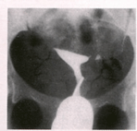
HSG
UTERINE CAVITY
THE CAVITY IS TRIANGULAR IN SHAPE
WALLS ARE REGULAR AND CONCAVE
FUNDUS MAY BE CONVEX
LENGTH AND INTERCORN. DIST. ARE ABOUT 35MM

Slide 25
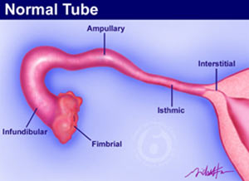

Slide 26
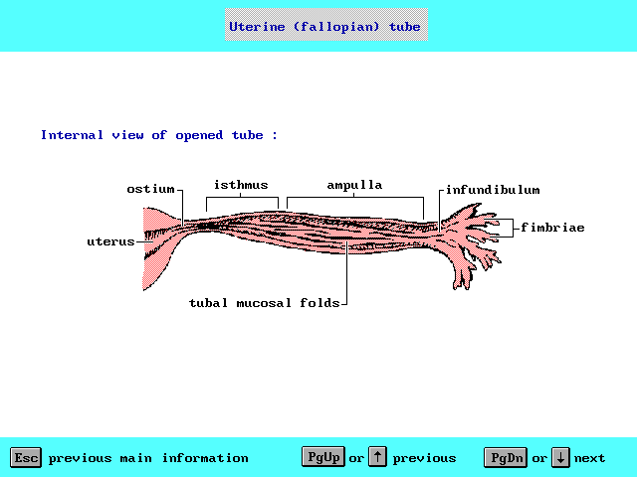

Slide 27
Fallopian Tube
ABOUT 7-14 CM LONG
DEVIDED INTO:
INTERSTITIAL
ISTHMIC
AMPULLARY
INFUNDIBULAR
FIMBRIAL

Slide 28
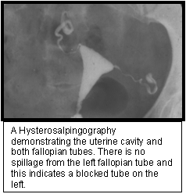

Slide 29
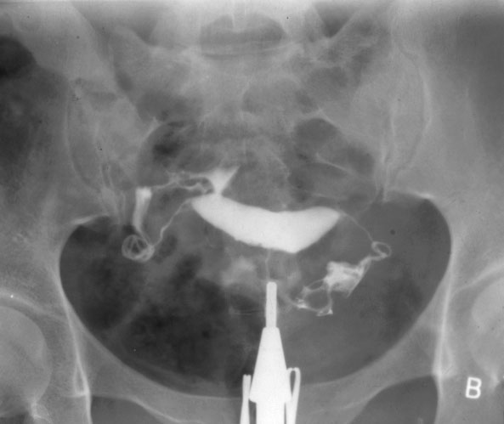

Slide 30
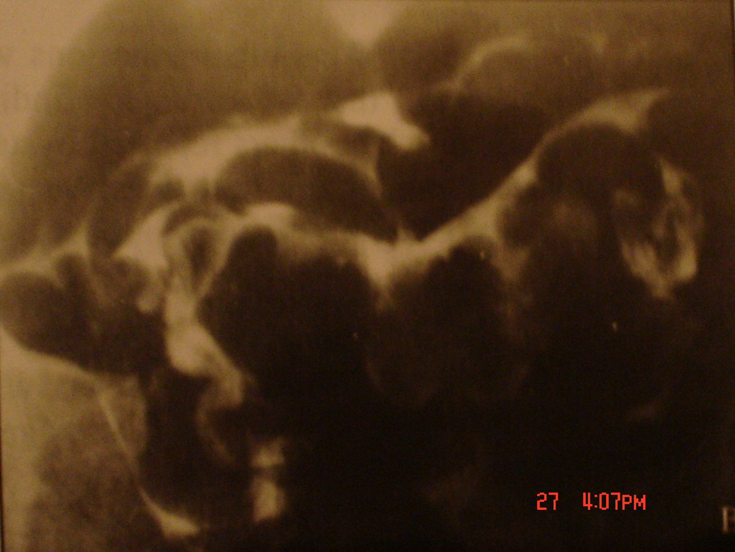

Slide 32
Fallopian Tube
Longitudinal mucosal folds indicate a healthy mucosa

Slide 33
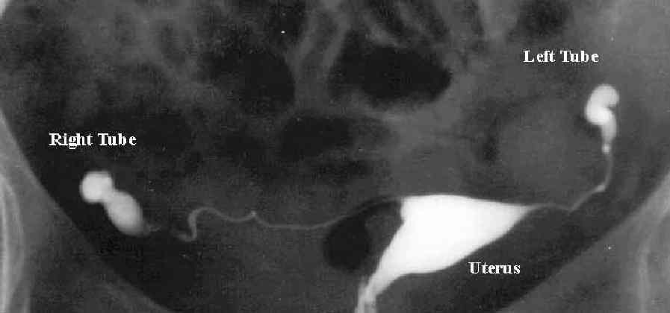

Slide 34

Hydroslpinx

Slide 35
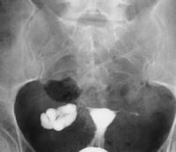
Hydroslpinx

Slide 36
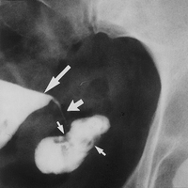
COBBLESTONE MUCOSA

Slide 37
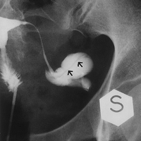
LONGITUDINAL BANDS

Slide 38
Pelvic adhesions
CONTRAST LOCULATION
Vertical tube orientation
Fixed uterine position

Slide 39
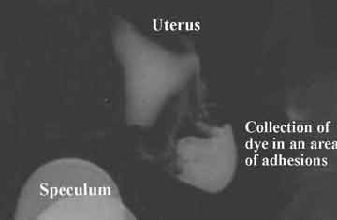
CONTRAST LOCULATION

Slide 40
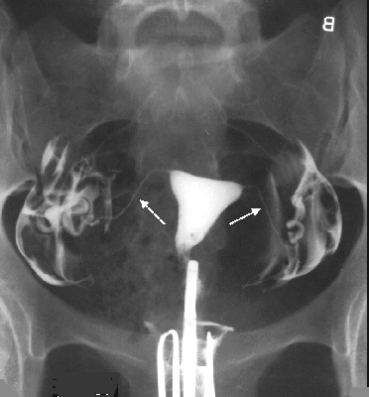
Vertical tube orientation

Slide 41
PITFALSS
AIR BUBBLES
REMOVE AIR BUBBLES FROM CANNULA
ADDITIONAL CONTRAST INJECTION
CHANGE PATIENT POSITION

Slide 42
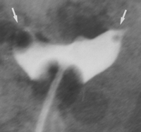
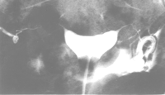

Slide 43
PITFALSS
VENOUS INTRAVASATION
FORCEFUL INJECTION AGAINST BLOCKED TUBES
VERY DANGEROUS IF WE USE OIL SOL. CONTRAST

Slide 44
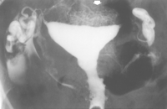

Slide 45
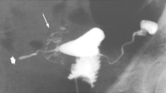

Slide 46
Thank You

