Slide 1
GIT Technique
BY
DR. Ahmed Okasha MD Consultant Radiology

Slide 2
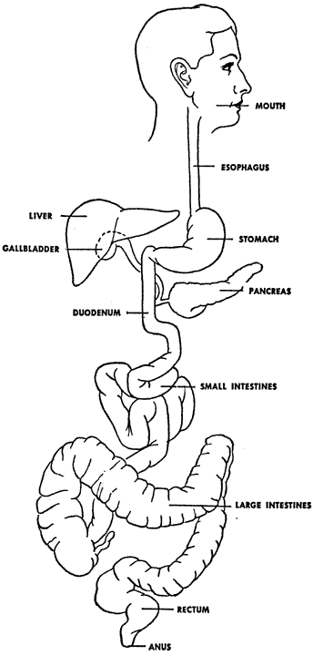

Slide 3
Anatomy of the esophagus

Slide 4
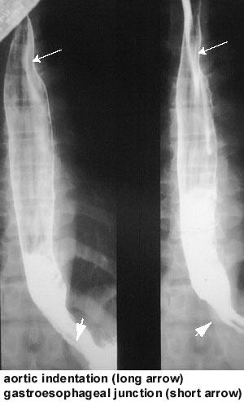
esophagus
Length 25-30cm
Breadth 12-30 mm
Cross section appears flattened with a stellite lumen.
From C6-D11.
Mucosa coat of 3 OR 4 straight parallel lines less than 2mm apart & become closely at lower part .

Slide 5
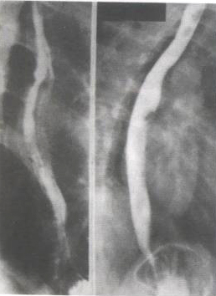
esophagus

Slide 6
esophagus
Esophagus divided into three parts:
Cervical esophagus
Thoracic esophagus
Abdominal esophagus
Three constrictions in the normal esophagus
At the upper end
Crossed by the LT main bronchus
At the diaphragmatic hiatus in the lower end.

Slide 7
Aortic indentation
Gastroesophagesl junction

Slide 8
esophagus
Normal impression on the anterior aspect of the esophagus :
Aortic arch
Left main bronchus
Left atrium

Slide 9
Notes
Esophagus
25cm long.
It traverses the diaphragm at the level of T10.

Slide 10
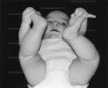

Slide 11
Barium Swallow
Indication
Dysphagia
Esophageal Varices in portal hypertension
To assess the effect of any mediastinal masses on the esophagus e.g. hilar, intracarinal or mediastinal lymphadenopathy or aortic aneurysm
Gastro-esophageal reflux.
Foreign body obstructing the esophagus.

Slide 12
Barium Swallow
Patient Preparation
Fasting 3-4 hours
In cases of lower esophageal obstruction e.g. achalasia insert a Ryle tube & wash with a saline or NaCo2 till the oseophagus is clean then give the barium to visualize the site of the obstruction.

Slide 13
Barium Swallow
Contrast media
Barium paste Thick; 1 brium:1 water
Thin ; 1 brium:2 water
The examination should be done under fluoroscopic control

Slide 14
Imaging In GIT
Contrast Studies :
Barium : used in most studies , with different composition according to part examined.
Gastrographin : in suspected perforation or intestinal obstruction , in CT examination as barium will cause artifact .

Slide 15
Barium Swallow
Preliminary Films
AP
Lateral for neck & soft tissue exposure.

Slide 16
Barium Swallow
Steps
Patient is in the erect position RAO
The patient is asked to swallow a mouth-full of the barium paste & observe on the screen the passage from the mouth to stomach.
Spot films for the different parts of the esophagus, the lateral view is better than the oblique view to get rid of the breast shadow, AP, RT.Lat. ,RAO, PA for upper &lower esophagus.

Slide 17
Barium Swallow
In case of varices:
Thick paste
Fill the esophagus with barium
Ask patient to perform Valsalva’s maneuver to enhance visualization of the varices.

Slide 18
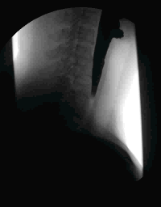
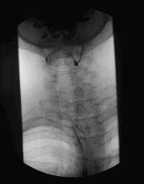

Slide 19
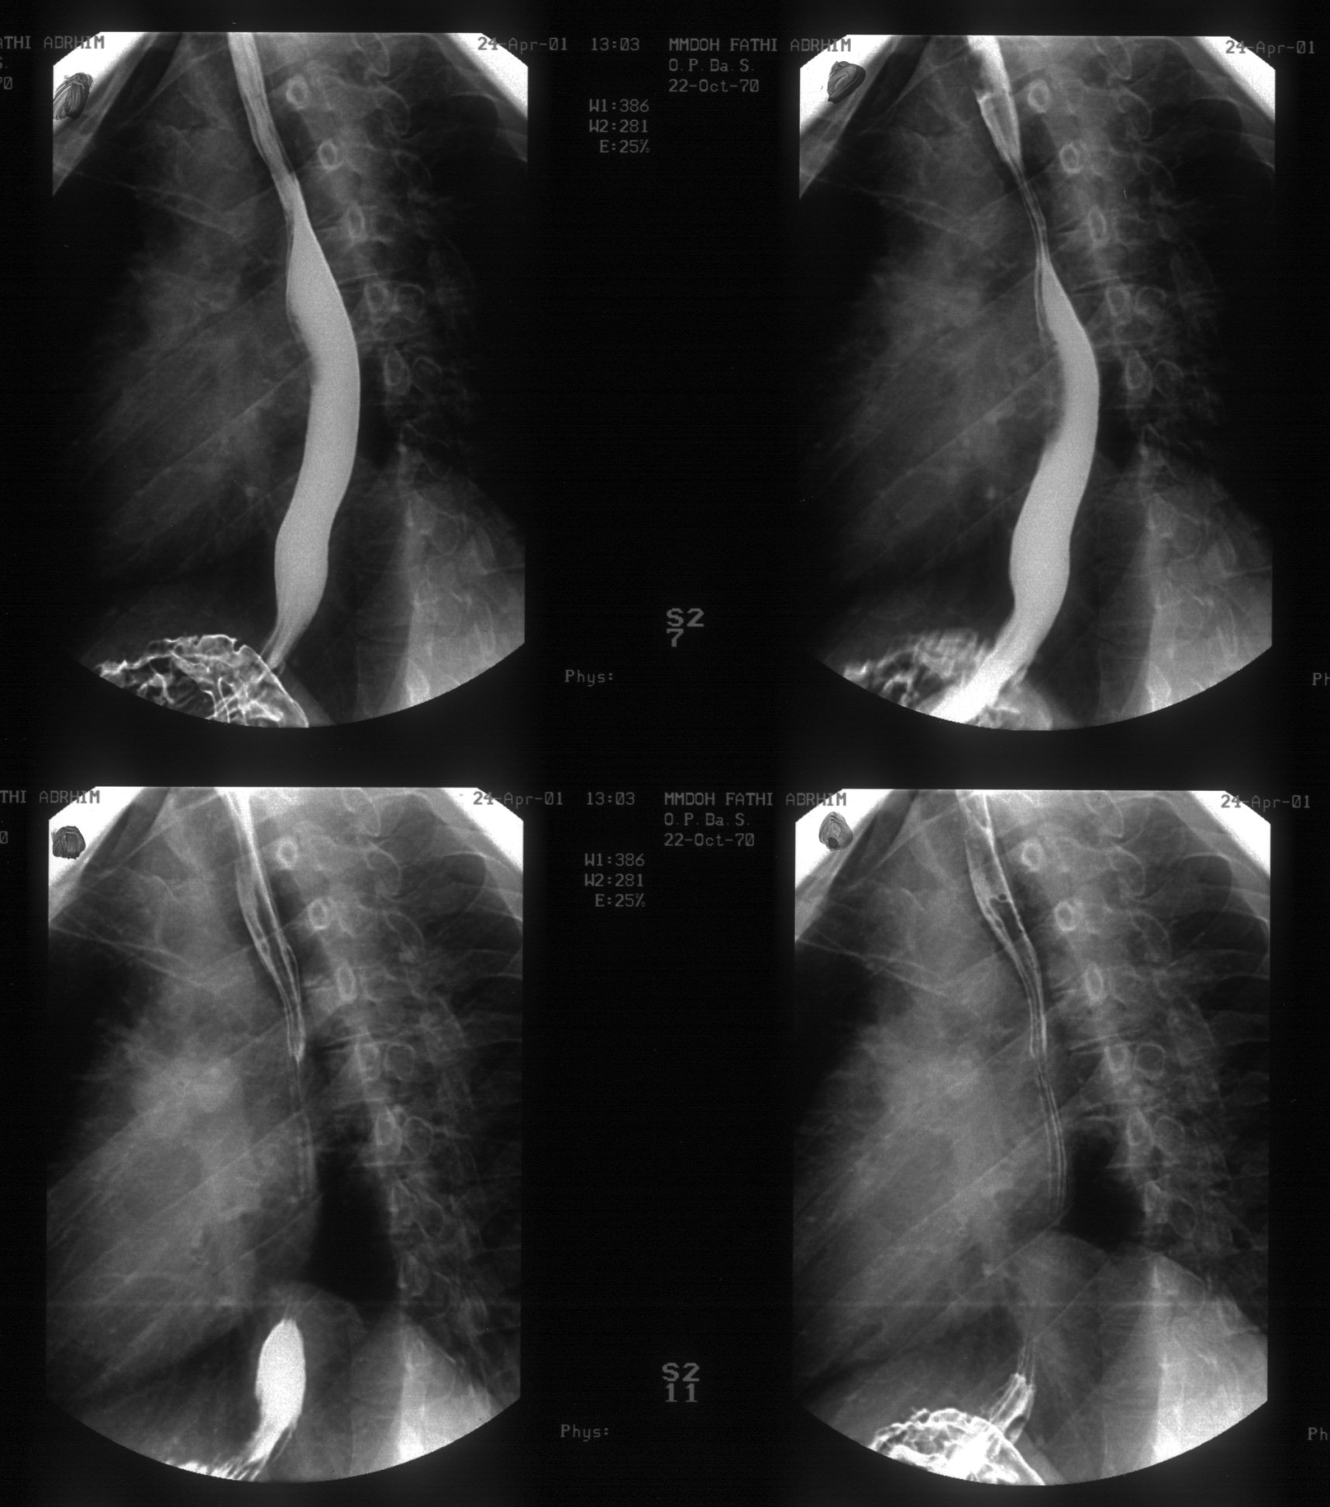

Slide 20
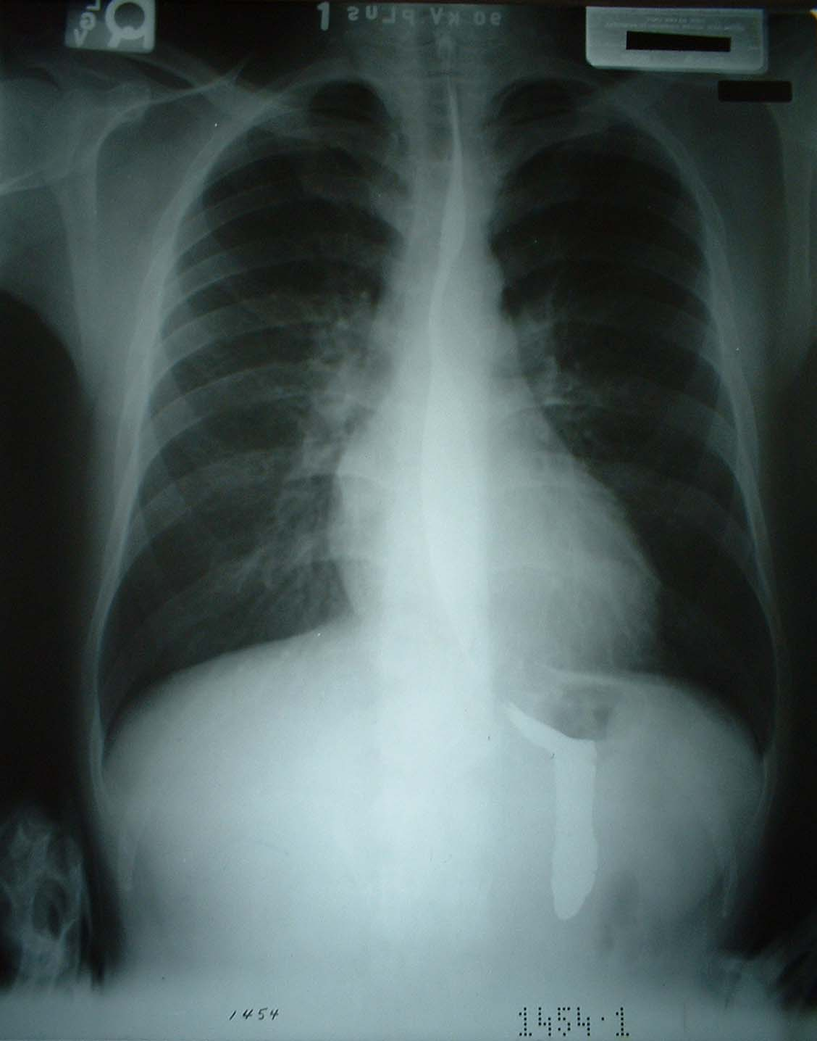

Slide 21
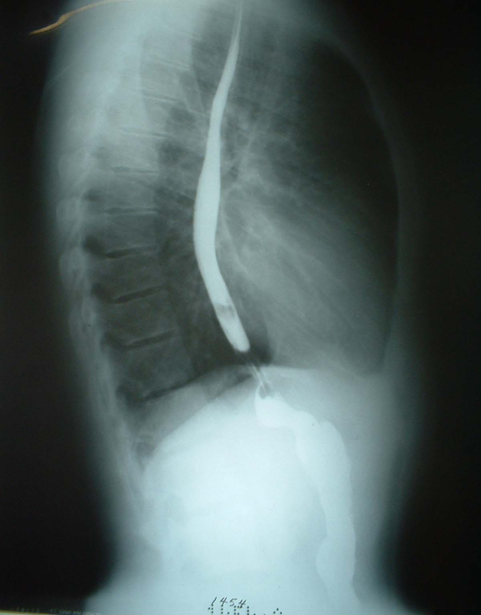

Slide 22
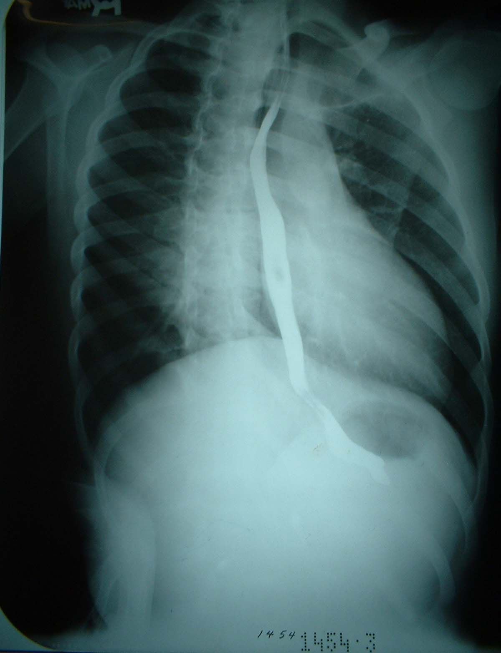

Slide 23
Notes
Barium sulphate are non ionic.
Barium particle are 0.5-5 um.
Suspension are acidic PH (5.3).

Slide 24
Notes
As regard contrast swallow:
A high KV technique is preferred to demonstrate mucosal detail.

Slide 25


Slide 26
Anatomy of the Stomach

Slide 27
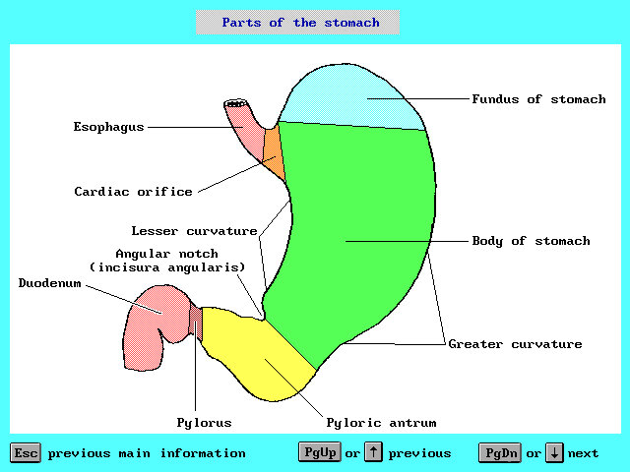

Slide 28
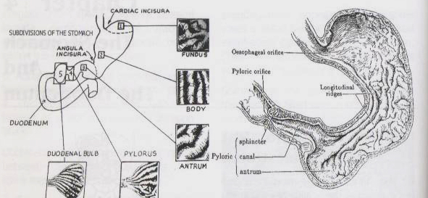

Slide 29
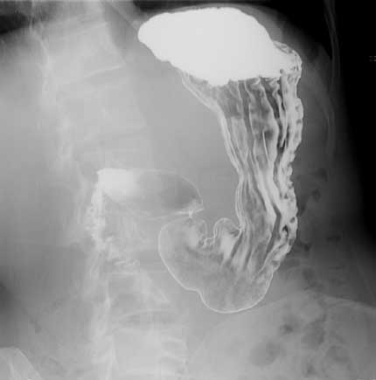

Slide 30
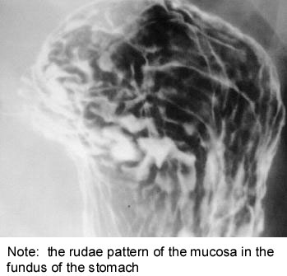

Slide 31
Normal Fluid Levels (X-Ray)
Stomach
  Always (except supine film)
Small Bowel
  Two or three levels possible
Large Bowel
  None normally

Slide 32
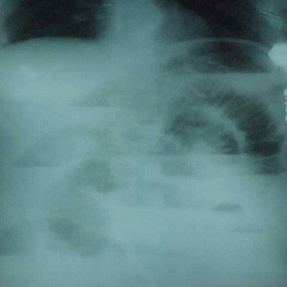

Slide 33
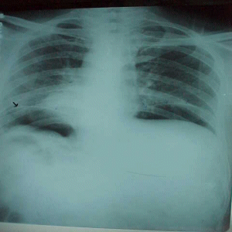

Slide 34
Stomach
The stomach is divided into three parts:
The Fundus
The body
The pyloric

Slide 35
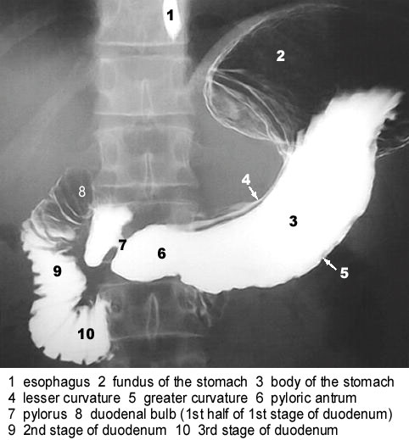

Slide 36
Stomach
The Stomach is out lined by a lesser & a greater curve, the incisura angularis is the notch on the lesser curve which separates the body from the antrum.

Slide 37
Notes
Stomach
Gastric rugae are normally 3-5 mm thick.
The incisura angularis occurs on the lesser curve.

Slide 38
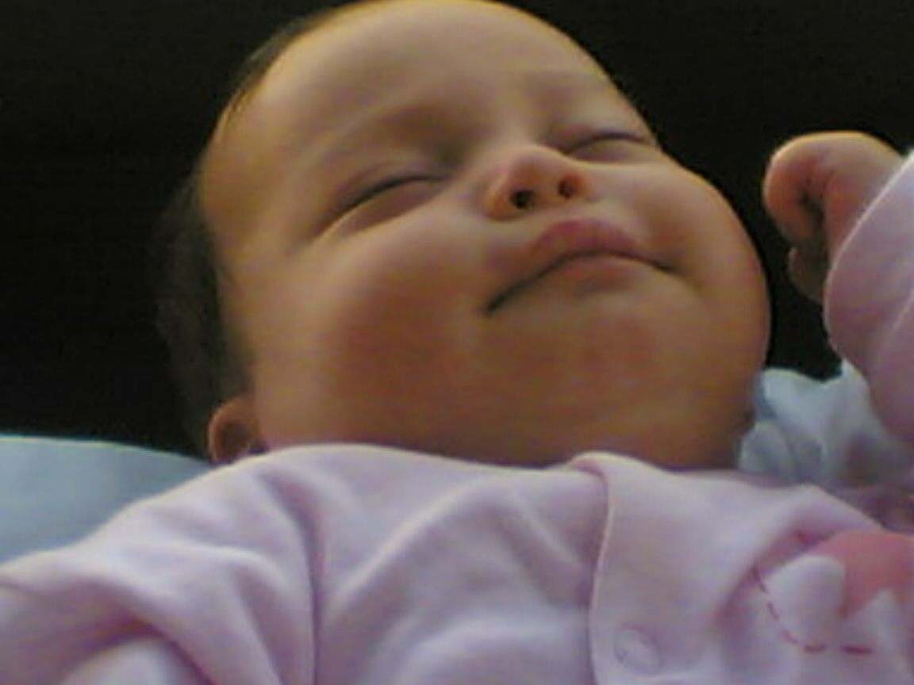

Slide 39
Barium meal
Patient preparation
Fasting 6-8hours
No smoking …increase gastric secretions…. Dilution of the contrast media ….impairs the barium coating.

Slide 40
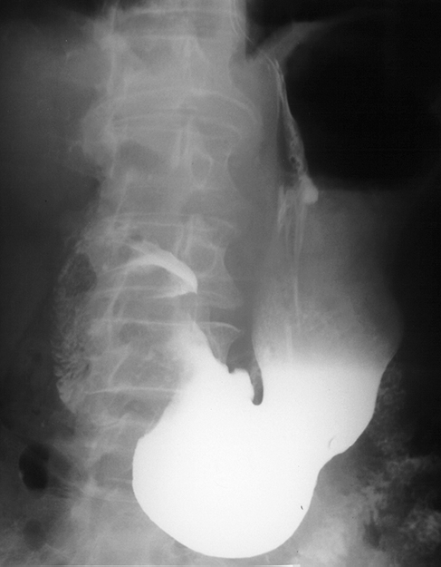
incisura angularis

Slide 41
Barium meal
Preliminary Films
Erect PA For
Foreign body, Gall bladder stones, pancreatic calcification & be sure that there is no intestinal obstruction.

Slide 42
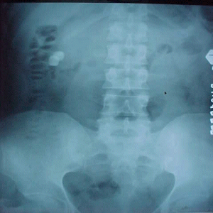

Slide 43
Barium meal
150-200ml is given to the patient.
Gas producing agent is swallowed.
Patient drink the barium while lying on his LT. side (to prevent rapid escape of Ba. To duodenum).
Ask the patient to rotate 360 degree to coat all the gastric walls with Ba. Then ask him to lie in supine, then RT. Side up, prone, LT. side up.

Slide 44
Barium meal
Certain points should be noted.
The position & shape of the stomach.
Tone & peristalsis.
Gastric wall.
Irregularity.
Points of tenderness.

Slide 45
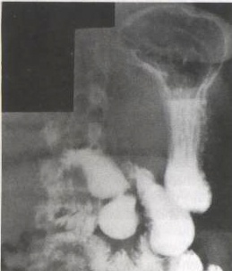
Barium meal
5 films are taken
P-A erect to see lesser & grater curvatures.

Slide 46
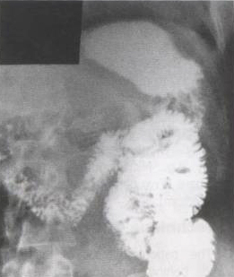
Barium meal
2. RT. Anterior oblique to see the ant. &post. Wall of the stomach & duodenal curve.
3. Supine view to see the fundus filled with barium. supine oblique to fill the antrum with air.

Slide 47
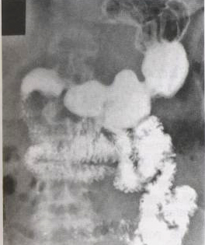
Barium meal
4. Prone view to see the pyloric antrium filled with barium & the fundus filled with air.
5. Lateral view to show a post. Wall of the ulcer.

Slide 48
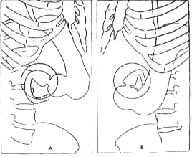
Barium meal
Serial ex.
Of the duodenum.

Slide 49
Double contrast Barium meal
Conventional barium meal The disadvantage of the single contrast upper GIT examination is its lack of sensitivity in detecting small erosions, linear ulcerations& minimal mucosal abnormalities.

Slide 50
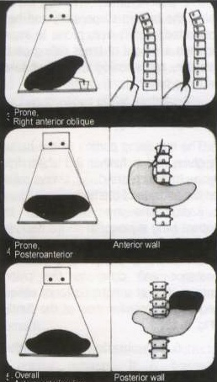
Double contrast
Barium meal
RAO
It is barium (opaque) + gas (radiolucent).
Glucagons 0.1 to 0.2 mg I.V.
supine RAO position move the gastric gas toward the pylorus.
Wall of the Stomach
PA
AP

Slide 51
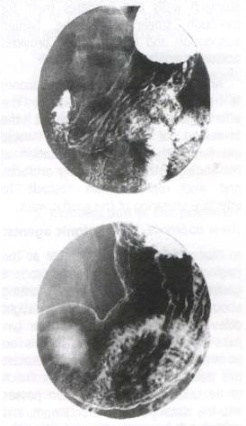
Double contrast

Slide 52
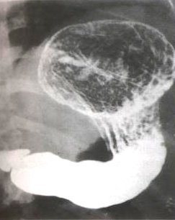
Double contrast

Slide 53
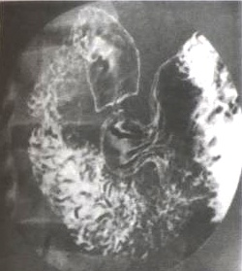
Double contrast

Slide 54
How to demonstrate reflux?
Patient lies on his RT. Side (to bring Ba. Against GOJ).
Trendelberg position.
Valsalva
Straight legs & flex them to increase intra abdominal pressure).
Prone take films for esophagus all till the GOJ.
Water test (small amount to stimulate reflux).

Slide 55
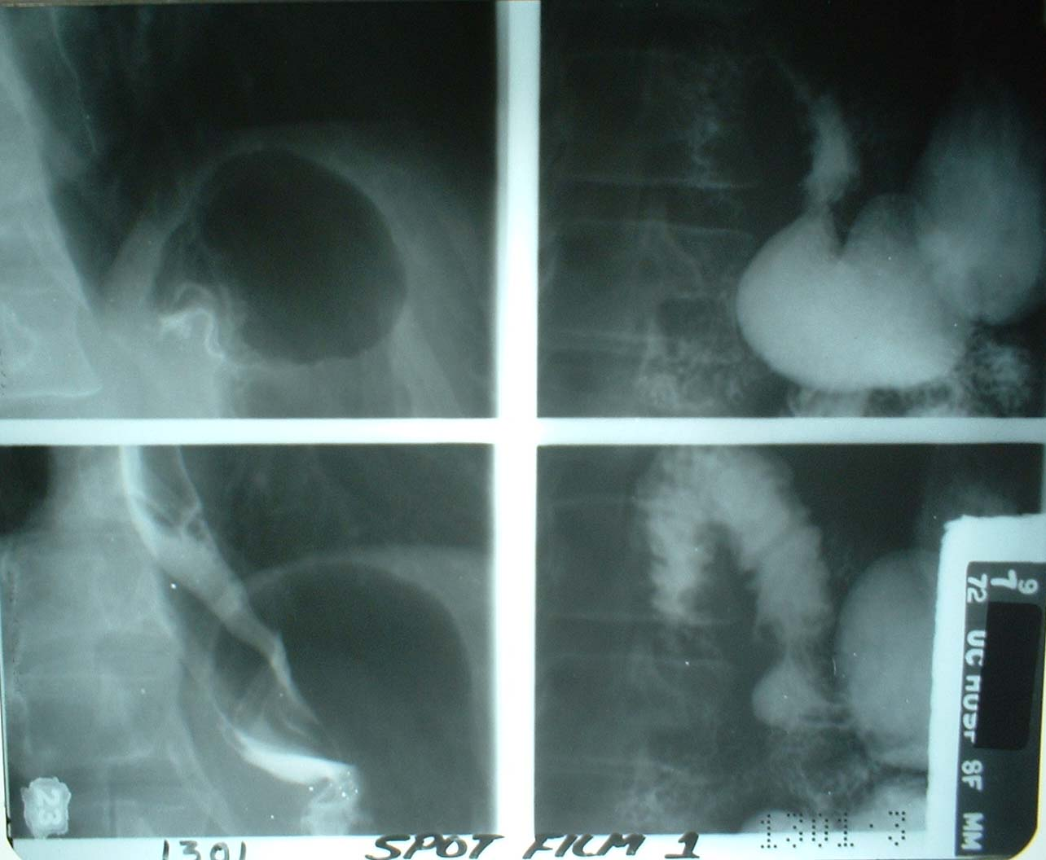
GOJ
GDJ
GOJ
GDJ

Slide 56
After care
Give him laxatives to avoid Ba. impaction.
Not to leave until burring of vision produced by buscopan has resolved.

Slide 57


Slide 58
Anatomy of the Duodenum

Slide 59
Duodenum
The shortest, widest &fixed part on the small intestine.
Forming a C shaped course which is divided into four parts:
First part (cap)
Second part (descending )
Third part (horizontal) Fourth part (ascending)

Slide 60
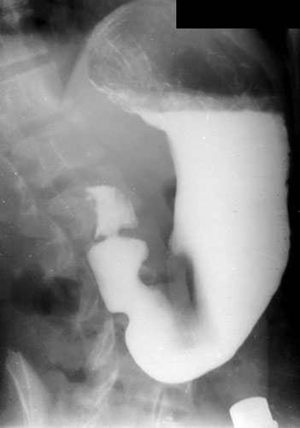

Slide 62
Duodenum
The head of pancreas is embedded in the concavity of the C shaped duodenal loop, the pancreatic duct & the common bile duct open in the ampulla of vater.

Slide 63
Duodenum
Indications
Dyspepsia, discomfort pain
Nausea& vomiting.
Unexplained weight loss
Unexplained anemia
Chronic upper GIT bleeding.
Mass in the upper abdomen.

Slide 64
Duodenum
Contraindication
Perforation……gastrografin.
Acute upper GIT bleeding….endoscopy
Bowel obstructions

Slide 65
Notes
Duodenum takes it’s blood supply from a branch of the superior mesenteric artery.
The first part = 5cm, second part =7.5cm, third part = 10cm, fourth part = 2.5cm.
Duodenum is anterior to the CBD in it’s second part.
Duodenum has the ampulla's of vater at the posteriomedial wall of the second part.

Slide 66


Slide 67
Upper GIT series
Osephagus
Stomach
Duodenal bulb
Duodenal sweep (c- loop).

Slide 68
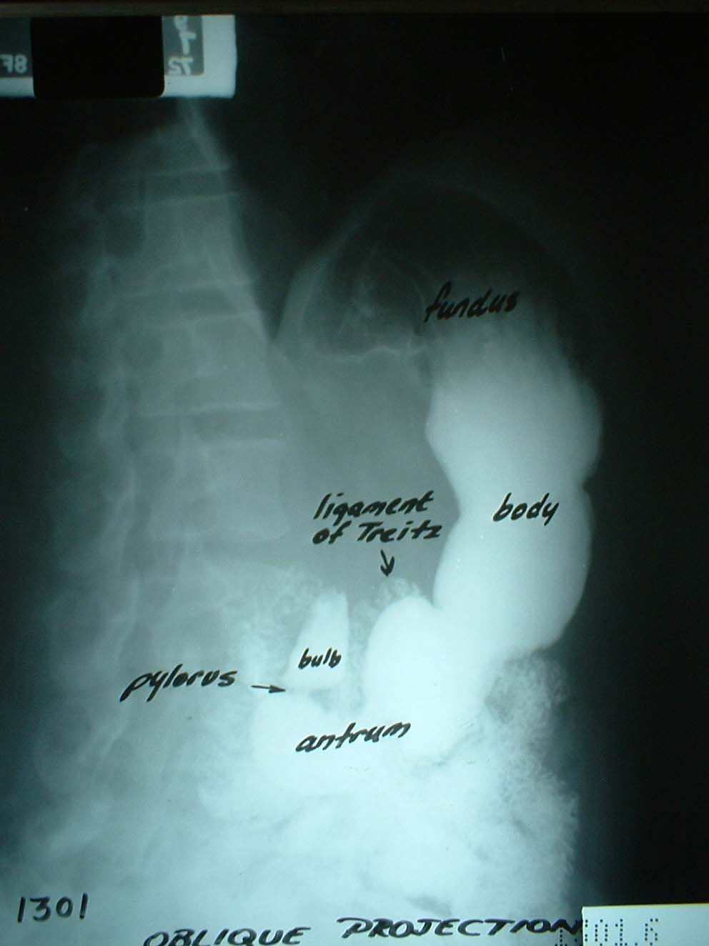
Ligament of treitz ( junction of the duodenum & jejunum)

Slide 69
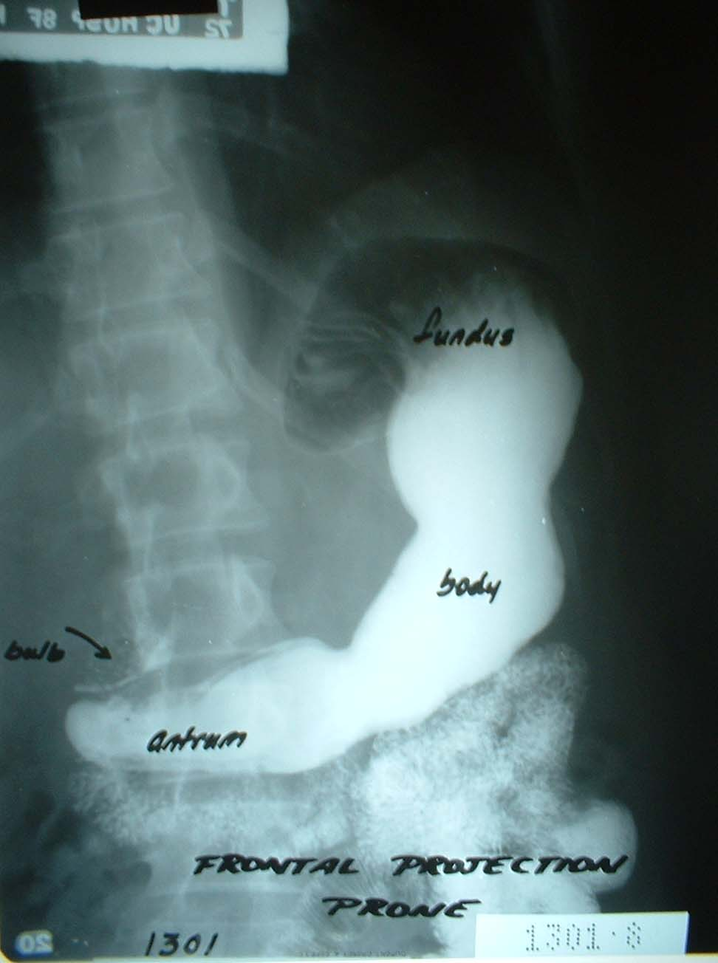

Slide 70
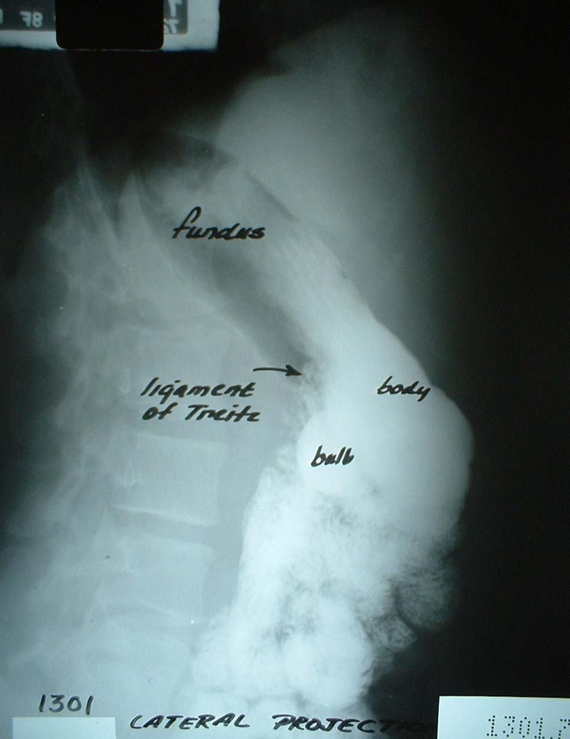
Ligament of treitz ( junction of the duodenum & jejunum)

Slide 71
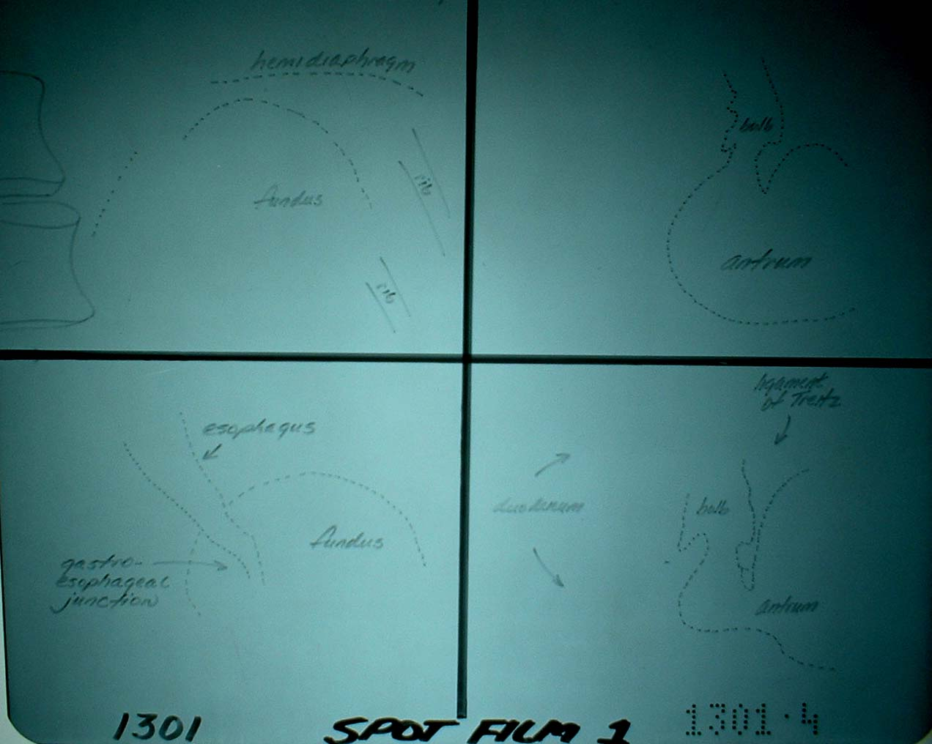

Slide 72
GOJ
GOJ

Slide 73
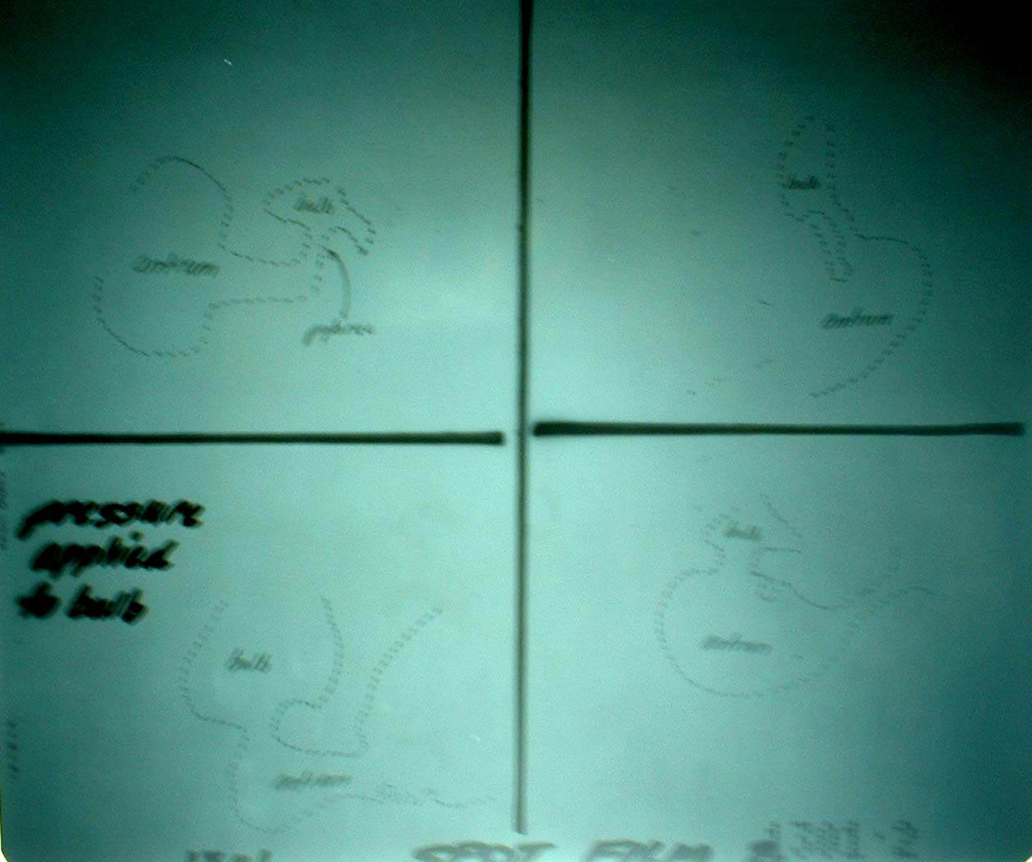

Slide 74
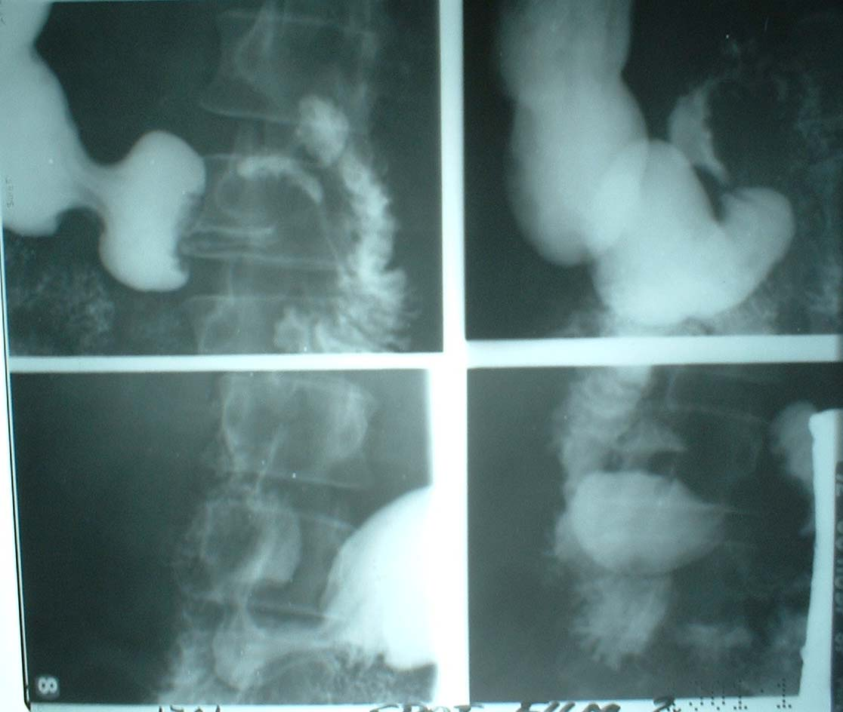
GDJ

Slide 75
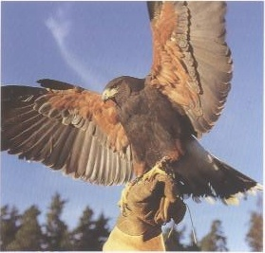

Slide 76
Barium follow through

Slide 77
Barium follow through
Laxative on the evening prior to the examination.
Cold isotonic saline to accelerate gastric empting.

Slide 78
Barium follow through
Films
Preliminary film plain abdominal film.
Prone PA every 20min during the first hour, then every 30 min until the colon is reached.
Spot films for terminal ileum.

Slide 79
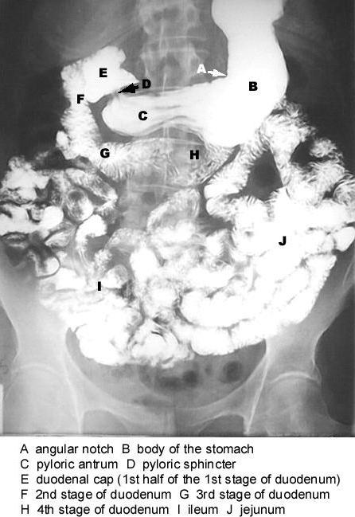

Slide 80
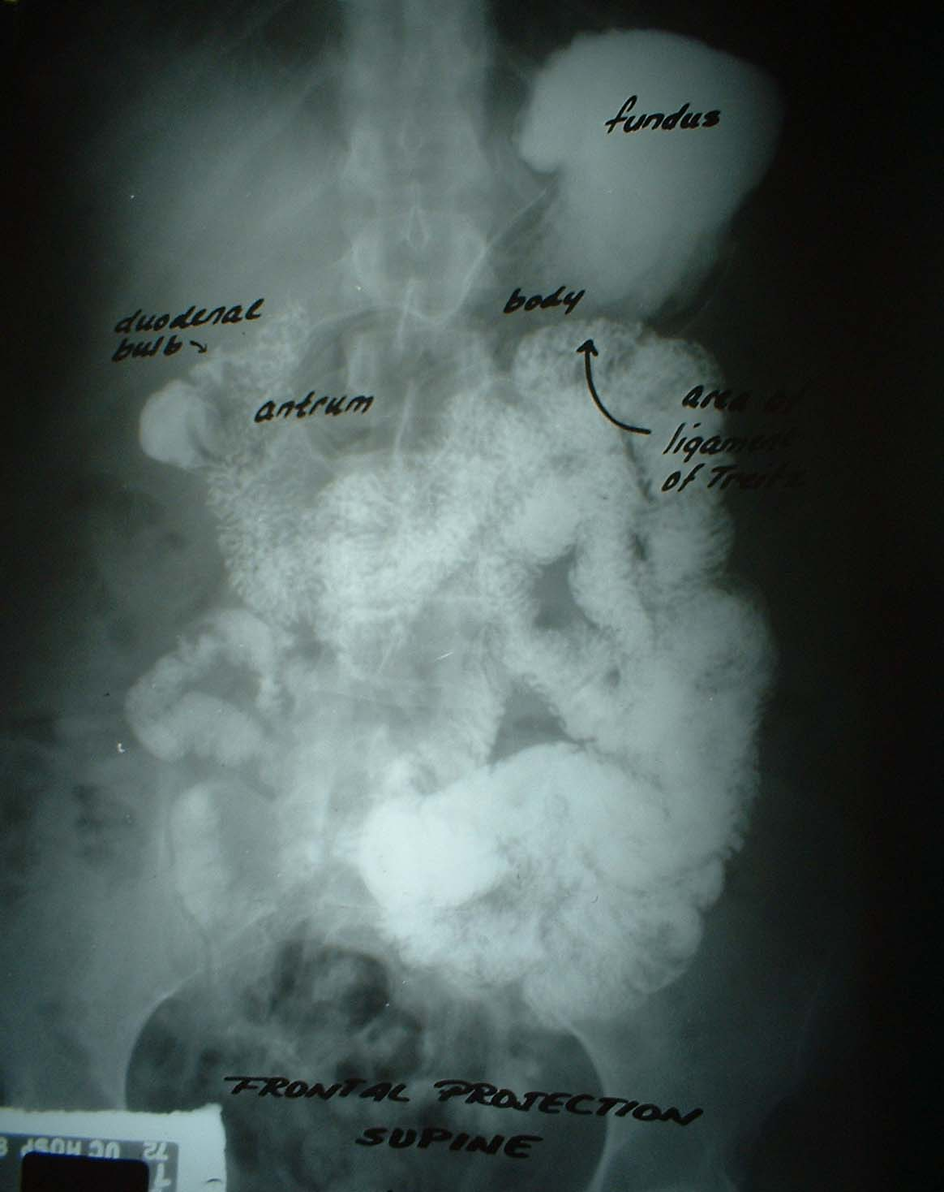

Slide 81
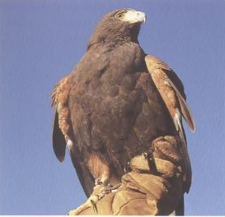

Slide 82
Anatomy of the Large intestine

Slide 83
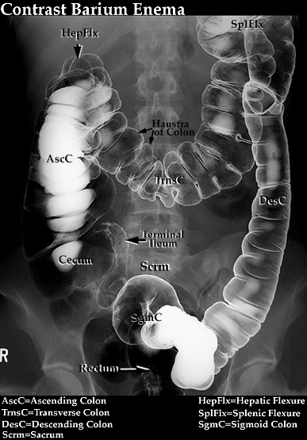

Slide 84
Anatomy of the Large intestine
Parts of the large intestine
Caecum- widest part – appendix arises from the posteriomedial aspect of the caecium.
Ascending colon –vertical parts-hepatic flexure.
Transverse colon – splenic flexure –mobile part.
Descending colon till LT. iliac crest .
Sigmoid colon.
Rectum

Slide 85
Notes
Colon
The ascending colon is wider than the descending colon.
The transverse colon is related anteriorly to the greater omentum.
The splenic flexure is usually more crainial than the hepatic flexure.

Slide 86
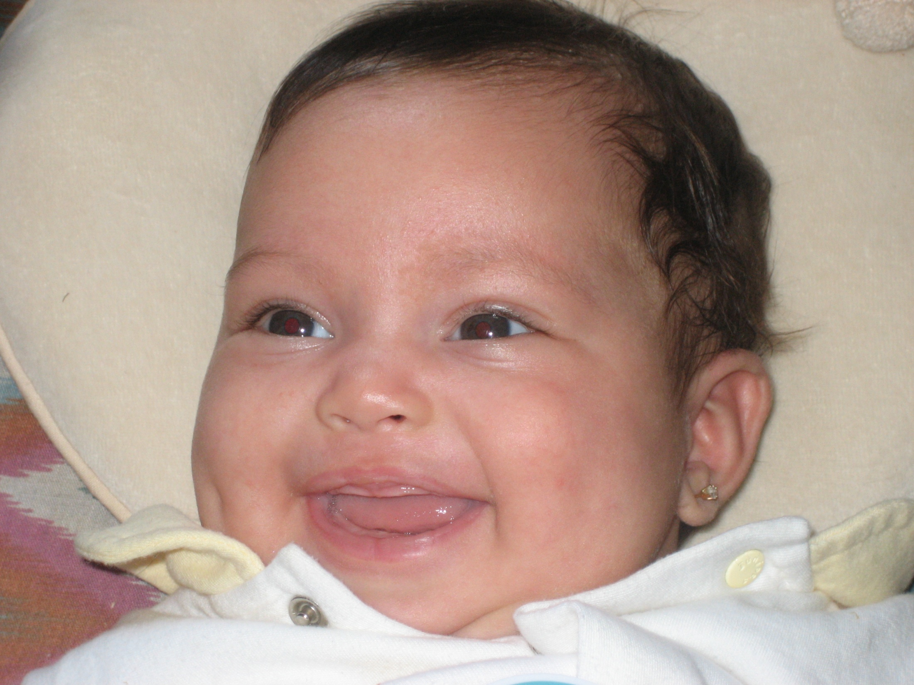

Slide 87
Barium enema
Indications
Change in the bowel habits.
Abdominal mass.
Suspected colonic obstruction.

Slide 88
Barium enema
Contraindication
Colonic perforation
recent biopsy of the rectum or colon after sigmoidoscopy or colonoscopy – 10 days interval to allows the mucosa to grow over the biopsy site.

Slide 89
Notes
Contra indication to double contrast barium enema are:
Pseudomembranous colitis.
Toxic mega colon.
Suspected perforation.

Slide 90
Barium enema
Preparation for Barium enema
Dietary restriction (avoid milk, red meat & row and cooked vegetables)
Purgative – caster oil.
Water enema.
Preliminary films: plain abdomen

Slide 91
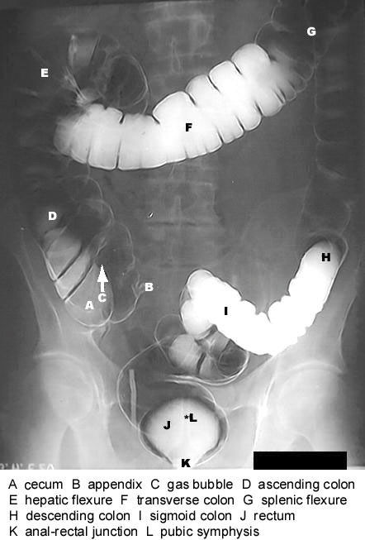

Slide 92
Barium enema
Patient lies on the LT. side & the catheter is introduced gently.
Drain Ba. by gravity till the mid transverse colon.
Air is then pumped gently into the bowel.
Patient is turned to prone position, & rolls 180 degree to coat the mucosa.

Slide 93
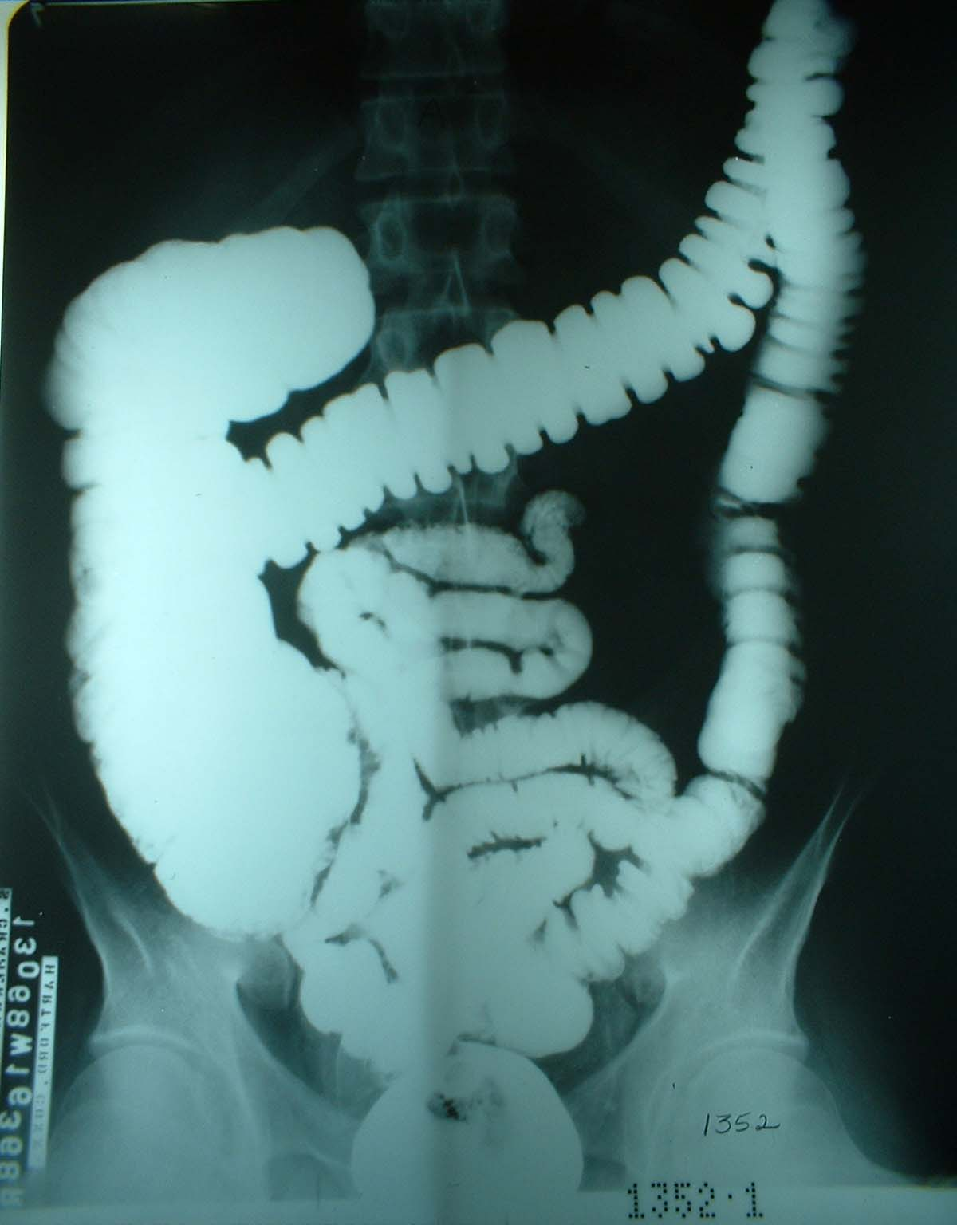
Pre evacuation

Slide 94
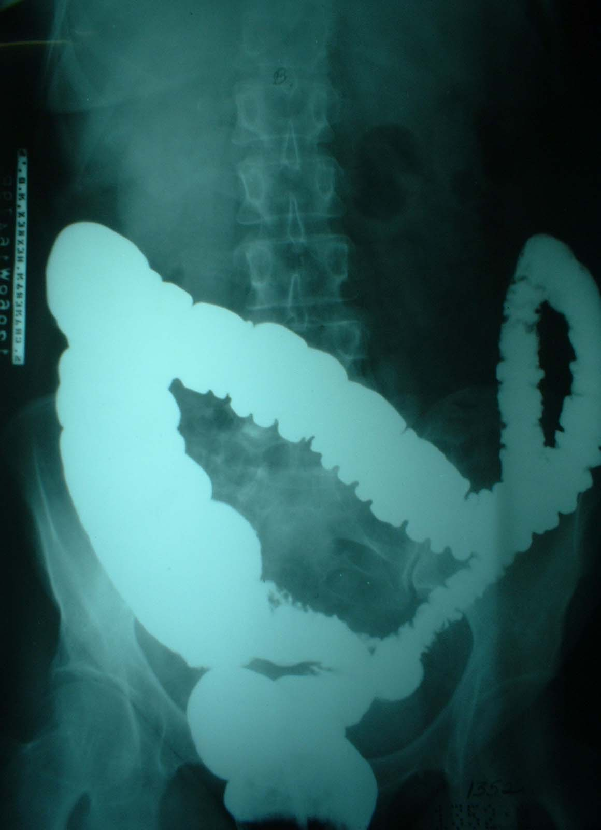
Pre evacuation

Slide 95
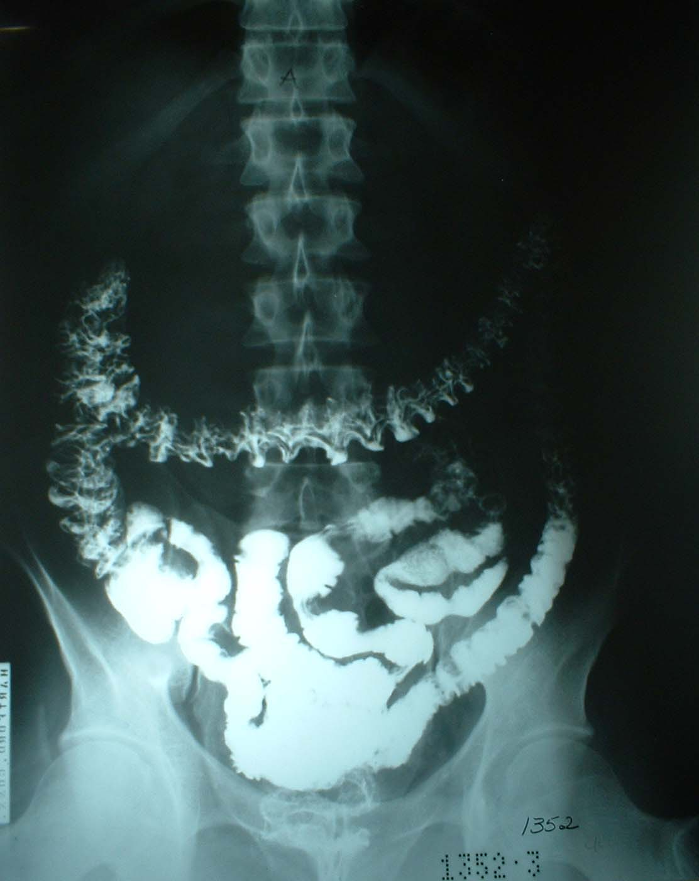
Post evacuation

Slide 96
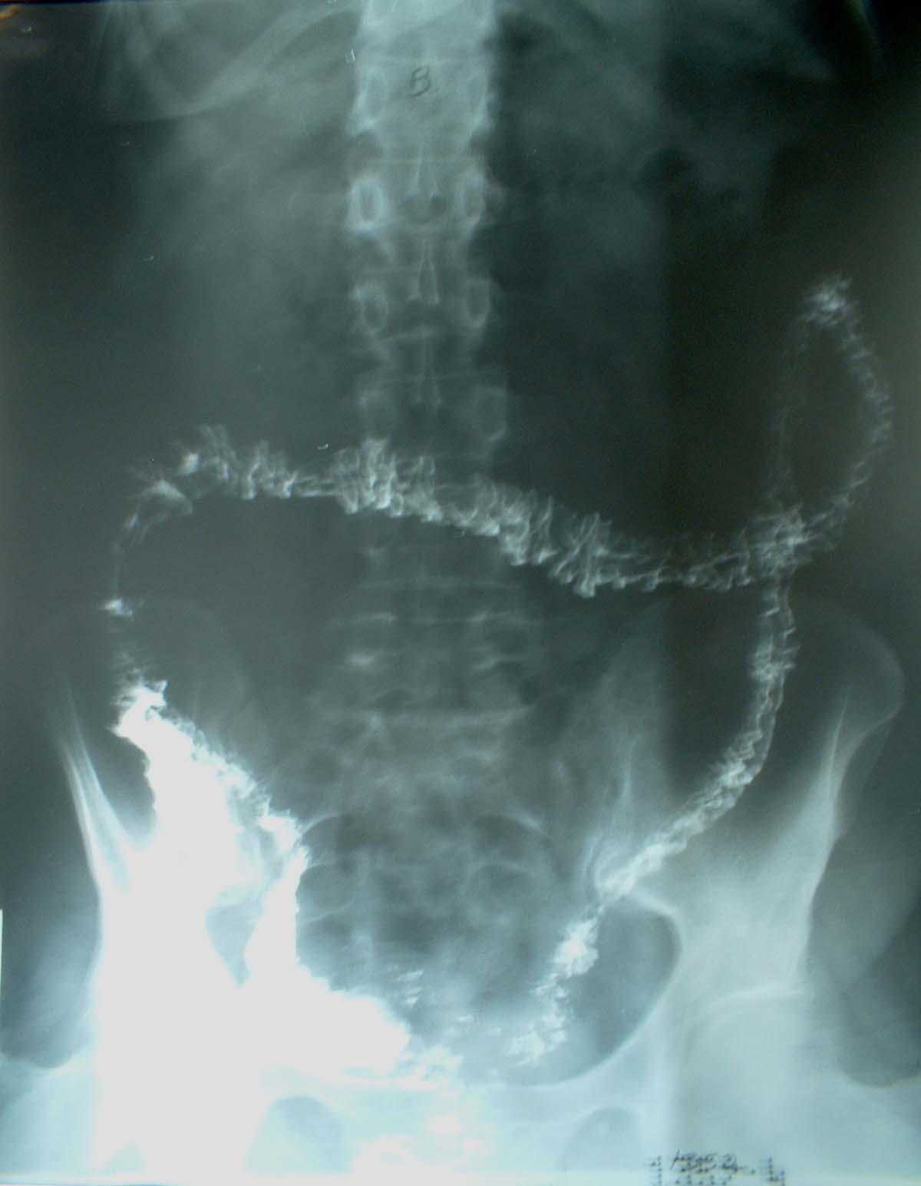
Post evacuation

Slide 97
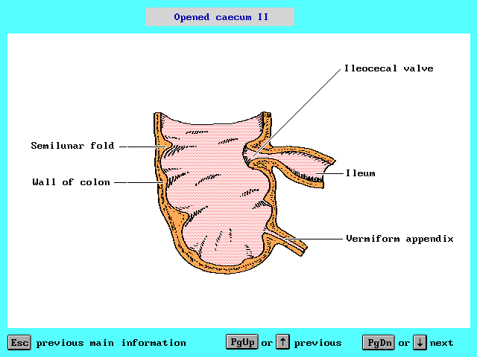

Slide 98
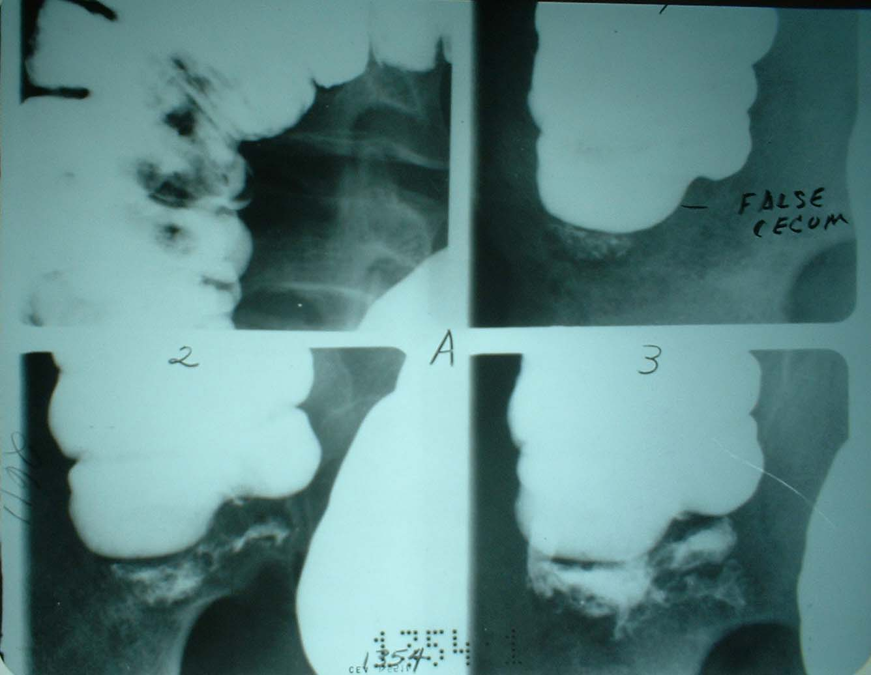
Tip of the Cecum

Slide 99
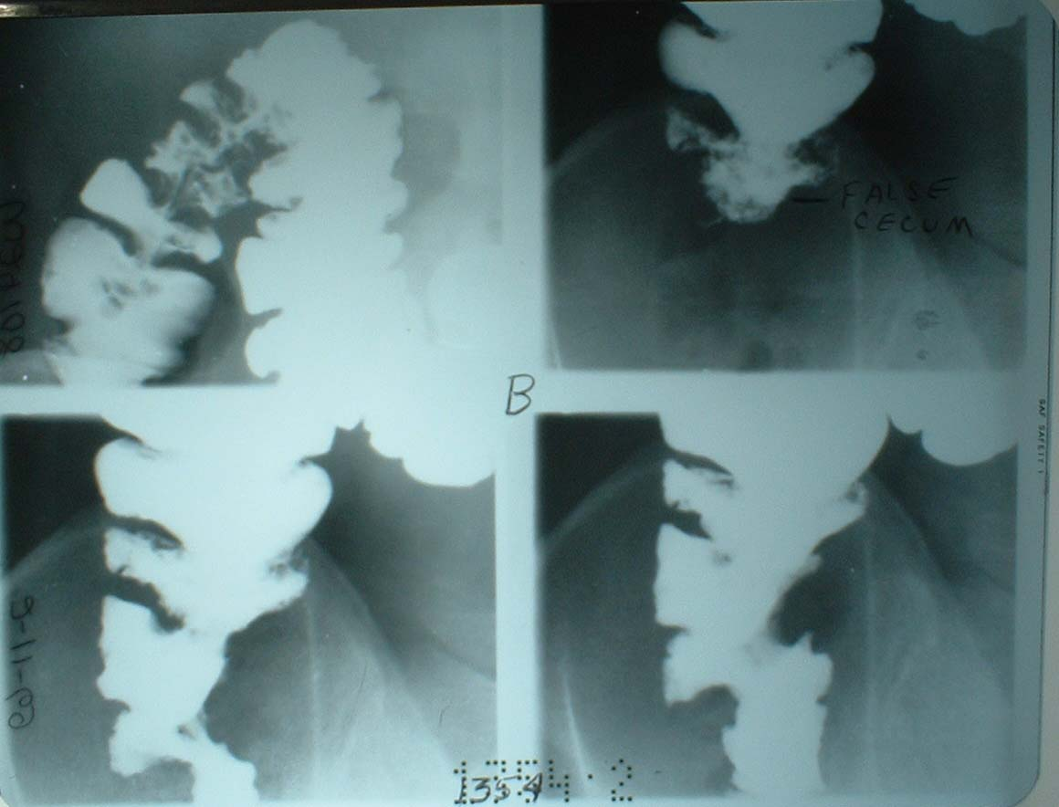
Tip of the Cecum

Slide 100


Slide 101


Slide 102


Slide 103


Slide 104


Slide 105


Slide 106


Slide 107


Slide 108


Slide 109

Sphincters of the colon
Mid& hind gut
Start of peristalsis
Thick muscle fiber
Thick muscle fiber

Slide 110


Slide 111
Thank You

