Slide 1
بسم الله الرحمن الرحيم
Lower limb

Slide 2
Foot
1- Dorsi-plantar (basic)
Position of patient and cassette
• The patient is seated on the X-ray table, supported if necessary, with the affected hip and knee flexed.
• The plantar aspect of the affected foot is placed on the
cassette and the lower leg is supported in the vertical position
by the other knee.
Direction and centering of the X-ray beam
• The central ray is directed over the cuboid-navicular joint,
midway between the palpable navicular tuberosity and the
tuberosity of the fifth metatarsal.
• The X-ray tube is angled 15 degrees cranially when the
cassette is flat on the table.
• The X-ray tube is vertical when the cassette is raised on a
15-degree pad.
  detector size 18 cm x 24 cm exposure50-55 kVp
  3-4 mAs

Slide 3
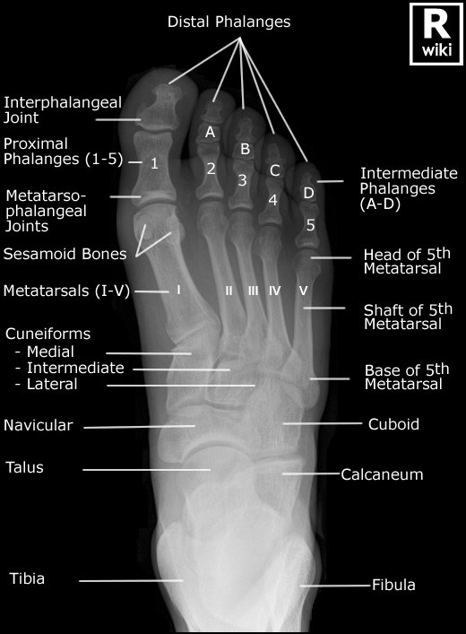
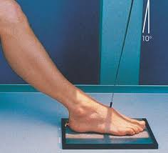

Slide 4
2- Dorsi-plantar oblique
Position of patient and cassette
• From the basic dorsi-plantar position, the affected limb is allowed to lean medially to bring the plantar surface of the foot approximately 30–45 degrees to the cassette.
• A non-opaque angled pad is placed under the foot to maintain the position, with the opposite limb acting as a support.
Direction and centering of the X-ray beam
• The vertical central ray is directed over the cuboid-navicular joint.
detector size 18 cm x 24 cm exposure 50-55 kVp 3-4 mAs

Slide 5


Slide 6
3- Lateral
Position of patient and cassette
• From the dorsi-plantar position, the leg is rotated outwards
to bring the lateral aspect of the foot in contact with the cassette.
• A pad is placed under the knee for support.
• The position of the foot is adjusted slightly to bring the plantar
aspect perpendicular to the cassette.
Direction and centering of the X-ray beam
• The vertical central ray is centered over the navicular cuneiform.
detector size
  18 cm x 24 cm
exposure
  55-60 kVp
  4-6 mAs

Slide 9
Ankle joint
1- Antero-posterior – basic (Mortice projection)
Position of patient and cassette
• The patient is either supine or seated on the X-ray table with
both legs extended.
• A pad may be placed under the knee for comfort.
• The affected ankle is supported in dorsiflexion by a firm
90-degree pad placed against the plantar aspect of the foot.
The limb is rotated medially (approximately 20 degrees) until
the medial and lateral malleoli are equidistant from the cassette.
• The lower edge of the cassette is positioned just below the
plantar aspect of the heel.
Direction and centering of the X-ray beam
• Centre midway between the malleoli with the vertical central
ray at 90 degrees to an imaginary line joining the malleoli.

Slide 10
detector size
  24 cm x 30 cm
exposure
  50-60 kVp
  3-5 mAs

Slide 11
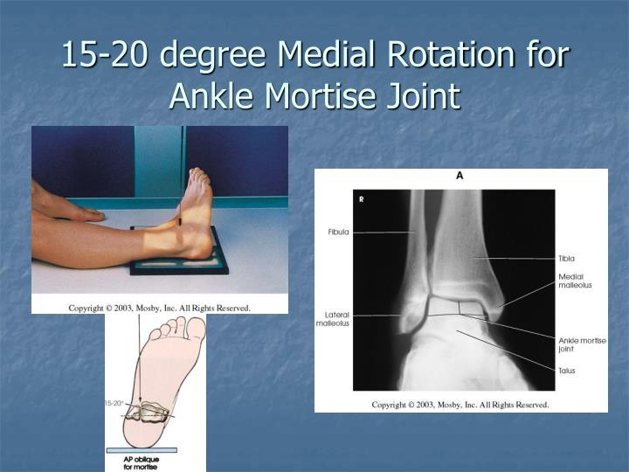

Slide 12
2- Lateral (basic) – medio-lateral
Direction and centering of the X-ray beam
• Centre over the medial malleolus, with the central ray at right-angles to the axis of the tibia
Essential image characteristics
• The lower third of the tibia and fibula should be included.
• The medial and lateral borders of the trochlear articular surface of the talus should be superimposed on the image.

Slide 13
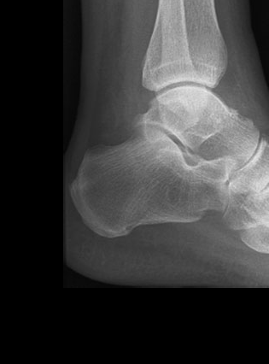
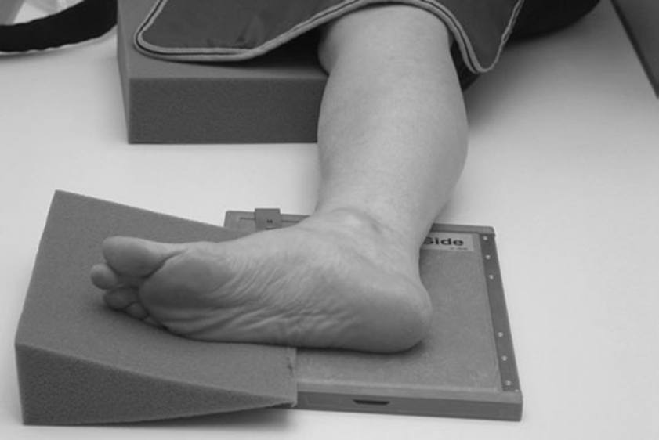

Slide 14
3- Antero-posterior
Position of patient and cassette
• From the sitting position, whilst the patient is in a wheelchair,
the whole limb is raised and supported on a stool and a
pad is placed under the raised knee for support.
• The lower limb is rotated medially, approximately 20 degrees, until the medial and lateral malleoli are equidistant
from the cassette. A non-opaque angled pad is placed again the medial border of the foot and sandbags are placed at each
side of the leg for support.
• The lower edge of the cassette is placed just below the
plantar aspect of the heel.
Direction and centering of the X-ray beam
• Centre midway between the malleoli, with the vertical central
ray at 90 degrees to the imaginary line joining the malleoli or
compensatory angulation of the beam if the foot is straight.

Slide 15

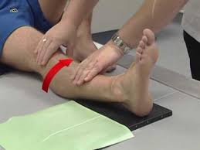

Slide 16
Calcaneum
1- Lateral – basic
Position of patient and cassette
• the patient rotates on to the affected side.
• The leg is rotated until the medial and lateral malleoli are
superimposed vertically.
• A 15-degree pad is placed under the anterior aspect of the
knee and the lateral border of the forefoot for support.
• The cassette is placed with the lower edge just below the
plantar aspect of the heel.
Direction and centering of the X-ray beam
• Centre 2.5 cm distal to the medial malleolus, with the vertical central ray perpendicular to the cassette.
detector size 18 cm x 24 cm exposure50-60 kVp 3-5 mAs

Slide 17
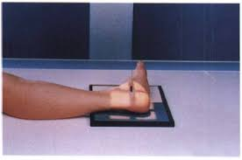
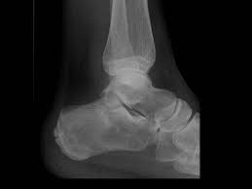

Slide 18
• The cassette is positioned with its lower edge just distal to the plantar aspect of the heel. Direction and centering of the X-ray beam
• Centre to the plantar aspect of the heel at the level of the tubercle of the fifth metatarsal.
• The central ray is directed cranially at an angle of 40 degrees to the plantar aspect of the heel.

Slide 19
2- Axial – basic
Position of patient and cassette
• The patient sits or lies supine on the X-ray, table with both limbs extended.
• The affected leg is rotated medially until both malleoli are equidistant from the film.
• The ankle is dorsiflexed The position is maintained by using a bandage strapped around the forefoot and held in position by the patient.

Slide 20
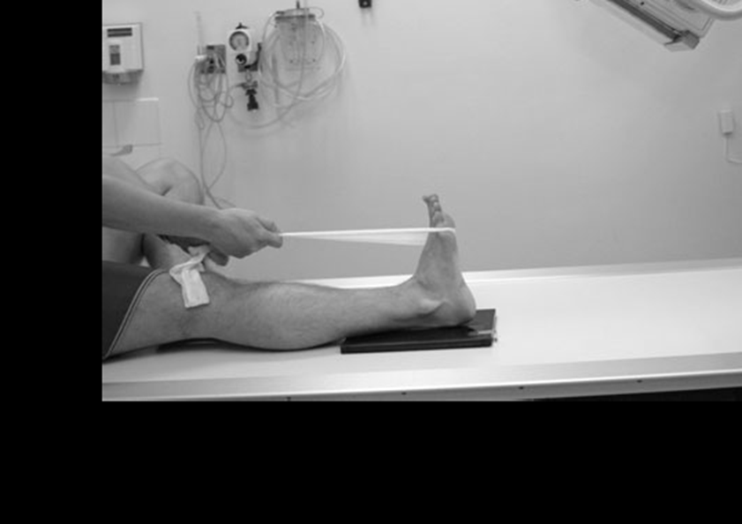

Slide 21
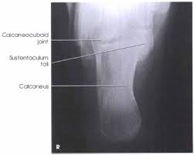

Slide 22
Tibia and fibula
1- Antro-postereior
Position of patient and cassette
• The patient is either supine or seated on the X-ray table, with both legs extended.
• The ankle is supported in dorsiflexion by a firm 90-degree pad placed against the plantar aspect of the foot. The limb is rotated medially until the medial and lateral malleoli are equidistant from the cassette. The lower edge of the cassette is positioned just below the plantar aspect of the heel.
Direction and centering of the X-ray beam.
• Centre to the middle of the cassette, with the central ray at right-angles to both the long axis of the tibia and an imaginary line joining the malleoli. detector size
  35 cm x 43 cm or 43 cm x 35 cm
exposure
  50-60 kVp
  3-5 mAs

Slide 23
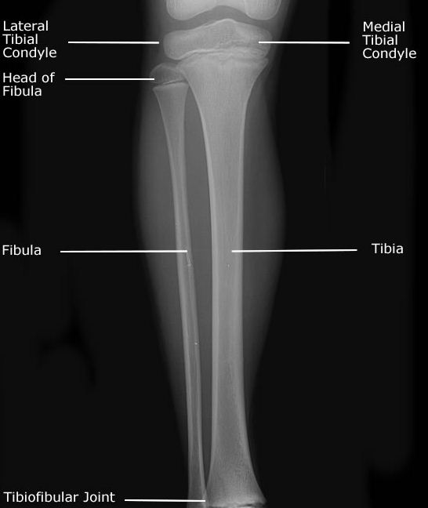
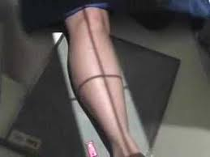

Slide 24
2- lateral
Position of patient and cassette
• From the supine/seated position, the patient rotates on to the affected side.
• The leg is rotated further until the malleoli are superimposed vertically, The tibia should be parallel to the cassette.
• A pad is placed under the knee for support.
• The lower edge of the cassette is positioned just below the plantar aspect of the heel.
Direction and centering of the X-ray beam
• Centre to the middle of the cassette, with the central ray at right-angles to the long axis of the tibia and parallel to an imaginary line joining the malleoli.

Slide 25
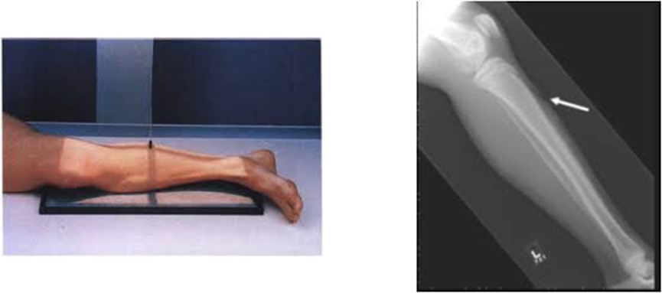

Slide 26
Knee joint
1- Antero-posterior
Position of patient and cassette
• The patient is either supine or seated on the X-ray table, with both legs extended. The affected limb is rotated to centralize the patella between the femoral condyles, and sandbags are placed against the ankle to help maintain this position.
• The cassette should be in close contact with the posterior aspect of the knee joint, with its centre level with the upper borders of the tibial condyles.
Direction and centering of the X-ray beam.
• Centre 2.5 cm below the apex of the patella through the joint
space, with the central ray at 90 degrees to the long axis of the tibia
  detector size 24 cm x 30 cm exposure60-70 kVp
  7-10 mAs

Slide 27
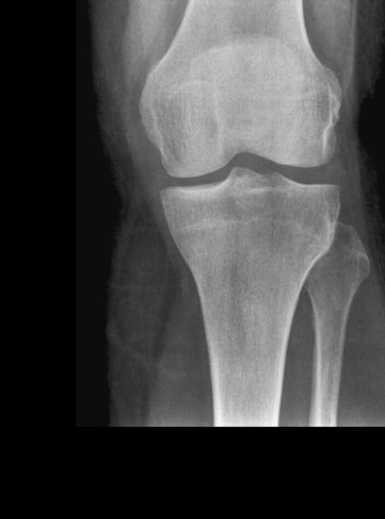

Slide 28
2- Lateral knee
• The patient lies on the side to be examined, with the knee flexed at 45 or 90 degrees.
• The other limb is brought forward in front of the one being examined and supported on a sandbag
• A sandbag is placed under the ankle of the affected side to bring the long axis of the tibia parallel to the cassette.
• The position of the limb is now adjusted to ensure that the femoral condyles are superimposed vertically.
• The center of the cassette is placed level with the medial tibial condyle.
• Centre to the middle of the superior border of the medial tibial condyle, with the central ray at 90 degrees to the long axis of the tibia
detector size 24 cm x 30 cm exposure 60-70 kVp
  7-10 mAs

Slide 29
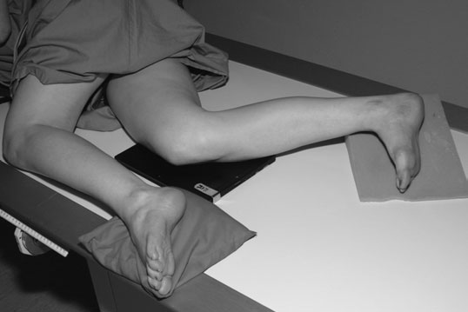
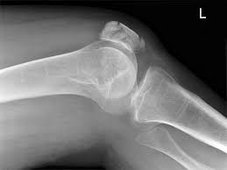

Slide 30
The skyline projection can be used to:
• assess the retro-patellar joint space for degenerative disease;
• determine the degree of any lateral subluxation of the patella with
ligament laxity; diagnose chondromalacia patellae;
The optimum retro-patellar joint spacing occurs when the
knee is flexed approximately 30–45 degrees. Further flexion
pulls the patella into the intercondylar notch, reducing the joint
spacing; as flexion increases, the patella tracks over the lateral
femoral condyle. The patella moves a distance of 2 cm from full
extension to full flexion.
There are three methods of achieving the skyline projection:
• conventional infero-superior;
• supero-inferior – beam directed downwards;
• infero-superior – patient prone. skyline projections

Slide 31
A- Conventional infero-superior
Position of patient and cassette
• The patient sits on the X-ray table, with the knee flexed
30–45 degrees and supported on a pad placed below the knee.
• A cassette is held by the patient against the anterior distal
femur and supported using a non-opaque pad, which rests on
the anterior aspect of the thigh.
Direction and centering of the X-ray beam
• The tube is lowered, the central ray is directed cranially to pass
through the apex of the patella parallel to the long axis
• The beam should be closely collimated to the patella and
femoral condyles to limit scattered radiation to the trunk and
head. detector size
  18 cm x 24 cm exposure 60-70 kV
  7-10 mAs

Slide 32
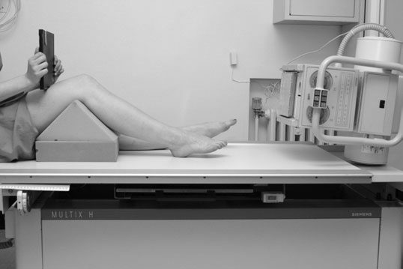
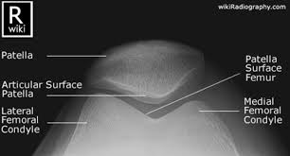

Slide 33
B- Supero-inferior
Position of patient and cassette
• The patient sits on the X-ray table, with the affected knee flexed over the side.
• Ideally, the leg should be flexed to 45 degrees to reflect a similar knee position to the conventional skyline projection. Too much flexion reduces the retro-patellar spacing. Sitting the patient on a cushion helps to achieve the optimum position.
• The cassette is supported horizontally on a stool at the level of the inferior tibial tuberosity border.
Direction and centering of the X-ray beam
• The vertical beam is directed to the posterior aspect of the proximal border of the patella. The central ray should be parallel to the long axis of the patella.
• The beam is collimated to the patella and femoral condyles.
detector size
  18 cm x 24 cm
exposure
  60-70 kVp
  7-10 mAs

Slide 34
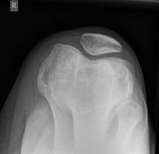

Slide 35
C- Infero-superior – patient prone
Position of patient and cassette
• The patient lies prone on the X-ray table, with the cassette
placed under the knee joint and the knee flexed through 90
degrees.
• A bandage placed around the ankle and either tethered to a
vertical support or held by the patient may prevent unnecessary
movement.
Direction and centering of the X-ray beam
• Centre behind the patella, with the vertical central ray angled
approximately 15 degrees towards the knee, avoiding the toes
detector size
  18 cm x 24 cm
exposure
  60-70 kVp
  7-10 mAs.

Slide 36
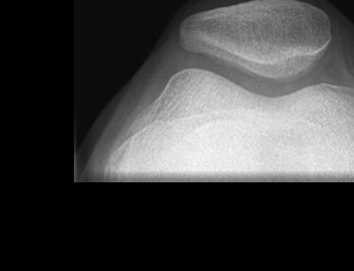

Slide 37
Shaft of femur
1- Antero-posterior
Position of patient and cassette
• The patient lies supine on the X-ray table, with both legs
extended.
• The affected limb is rotated to centralize the patella over the
femur.
• The cassette is positioned in the Bucky tray immediately under
the limb, adjacent to the posterior aspect of the thigh to include
both the hip and the knee joints.
• Alternatively, the cassette is positioned directly under the limb,
against the posterior aspect of the thigh to include knee joint.
Direction and centering of the X-ray beam
• Centre to the middle of the cassette, with the vertical central
ray at 90 degrees to an imaginary line joining femoral condyles.

Slide 38
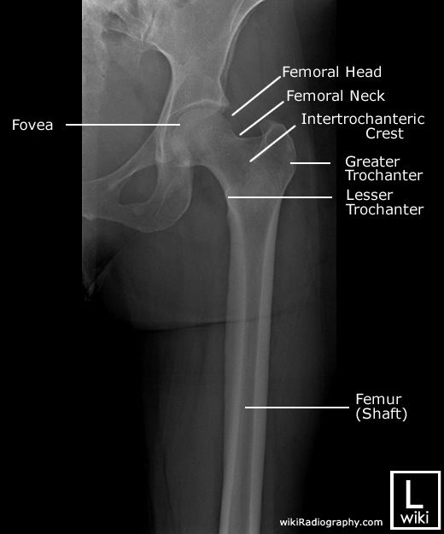
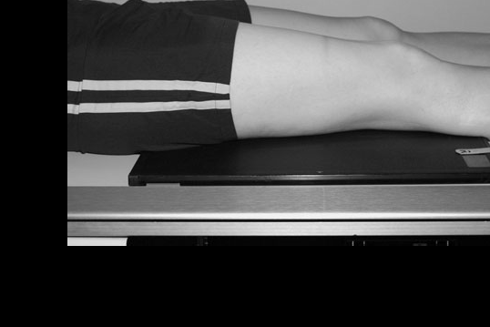

Slide 39
2- Lateral – basic
Position of patient and cassette
• From the antero-posterior position, the patient rotates on to
the affected side, and the knee is slightly flexed.
• The pelvis is rotated backwards to separate the thighs.
• The position of the limb is then adjusted to vertically superimpose
the femoral condyles.
• The cassette is positioned in the Bucky tray under the lateral
aspect of the thigh to include the knee joint.
• Alternatively, the cassette is positioned directly under the limb,
against the lateral aspect of the thigh to include the knee joint.
Direction and centering of the X-ray beam
• Centre to the middle of the cassette, with the vertical central
ray parallel to the imaginary line joining the femoral condyles.

Slide 40
