Slide 1
BONE DISEASES
Dr. Ahmed M. Attay

Slide 2
Nutritional and metabolic bone diseases

Slide 3
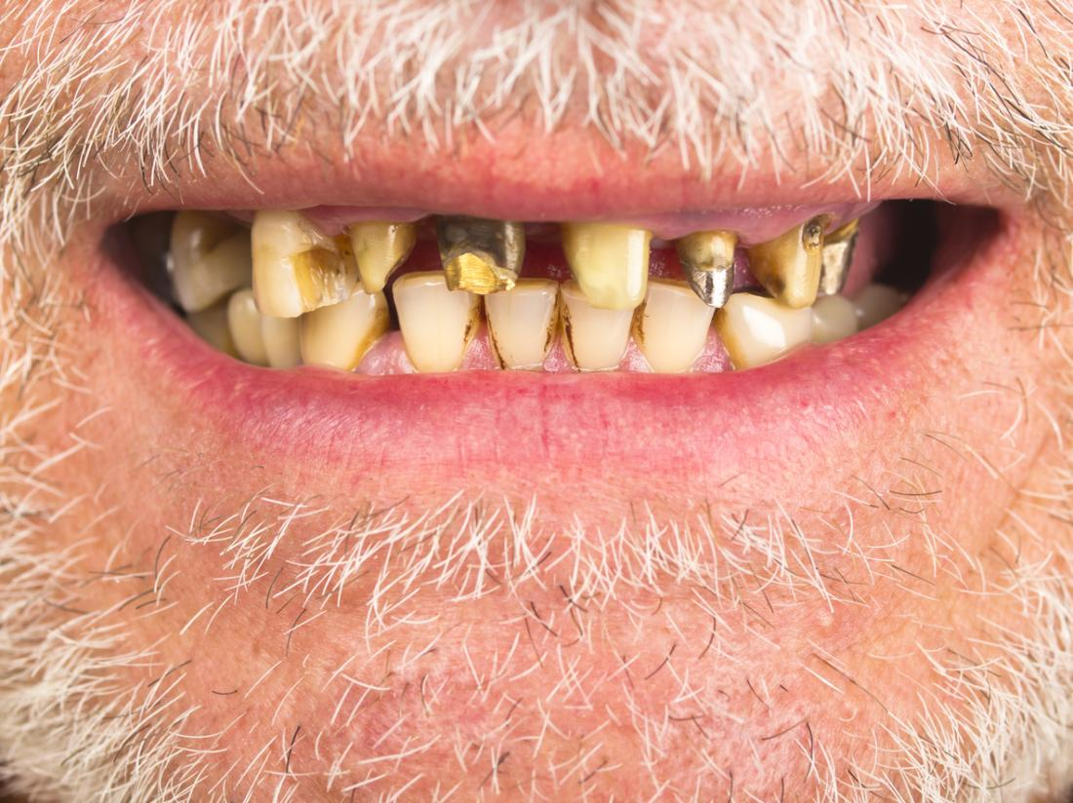
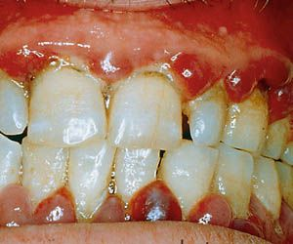
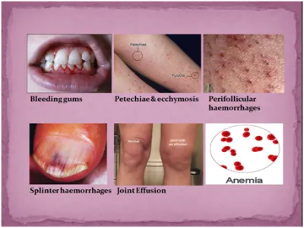
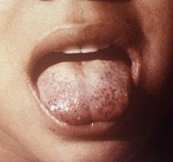
Nutritional and metabolic bone diseases
Vitamin C deficiency (Scurvy)
Scurvy causes defective formation of the collagenous and osteoid matrix, the matrix as it forms is well calcified.
Oral manifestations:
Scorbutic gingivitis; generalized gingival swelling with hemorrhage and redness.
Oral ulcerations and delayed wound healing.
Tooth mobility and increased severity of periodontal infection with bone loss.
Weakened vascular walls resulting in petechial hemorrhage and ecchymosis.
Gross dental caries of anterior teeth due to sugar rich vitamin C syrup.

Slide 4
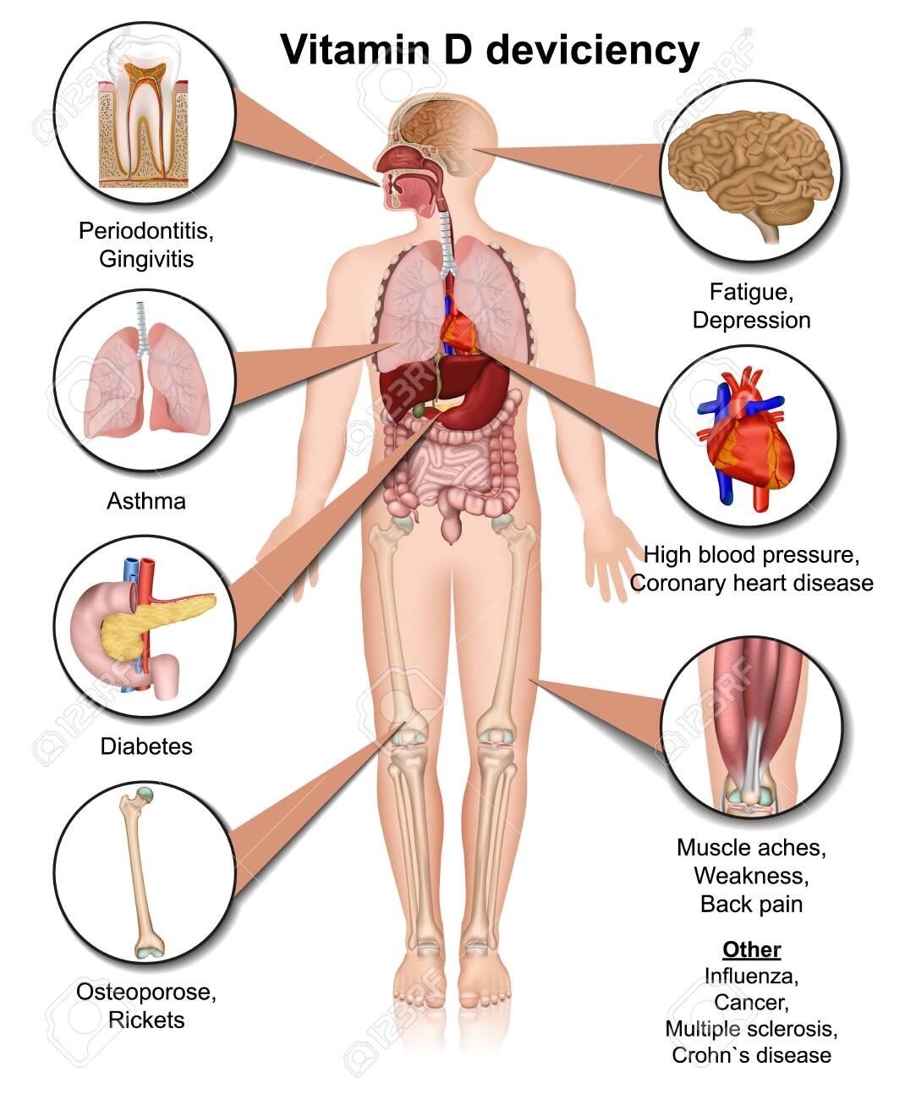
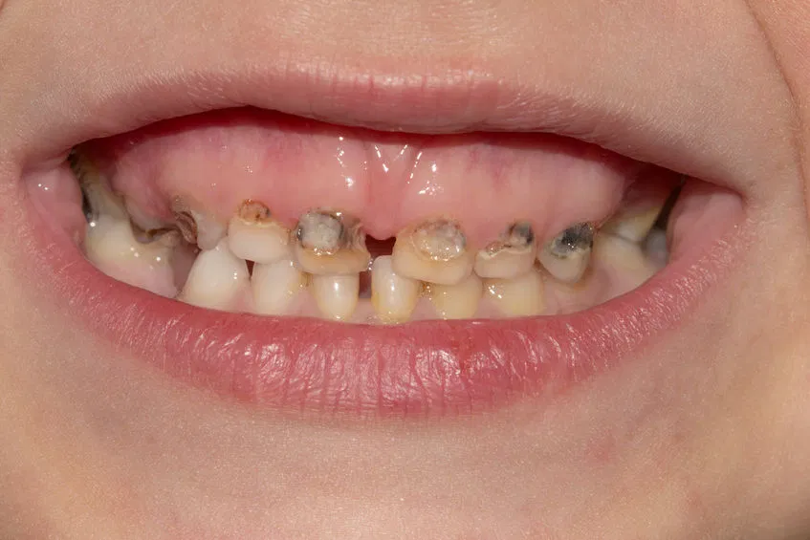
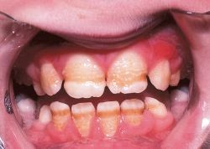
Nutritional and metabolic bone diseases
Vitamin D deficiency
In children will cause rickets, while in adults results in osteomalacia.
Cause: lack of adequate sunlight exposure, or lack of adequate calcium intake.
Rickets and osteomalacia there are failure of mineralization of osteoid and cartilage matrix.
Oral manifestations:
Enamel hypoplasia. Delayed eruption of teeth.
Increased width of pre-dentine and excessive interglobular spaces.
Involvement of the jaws has been reported in the form of deficient growth of condylar cartilage. This leads to lack of growth of vertical ramus of the mandible.
Histological features:
The bone trabeculae in both rickets and osteomalacia are characterized by wide seams of uncalcified osteoid tissue.

Slide 5
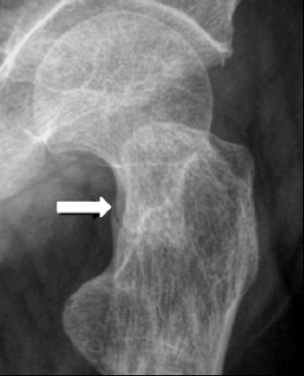
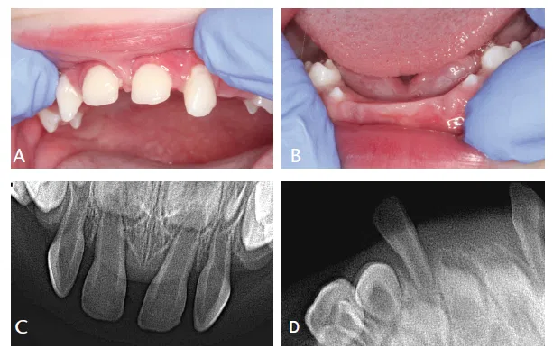
Nutritional and metabolic bone diseases
Hypophosphatasia
Represents deficiency of alkaline phosphatase enzyme transmitted as an autosomal recessive manner. It is of dental significance in children due to premature teeth loss.
Dental findings:
Enlarged pulp chambers of primary dentition.
Reduced marginal alveolar bone.
Hypoplasia or aplasia of cementum over root surface.
Deficiency of root development.
Premature teeth exfoliation in both dentitions (defect in cementogenesis).
Focal areas of dentin resorption.

Slide 6
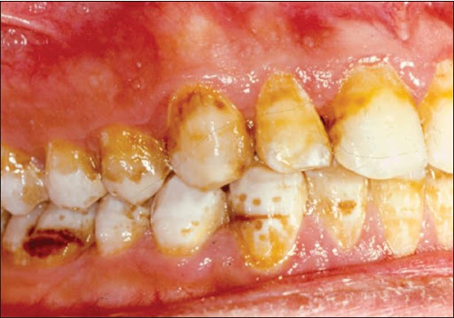
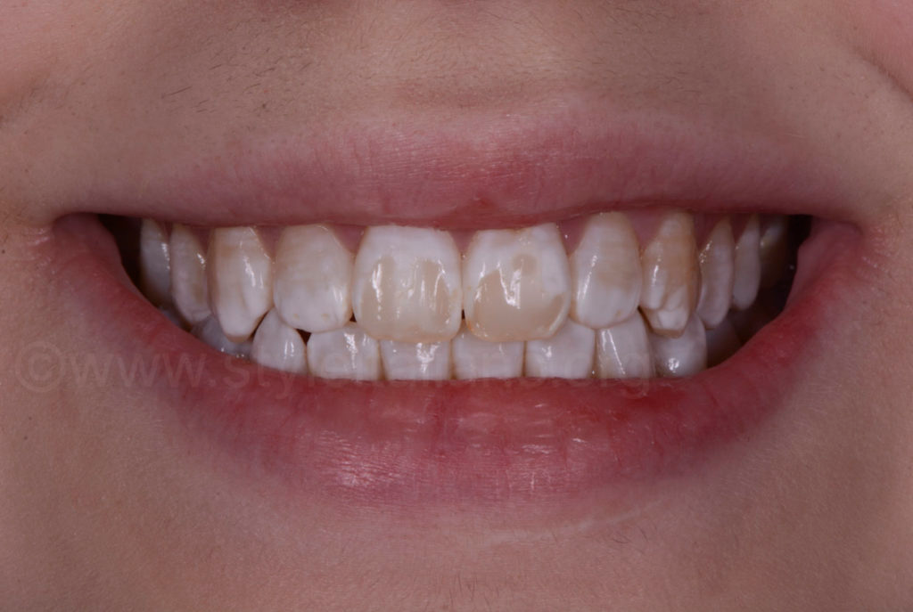
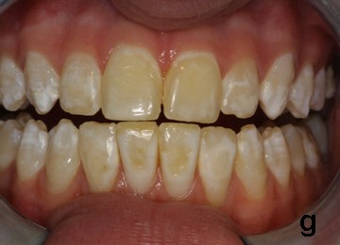
Nutritional and metabolic bone diseases
Fluorosis
This results from the ingestion of excess amounts of fluoride leading to significant enamel defects known as dental fluorosis.
Intake of water containing fluoride at level greater than 1 part per million during crown formation may result in enamel hypoplasia or hypocalcification.
The extent of damage depends on duration, timing and concentration.
Mild to moderate fluorosis ranges from white enamel spots to mottled brown and white discoloration.
Severe fluorosis appears as pitted, irregular and discolored enamel.
Excessive ingestion of fluoride in the drinking water results also in sclerosis of the skeleton.
Calcification of intervertebral ligaments and the insertion of the muscles causing pain and stiffness.

Slide 7
Idiopathic bone diseases

Slide 8
Idiopathic bone diseases
Langerhans cell histiocytosis
(Histiocytosis X)
Histiocytosis X is a collective designation for a spectrum of clinico-pathologic disorders characterized by proliferation of histiocytic-like cells (Langerhans cells) that are accompanied by varying numbers of eosinophils, lymphocytes, plasma cells and multinucleated giant cells. It is now believed to be a neoplastic process.
Langerhans cells are dendritic mononuclear cells normally found in epidermis, mucosa, lymph nodes and bone marrow.
Langerhans cells are antigen presenting cells, they process and present antigens to T-lymphocytes.

Slide 9
Idiopathic bone diseases
Langerhans cell histiocytosis
(Histiocytosis X)
Langerhans cell histiocytes include three disorders:
a. Hand-Schüller-Christian disease.
b. Letterer-Siwe disease.
c. Monostotic or polyostotic eosinophilic granuloma.

Slide 10
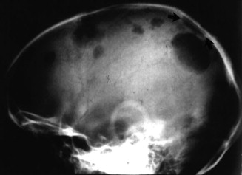
Idiopathic bone diseases
Hand-Schüller-Christian disease
It is the chronic disseminated form of the disease.
It occurs in children and adults.
It is characterized by a triad of:
Exophthalmos.
Diabetes insipidus.
Osteolytic bone lesions.
In addition to lymphadenopathy, dermatitis and hepatosplenomegaly.
Child may survive for 5 years.

Slide 11
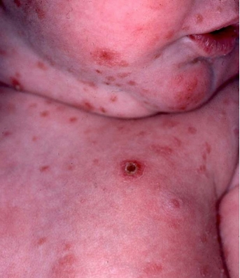
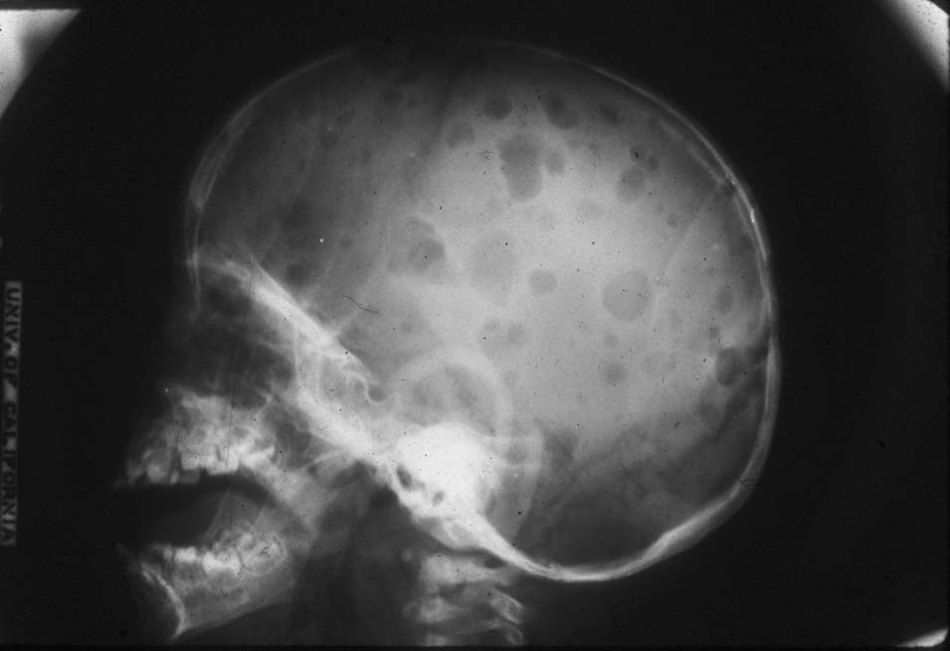
Idiopathic bone diseases
Letterer-Siwe disease
It is the acute disseminated form of the disease.
It is a disease of infancy.
It is characterized by osteolytic bone lesions, lymphadenopathy, dermatitis and wide visceral organ involvement.
Fatal disease within one year.

Slide 12
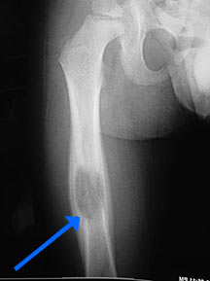
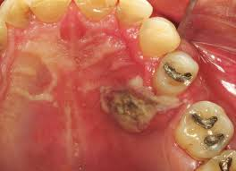
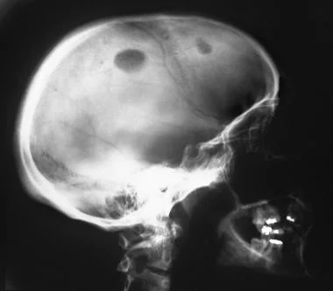
Idiopathic bone diseases
Eosinophilic granuloma
It is the chronic localized form of the disease characterized by solitary or multiple bone lesions without visceral involvement.
Clinical features:
Young children are affected and there is a male predilection.
Dull pain and tenderness often accompany bone lesions which are either solitary or multiple.
Jaws, skull, ribs and vertebrae are the most common affected sites.
The jaws are affected in 10-20% of all cases.
Looseness of teeth due to alveolar bone destruction (simulate severe periodontitis).
If the disease breaks out the bone a proliferative (hyperplastic) gingival tissue or gingival ulcerations may be developed.

Slide 13
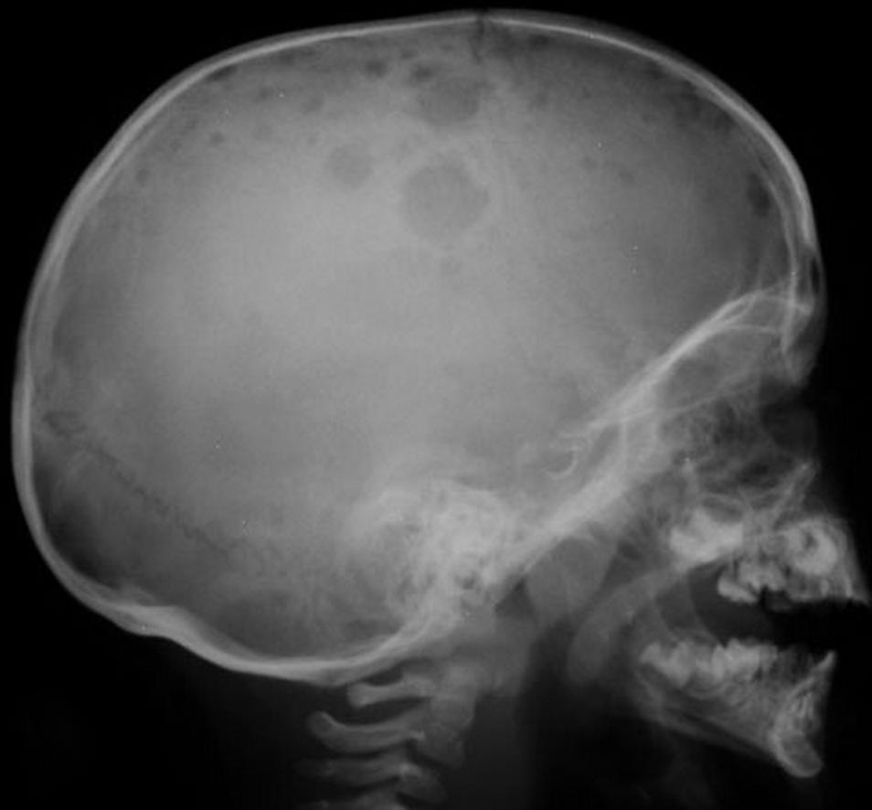
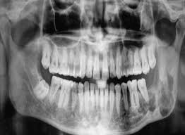
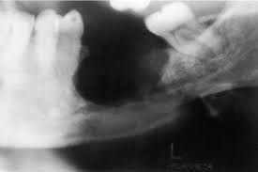
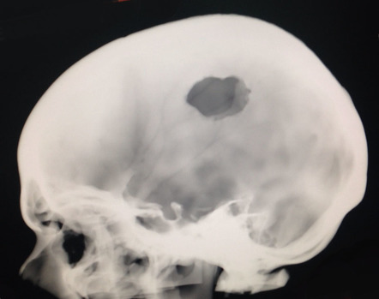
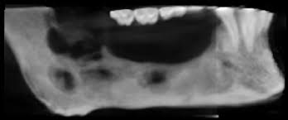
Idiopathic bone diseases
Eosinophilic granuloma
Radiographic features:
It appears as well or poorly demarcated radiolucent area (focal osteolytic lesion without cortical rim).
If well circumscribed in the jaws, it resembles cysts or periapical granuloma. The lesion stimulates periapical inflammatory condition, but with vital tooth.
It gives a typical “punched out” osteoporotic area of bone, well demarcated radiolucency without corticated rim.
If alveolar bones are destroyed “scooped out” appearance may be evident and the teeth appear as if they are floating in air.

Slide 14
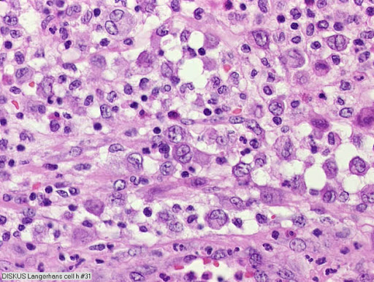
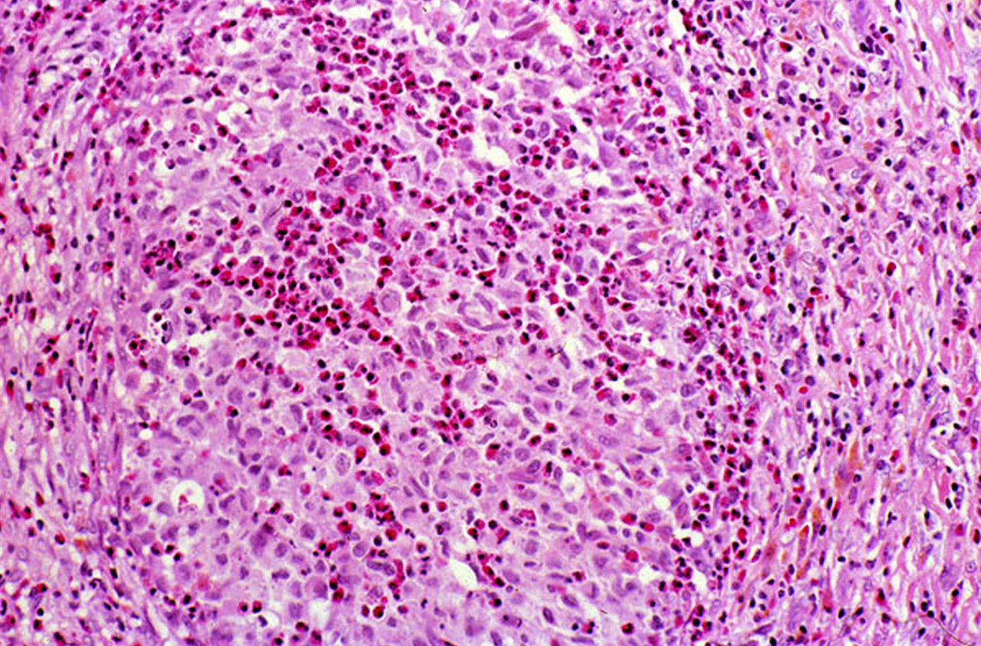
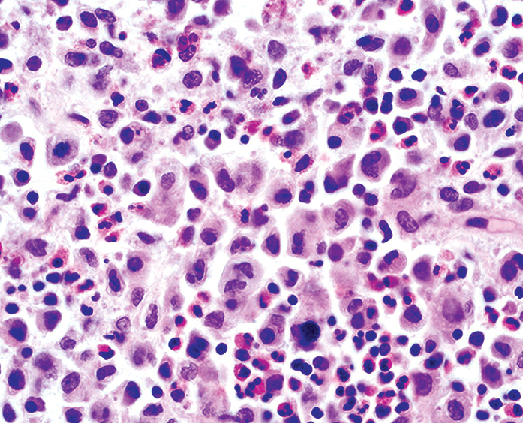
Idiopathic bone diseases
Eosinophilic granuloma
Histological features:
The bone lesions show diffuse proliferation of sheets of histiocytes-like cells that are large pale mononuclear cells, having indistinct cytoplasm border and vesicular nuclei.
Varying numbers of eosinophils, plasma cells, lymphocytes and multinucleated giant cells are typically interspersed among the histiocytes-like cells.
Areas of hemorrhage and necrosis may be present.
By electron microscope, Langerhans cells contain rod shaped cytoplasmic structures “Birebeck granules” that differentiate them from other mononuclear phagocytes.
Immunohistochemically; they are positive to S-100 protein and CD1a.

Slide 15
Neoplastic bone diseases

Slide 16
Neoplastic bone diseases
Malignant myelogenic bone tumors
Normal blood cells: most blood cells develop from cells in the bone marrow called stem cells.
Bone marrow is the soft material in the center of most bones, where stem cells mature into different types of blood cells. Each type has a special function.
Plasma cells are white blood cells that make antibodies.
Antibodies are part of the immune system. They work with other parts of the immune system to help protect the body from germs and other harmful substances.

Slide 17
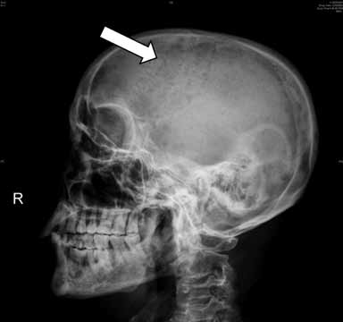
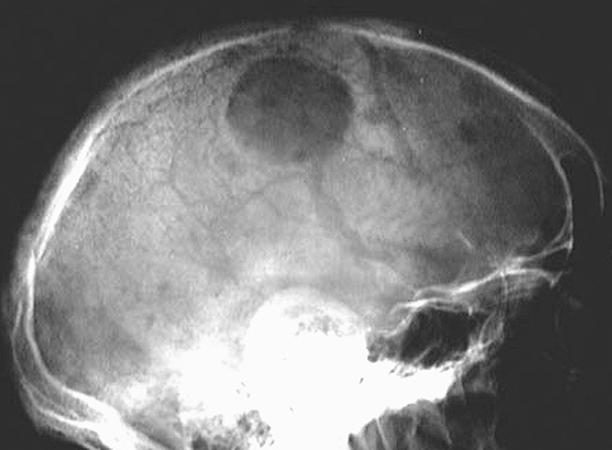
Neoplastic bone diseases
Plasma cell myeloma (Plasmacytoma)
Plasmacytoma is a univocal neoplastic proliferation of plasma cells that usually arises within bone.
Clinical features:
Males are more affected than females.
Single bone is affected; with the spine is the most commonly to be affected.
Symptoms are:
Bone pain.
Pathological fracture of the bone.
Repeated infection.
Weight loss.

Slide 18
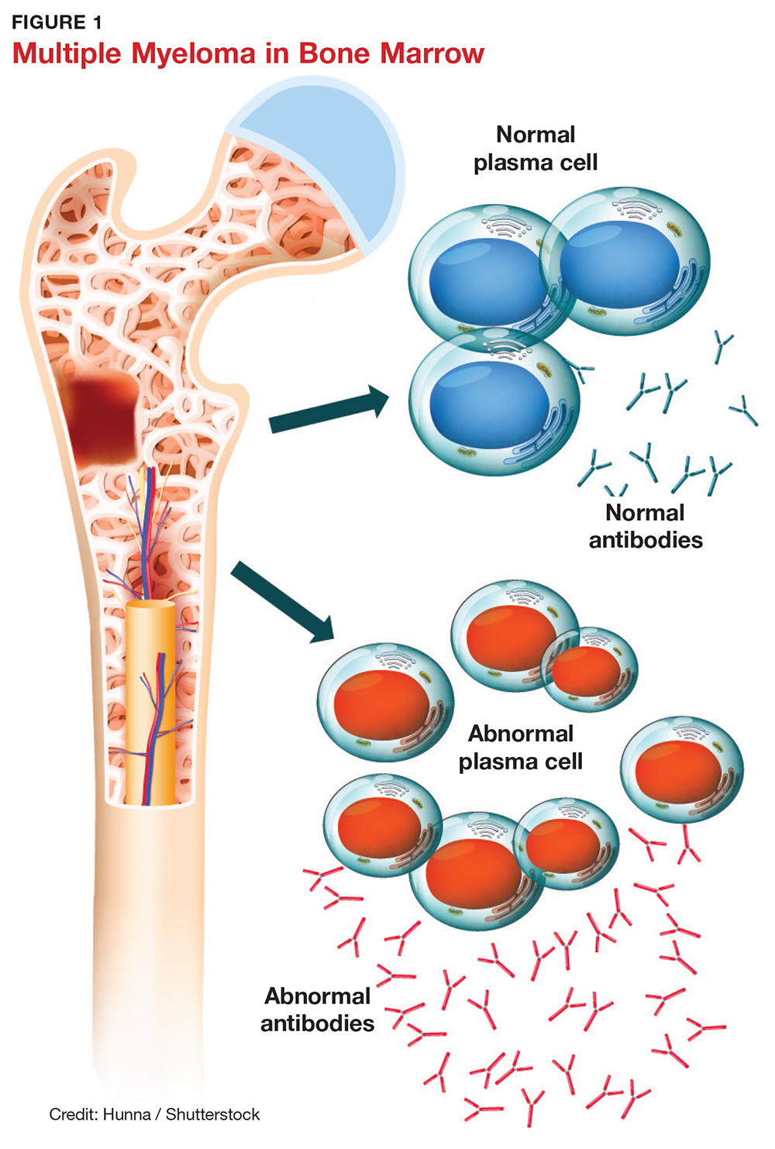
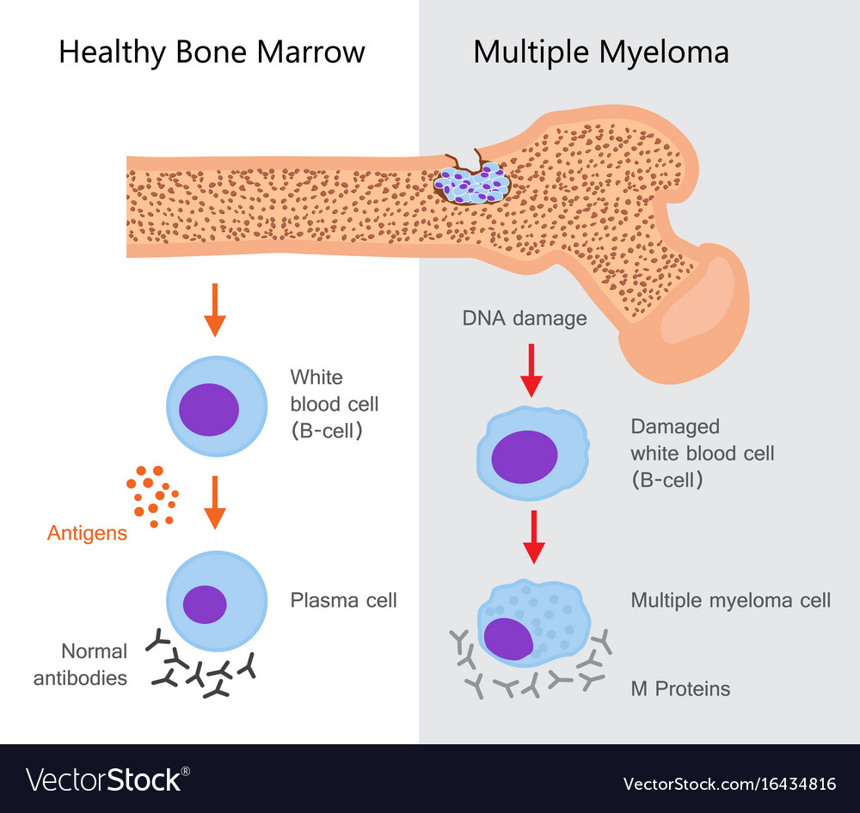
Neoplastic bone diseases
Multiple myeloma
Multiple myeloma is multicentric (more than one bone) malignancy of plasma cell origin.
It begins when plasma cells become abnormal. The abnormal cells will undergo uncontrolled mitotic division, giving abnormal plasma cells, called myeloma cells.
Myeloma cells make a large number of abnormal proteins called M proteins.
Clinical features:
Males are more affected than females.
In addition to the symptoms of plasmacytoma that also seen in multiple myeloma, the M proteins crowed normal bone marrow cells and harm the bone structure.
There is no enough room for bone marrow to make as many healthy cells. Several kinds of blood problems may results: Anemia, Leukopenia, thrombocytopenia and hypercalcemia.

Slide 19
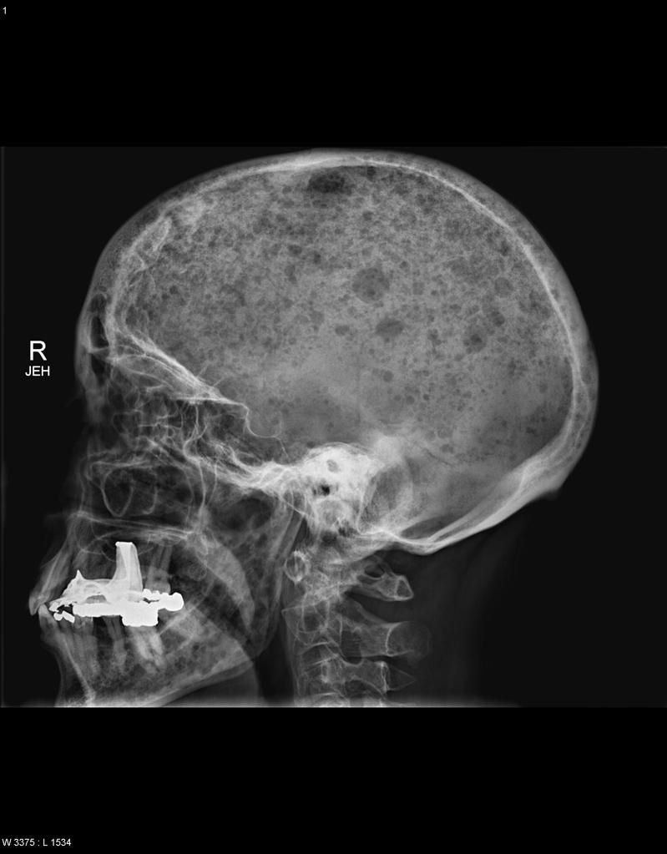
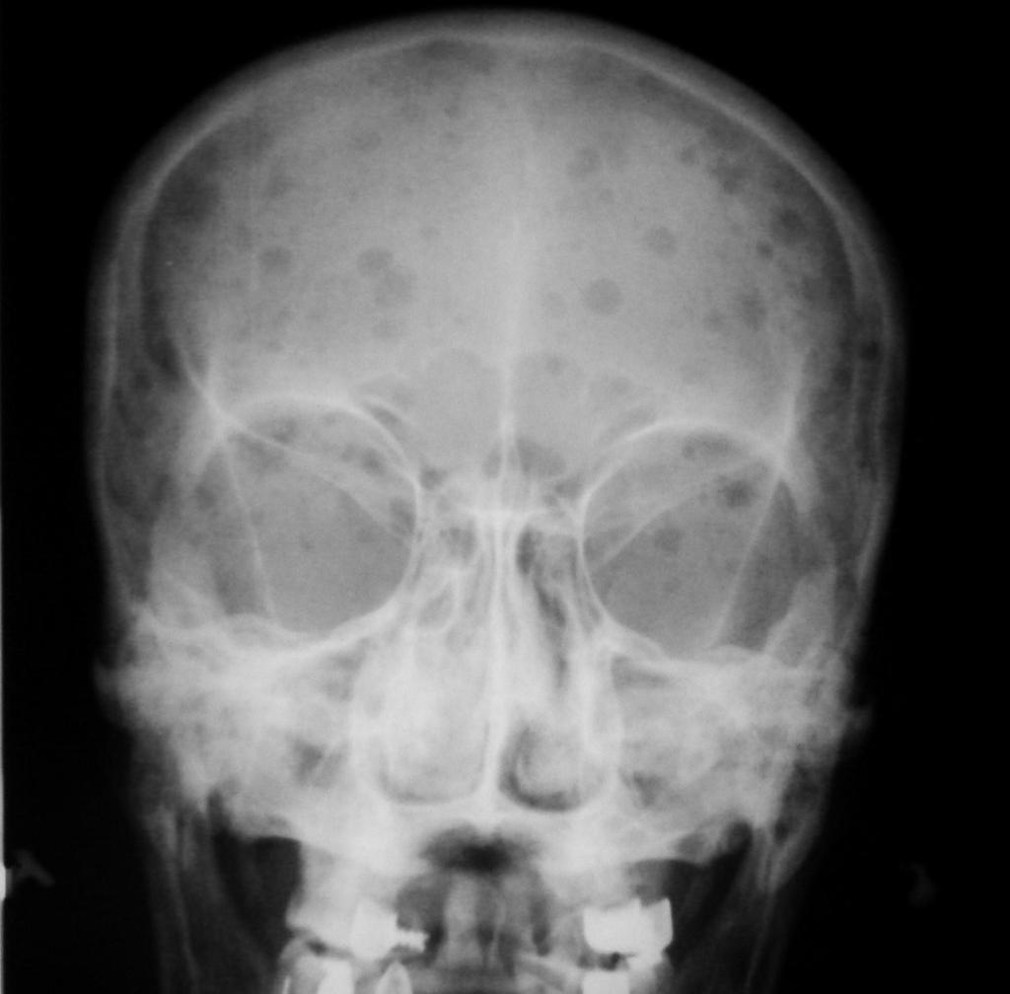
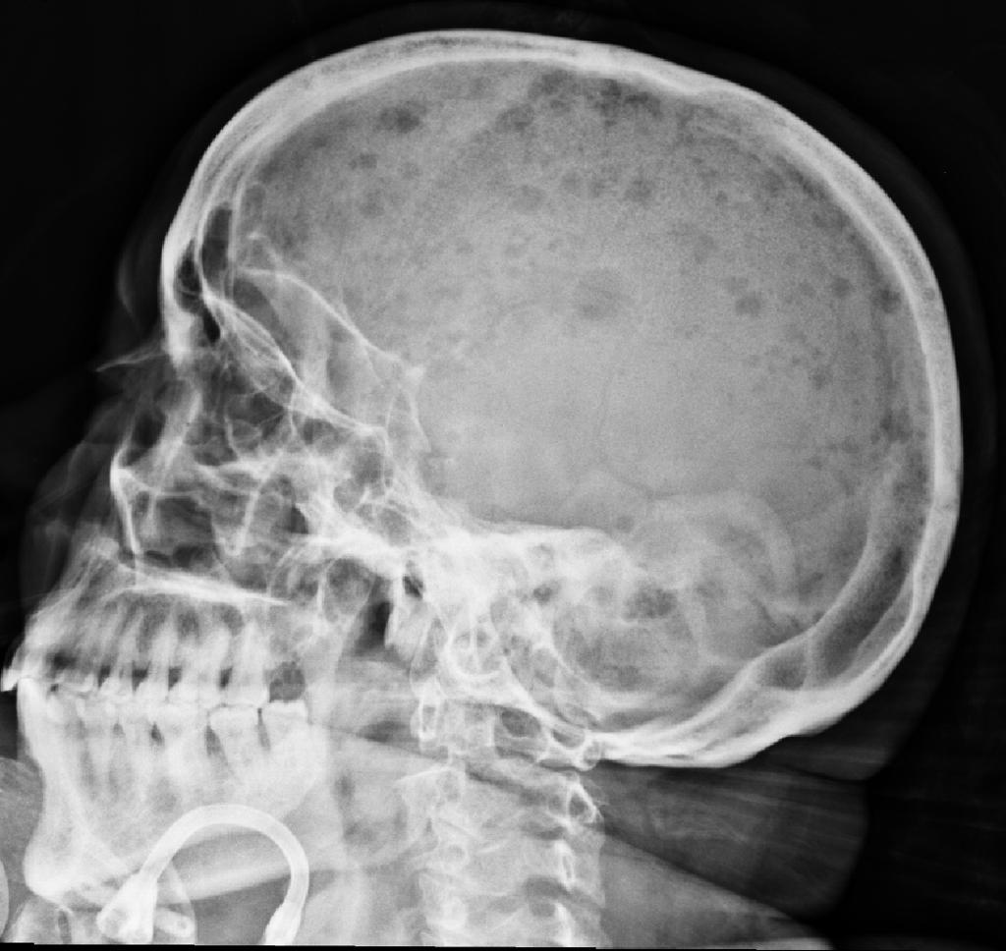
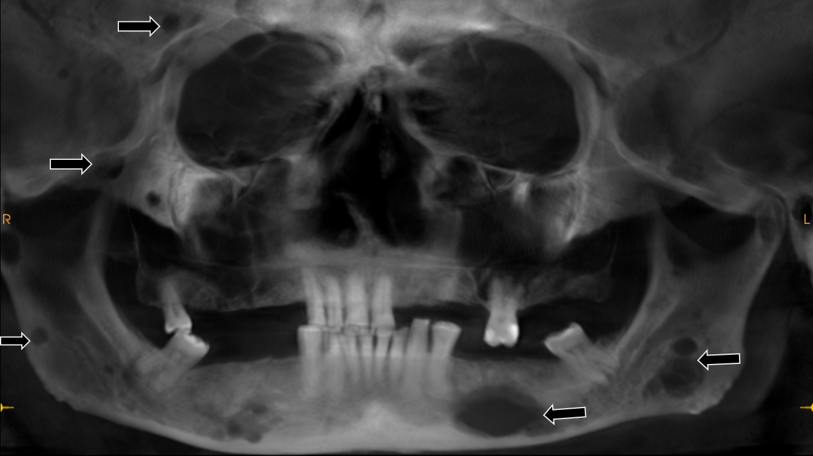
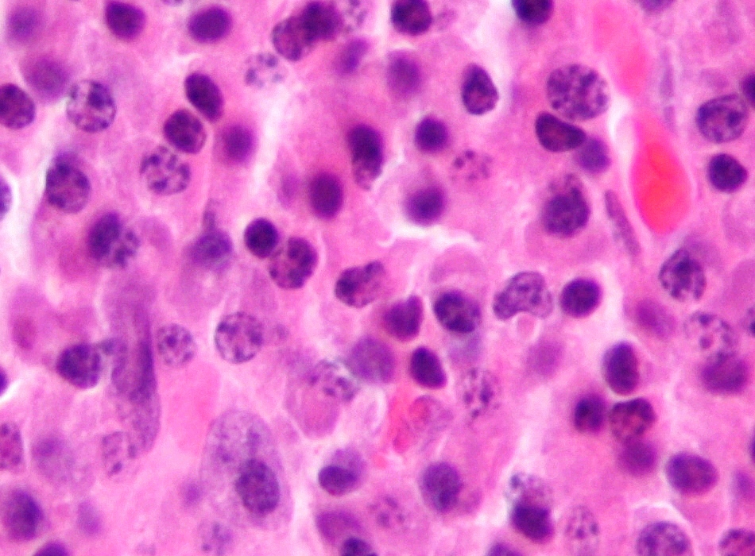
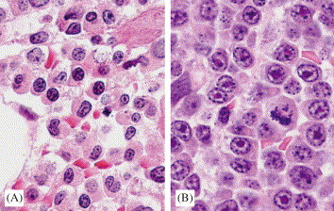
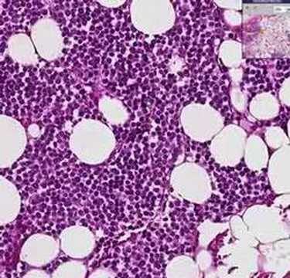
Neoplastic bone diseases
Multiple myeloma
Radiographic features:
Plasmacytoma appears as solitary radiolucency in the single affected bone, while multiple myeloma produces multiple radiolucent lesions in the affected bones.
Radiolucencies in both tumors are punched out that is well demarcated without corticated rim.
Histological features:
In both tumors histological examination of the lesional tissue shows increase in the number of plasma cells constituting about 90% of all cells of bone marrow.
These cells may be well differentiated as normal plasma cells or may be large and pleomorphic.

