Slide 1

Accounting evaluation
Fifth lecture

Slide 2
The third topic: estimating the operating costs and the current revenues of the project

Slide 3
Example 1
The following are the data for an investment project based on its feasibility study:
-The invested capital is 5,000,000L.E
-The expected quantity of demand is 200,000 units per year
-Estimated manufacturing costs 450,000 L.E annually
-Estimated variable costs 400,000 L.E
-Selling and administrative expenses estimated at 150,000 L.E
If you know that the project wants to achieve a return of 20% on the invested capital
Required: Determine the expected selling price for the unit.

Slide 4
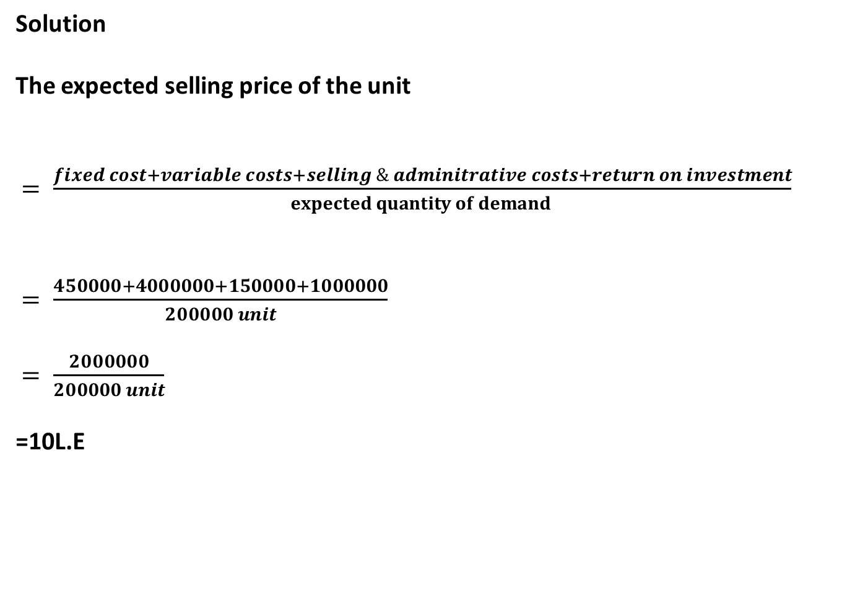
Solution
The expected selling price of the unit
$= \frac{fixed cost+variable costs+selling \& adminitrative costs+return on investment}{expected quantity of demand }$
$= \frac{450000+4000000+150000+1000000}{200000 unit}$
$= \frac{2000000}{200000 unit}$
=10L.E

Slide 5
Estimated income statement
Sales =200000×10 L.E |  | 2000000
Deduct : variable costs |  | 400000
Gross profit |  | 1600000
Deduct : fixed costs
manufacturing costs | 450000
Selling and administrative expenses | 150000 | 600000
Net profit |  | 1000000

Slide 6

Thus, the rate of return on invested
capital$= \frac{1000000}{5000000}$ ×100
=20%

Slide 7
Example 2
The following are the data for an investment project based on its feasibility study:
-Estimated fixed costs are 40,000L.E
-Estimated variable costs per unit 100L.E
-The estimated selling price of the unit is 180L.E
-Target net profit (after income tax) 32800L.E
If you know that the income tax is 30% of the net profit
Required: Estimate current revenue

Slide 8
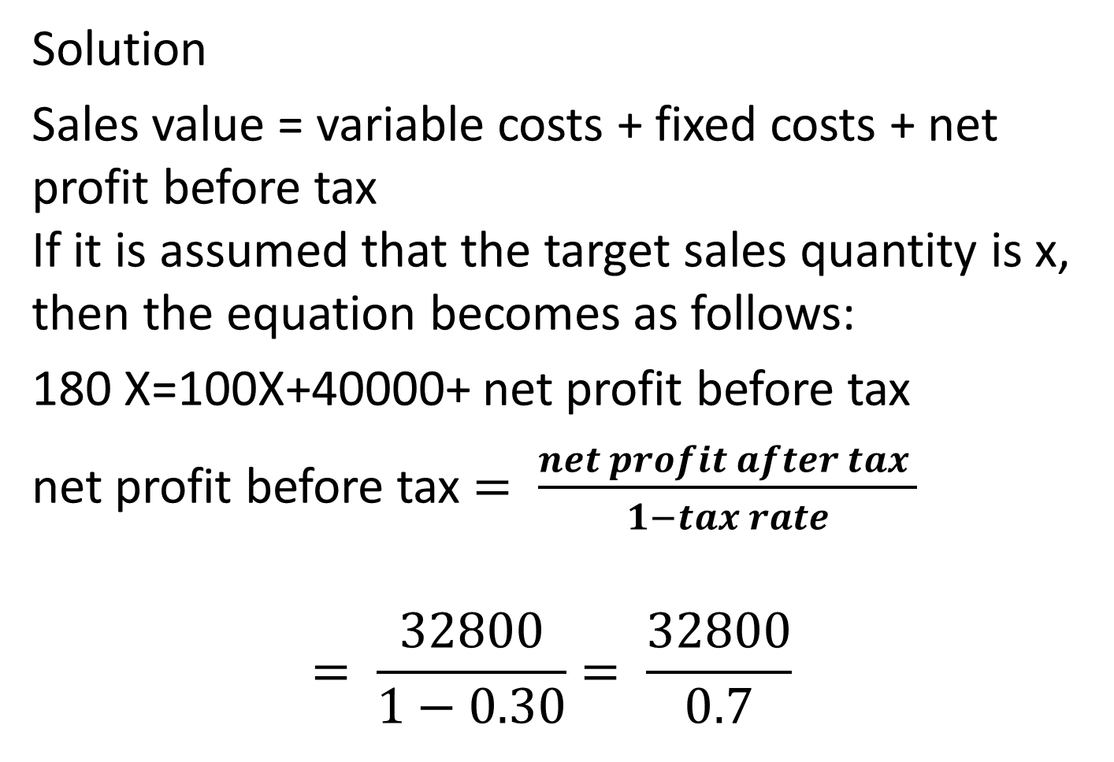
Solution
Sales value = variable costs + fixed costs + net profit before tax
If it is assumed that the target sales quantity is x, then the equation becomes as follows:
180 X=100X+40000+ net profit before tax
net profit before tax $= \frac{net profit after tax }{1−tax rate}$
$$= \frac{32800}{1−0.30}= \frac{32800}{0.7}$$

Slide 9
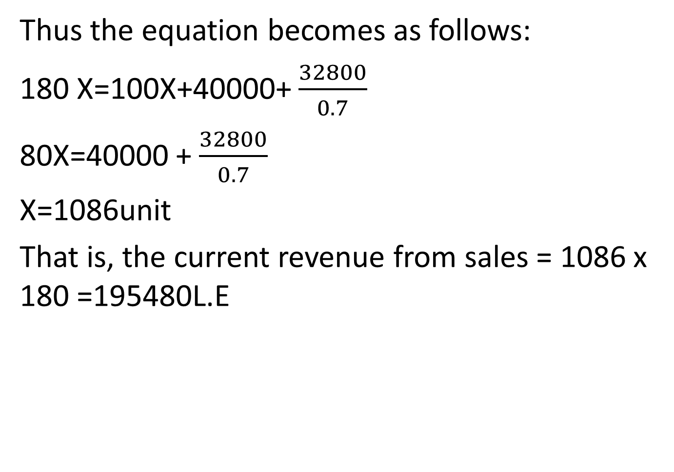
Thus the equation becomes as follows:
180 X=100X+40000+ $\frac{32800}{0.7}$
80X=40000 + $\frac{32800}{0.7}$
X=1086unit
That is, the current revenue from sales = 1086 x 180 =195480L.E

Slide 10
The previous results can be confirmed as follows:
Sales | 195480
Deduct: variable costs =1086×100 | 108600
Gross profit | 86880
Deduct: fixed costs | 40000
Net profit before tax | 46880
Deduct : income tax =46880×30% | 14064
Net profit | 32816

Slide 11
Example 3
The following are the data for an investment project based on its feasibility study:
-Revenue from sales is estimated at 4,000,000L.E
-The variable costs associated with these sales are estimated at 2,400,000L.E
-Estimated fixed costs 1,000,000L.E
Required: determine The break-even point for the project

Slide 12
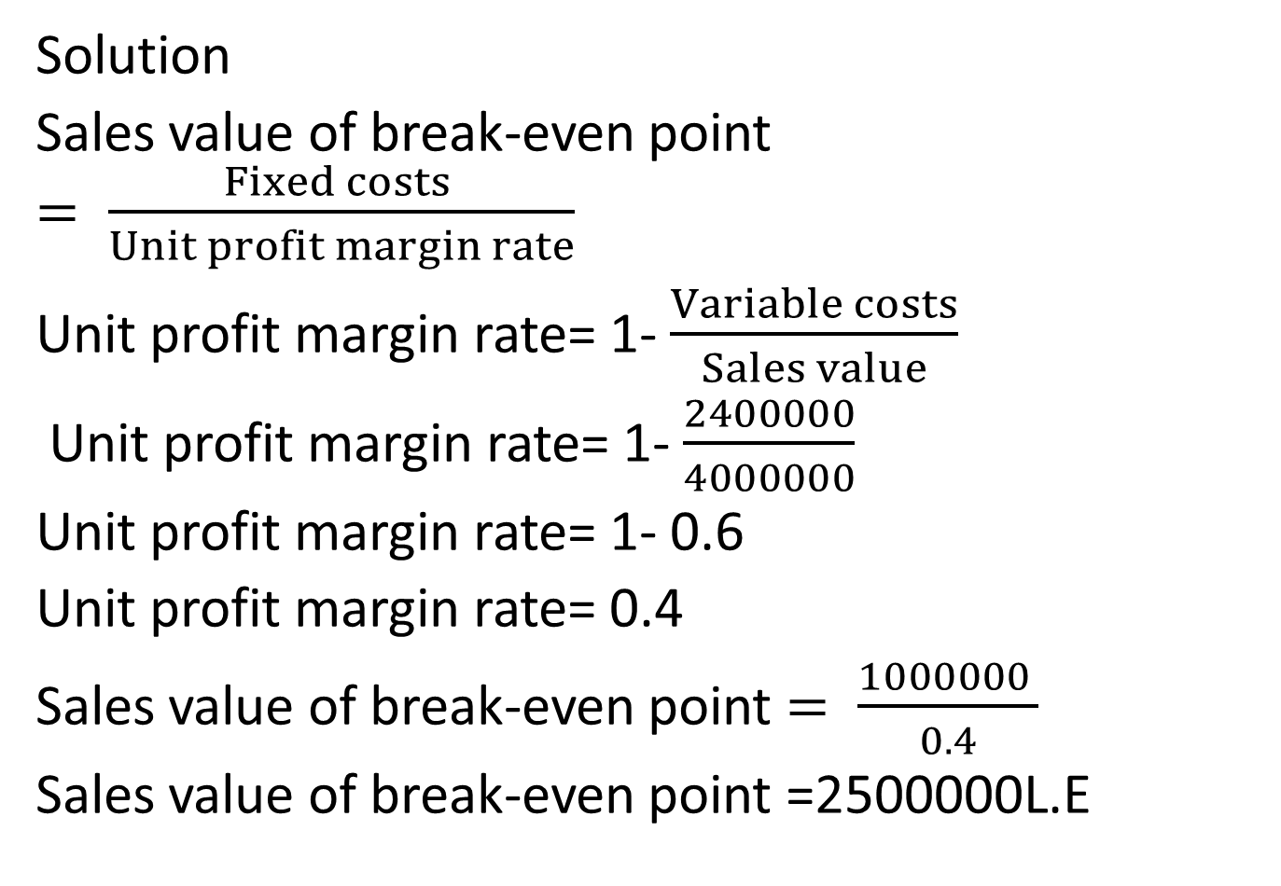
Solution
Sales value of break-even point $= \frac{Fixed costs }{Unit profit margin rate}$
Unit profit margin rate= 1-$\frac{Variable costs}{Sales value}$
Unit profit margin rate= 1-$\frac{2400000}{4000000}$
Unit profit margin rate= 1- 0.6
Unit profit margin rate= 0.4
Sales value of break-even point $= \frac{1000000 }{0.4}$
Sales value of break-even point =2500000L.E

